Slide 1
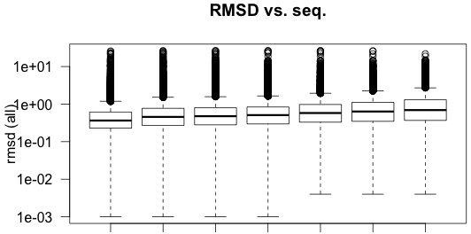
0.56 0.70 0.72 0.75 0.85 0.93 1.06
100 95 90 70 50 40 30
Seq. ID
Notes:
Distributions of average pairwise RMSD values for sequence clusters at varying levels of sequence identity. RMSD values shown in log scale for clarity. Average values for each sequence identity level are provided at the top.

Slide 2
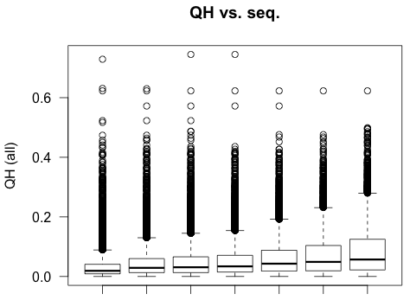
QH Distributions Across Different Seq. IDs
Avg (x 10⁻²) 3.37 4.58 4.94 5.32 6.30 7.24 8.62
100 95 90 70 50 40 30
Seq. ID
Notes:
Distributions of average pairwise QH values for sequence clusters at varying levels of sequence identity. Average values for each sequence identity level are provided at the top.

Slide 3
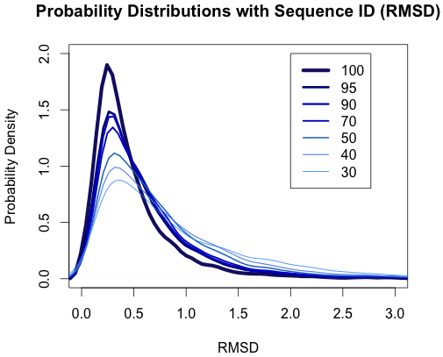
Notes:
Probability density distributions (for pairwise RMSD values) for the varying levels of sequence identity. As the level of sequence identity decreases, the avg pairwise RMSD values tend to increase (as expected)

Slide 4
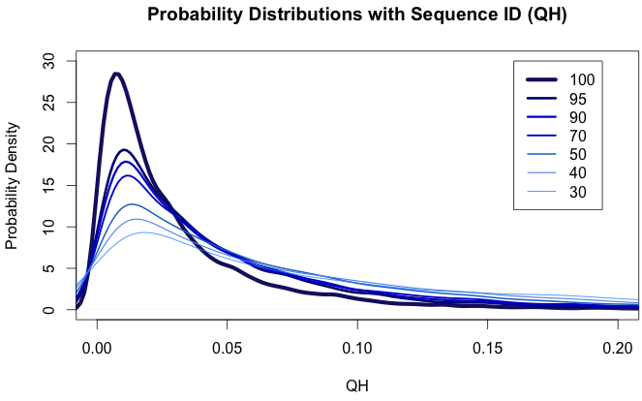
Notes:
Probability density distributions (for pairwise QH values) for the varying levels of sequence identity. The same trend is observed for RMSD (slide 3), and is what we’d expect.

Slide 5
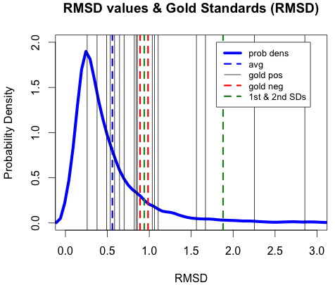
Notes:
Comparing gold standard proteins to distribution of RMSD values in the entire SCOP dataset. Most gold standards do not appear to exhibit significantly higher RMSD value relative to the SCOP dataset as a whole. 1st and 2nd standard deviations (of RMSD values in entire SCOP dataset) above the mean are shown with green dotted lines.

Slide 6
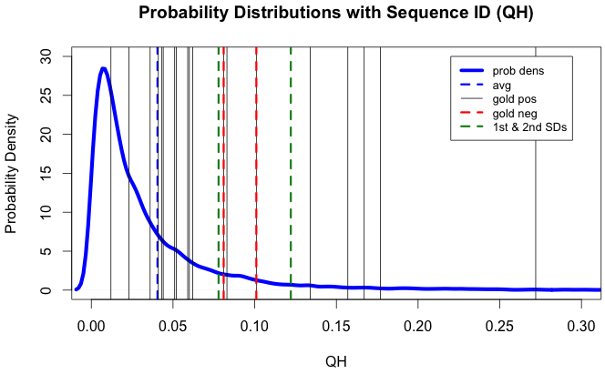
Notes:
Same type of distribution as shown in slide 4, but with QH values for entire SCOP dataset instead of RMSD values. Note that, again, although the gold standards are higher, they don’t seem to differ significantly from the mean. (Note that there are clusters w/QH values well above 0.3, but a cutoff of 0.3 was used on the y axis for clarity)

Slide 7
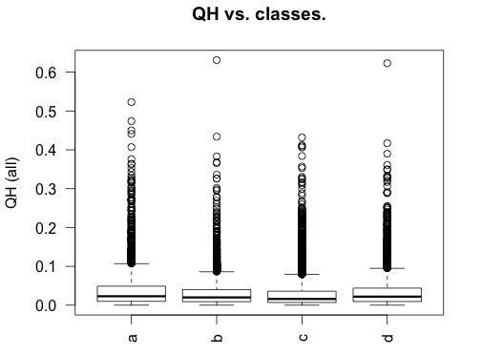
QH across different SCOP classes (data shown for 100% seq ID)
Avg (x 10⁻²) 4.05 3.16 3.03 3.55
Notes:
Same type of distribution as shown in slide 4, but with QH values for entire SCOP dataset instead of RMSD values.

Slide 8
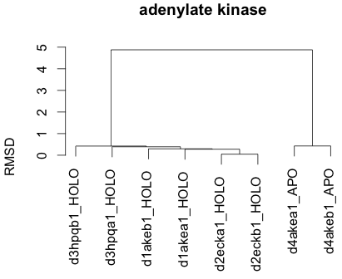
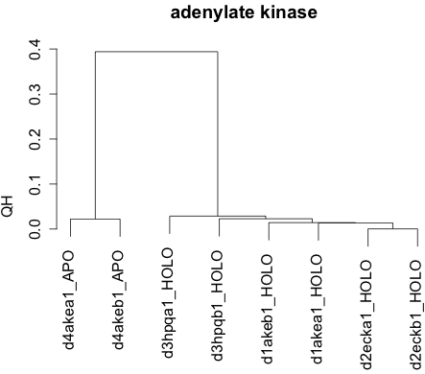
Gold standard positive

Slide 9
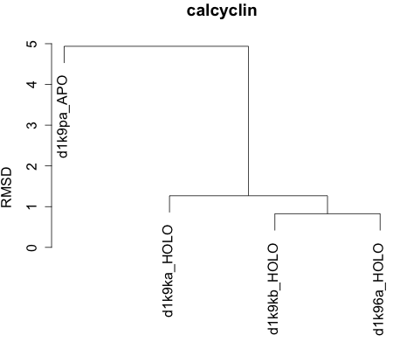
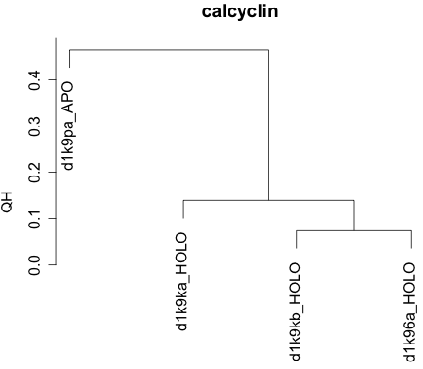
Gold standard positive

Slide 10
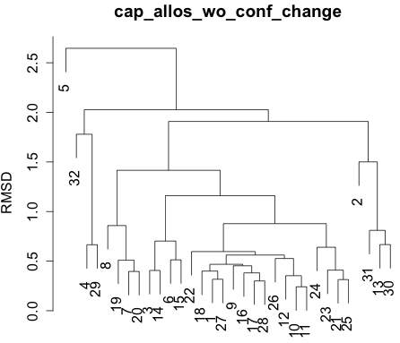
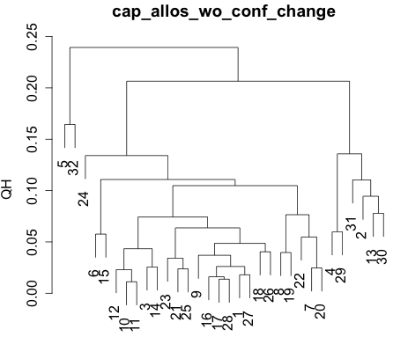
Gold standard negative (allosteric without conformational change)

