Slide 1

Group Meeting
Yan Zhang
1/14/2014
Notes:
Image from:
http://www.devbio.biology.gatech.edu/wp-content/uploads/2011/04/homer-and-fish3.jpg

Slide 2
Topics
Pseudogenes
  Localization & mobility (comparison of 4 species)
  Pseudogene translation (human)
Retroduplication in human genome

Slide 3
Topics
Pseudogenes
  Localization & mobility (comparison of 4 species)
  Pseudogene translation (human)
Retroduplication in human genome

Slide 4
Pseudogenes background information
Duplicated pseudogene (DUP)
Gene
Gene copy
Gene
Pseudogene

Slide 5
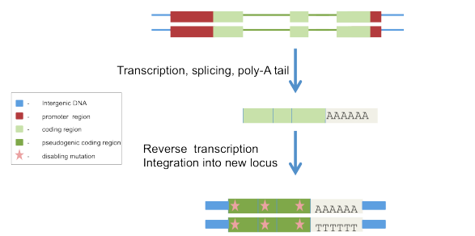
Pseudogenes background information
Processed pseudogene (PSSD)
Coding gene
Mature mRNA
PSSD
Poly-A tail
Introns spliced out
Lack upstream promoter region
Truncation of 5’ end
Figure adapted from: GencodeGenes wordpress blog
Ref: Zheng D, et al. Pseudogenes in the ENCODE regions: Consensus annotation, analysis of transcription, and evolution. Genome Res, 2—7.
Notes:
Figure from:
http://gencodegenes.wordpress.com/2011/11/30/processed-pseudogenes-junk-or-gene/processed_pseudogene/

Slide 6
Pseudogenes background information
Unitary pseudogene
Gene
Pseudogene
“In contrast to the high number of duplicated and retroduplicated pseudogenes in mammalian genomes, unitary pseudogenes are rare.”
- Marques AC, et al. Genome Biology, 2012.
Notes:
Ref:
Marques AC, et al. Evidence for conserved post-transcriptional roles of unitary pseudogenes and for frequent bifunctionality of mRNAs. Genome Biology, 2012

Slide 7
Pseudogene analyses
Localization & mobility (human, worm, fly & zebrafish)
  Co-localization tendency of pseudogenes and their parent genes
  Material exchange between chromosomes

Slide 8
Part of the results for human
Notes:
Image from:
http://www.devbio.biology.gatech.edu/wp-content/uploads/2011/04/homer-and-fish3.jpg

Slide 9
Co-localization tendency (human)
Duplicated
1 2 3 4 5 6 7 8 9 10 11 12 13 14 15 16 17 18 19 20 21 22 X Y

Slide 10
Co-localization (human)
1 2 3 4 5 6 7 8 9 10 11 12 13 14 15 16 17 18 19 20 21 22 X Y
Chr 11 - olfactory receptor, expansion of gene family
- for human they turn into pseudogenes.
Ref: Glusman G, et al. The complete human olfactory subgenome. Genome Res, 2001.
Chr 7 - mhc (Major histocompatibility complex), large amount of segmental duplications
Ref: Hillier LW, et al. The DNA sequence of human chromosome 7. Nature, 2003.
Chr Y - sex chromosome, numerous loss of Y in evolution
Notes:
This results relates to the fact that chromosome 11 is enriched in olfactory receptors \cite{11337468} while chromosome 7 is enriched for genome duplication events \cite{12853948}.

Slide 11
Material exchange – importers
A
DUPs Paralogs
B
Strong importers Strong importers
Weak importers Weak importers
Import pattern of pseudogenes and paralogs in human (excluding self-contribution).
Notes:
More focus on sex chromosomes.
(1)
DUP & Paralogs similar genesis – through gene duplication.
DUP – neutral selection. Paralogs – under selection.
(2)
Chr Y – very opposite pattern.
Note: Y is a strong importer of DUP, most of which come from X. In contrast, very small number of imported paralogs.
This shows very close relationship between X and Y.
The opposite pattern may be explained: Numerous gene loss event in Y’s evolution history \cite{16847345}
“This discrepancy can be explained regarding the duplicated pseudogenes as paralogs, products of gene duplications, that subsequently accumulated deleterious mutations \cite{15233989} due to the numerous gene loss events in Y’s evolutionary.“ – our paper draft
(3)
Special sex chromosomes:
Pseudogene exchange between the sex chromosomes is significantly larger than the exchange with autosomes. (except Zebrafish)

Slide 12
Material exchange – importers
C
PSSDs
Strong importers
Weak importers
Import pattern of pseudogenes and paralogs in human (excluding self-contribution).
Notes:
Consistent with previous reports \cite{14739461}, we observed that in human, X is an importer of processed pseudogenes. By contrast, the worm and fly genomes show a uniform pseudogene exchange between all the chromosomes.

Slide 13
Material exchange – exporters
D
DUPs Paralogs
E
Strong exporters Strong exporters
Weak exporters Weak exporters
Export pattern of pseudogenes and paralogs in human (excluding self-contribution).

Slide 14
Material exchange – exporters
F
PSSDs
Strong exporters
Weak exporters
Export pattern of pseudogenes and paralogs in human (excluding self-contribution).

Slide 15
Part of the results for zebrafish
(using ensembl data)
Notes:
Image from:
http://www.devbio.biology.gatech.edu/wp-content/uploads/2011/04/homer-and-fish3.jpg

Slide 16
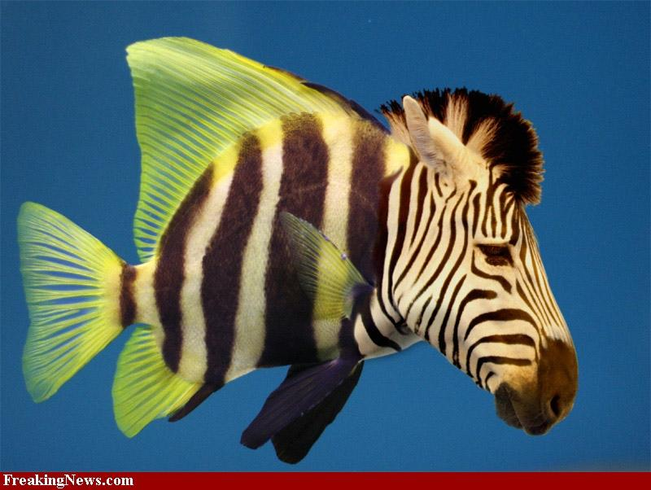
Sex determination in zebrafish
No sex chromosomes
Polygenic sex determination
Ref: Liew WC, et al. Polygenic sex determination system in zebrafish. PLoS One, 2012.
Notes:
Image from:
http://www.ddw-online.com/img/32/800/600/0/0/zebrafish.jpg

Slide 17
Co-localization tendency (zebrafish)
Co-localization significance
Duplicated
Not as significant as what we saw in other species
Co-localization significance

Slide 18
Zebrafish pgene importer/exporter chromosomes

Slide 19
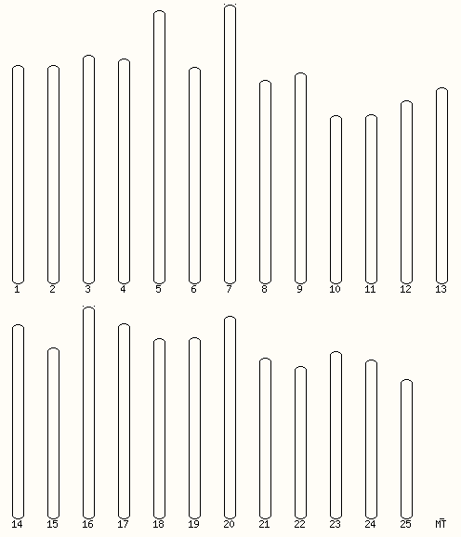
Importer/exporter summary
Exporters of DUPs: 4, 6, 18
Exporters of PSSDs: 10, 20, 21
Importers of DUPs: 4, 10, 18
Importers of PSSDs: 4
Chr 4 “is highly heterochromatic, repetitive, late replicating, and has reduced recombination.” “this chromosome arm shares features with known sex chromosomes”
- Anderson JL, et al.

Slide 20
Discussion
Localization & mobility (human, worm, fly & zebrafish)
  Co-localization tendency of pseudogenes and their parent genes
    Consistent with the mechanism of pseudogenization of DUP and PSSD
    Zebrafish, comparison b/w DUP & PSSD not significant
  Material exchange between chromosomes
    Importers and exporter chromosomes, related to enrichment of segmental duplication on some chr., examples in human
    Special behavior of sex chromosomes
      Fixation of pseudogenes vs. selection presure and evolution history
      Zebrafish potential sex chr.? – based on emsembl

Slide 21
Topics
Pseudogenes
  Localization & mobility (comparison of 4 species)
  Pseudogene translation (human)
Retroduplication in human genome

Slide 22
Topics
Pseudogenes
  Localization & mobility (comparison of 4 species)
  Pseudogene translation (human)
Retroduplication in human genome

Slide 23
Pseudogene translation (human)
Pseudogenes
  Multiple data source used for comparison/cross-validation
  Three interesting examples in human (table), and possible explanation

Slide 24
Workflow of identifying translated pseudogenes

Slide 25
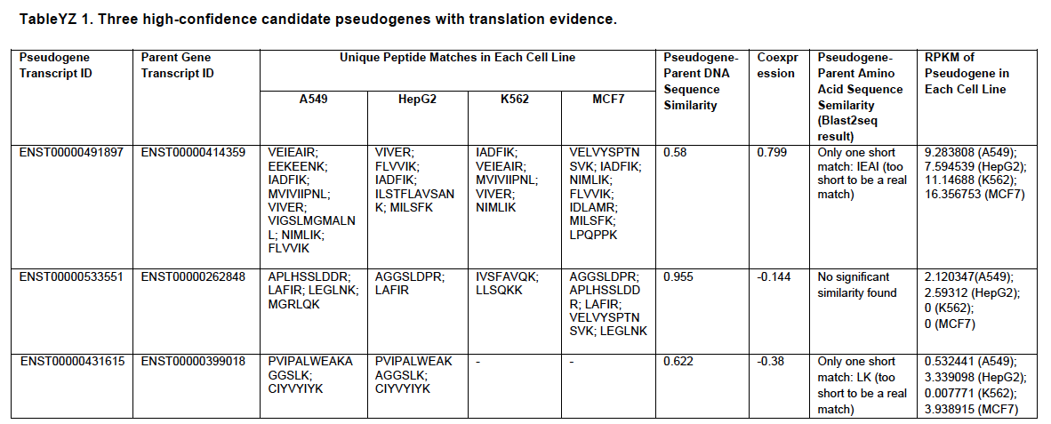
There interesting candidates having translation evidence

Slide 26
Topics
Pseudogenes
  Localization & mobility (comparison of 4 species)
  Pseudogene translation (human)
Retroduplication in human genome

Slide 27
Topics
Pseudogenes
  Localization & mobility (comparison of 4 species)
  Pseudogene translation (human)
Retroduplication in human genome

Slide 28
Retrodup workflow YZ’s understanding thanks to Alex
GENCODE,
Ref genome,
Null model (for generating fake annotation)
Mapped and mapped reads
from 1000 G
Exon junction libraries
(1 true library, multiple fake libraries)
Alignment
(BWA)
All unmapped reads
(single/double ends)
Done
Done
True exon-read alignment
(Fake exon-read alignment used for controlling FDR)
Novel duplications
Functional Enrichment
Insertion point detection
Notes:
Yan made this chart, according to her understanding of Alex’s Retrodup work.

Slide 29
Follow-up (1)
Detect CNV from the exome data, including the novel retrodups
  Compare different populations
Notes:
My interest in things downstream Retrodup

Slide 30
Follow-up (2)
Can we predict the role of retrodups (gene or pgene)?
From sequence features:
  Exons only ➔look like processed pseudogenes (PSSDs)
  Extend junction sequence in both directions (how long?)
  Does upstream regulatory exist?
    PSSD: no, novel gene: yes
  Does poly-A tail exist at 3’?
    PSSD: maybe yes, novel gene: yes/no
Exon junction
Exon 1
Exon 2

Slide 31
Acknowledgements
Pgenes
  Cristina, Baikang, Suganthi
  Jane, Wyatt, Michael, Mark
SVCANCMG
Alex
The Tech gang

