Slide 1
ANS, SK, DC
Automate identification of allosteric regions en masse
Collect instances of high-confidence conformational transitions
Pred. such sites and testing against gold standards and culled dataset
Binding Leverage
ENMs, network pathways
SVMs
Compare predictions against existing methods (Demerdash et al 2009, Mitternacht et al, 2011, Cobanoglu et al , 2013, others)
Correspondence btwn predicted sites and disease data from OMIM
Export high-confidence changes as a web resource

Slide 2

seq. groups (30-100%)
STAMP scan: perform align with each structure as root in group
Identify best-performing root structure
All sc scores >= 2
At least 1 sc score < 2
Standard struct-based alignment in VMD
Seq-informed struct align through STAMP
Calc. pairwise similarity metrics in resulting align
Compare across diff levels of seq id

Slide 3
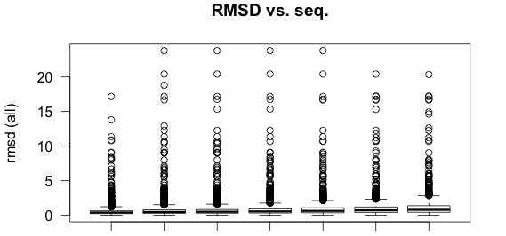
(all)
Av: 0.60 0.75 0.78 0.86 0.98 1.10 1.24
100 95 90 70 50 40 30
Seq. Identity
Notes:
RMSD distributions for the set of all available protein domains (criteria: resolution <= 3.0 A, R-Free <= 0.28, at least 3 crystal structures available)

Slide 4
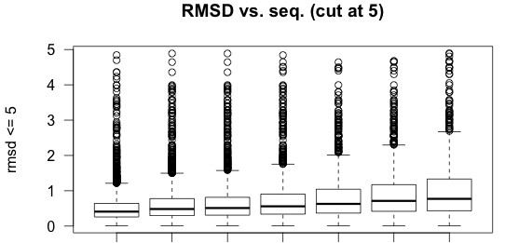
Av: 0.53 0.64 0.67 0.73 0.81 0.90 1.00
100 95 90 70 50 40 30
Seq. Identity
Notes:
Same as in slide 1, but showing only those RMSD values <= 5 for clarity

Slide 5
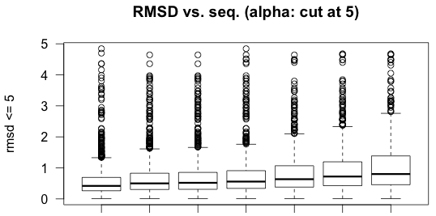
Av: 0.57 0.67 0.70 0.74 0.83 0.93 1.03
100 95 90 70 50 40 30
Seq. Identity
Notes:
Subset of values in slide 3, showing only the alpha domains

Slide 6
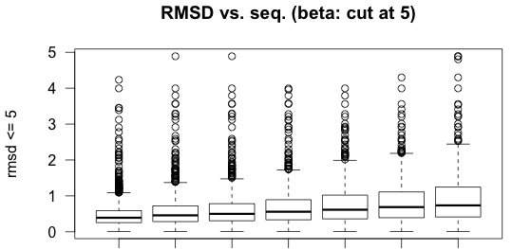
Av: 0.49 0.58 0.62 0.71 0.78 0.85 0.94
100 95 90 70 50 40 30
Seq. Identity
Notes:
Subset of values in slide 3, showing only the beta domains

Slide 7
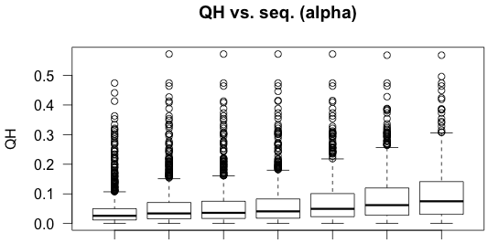
Av: 0.041 0.054 0.057 0.062 0.073 0.086 0.098
100 95 90 70 50 40 30
Seq. Identity
Notes:
Subset of values in slide 6, showing only the alpha domains

Slide 8
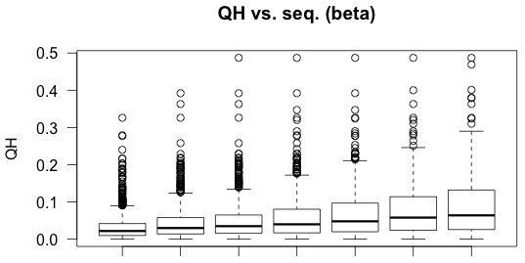
Av: 0.032 0.043 0.048 0.059 0.068 0.077 0.089
100 95 90 70 50 40 30
Seq. Identity
Notes:
Subset of values in slide 6, showing only the beta domains

