Slide 1
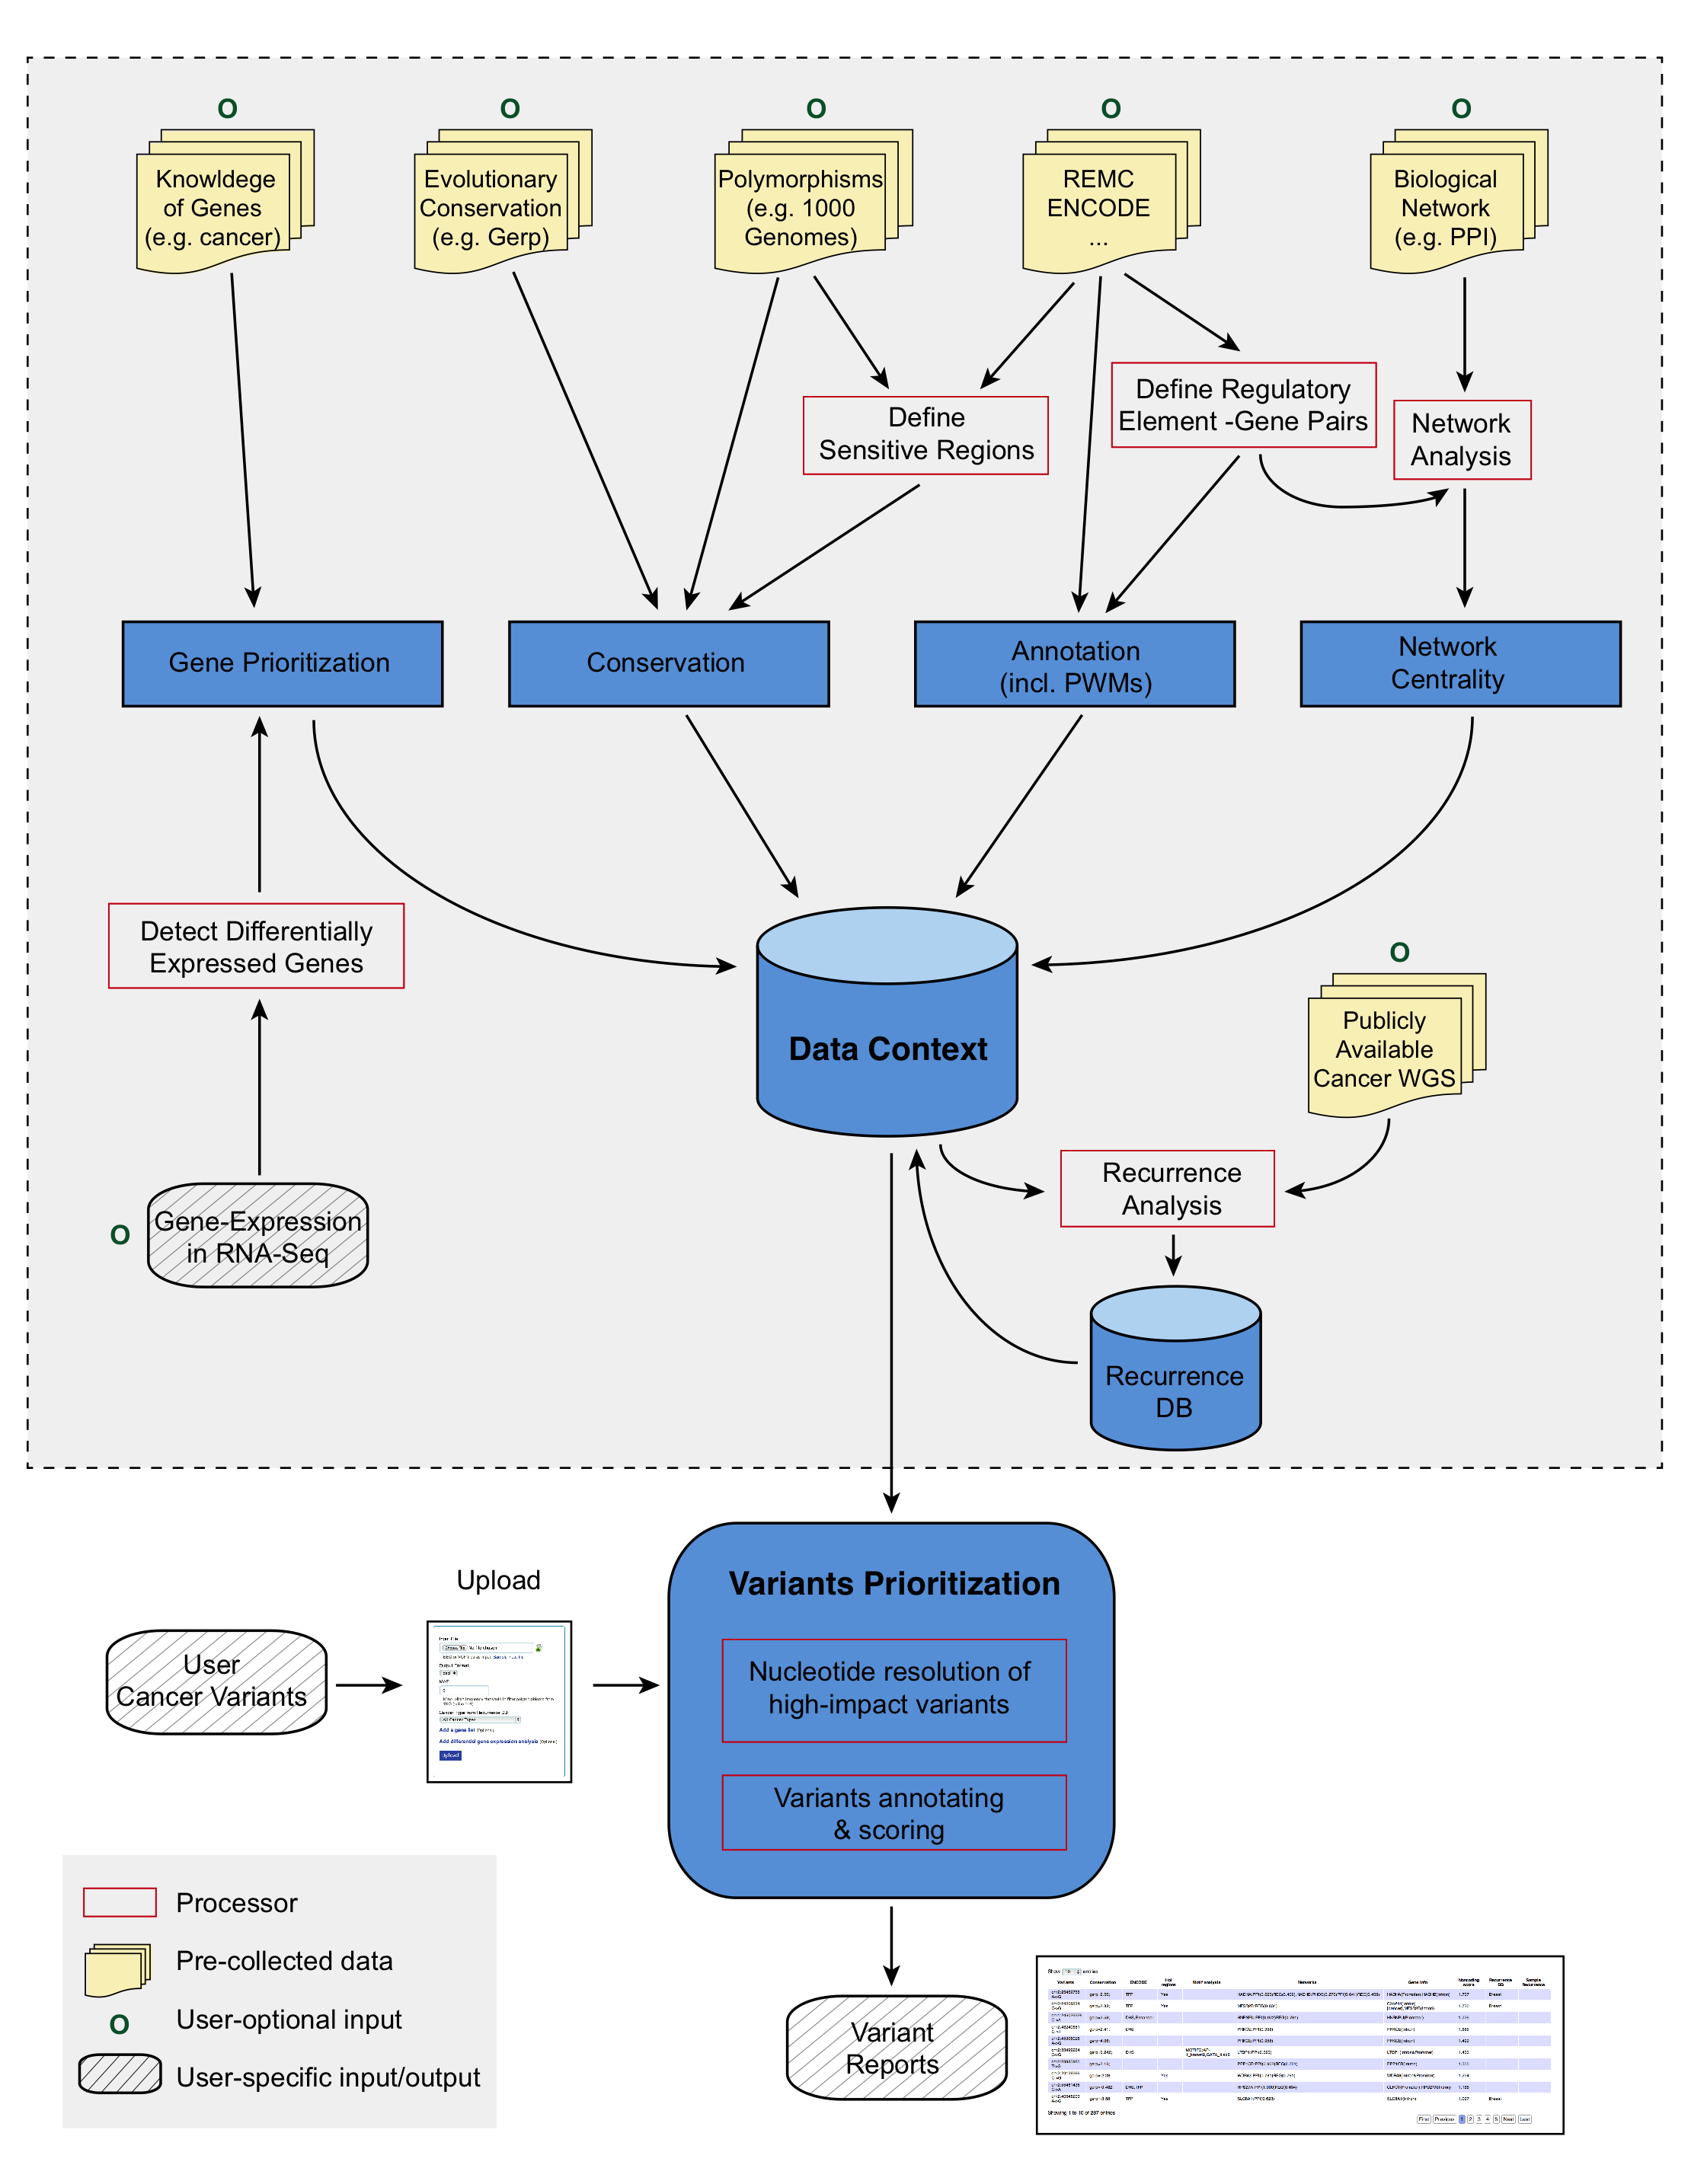
Figure 1. Schematic workflow of FunSVPT.

Slide 2
Figure 2. Weighted scoring scheme. Upper panel: Features used to score variants;
Lower panel: Motif-breaking values and 1-Shannon entropy observed in polymorphisms.

Slide 3
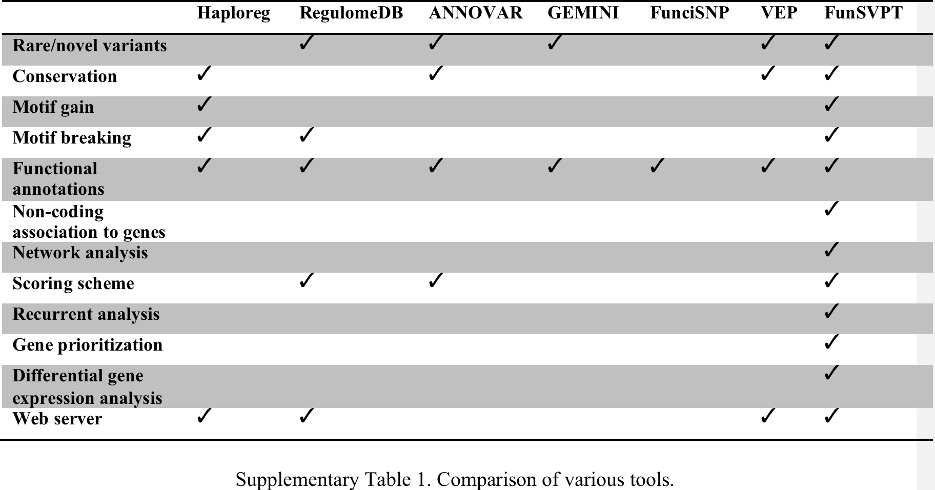

Slide 4
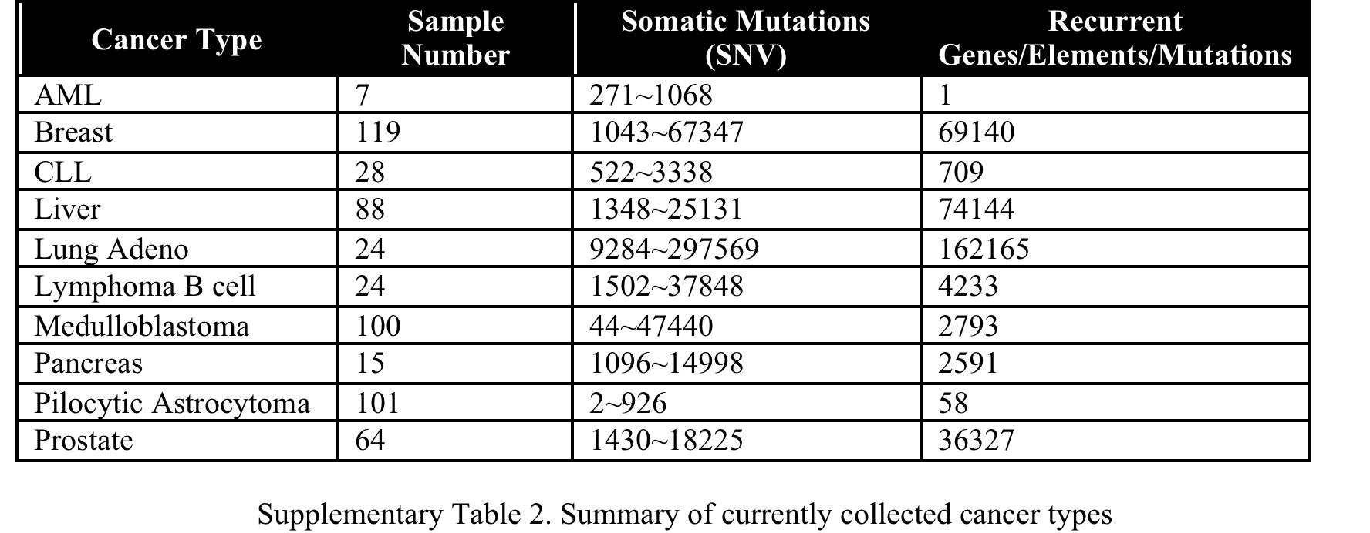

Slide 5
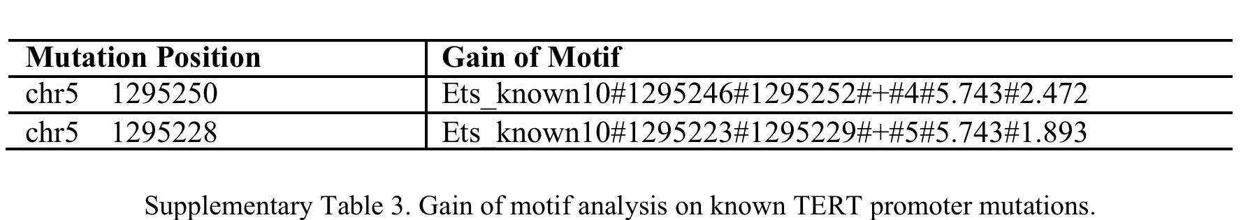

Slide 6
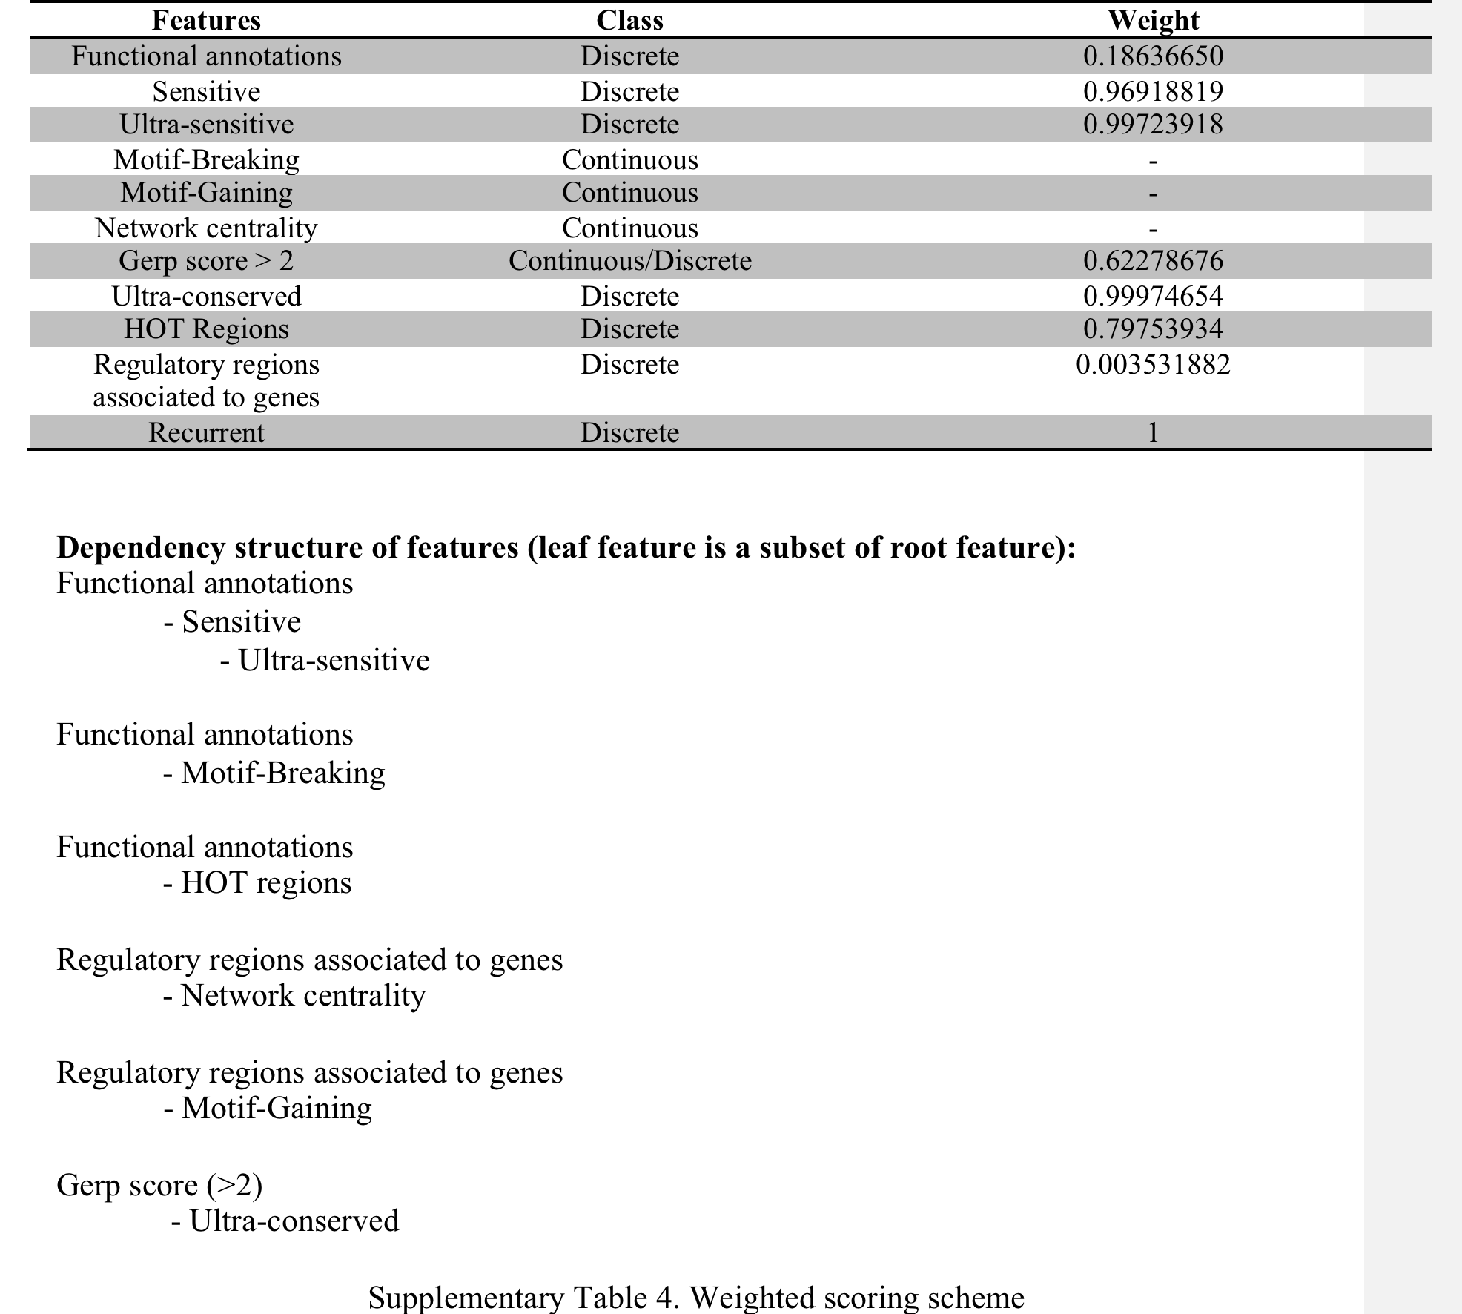

Slide 7
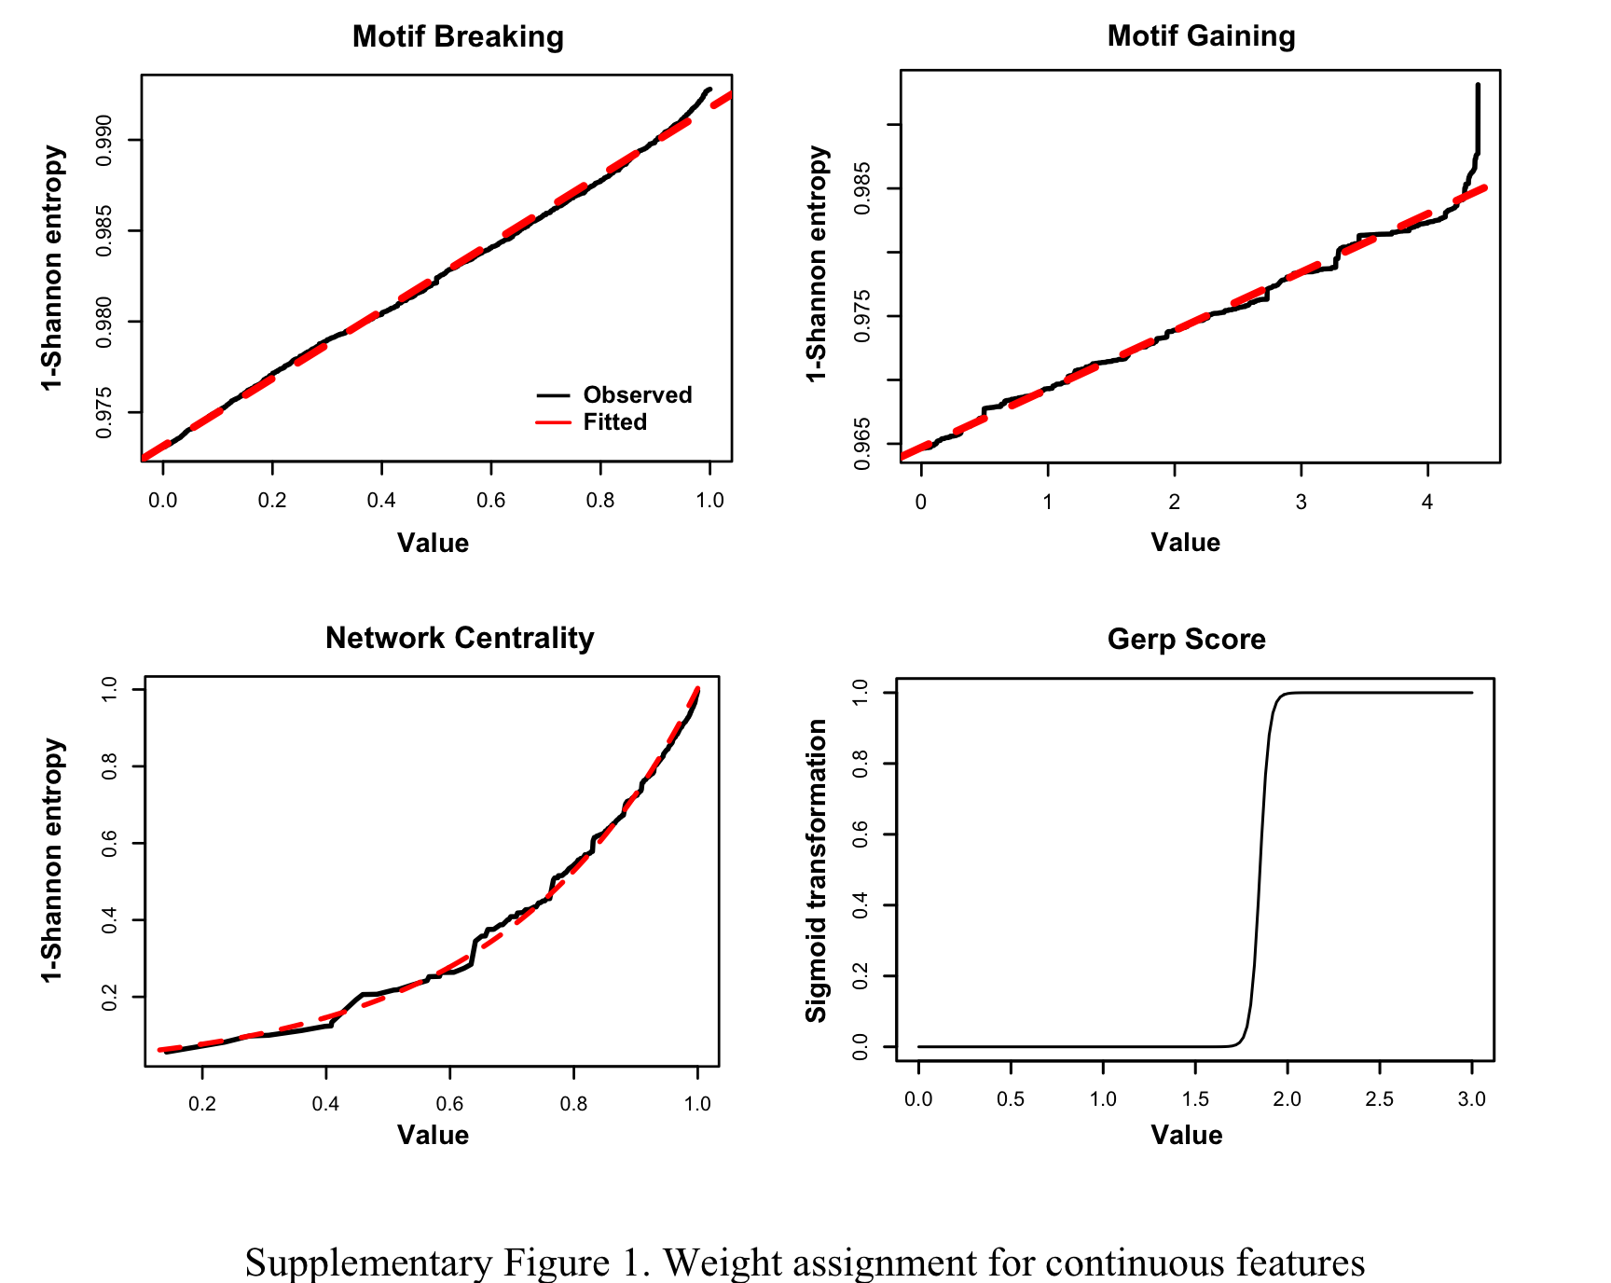

Slide 8
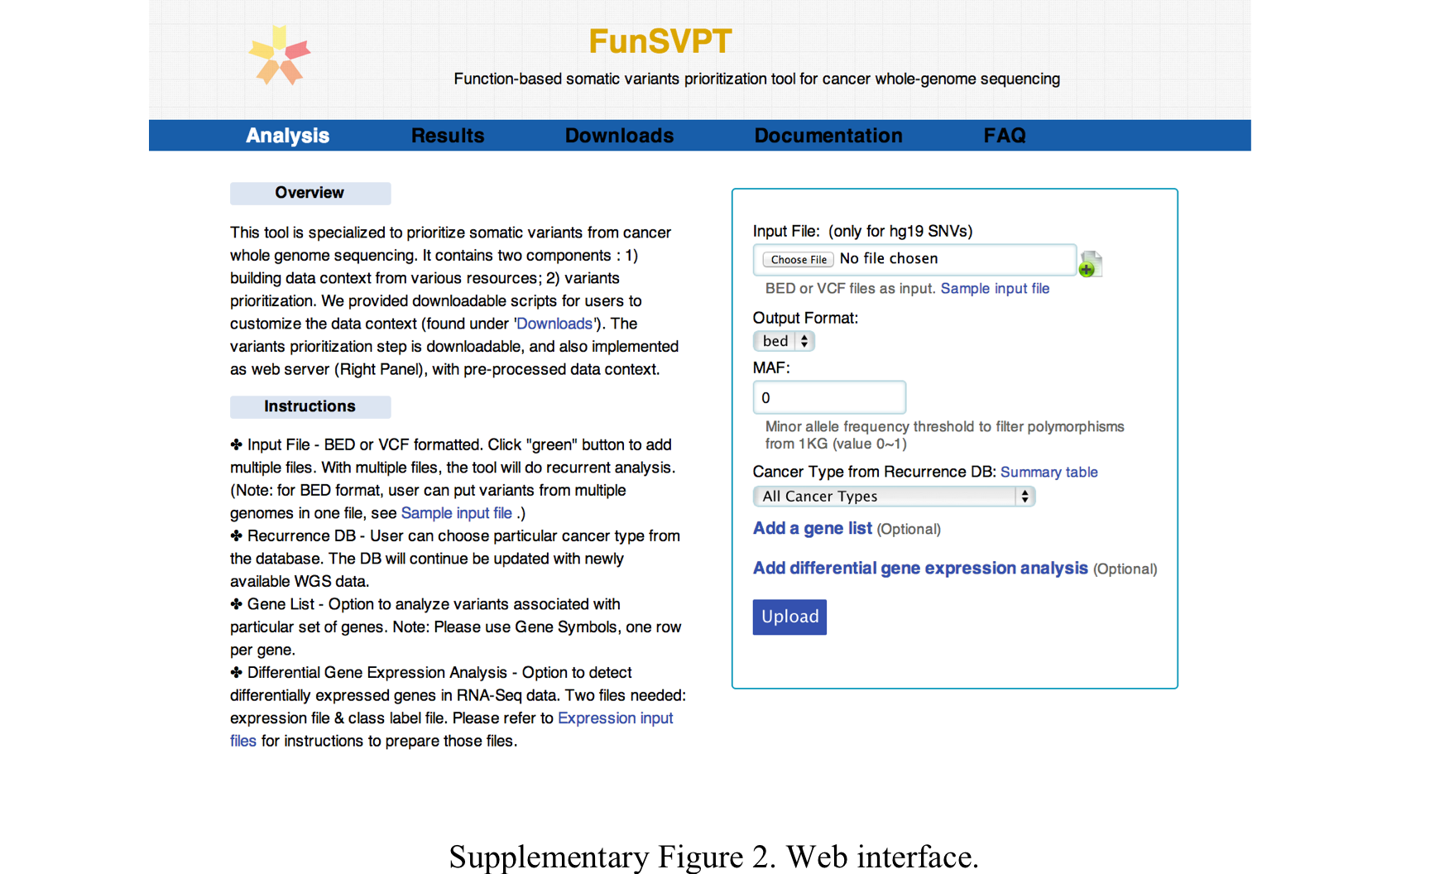

Slide 9
