Slide 1
Replication timing and breakpoints
Alexej Abyzov
December 17, 2013

Slide 2
Analyzing inserted seqs
67 seqs match reference genomes uniquely full length without mismatches
For 66 seqs more once can identify genomic origin by inspection of BLAT alignments
Total of 133 template sequences (TS)
Insertion
Other locus
Deletion

Slide 3
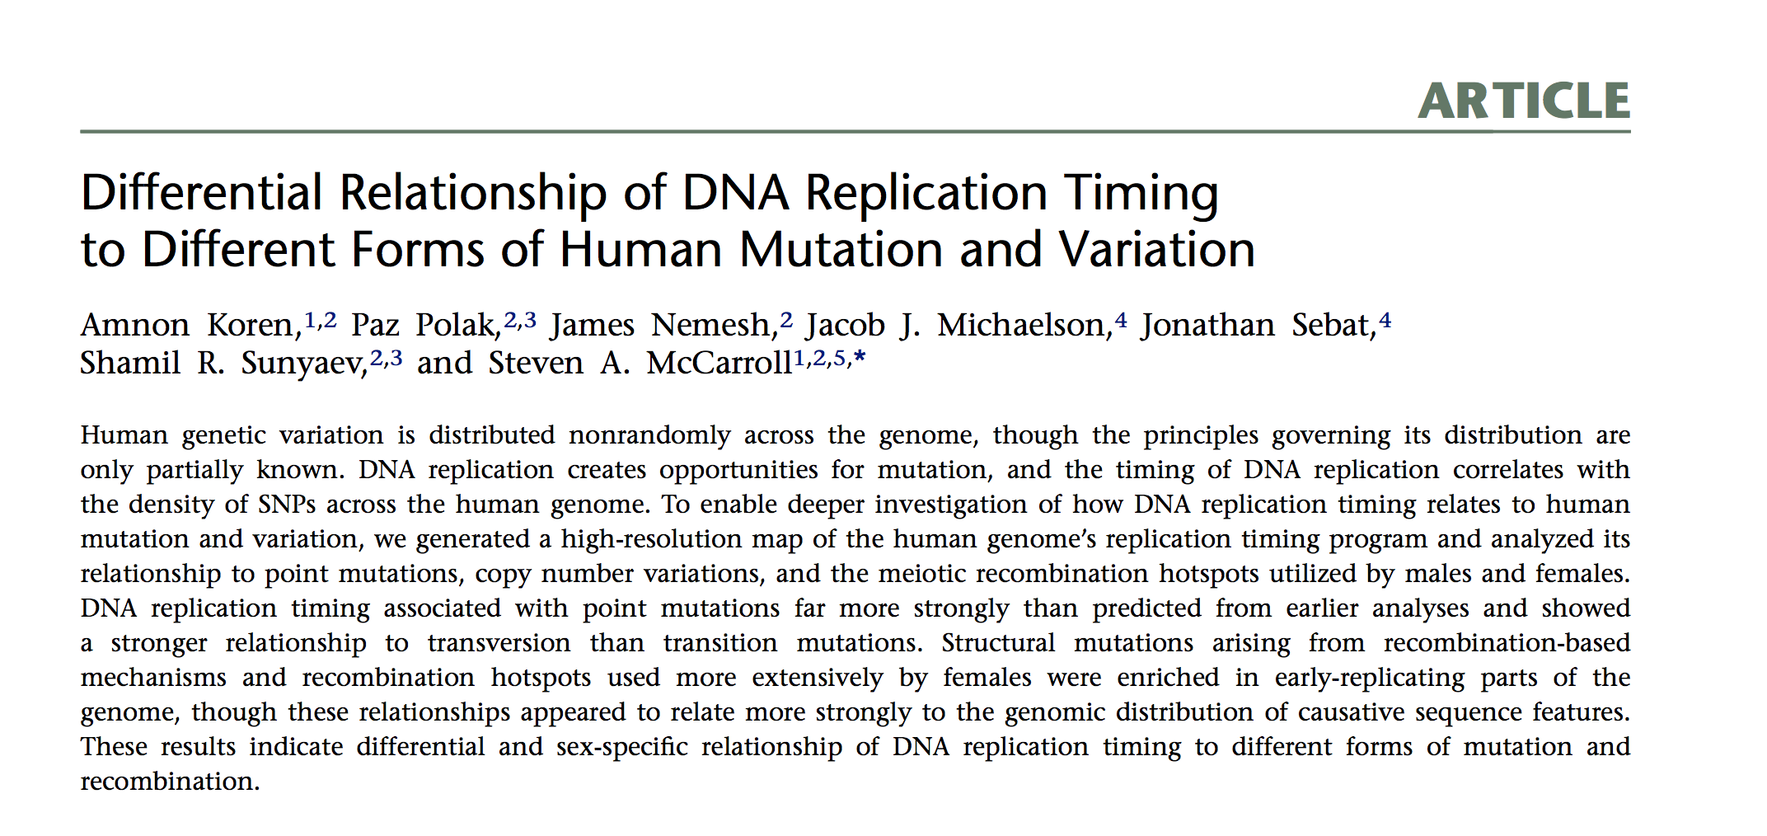
Time (~-2,~2), early replication is < 0, late replication > 0

Slide 4
Definitions
Insertion
Other locus
t3
t1
t2
Deletion
Scenario #1: inside 49 (37%) => 26/23 on +/-
Scenario #2: outside on the same chrom 52 (39%) => 32/20 on +/- ?
Scenario #3: on different chrom 25 (19%) => 18/7 on +/- ?

Slide 5
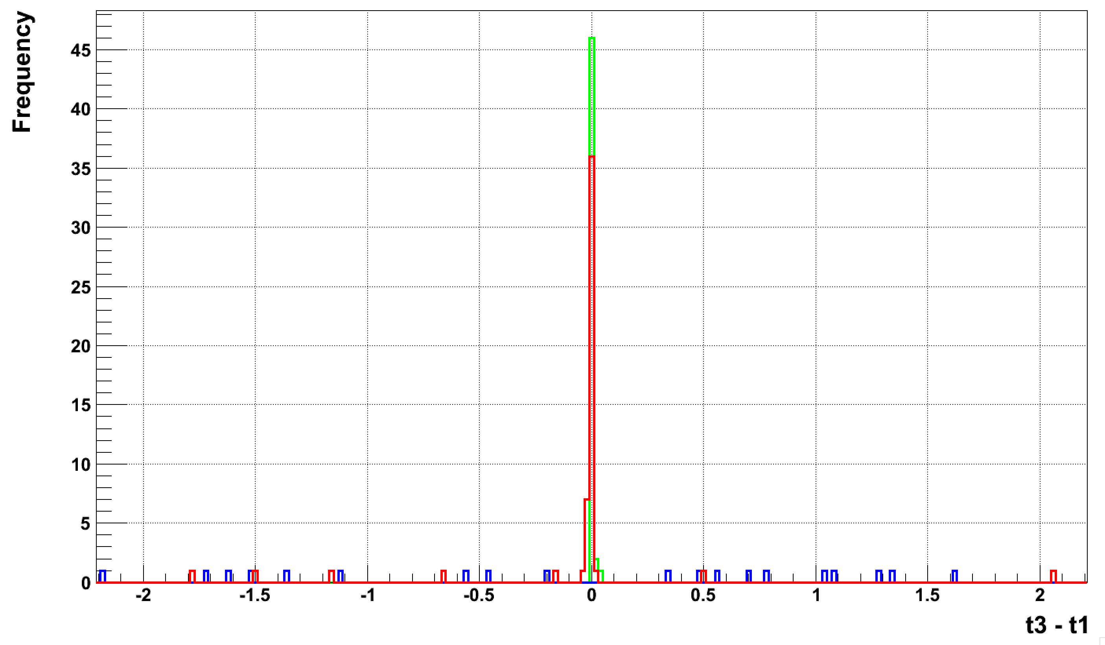
Replication time difference
13
3
p-val = 0.01
Template sequence
is located in early regions or earlier replication

