Slide 1
RNA-Seq Analysis Pipeline
Gerstein Lab
Yale University
December 19, 2013

Slide 2
RNA-Seq Analysis
Objective: Modular and flexible framework to perform common RNA-Seq analysis tasks
Expression measurements (RPKMs)
  Genes, transcripts, exons, novel transcribed regions
Transcript fusion detection
Splice junctions
  Transcript isoforms
Identification of non-coding RNAs
Aggregation and correlation of signal tracks

Slide 3
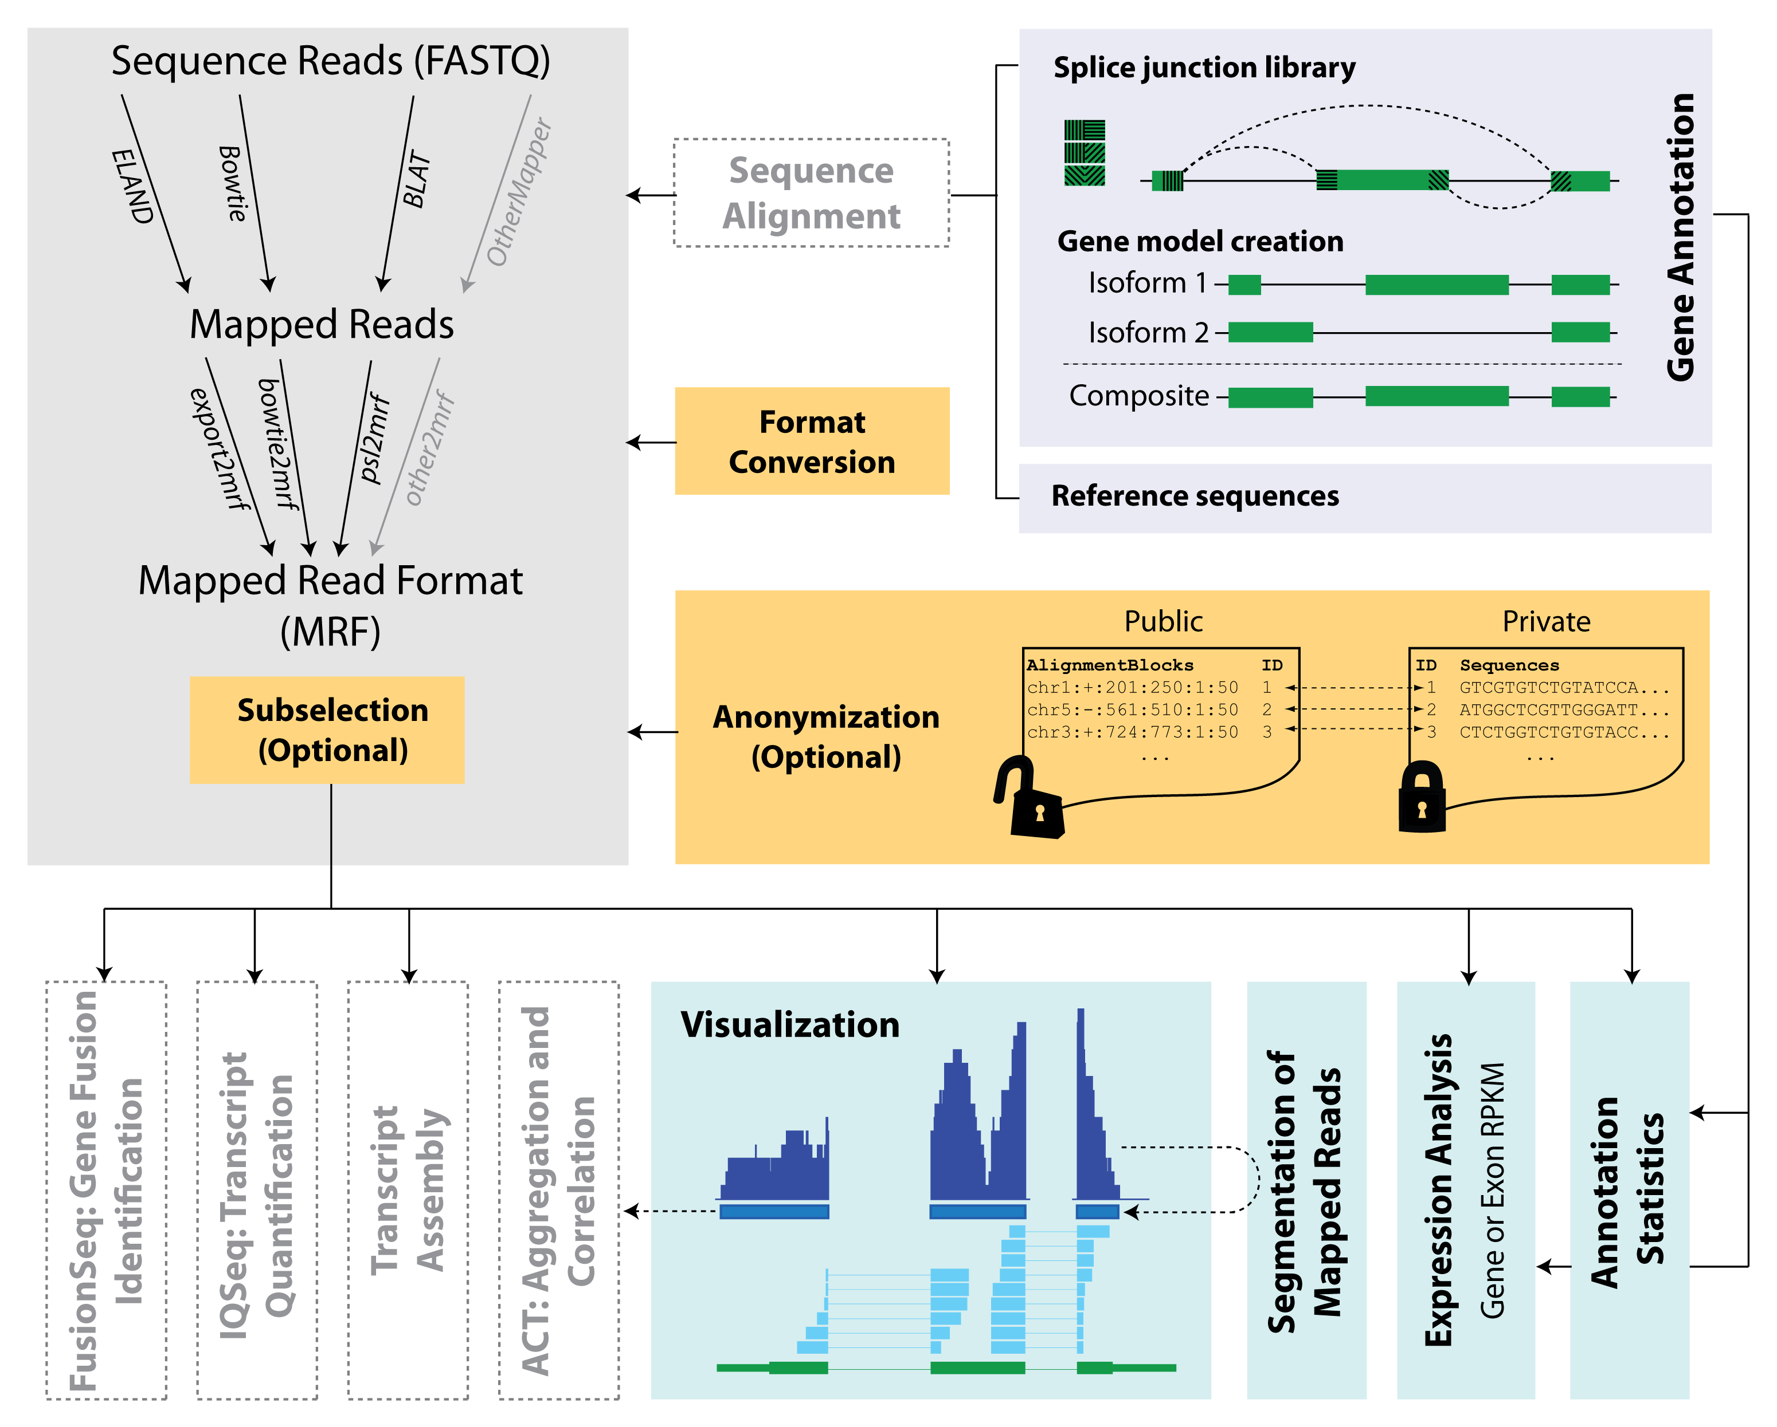
RSEQtools
Habegger et al., Bioinformatics, 2010

Slide 4
RSeqTools Installation
RSeqTools can be downloaded for free from:
http://archive.gersteinlab.org/proj/rnaseq/rseqtools/
RSeqTools Dependencies:
gsl library (http://www.gnu.org/software/gsl/)
ROOT library (http://root.cern.ch/drupal/)
bios library (in house library)
mrf library (in house library)

Slide 5
Core RSEQtools modules
Habegger et al., Bioinformatics, 2010.
Format conversion utilities
Genome annotation tools
Expression analysis
Visualization tools
Segmentation of mapped reads
Annotation statistics tools
MRF selection utilities
Auxiliary utilities

Slide 6
Need for common formats
Modular framework
Standardized data format
Challenges:
  Data sets are so large that they are difficult to share
  Sequence information potentially contains sufficient information to identify the underlying individual
    Privacy concerns (human)
Habegger et al., Bioinformatics, 2010

Slide 7
Mapped Read Format
Mapped Read Format (MRF)
  Compact data summary format for short and long read alignments
  Enables the anonymization of confidential information
  Still possible to carry out most functional genomics analyses
MRF flat file consists of three components
  Comment lines
  Header line
  Mapped reads (alignment blocks, sequences, quality scores, queryID)
Habegger et al., Bioinformatics, 2010

Slide 8
MRF example
AlignmentBlock = TargetName:Strand:TargetStart:TargetEnd:QueryStart:QueryEnd
Comment lines
Header line
# Example 1
AlignmentBlocks Sequence QualityScores
chr2:+:601:630:1:30,chr2:+:921:940:31:50 AGGCTCAA… effcghff…
Mapped reads
TS
TE
TS
TE
Reference
AlignmentBlock 1
AlignmentBlock 2
Splice junction Read
QS
QE/QS
QE
Legend: TS = TargetStart, TE = TargetEnd, QS = QueryStart, QE = QueryEnd

Slide 9
Friends of RSEQtools
RSEQtools (http://rseqtools.gersteinlab.org)
  RPKMs, utilities and standardized format (MRF)
FusionSeq (http://rnaseq.gersteinlab.org/fusionseq)
  Identification of chimeric transcripts
IQSeq (http://rnaseq.gersteinlab.org/IQSeq)
  Transcript isoform quantification
ACT (http://act.gersteinlab.org)
  Aggregation and correlation toolbox
incRNA
  Identification of non-coding RNAs

Slide 10
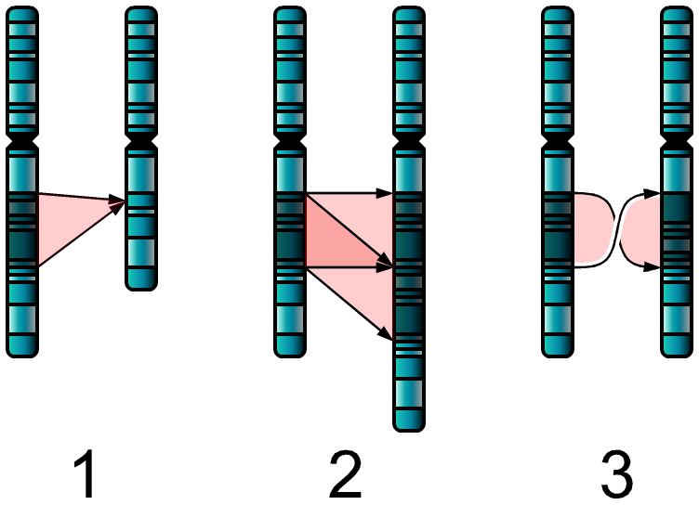
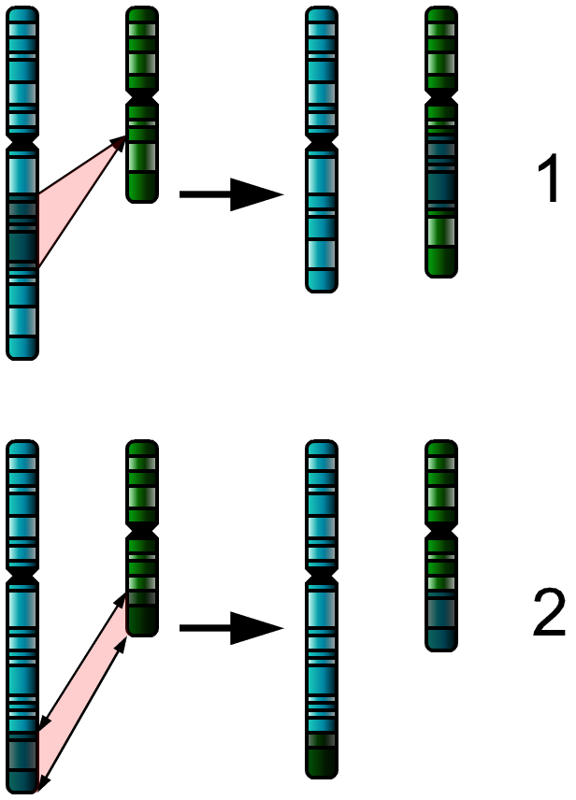
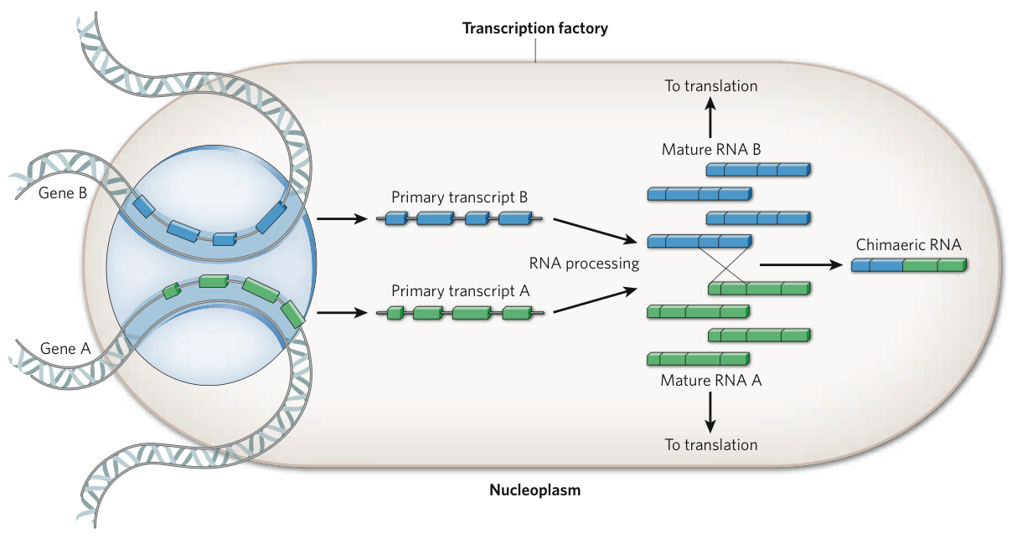
FusionSeq
Transcripts that are not co-linear in the genome space.
They can arise from:
  genomic rearrangements, i.e. gene fusions
  post-transcriptional events, i.e. trans-splicing
Single-chromosome abnormalities
Two-chromosome abnormalities
insertion
deletion
duplication
inversion
gene fusions
translocation
Wheeler R, wikipedia 2007
trans-splicing
Gingeras T, Nature 2009
Notes:
10
10
at the beginning say that it was developed for human, keep it general, don't go into detail

Slide 11
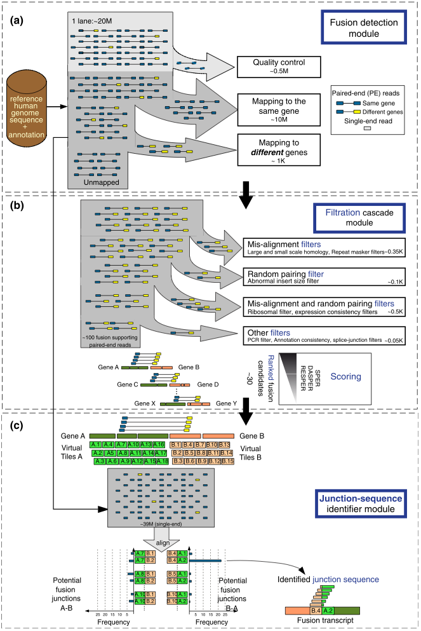
Identification of fusion transcripts
Traditional detection of fusion genes typically involves cytogenetic methods
Some require a hypothesis about the genes involved in the fusion
Next-generation sequencing can help to address this question, especially with:
  Paired-end RNA-Seq: keeping connectivity information
CTTGGAAGC
GTGCTATGAA
mRNA fragment
FusionSeq
http://rnaseq.gersteinlab.org/fusionseq/
11
Sboner et al., Genome Biol, 2010, 11:R104
Notes:
11
11

Slide 12
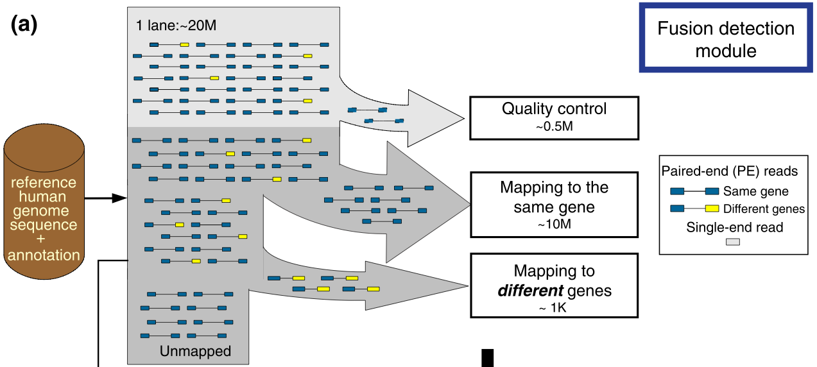
Fusion Detection Module
composite model 1
composite model 2
A
B
C
D
1
2
3
4
Potential Fusion Transcript
A
B
3
4
Sboner et al., Genome Biol, 2010, 11:R104
Notes:
12
12

Slide 13
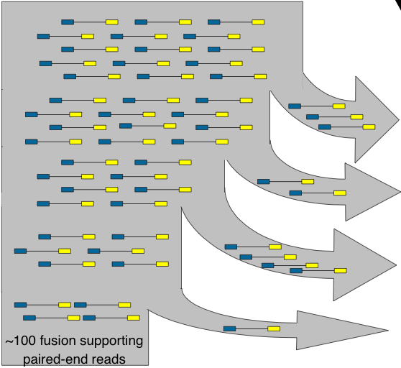
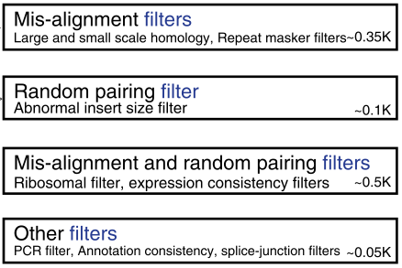
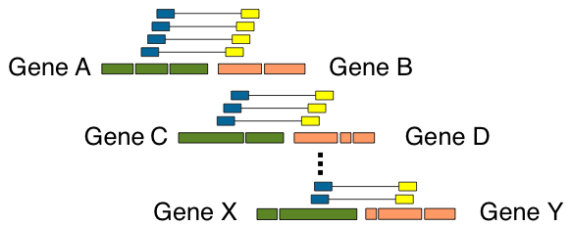
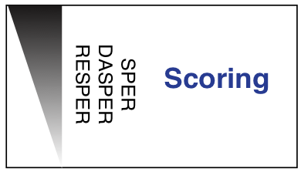
Not an ideal world: sources of errors
Mis-alignment
  Base caller errors
  SNPs
  RNA editing
  Sequence similarity (paralogs, pseudogenes)
Random pairing of transcript fragments
  Sample preparation
Combination of mis-alignment and random pairing
PCR amplification, gene annotation inconsistencies
Filtration Cascade module
95% of fusion candidates are filtered out
Ranked fusion
candidates
SCORING
Observed
Comparison with expectations
Supportive PE Reads per million mapped reads
Difference of observed SPER and Analytically computed SPER
Ratio of observed SPER and Empirically computed SPER
Sboner et al., Genome Biol, 2010, 11:R104
Notes:
13
13

Slide 14
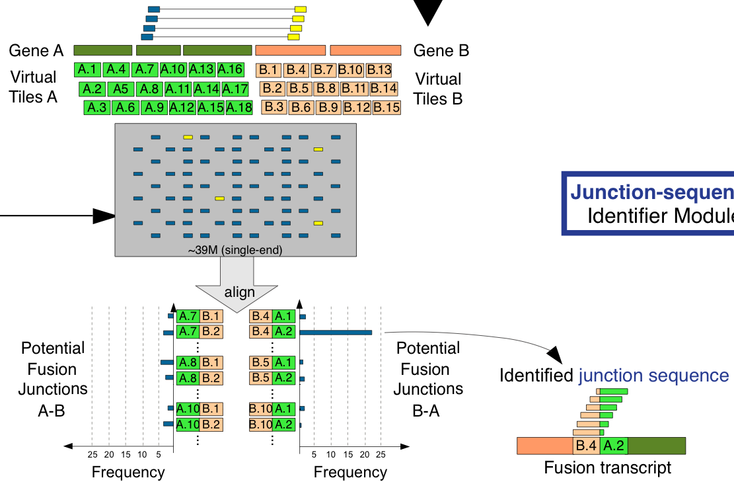
Junction-Sequence Identifier
Sboner et al., Genome Biol, 2010, 11:R104
Notes:
14
14
validateBpJunctions

