Slide 1
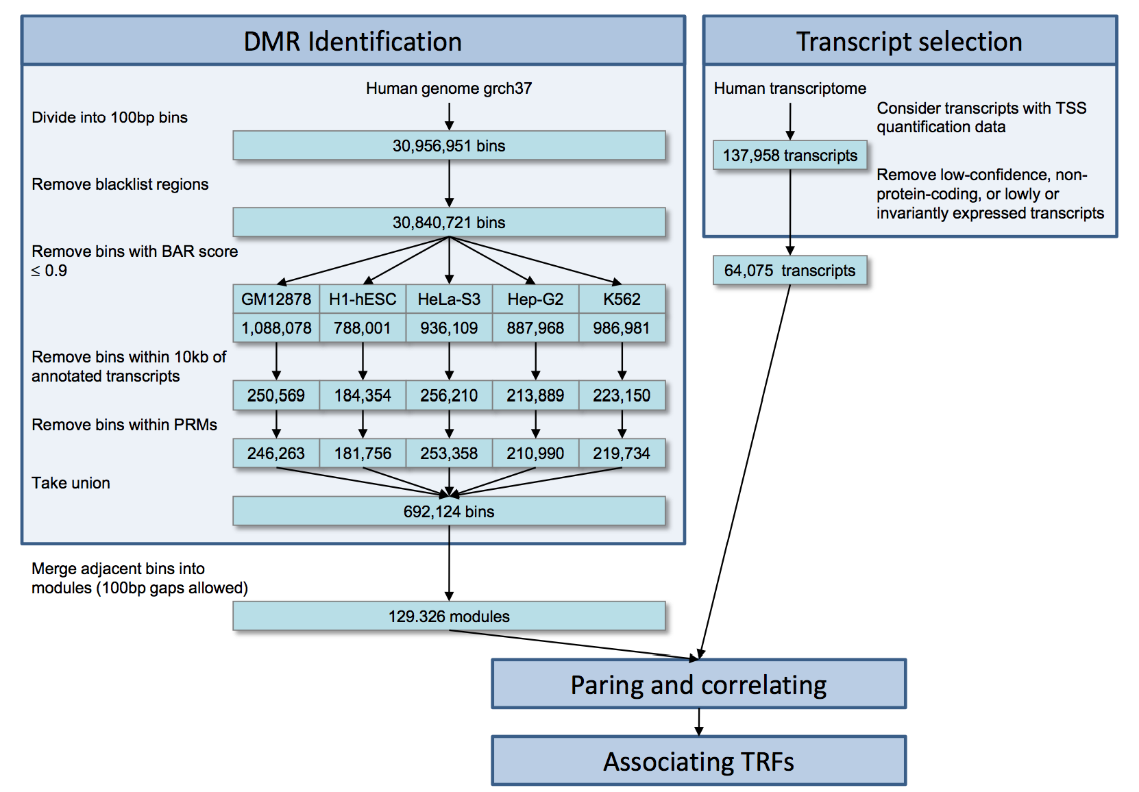
‘Supervised’ enhancer prediction
Supervised machine learning methods to predict BARs (binding active regions) and PRMs (proximal regulatory modules).
Features: DNase I hypersensitivity, FAIRE, and histone modifications
Define DRMs (distal regulatory modules)
DRM Identification
Yip et al., Genome Biology (2012)

Slide 2
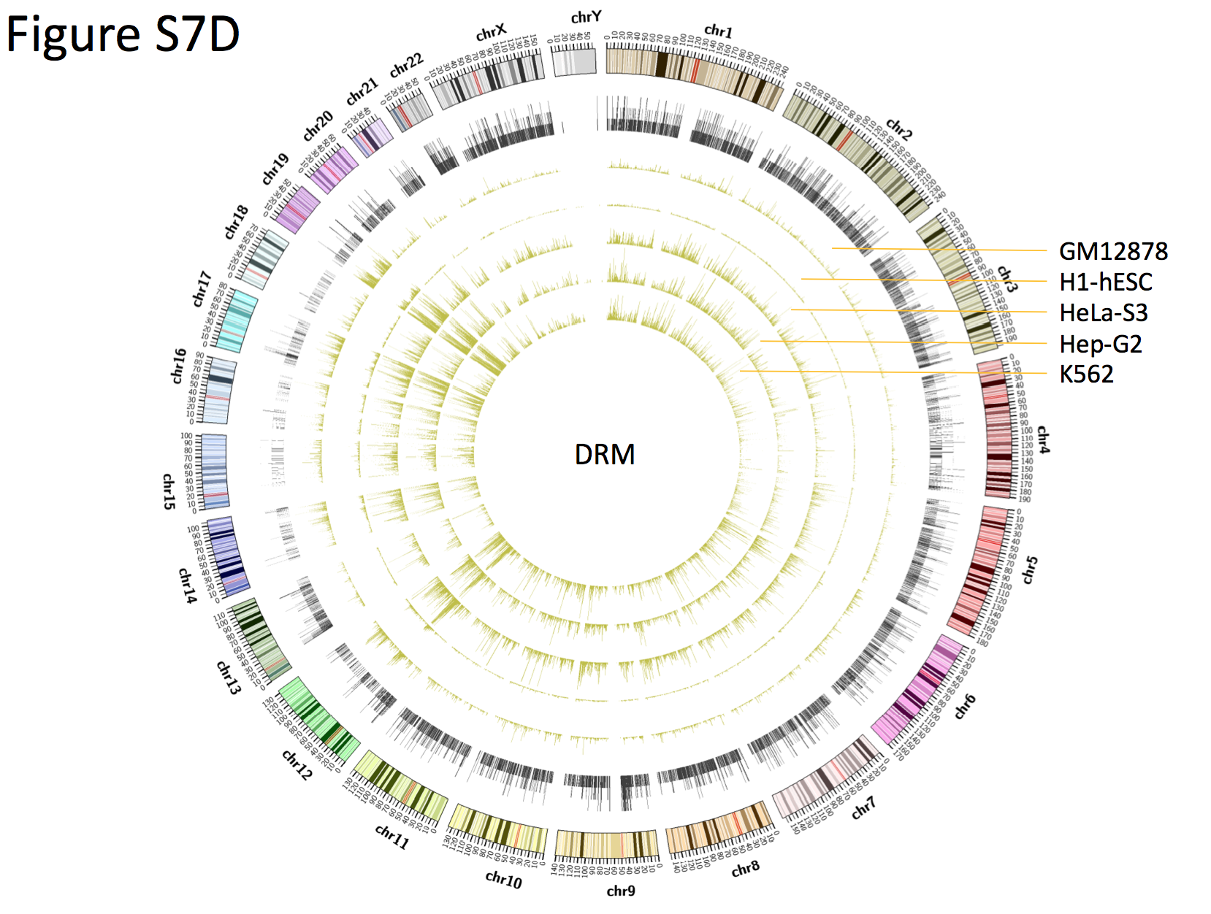
Cell-line specific distal regulatory modules

Slide 3
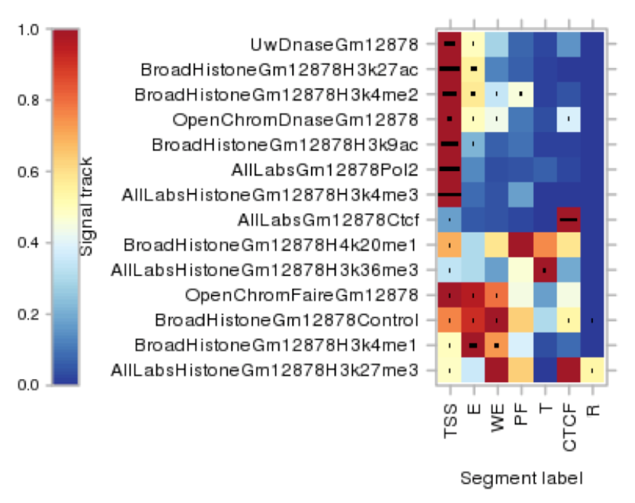
Combine DRMs with Segway/chromHMM
one approach worth investigating is combining enhancers captured by our method and some segmentation methods
enhancer / weak enhancer
http://metatracks.encodenets.gersteinlab.org
ENCODE combined segmentation from Segway and chromHMM

Slide 4
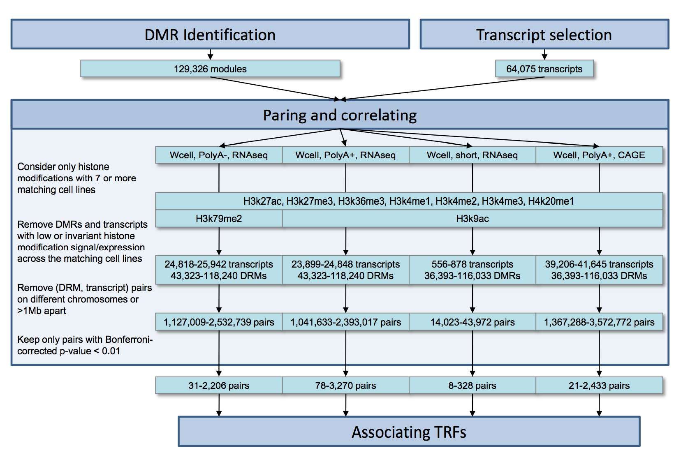
Associate enhancers with target genes
Idea: Histone modifications (such as H3K4me1 and H3K27ac) to predict the expression level of genes across multiple cell lines.
Another direction is to use whole-genome DNA long-range interaction data
Form distal regulatory networks
Enhancers (DRM)
Yip et al., Genome Biology (2012)

