Slide 1
Recap
LARVA-SAM: Statistical Assessment Module
Simulate the creation of entire exome variant call sets for comparison of recurrent variation to actual data
Detect significant results
Factors influencing rate of mutation in exome:
Expression, DNA replication timing, chromatin state, length

Slide 2
Development of Whole Genome Null Model
Expression not applicable to whole genome
Still locating a source of whole genome chromatin state data
Whole genome replication timing available from:
Chen, C. L. et al. Impact of replication timing on non-CpG and CpG substitution rates in mammalian genomes. Genome Research 20, 447–457 (2010).
MutSig only took exome data from this

Slide 3
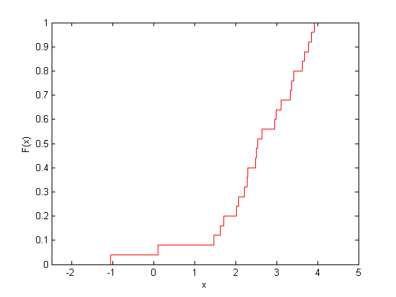
Development of Whole Genome Null Model
Data is a signal track in blocks of 100,000 bp
hg18
Mapped everything to hg19
Unmapped parts were filled in by taking the average signal of the surrounding regions
Essentially use the CDF of the replication timing distribution
Later replication times --> higher mutation rates
Length of each region is roughly the same --> no length term

Slide 4
Development of Whole Genome Null Model
Replication timing data does not cover chromosomes X, Y, or M
How to deal with this?
Anything else I should be thinking about?

