Slide 1
Group meeting
Alexej Abyzov
December 4, 2013

Slide 2
Breakpoints in phase I of
1000 Genomes Project

Slide 3
Breakpoint datasets
GenomeStrip calls
CNVnator calls
XXX calls
Merged callset
Breakpoint assembly
GS subset
Refinment
Integration with other variants
Confident subset

Slide 4
Acquiring read support for breakpoints
Start from a set of bpts after assembly
Map unaligned reads (flag 0x4) to breakpoint junctions (low quality end is trimmed up to q15 a la BWA)
Allow up to 3% of mismatches
Select junctions with mapped reads from at least 2 individuals
Changing min_d = min(d1,d2)
Use distribution of mismatches within reads for additional selection
d1 d2

Slide 5
Estimating FDR of breakpoints
deletion
1 4
1 2 3 4
Real junction
Read mapping is
evidence for the junction
Null model imitates sequence
homologies around breakpoints
3 2
Null junction
Read mapping is background

Slide 6
Selecting confident set
< 5% Null Junctions FDR
Filtering
# of bpts
Rank Sum
FDR
Null
Junctions
FDR

Slide 7
PCR validation summary

Slide 8
By method

Slide 9
FDR
Average PCR FDR of 31%
  wrong deletion sites
  different breakpoints
  complex events
  possibly, misgenotyped samples
Mostly for deletions classified as NAHR and VNTR
  strong association of false breakpoints with repeats
Greater but generally corresponds to IRS FDR (18%)
Large residual FDRs for SR method
  Repeated mistakes by SR method, then by assembly, and then by mapping to deletion junctions?
  Perhaps assembly does not validate calls made by SR methods
  Excluding breakpoints for deletions found only by SR methods

Slide 10
Filtering breakpoints
Remove breakpoints aligned by CROSSMATCH only
Remove breakpoints aligned by AGE only && having alternative contigs && found by only one caller (out of 5)
Remove breakpoints found by only one SR caller (EMBLdelly, Pindel, and PilotAssembly)
Remove breakpoints classified as VNTR

Slide 11
Filtered/confident set
8,943 breakpoints
Mechanisms:
  NHR – 5,433 (60.8%)
  TEI – 2,269 (25.3%)
  NAHR – 1,167 (13.0%)
  VNTR – 0 (0%)
  Unsure – 81 (1%)
Callers
  GenomeStrip – 5,756 (64%)
  CNVnator – 2,087 (23%)
  BreakDancer – 6,643 (74%)
  EMBLdelly – 6,062 (68%)
  Pindel – 3,903 (44%)
FDR
  From PCR – 13.7% (4 possible negative out of 30 total)
  From IRS – less than 6.4%
  ~20% of breakpoints are genotyped by OMNI 2.5s array!

Slide 12
Band 138 TGGTCAGAGAGTAAAATAATGAGAGGAAAAACAGGAGAT-AATATGTTCG 186
Reference 218 TGGTCAGAGAGTAAAATAATGAGAGGAAAAACAGGAGATaAATATGTTCG 267
Band 187 GAGAGTAAAATAATGAGAGGAAAAACAAGAGAT----------------- 219
Reference 268 GAGAGTAAAATAATGAGAGGAAAAACAAGAGATAAATATGTTCAGgccgg 317
Band 220 -------------------------------------------------- 219
Reference 318 gcgcggtggctcacgcctgtaatcccagcactttgggaggccgaggcggg 367
Band 220 -------------------------------------------------- 219
Reference 368 cggatcacgaggtcaagagatcgagaccatcccggctaaaacggtgaaac 417
Band 220 -------------------------------------------------- 219
Reference 418 cccgtctctactaaaaatacaaaaaaattagccgggcgtagtggcgggcg 467
Band 220 -------------------------------------------------- 219
Reference 468 cctgtagtcccagctacttgggaggctgaggcaggagaatggcgtgaacc 517
Band 220 -------------------------------------------------- 219
Reference 518 cgggaggcggagcttgcagtgagccgagatcccgccactgcactccagcc 567
Band 220 ------------------------------------AAATATGTTCAGAG 233
Reference 568 tgggcgacagagcgagactccgtctcaaaaaaaaaaaaatatgttcagAG 617
Band 234 ACTCCACTCATTTTATGAGTTCTTAGAGGTAAAAGAGATGATGGAAAGAG 283
Reference 618 ACTCCACTCATTTTATGAGTTCTTAGAGGTAAAAGAGATGATGGAAAGAG 667
Different
breakpoints
MERGED_DEL_2_53029
Reference
PCR band
Contig
Homologous
sequences

Slide 13
Uncertain MERGED_DEL_2_16800
Predicted SV size is 288 bps
Expected bands
  913 bps – for reference allele
  624 bps – for SV allele
Observed band
  1000 bps and 1200 bps
No band sequencing

Slide 14
Perhaps false MERGED_DEL_2_17928
Predicted SV size is 712 bps
Expected bands
  1153 bps – for reference allele
  440 bps – for SV allele
Observed band
  400 bps (weak) and 1100 bps
Sequenced band pool => no indel

Slide 15
False MERGED_DEL_2_38026
Predicted SV size is 98 bps
Expected bands
  622 bps – for reference allele
  523 bps – for SV allele
Observed band
  650 bps
Sequenced the band => no indel

Slide 16
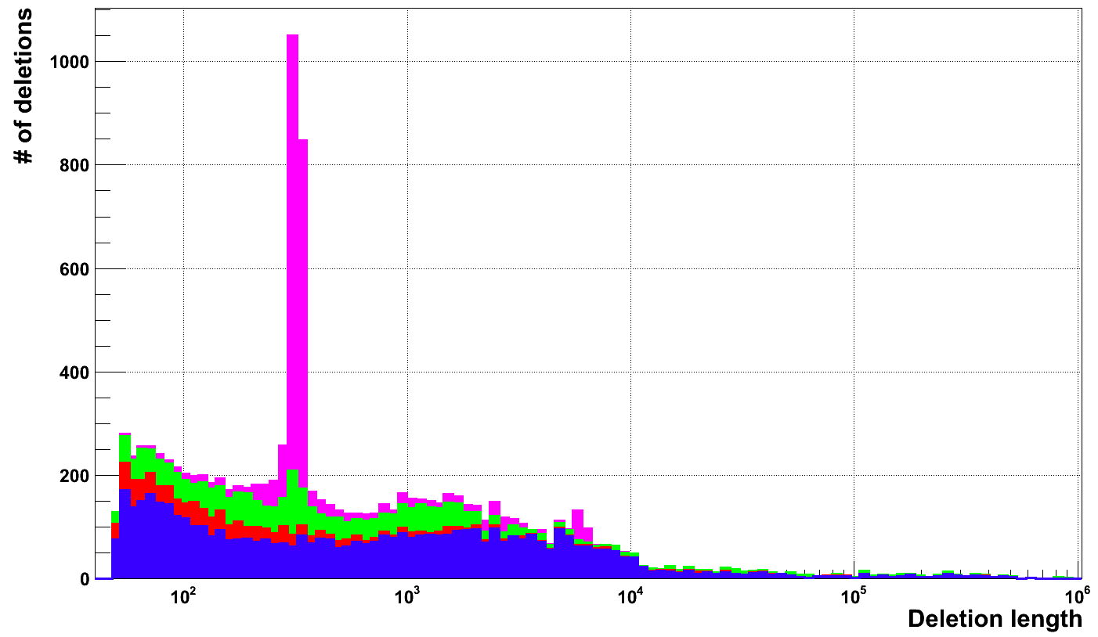
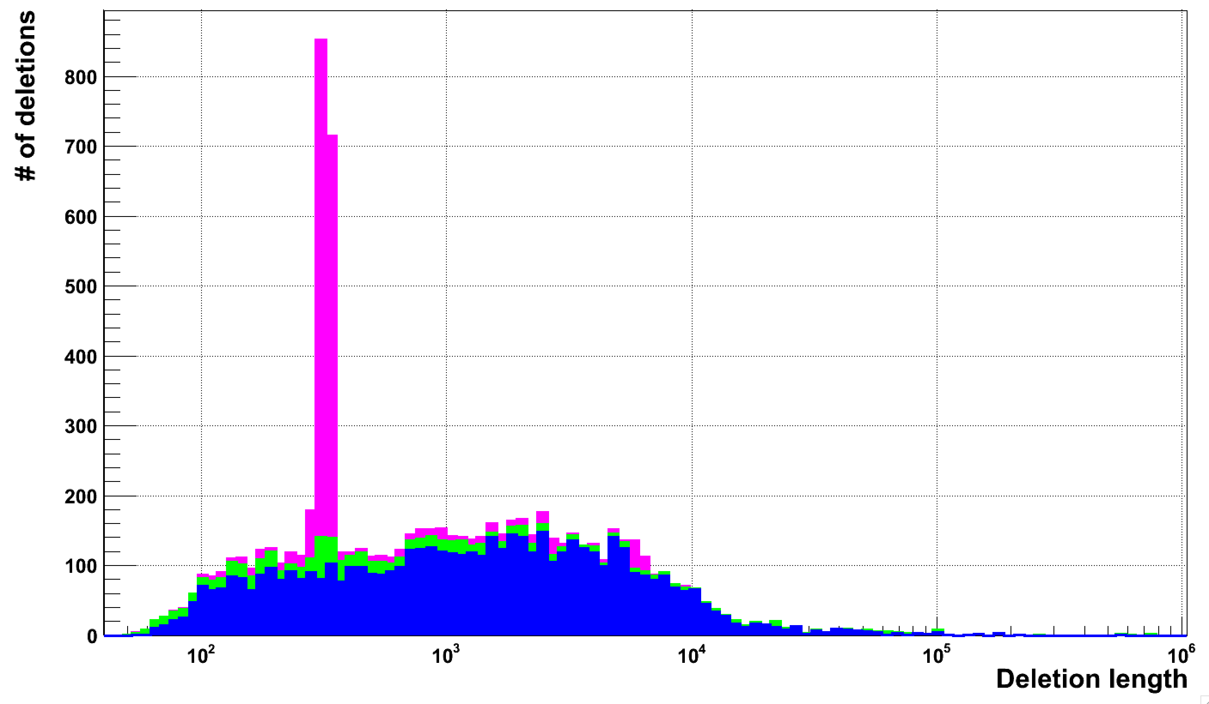
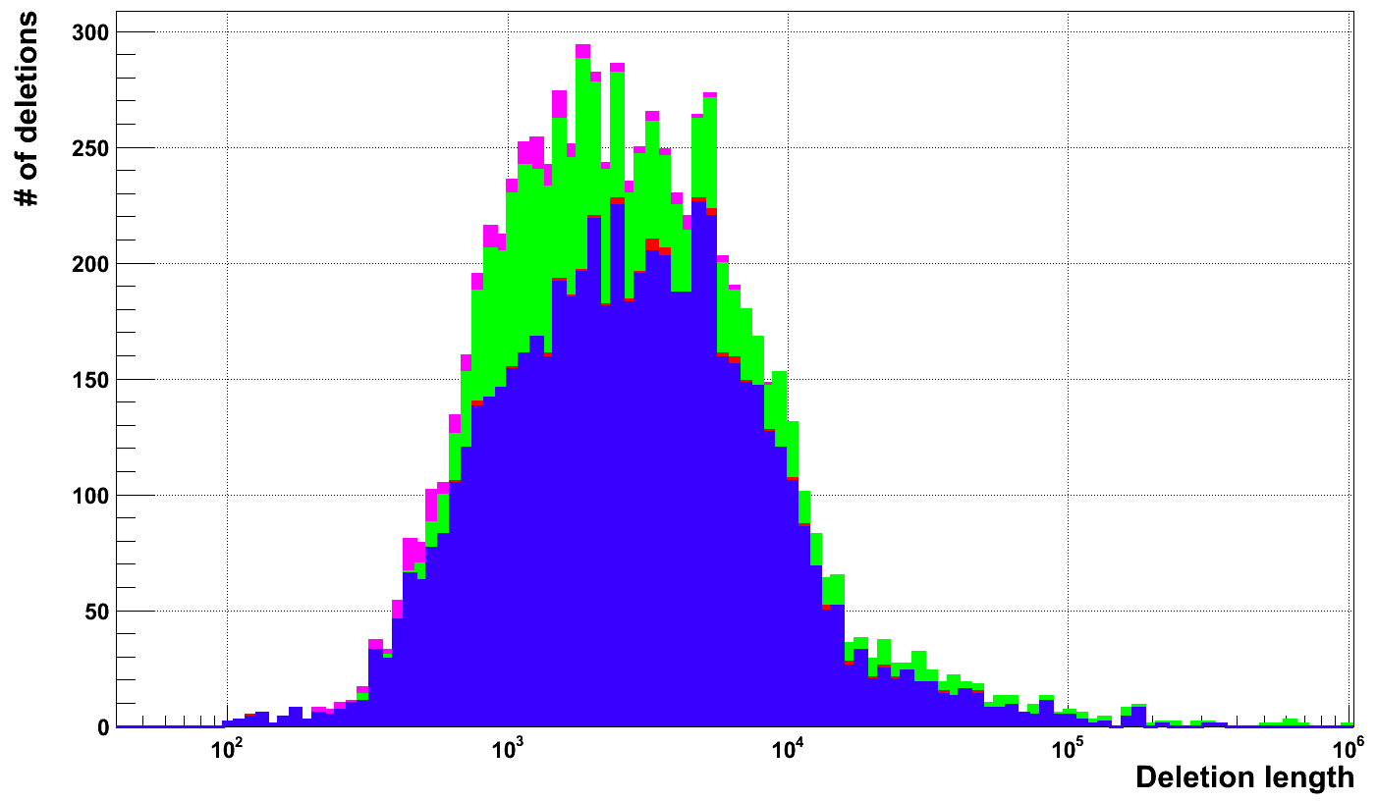
Pilot
10,871
Confident
8,943
Integrated
8,934

Slide 17
Integrated vs confident
Confident
Integrated
4,965 (55.5%)
3,978 (44.5%)
4,956 (55.5%)

Slide 18
Analysis

Slide 19
Correlation/association with other variants
Aggregate SNPs and indels around deletion breakpoints
Consider SNPs and indels only in confident bases (where confident calling can be made, i.e. ‘P’)
Normalized aggregation signal by the number of accessible (by mask) bases

Slide 20
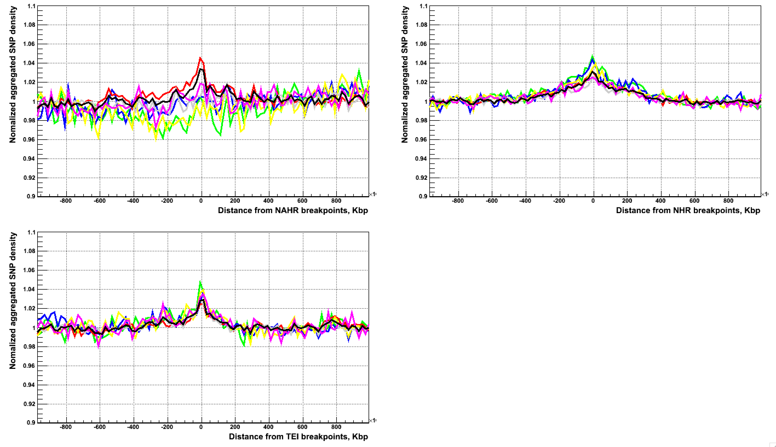
SNP aggregation at LARGE SCALE
all, C>A, C>G, C>T, T>A, T>C, T>G

Slide 21
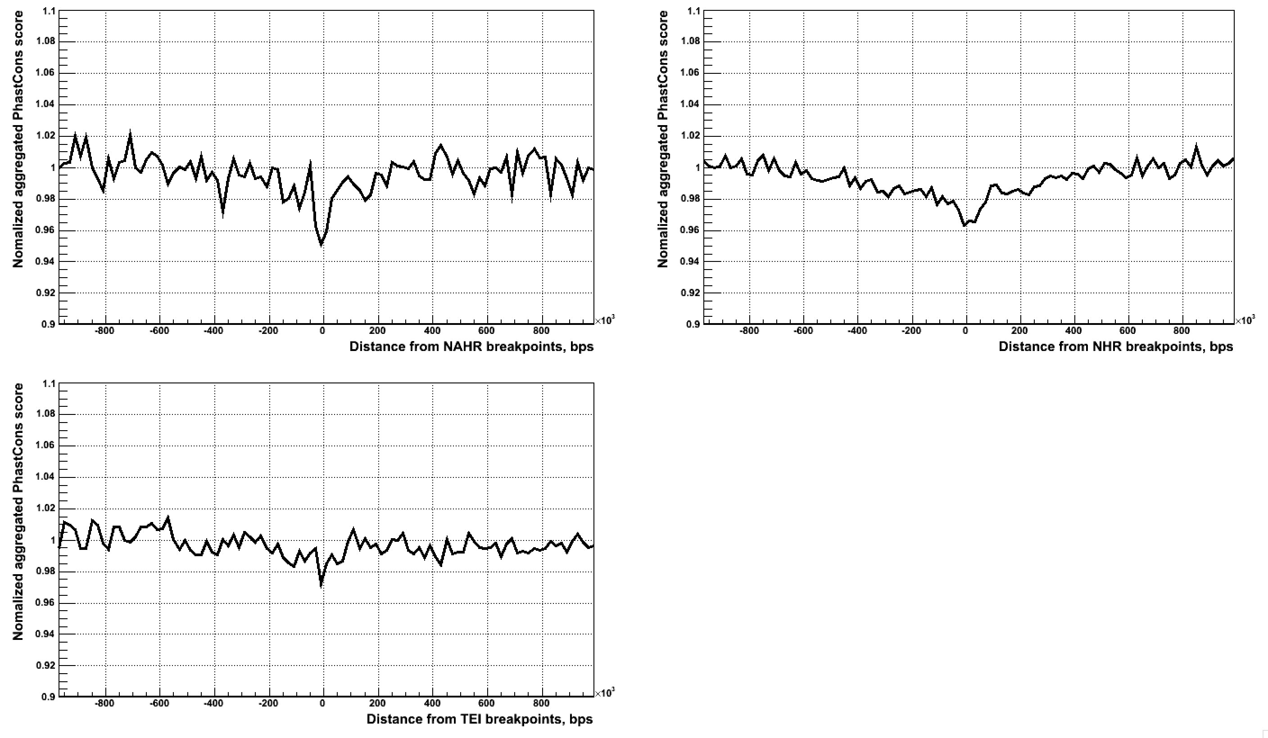
PhastCons (primates) aggregation at LARGE SCALE
all, C>A, C>G, C>T, T>A, T>C, T>G

Slide 22
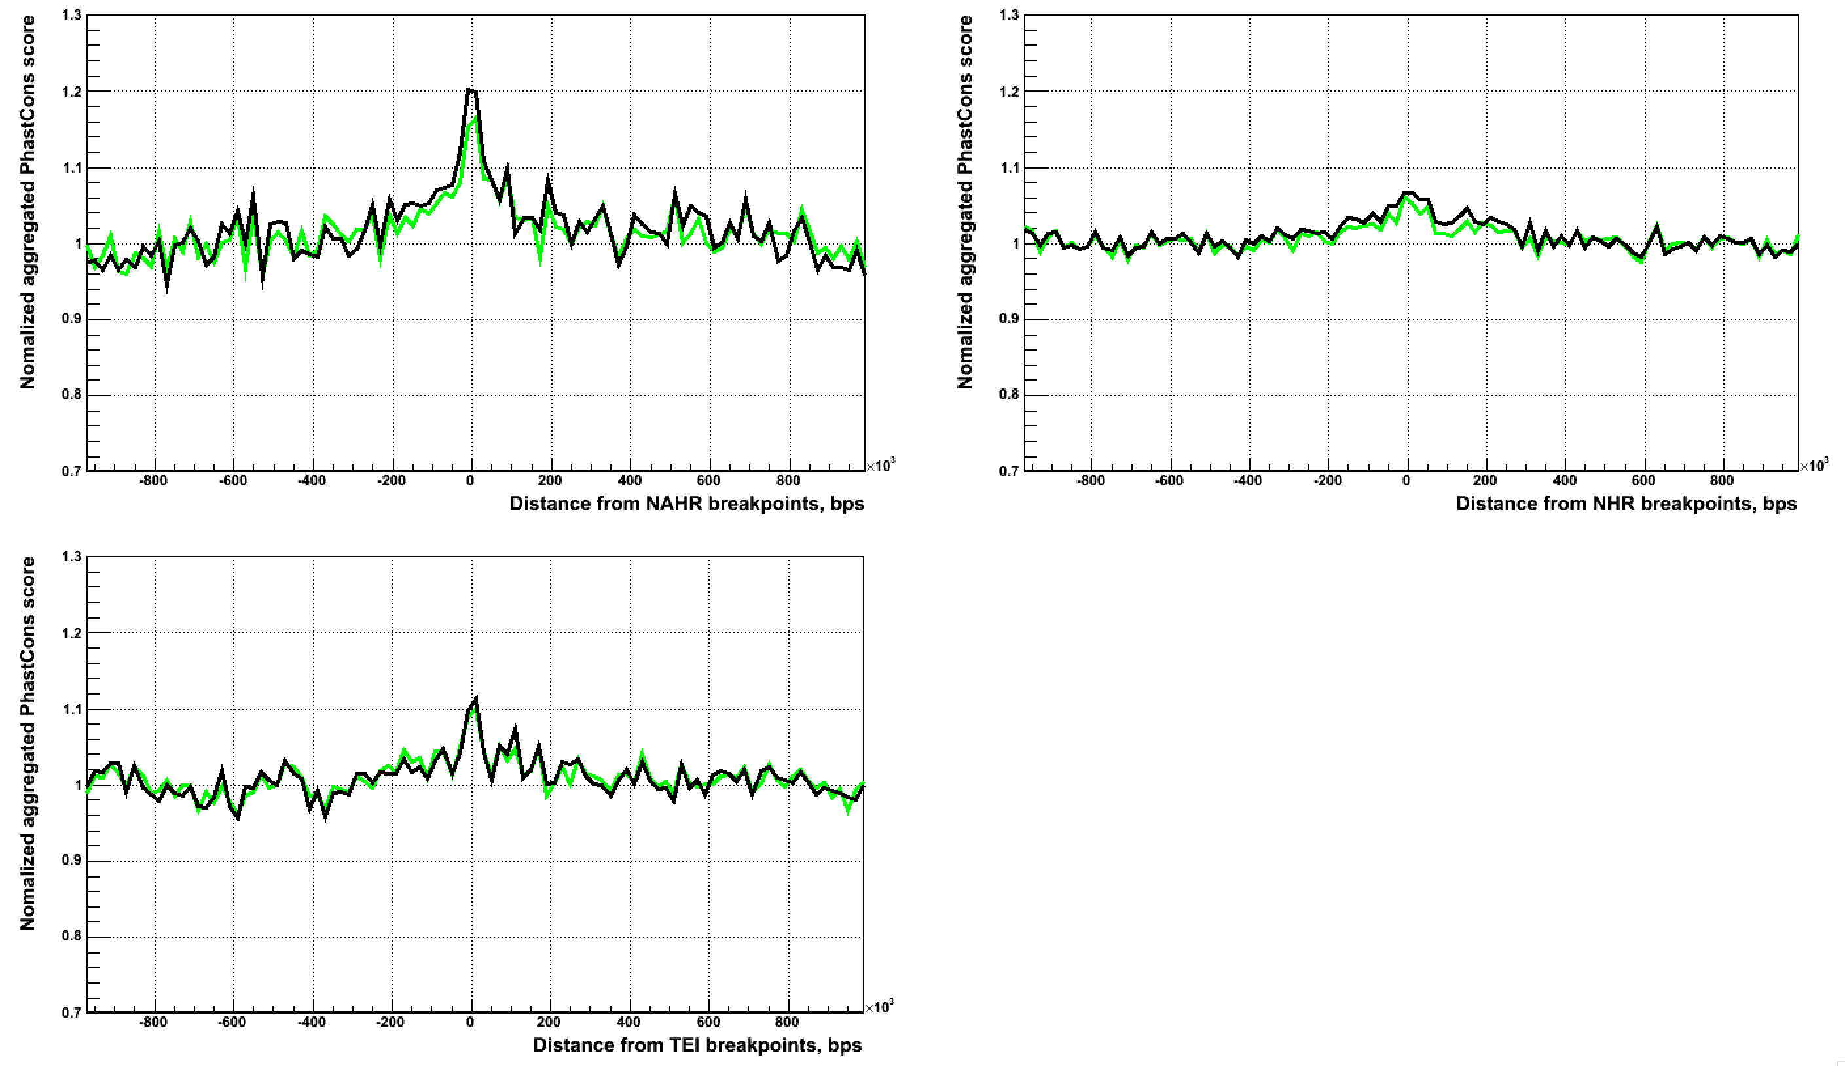
Indel aggregation at LARGE SCALE
Indels 1 – 6 bps in length
Indels 1 bp in length

Slide 23
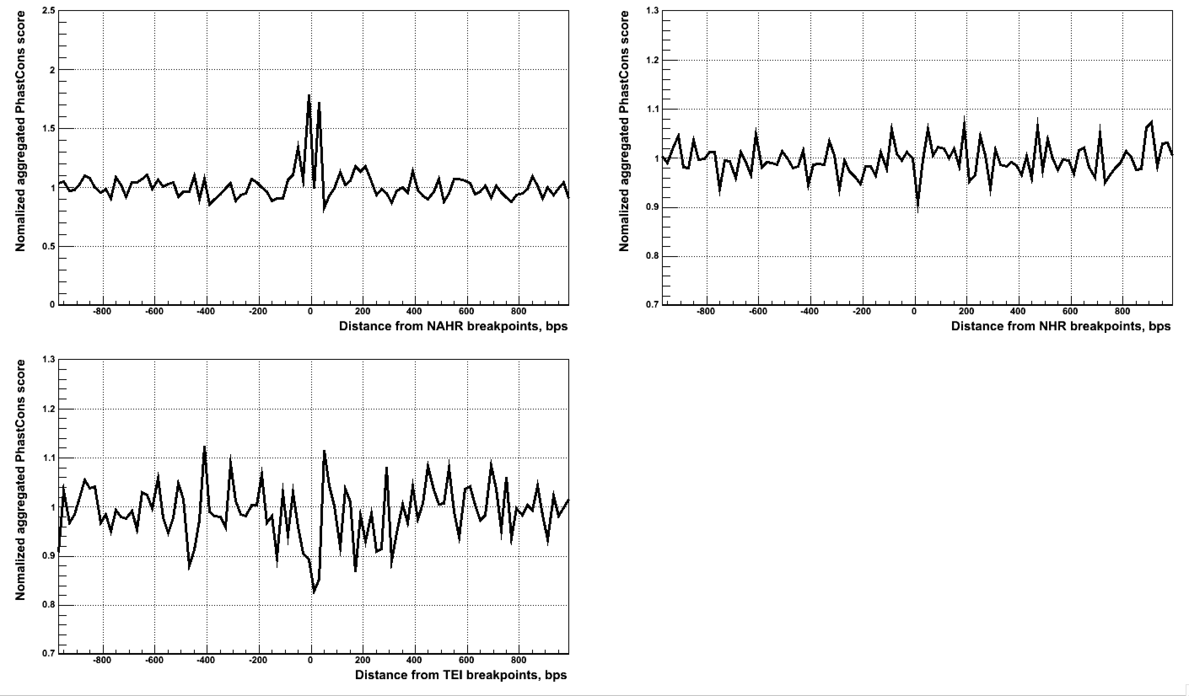
SNP aggregation at small scale

Slide 24
Conclusion
Aggregation of different types of variants is likely due to variants being confound to regions of weaker evolutionary selection

Slide 25
NAHR

Slide 26
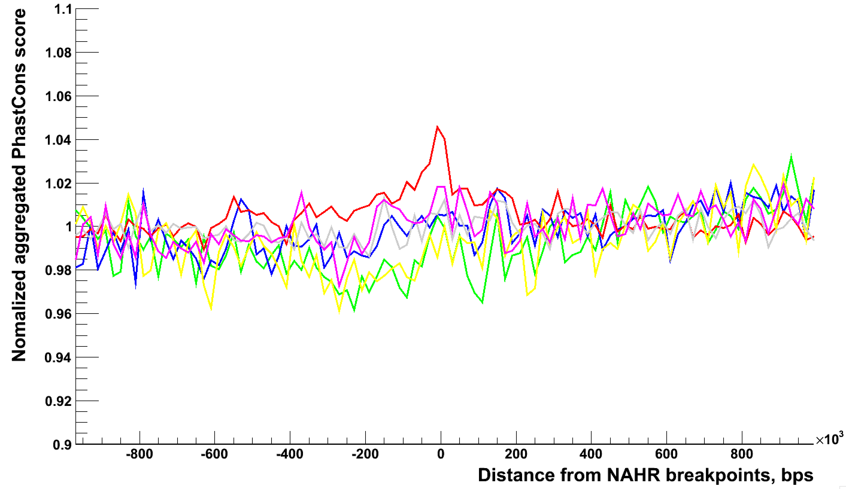
SNP aggregation for NAHR
C>A, C>G, C>T, T>A, T>C, T>G
Possible APOBEC mutation
(DNA editing)

Slide 27
Histones at breakpoints
Two chromatin states: transcriptionally active and structurally accessible; transcriptionally repressive and structurally condensed
H3K4me1 is an activating histone mark
H3K27me3 is an repressive histone mark
Khurana et al, Science 2013
Notes:
The processes responsible for this higher order architecture are still not fully understood. Over the last two decades it has become evident that chromatin is a highly flexible environment, wherein spatially and temporally coordinated changes between transcriptionally repressive/structurally condensed states, and transcriptionally active/structurally accessible states regulate gene expression.
http://www.sciencedirect.com/science/article/pii/S0959437X05000237
http://genome.ucsc.edu/cgi-bin/hgEncodeVocab?ra=encode/cv.ra&deprecated=true&target=H3K4me1
Fig. 4. Functional annotations of indels and
SVs. (A) Fraction of rare indels in coding-gene
categories. Total number of indels shown. (B) Enrichment
of SVs affecting functional annotations.
Middle box shows genes, pseudogenes, and TF motifs;
upper blow-out shows gene parts in different modes,
and bottom blow-out shows enhancers with different
formation mechanisms, i.e., NAHR, NH (nonhomologous),
TEI (transposable element insertion), and
VNTR (variable number of tandem repeats). Asterisks
indicate significant enrichment (green) or
depletion (red) after multiple hypothesis correction.
SVs intersecting various functional categories in
different modes (e.g., whole/partial) are shown in
the right-hand schematics. (C) Aggregation of histone
signal around breakpoints of deletions formed
by different mechanisms. Breakpoints centered at
zero. Aggregation for upstream and downstream regions
corresponds to negative and positive distance,
respectively. Signals for an activating histone mark
(H3K4me1) and a repressive mark (H3K27me3) are
shown.
Histone H3 (tri-methyl K27). Marks promoters that are silenced by Polycomb proteins in a given lineage; large domains are found at inactive developmental loci.
Histone H3 (mono methyl K4). Is associated with enhancers, and downstream of transcription starts.

Slide 28
NAHR
Enriched for C>T mutations (possible APOBEC signature)
Associated with active histone marks
Enriched with enhancers (Jasmine)
Enriched with unpacked DNA (Shantao)
Depleted in methylation (Shantao)
What is the easiest explanation?
Signs of
active
regions

Slide 29
Working hypothesis
Active genomic regions are more likely to have ssDNA
ssDNA is a prerequisite for NAHR
ssDNA is a prerequisite for APOBEC editing
  Analysis of APOBEC motif around NAHR breakpoints (Alex & Shantao in progress)
NAHR are expected to have stronger than other deletion types effect on expression (Arif in progress)

Slide 30
NH

Slide 31
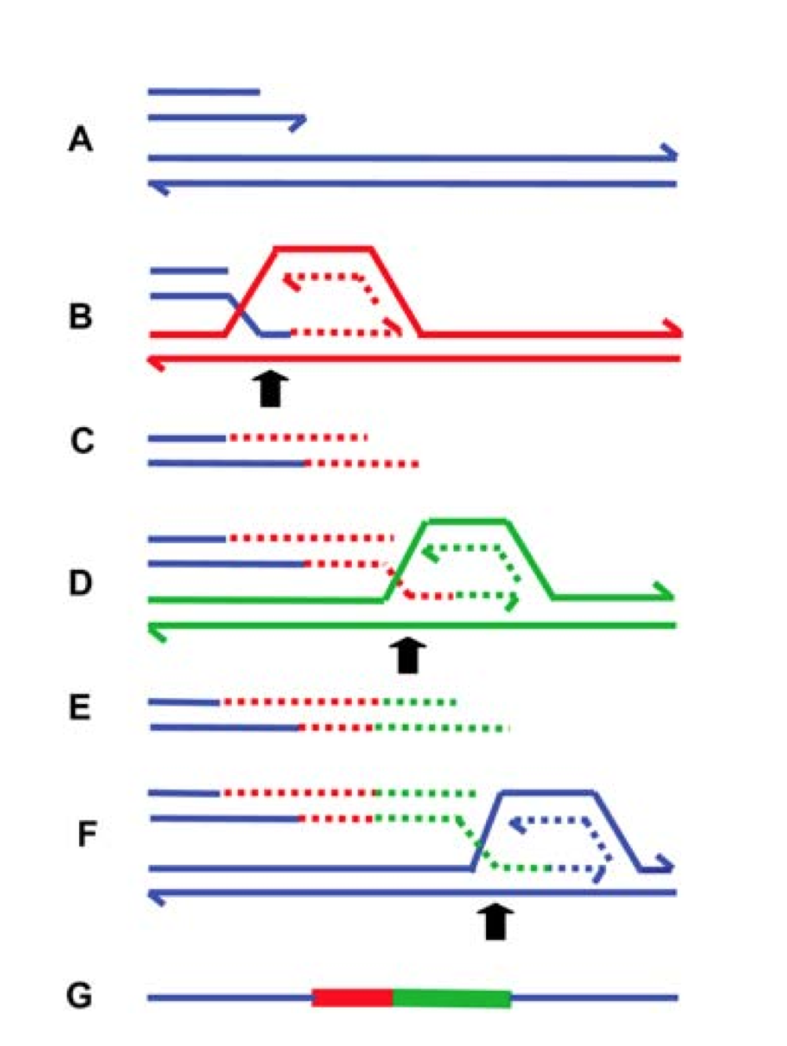
How do they arose?
Double stranded breaks
  No obvious association of breakpoints with fragile sites for double strand brakes was detected (Shantao)
Replication mistakes, the model predicts
  Micro-homology around breakpoints
  Inserted sequence to originate from around the breakpoints
  Work in progress (Alex)
NTS

Slide 32
More explicit
Blunt
deletion
Blunt
duplication
Deletion
with NTS

Slide 33
Non-template sequence insertions (NTS)

Slide 34
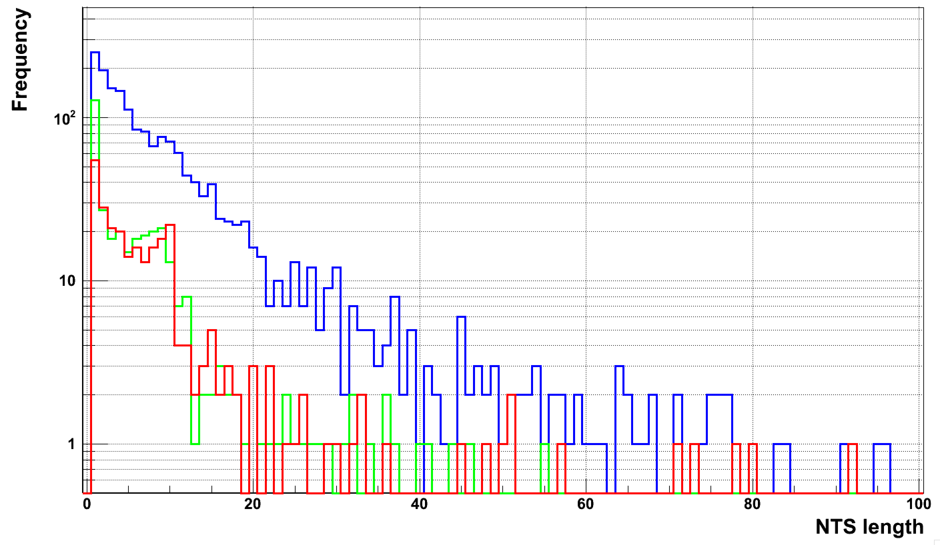
NTS length distribution
Alignment artifacts due to SNP/indel close to deletion breakpoints
NH
NAHR
MEI

Slide 35
So …
Out of 2,391 deletions with NTS
  For only 67 deletions NTS’ match reference genomes uniquely full length without mismatches
Where do they align?
  54 (81%=54/67) align to the same chromosome
  How close to deletion?

Slide 36
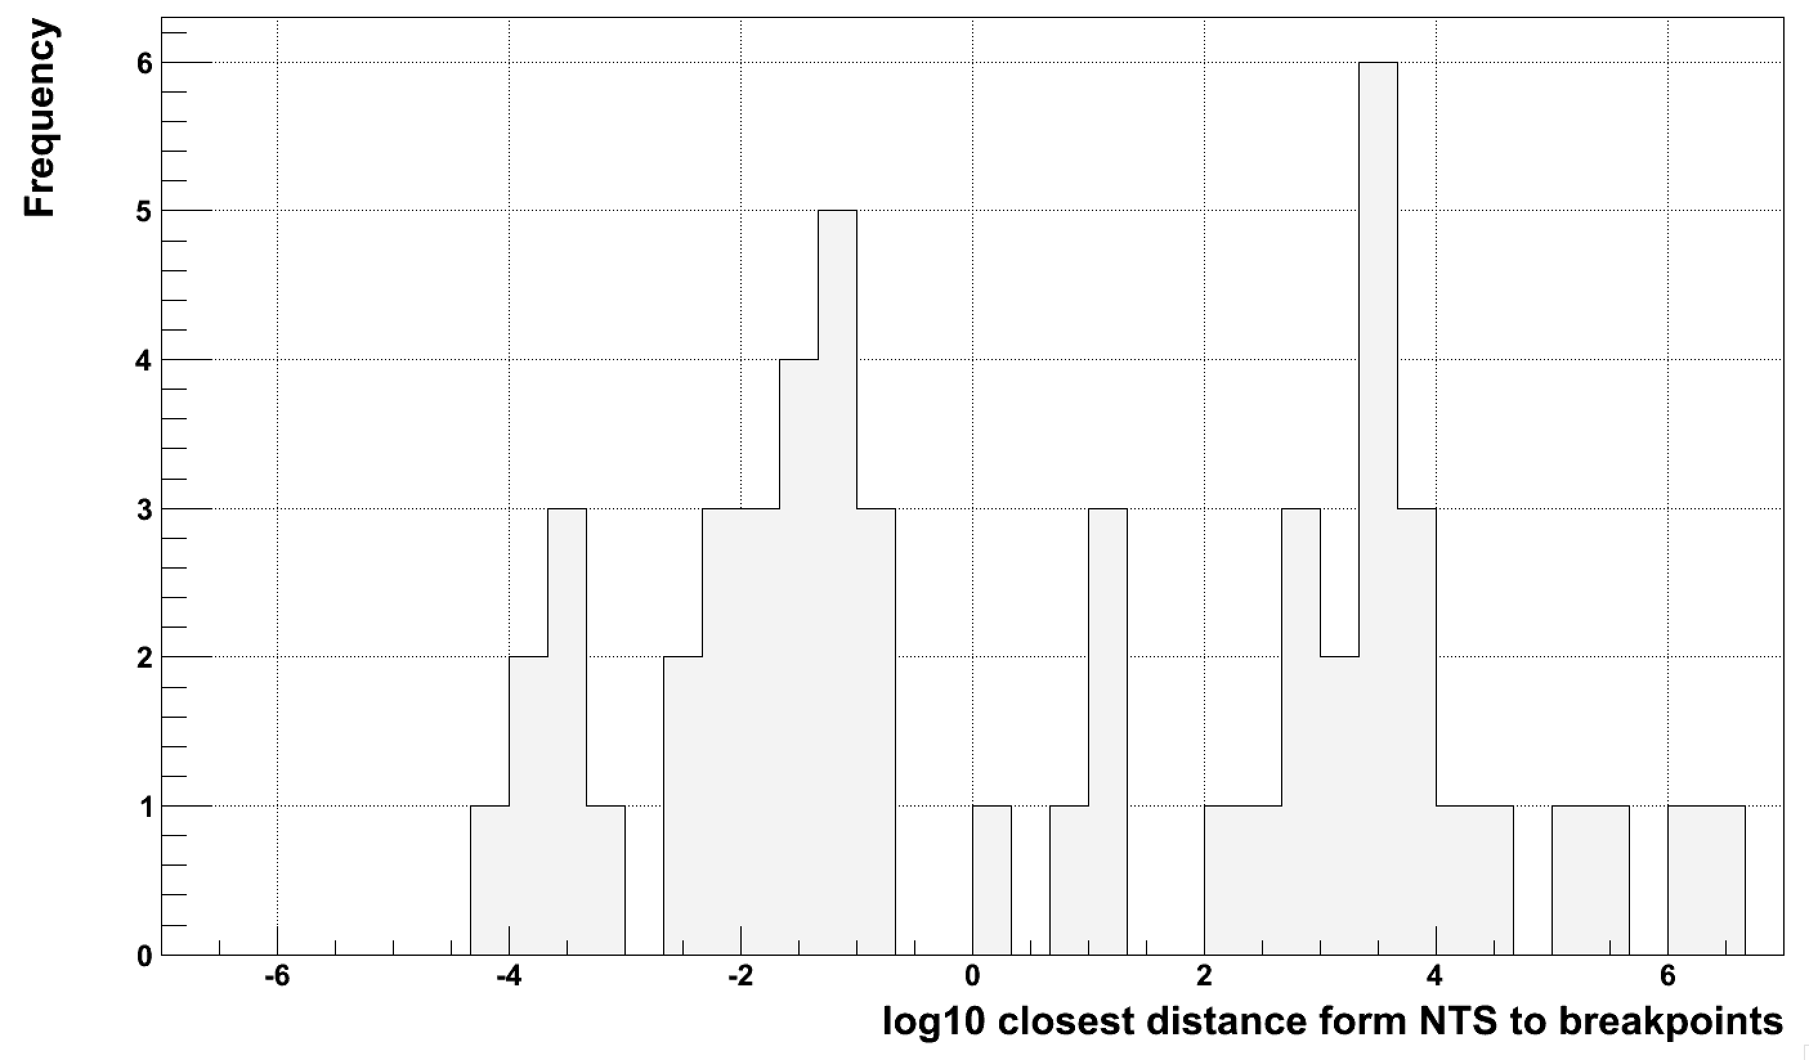
Distance distribution
Inside deletion
Outside deletion

Slide 37
Micro-homology around NTS
Deletion
with NTS
3
4
1
2
Signal is 1 & 2
Noise is 3 & 4

Slide 38
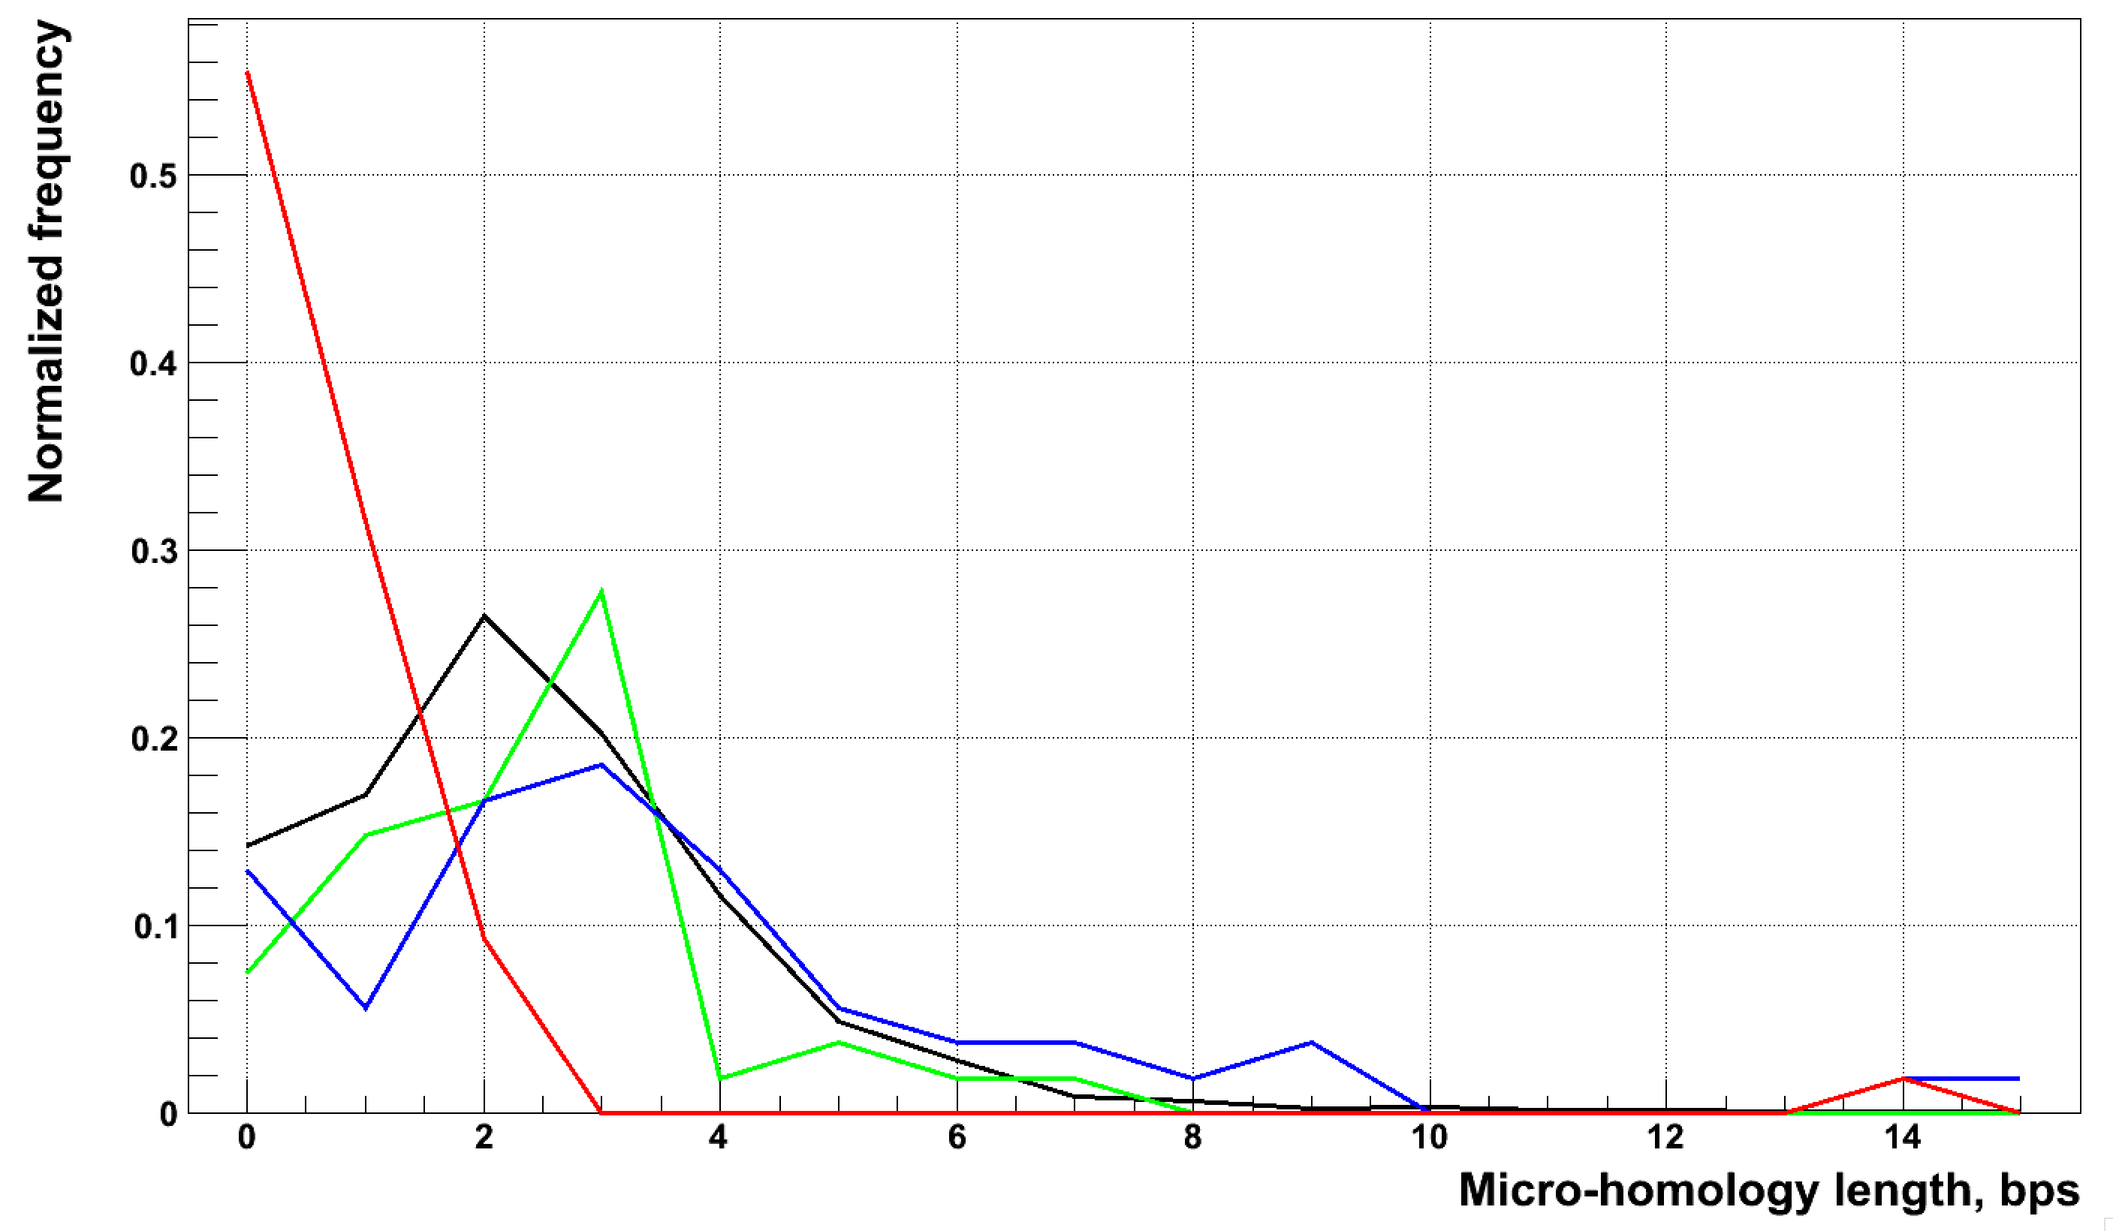
Micro-homology length distribution
Blunt deletions
NTS 5’-end
NTS 3’-end
NTS null

Slide 39
Other outstanding tasks
Correlating NTS locations with replication timing
Validation of breakpoints in high coverage PCR free trios (Daniel & Alex in progress)
Association of SVs and SNP on the same haplotype (Daniel & Alex in progress)
Association of breakpoints with recombination hotspots

Slide 40
Acknowledgements
Shantao Li
Daniel Kim
Baikang Pei
Yao Fu
Mark Gerstein
Annotation group
Ken Chen (contig assembly)
Adrian Stuetz (PCR validation)
Jan Korbel (PCR validation)
Matt Hurles (OMNI 2.5s data)

