Slide 1
PhastCons aggregation
Alexej Abyzov
November 15, 2013

Slide 2
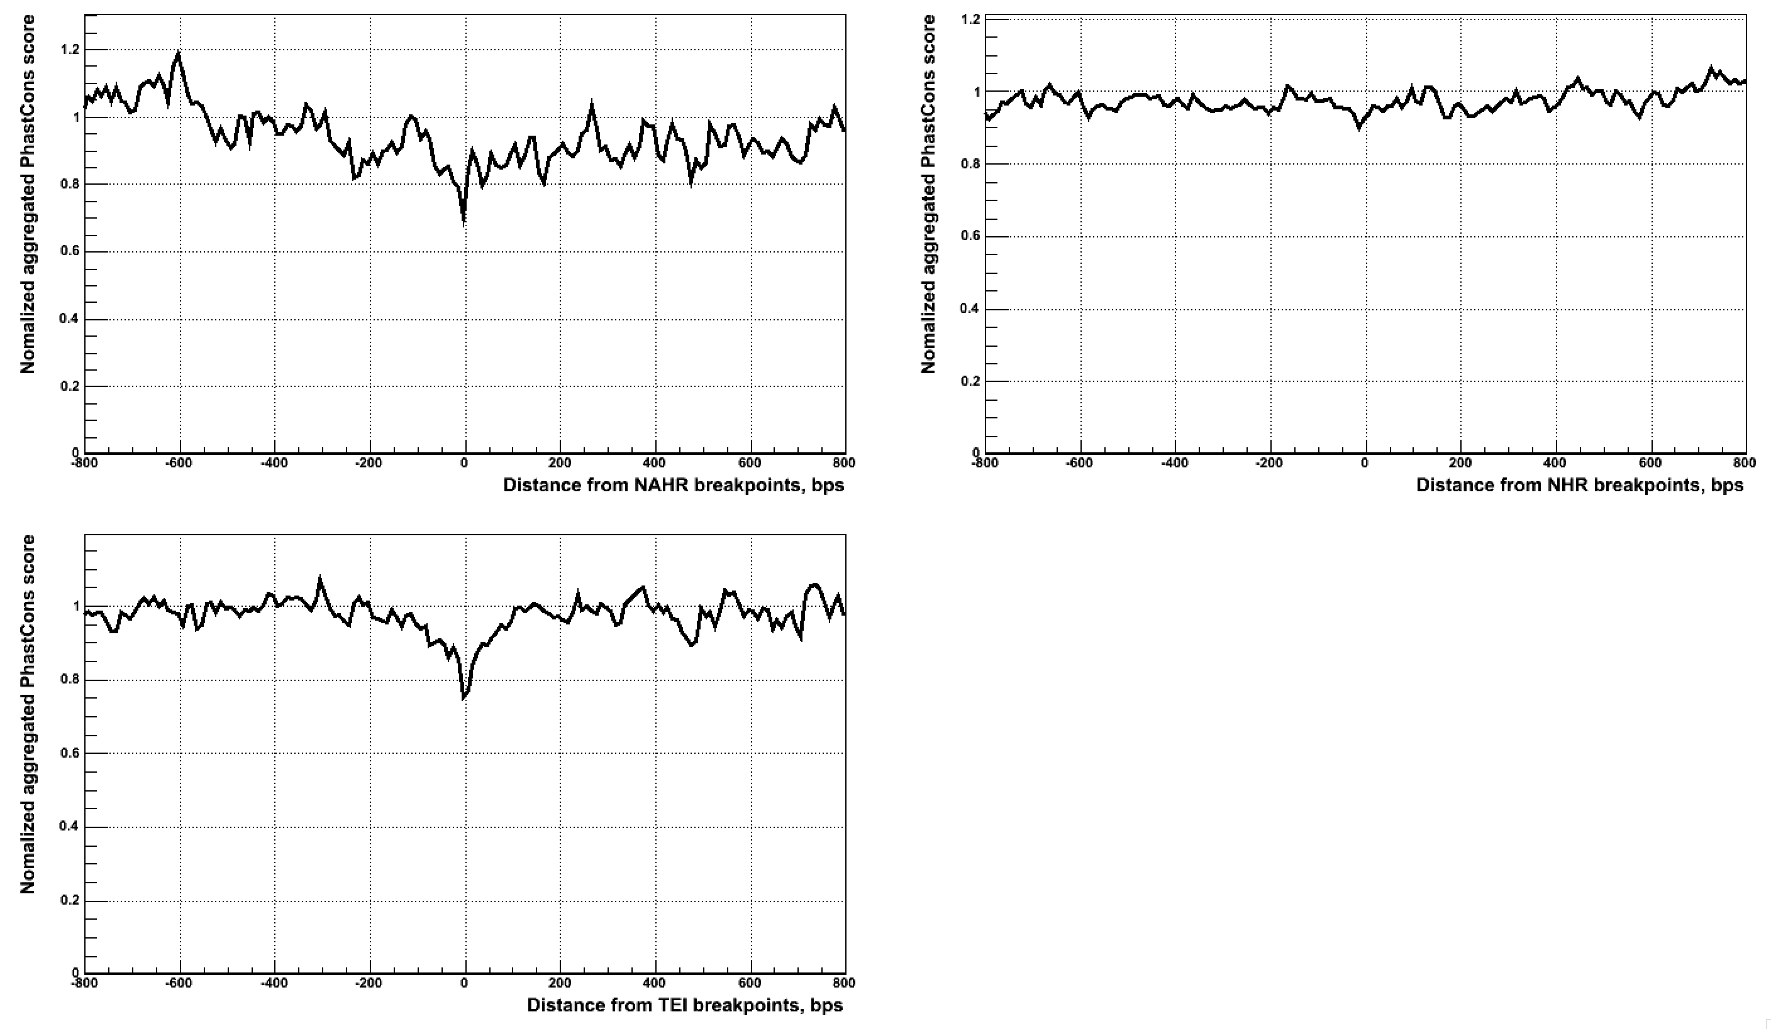
Small scale

Slide 3
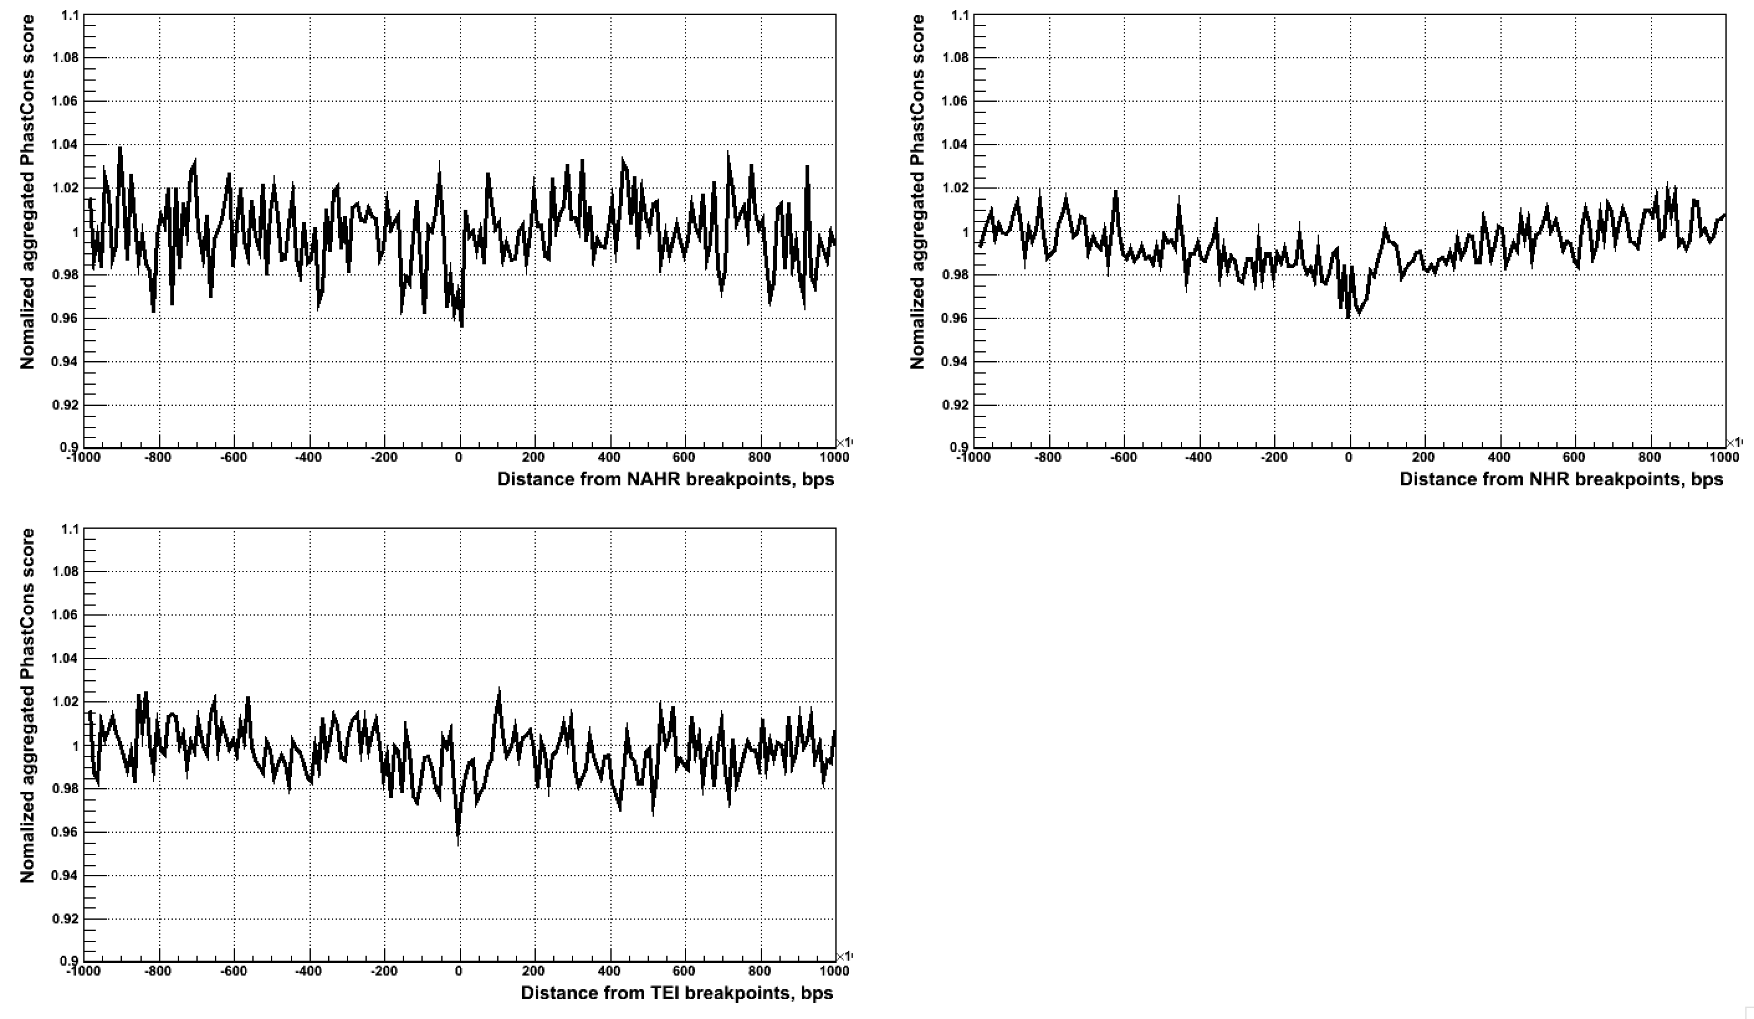
Large scale

Slide 4
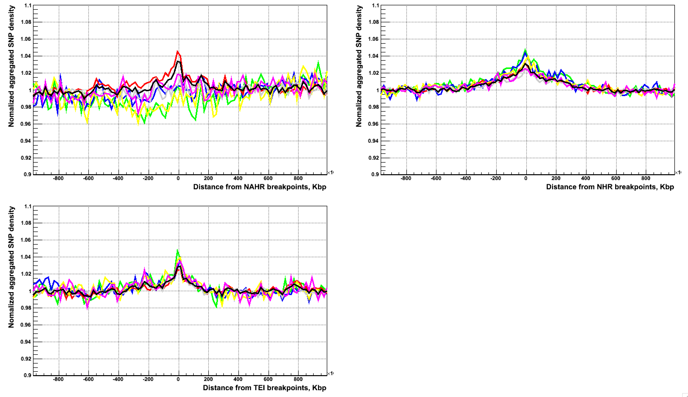
Aggregation at large scale

