Slide 1
PhastCons aggregation
Alexej Abyzov
November 21, 2013

Slide 2
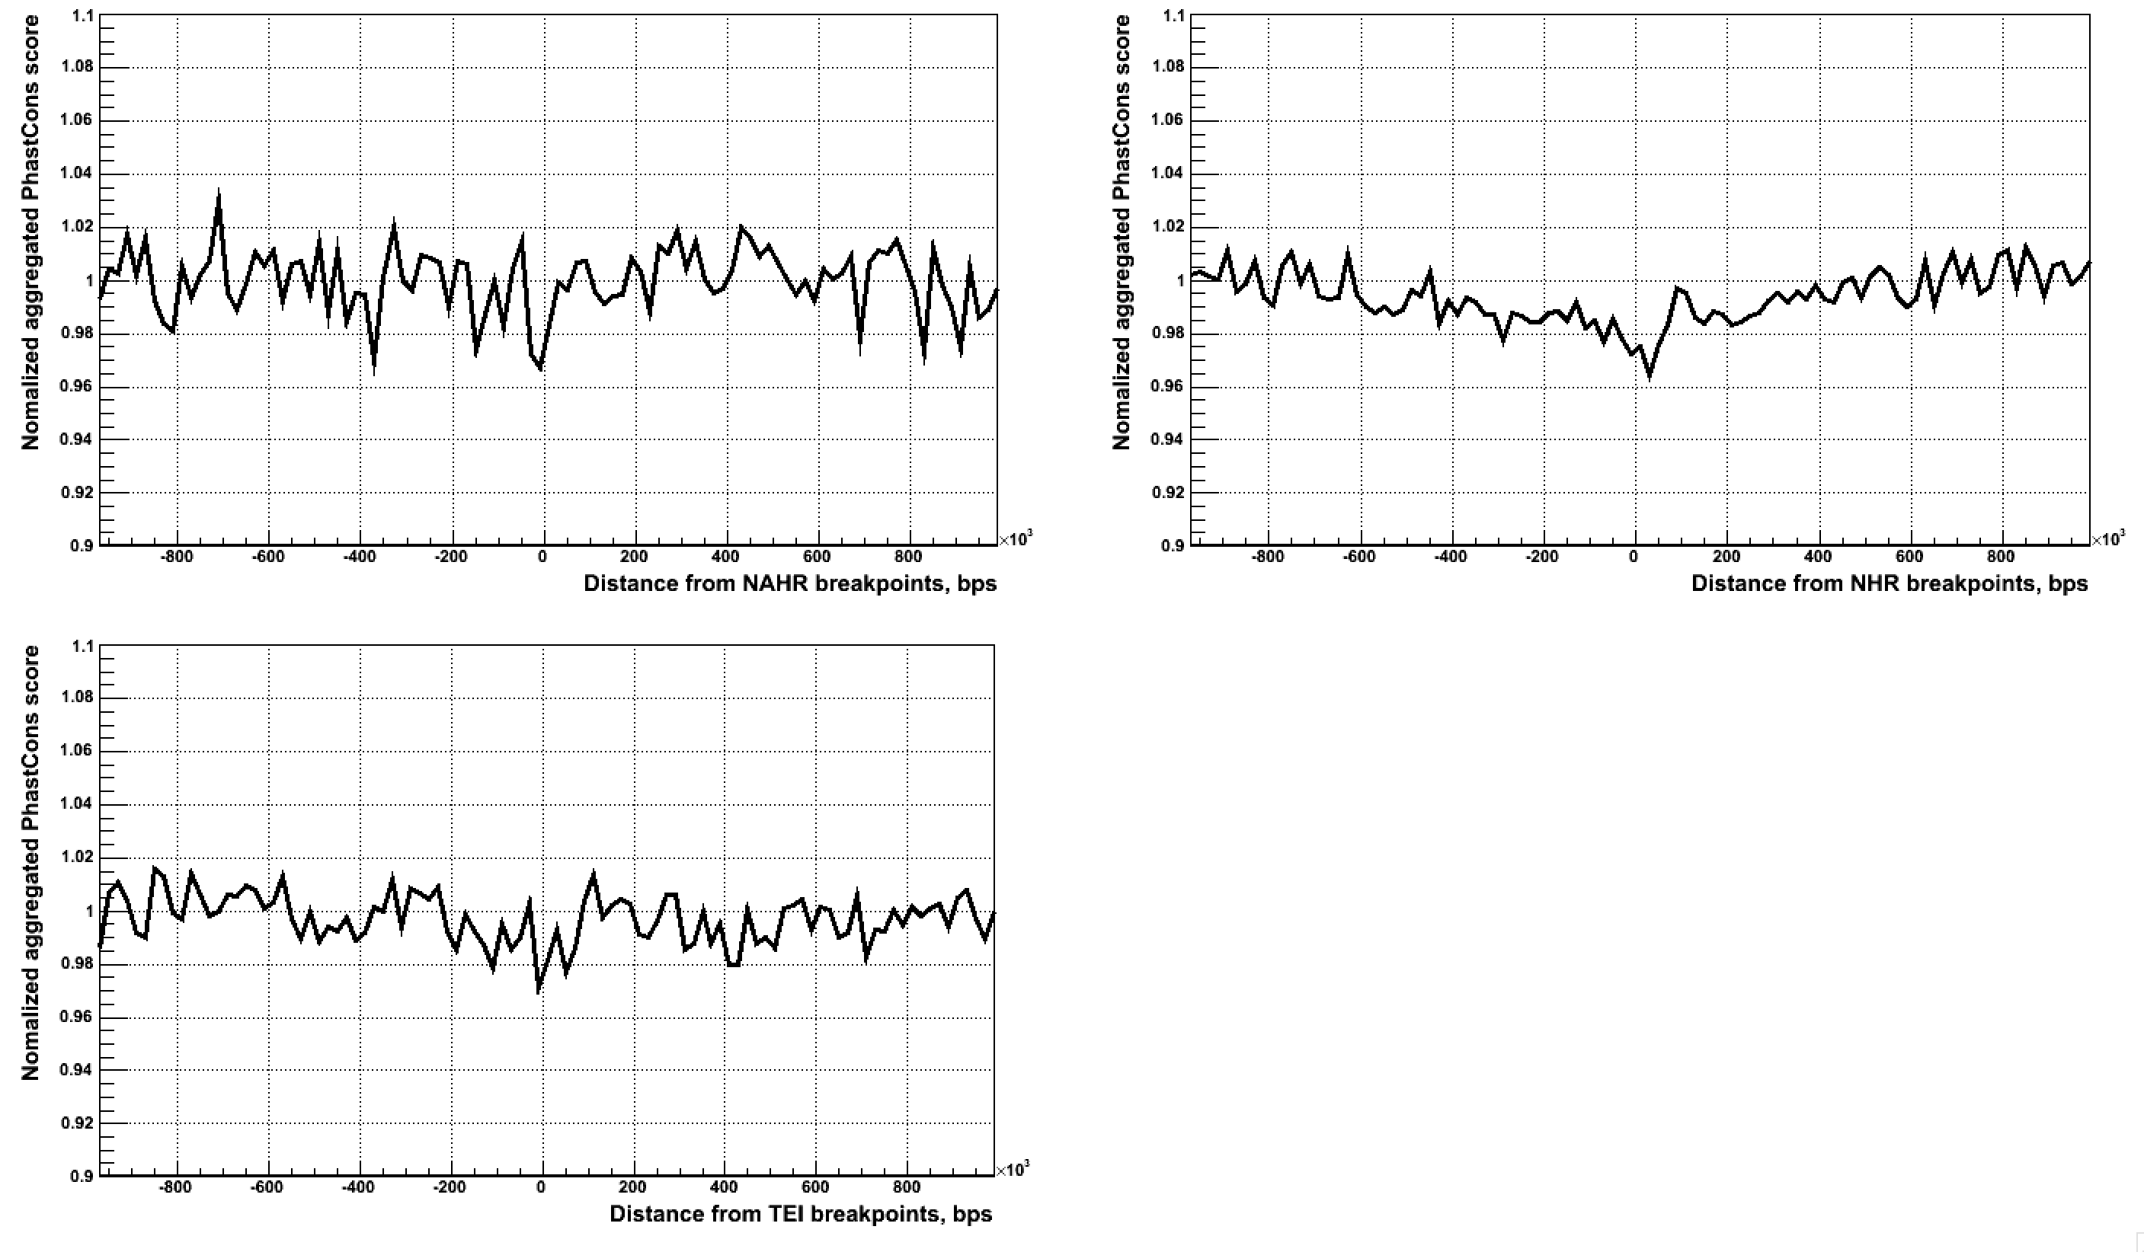
PhastCons (placental mammals) aggregation at LARGE SCALE

Slide 3
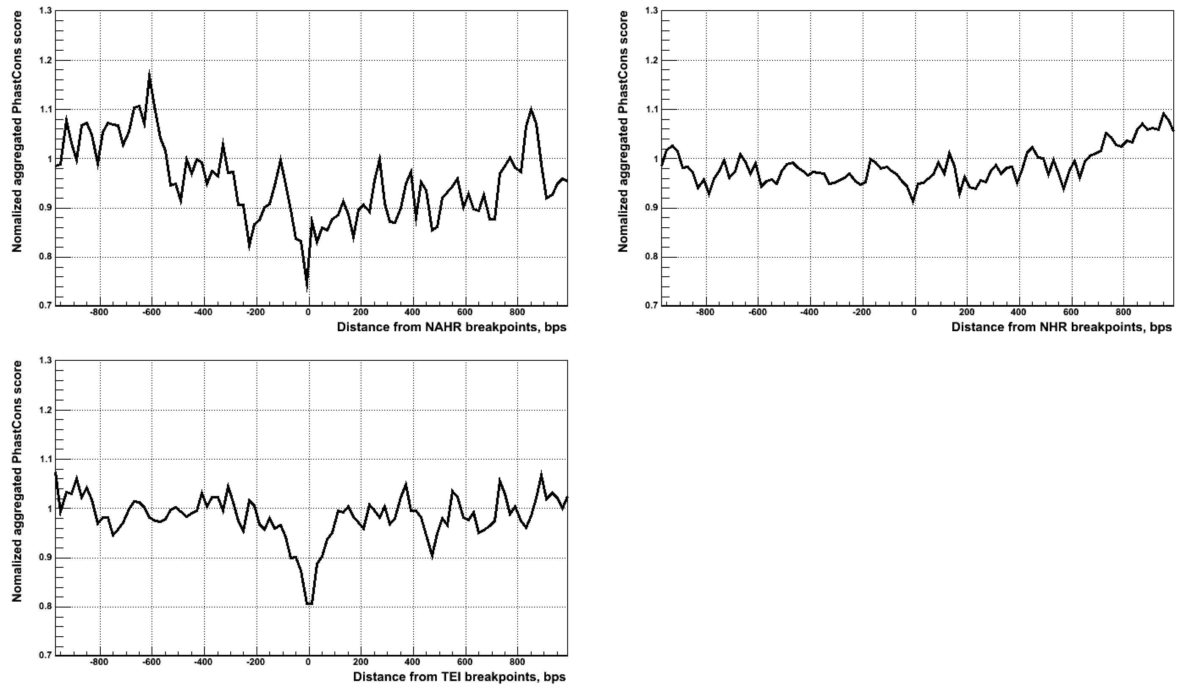
PhastCons (placental mammals) aggregation at _{small scale}

Slide 4
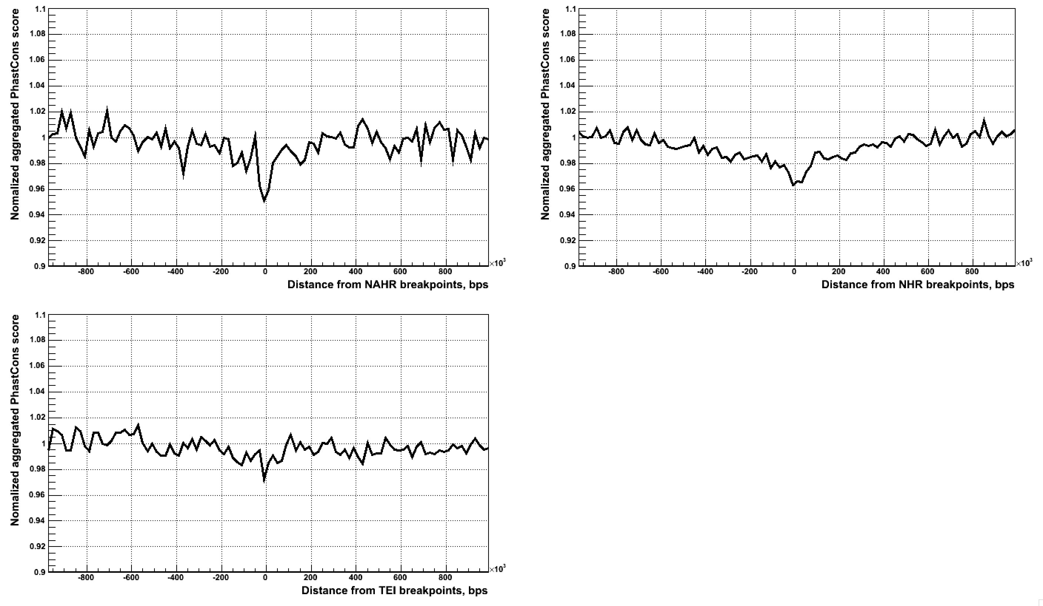
PhastCons (primates) aggregation at LARGE SCALE

Slide 5
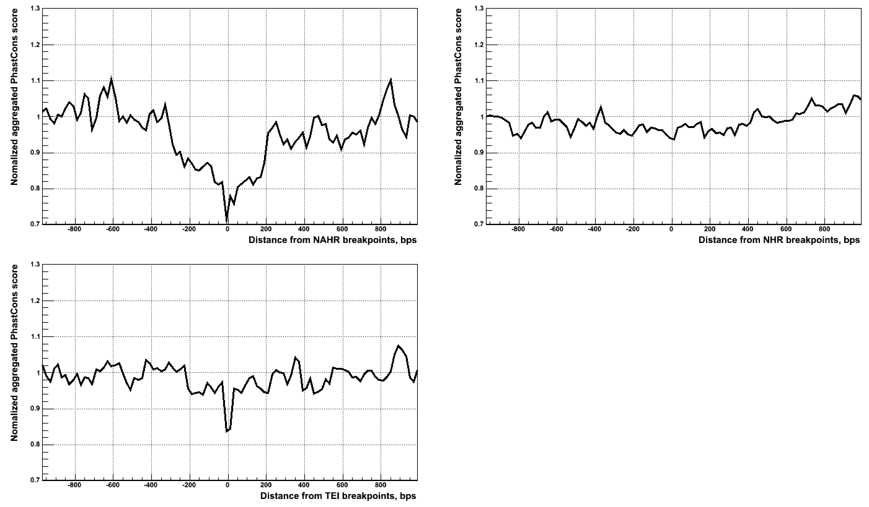
PhastCons (primates) aggregation at _{small scale}

Slide 6
Non-template sequence insertions (NTS)

Slide 7
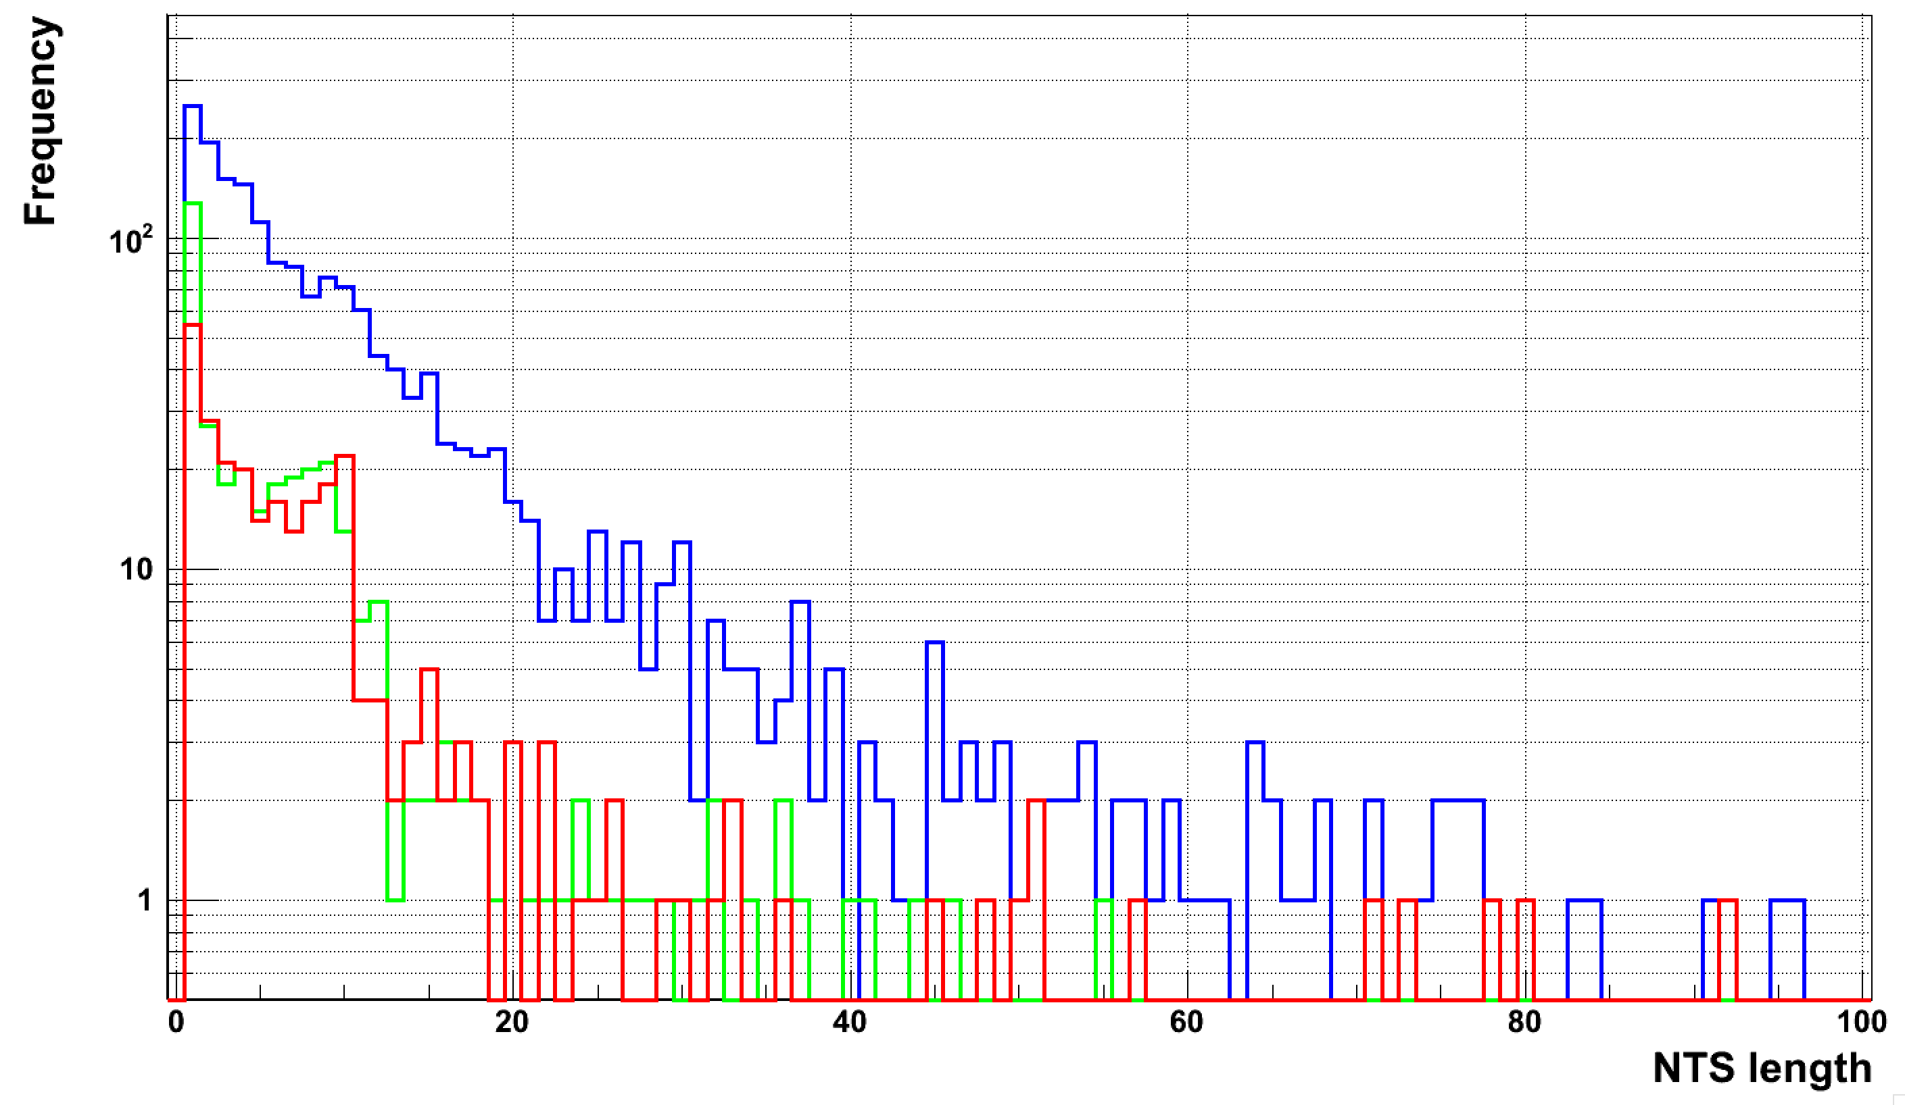
NTS length distribution
NHR
NAHR
MEI

Slide 8
Where NTS come from

Slide 9
Aligning NTS to reference

Slide 10
So …
Out of 2,391 deletions with NTS
  For only 67 deletions NTS’ match reference genomes uniquely full length without mismatches
Where do they align?
  54 (81%=54/67) align to the same chromosome
  How close to deletion?

Slide 11
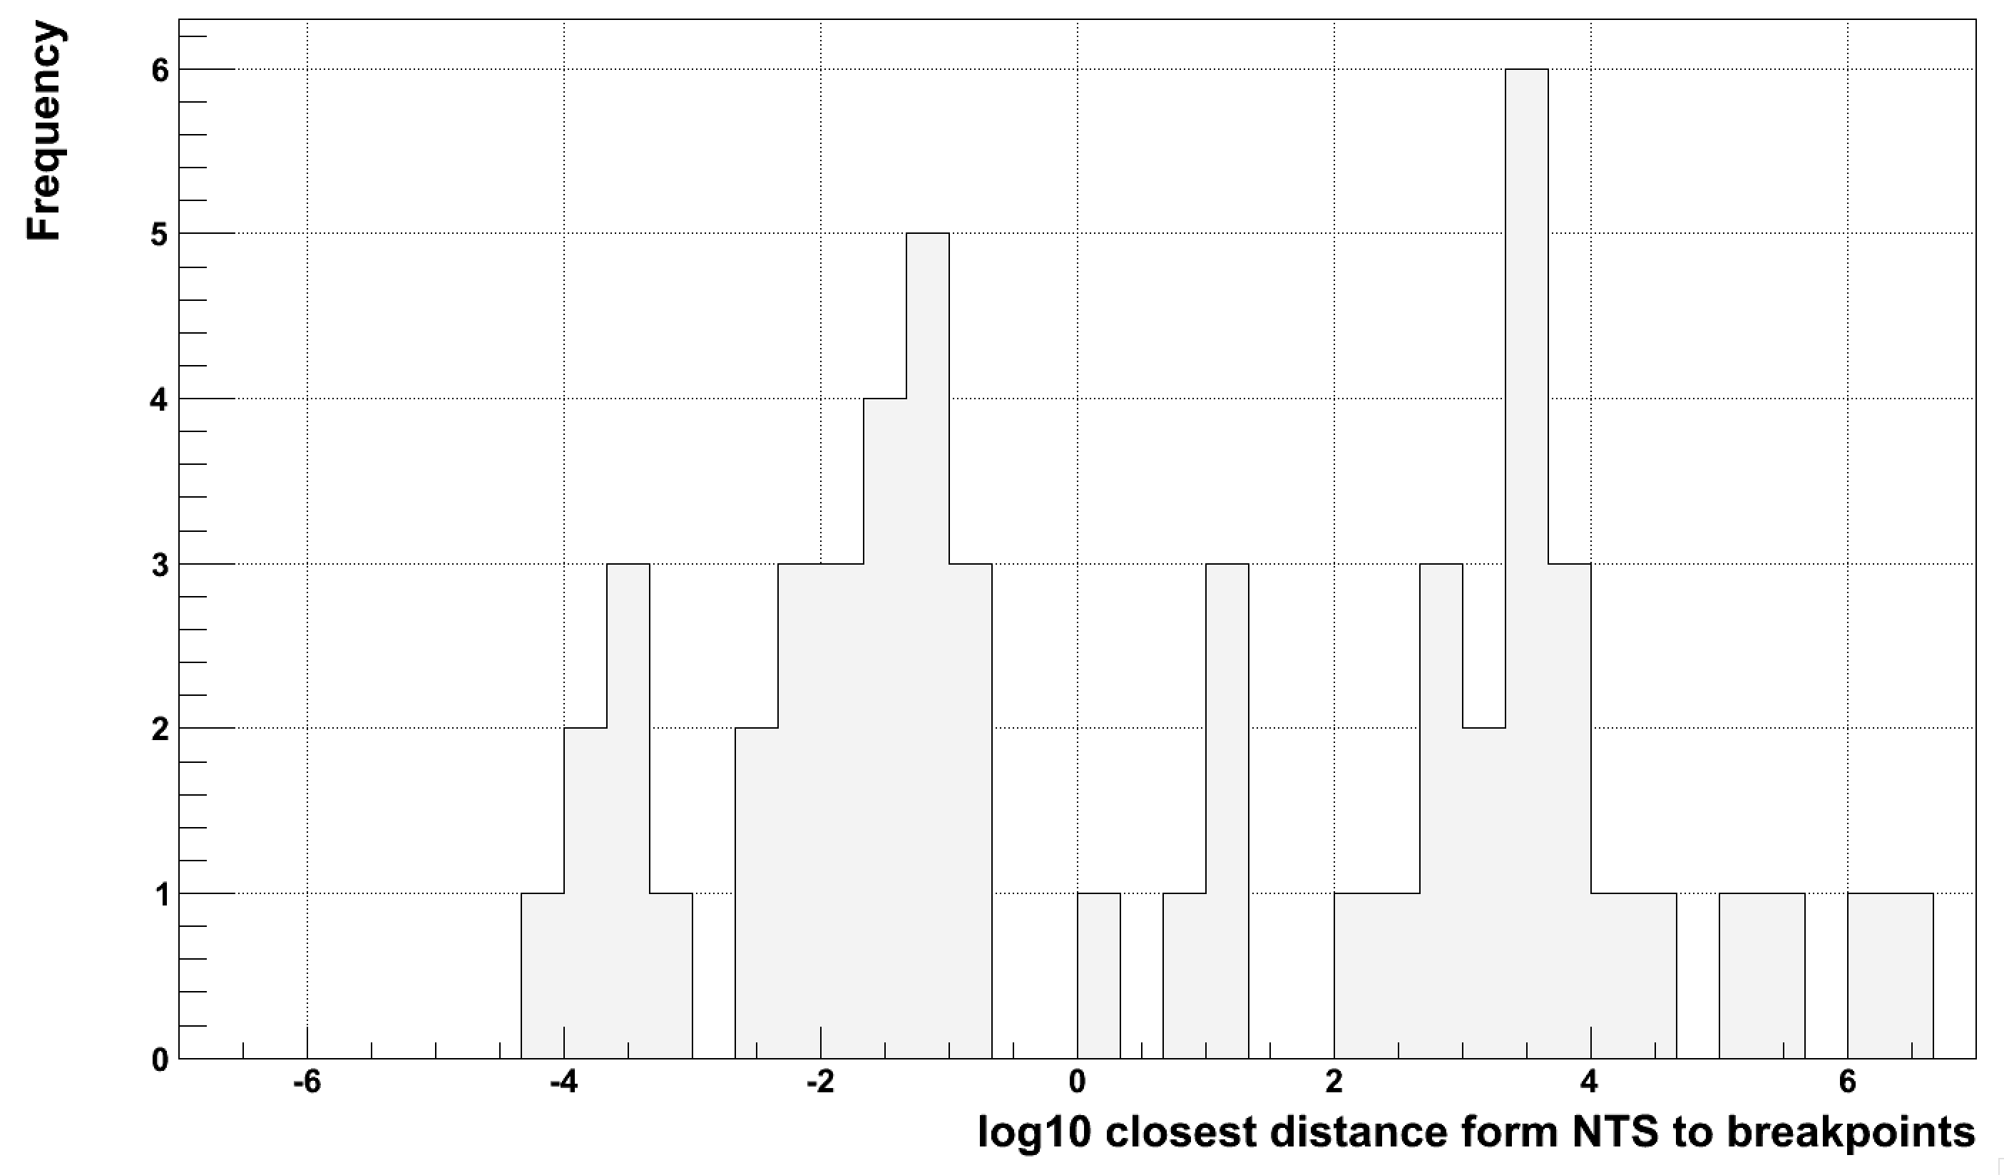
Distance distribution
Inside deletion
Outside deletion

Slide 12
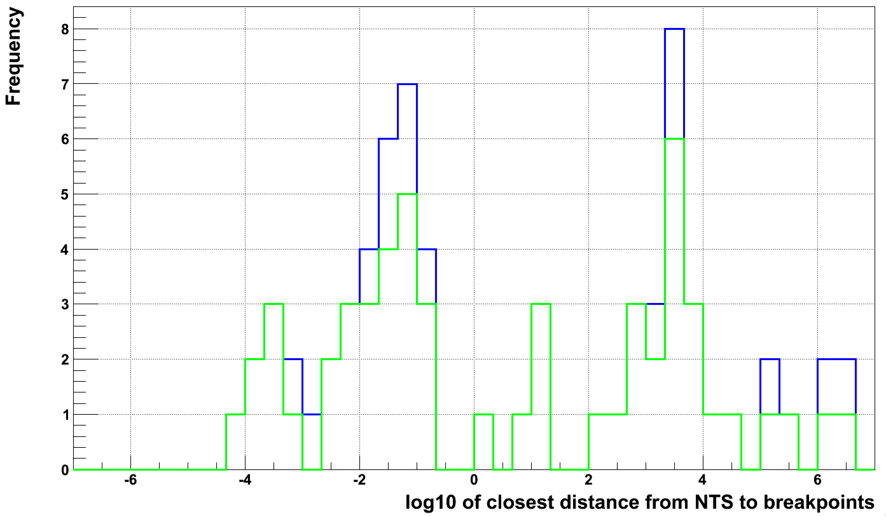
With non-unique mapping
Inside deletion
Outside deletion
Unique mapping
<=10 mappings

