Slide 1
SNP aggregation
Alexej Abyzov
October 27, 2013

Slide 2
Fixing errors
Using SNPs in confident mask sites (marked as ‘P’)
Correct the aggregation signal by the number of accessible bases and GC content.

Slide 3
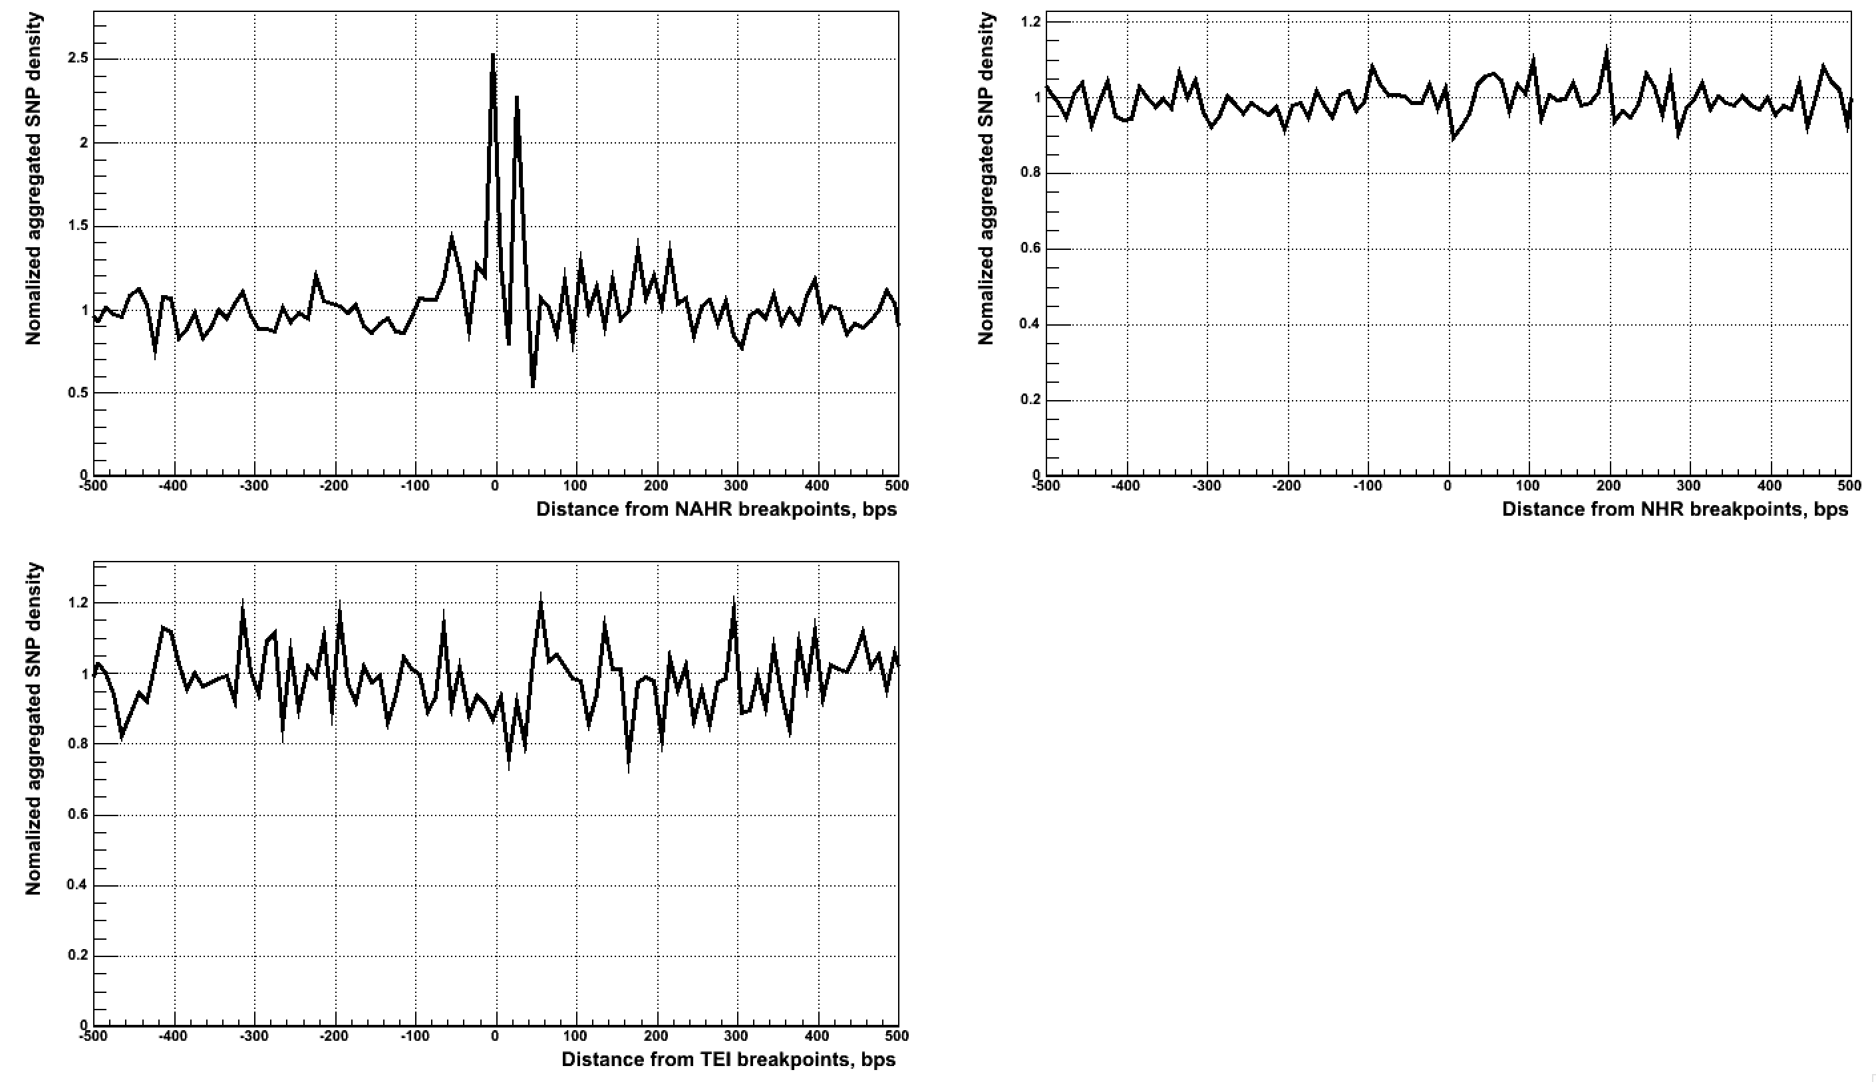
Aggregation at small scale

Slide 4
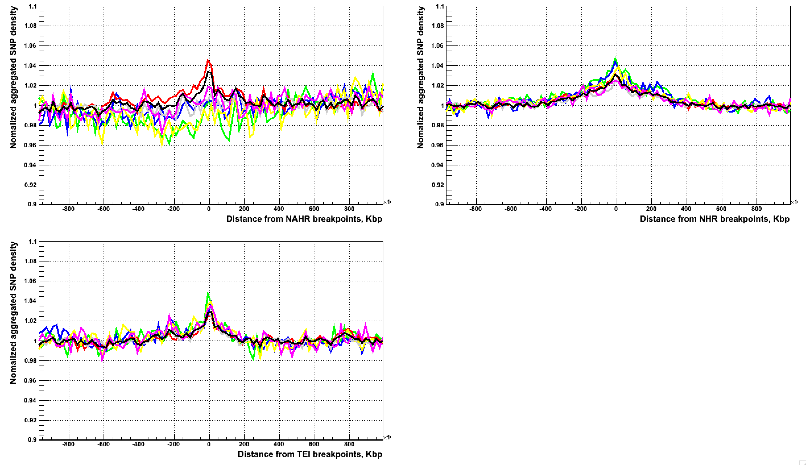
Aggregation at large scale

