Slide 1
SNP aggregation
Alexej Abyzov
October 17, 2013

Slide 2
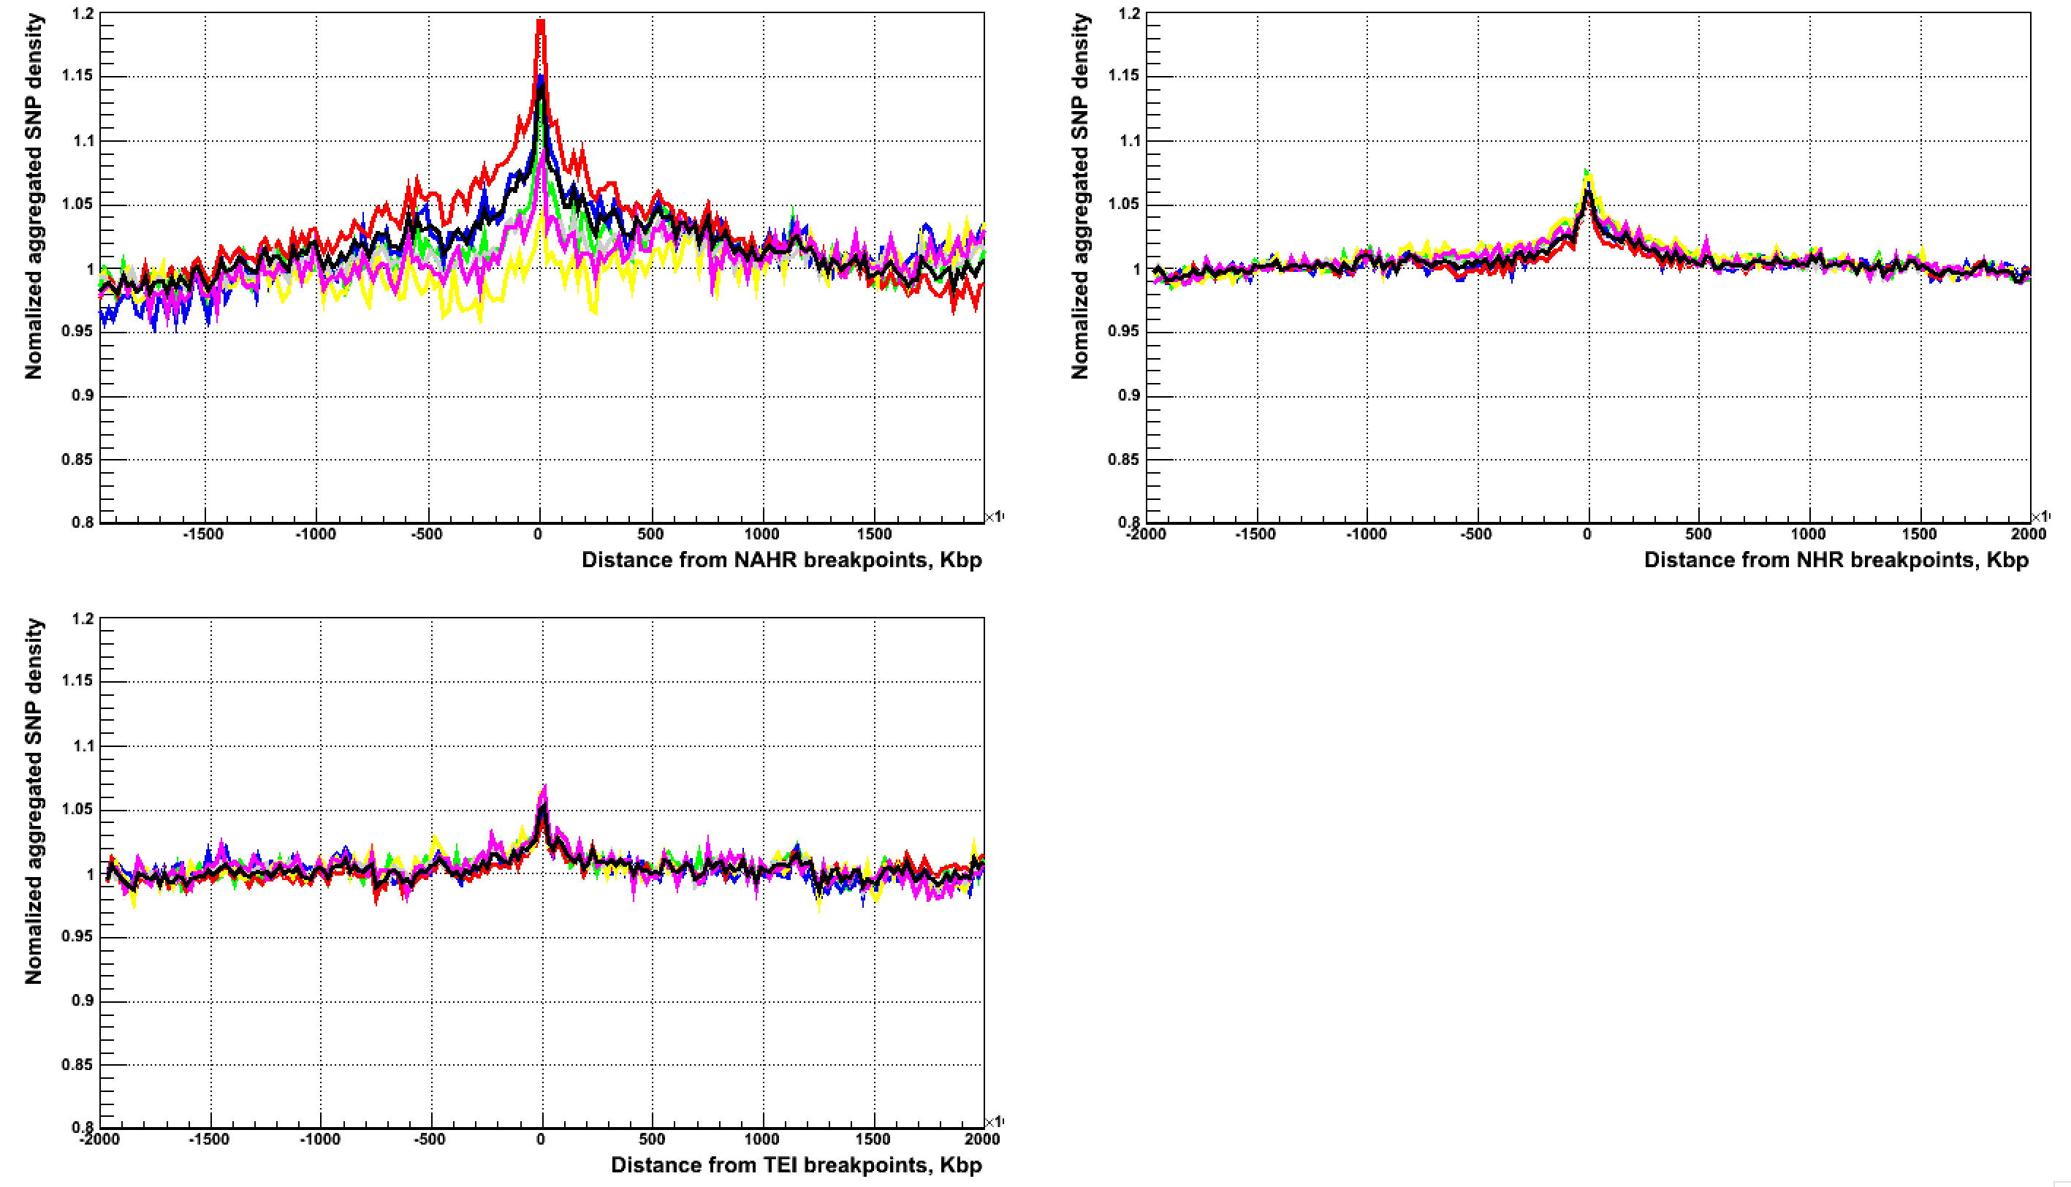
SNP aggregation corrected by mask
All, CA, CG, CT, TA, TC, TG

Slide 3
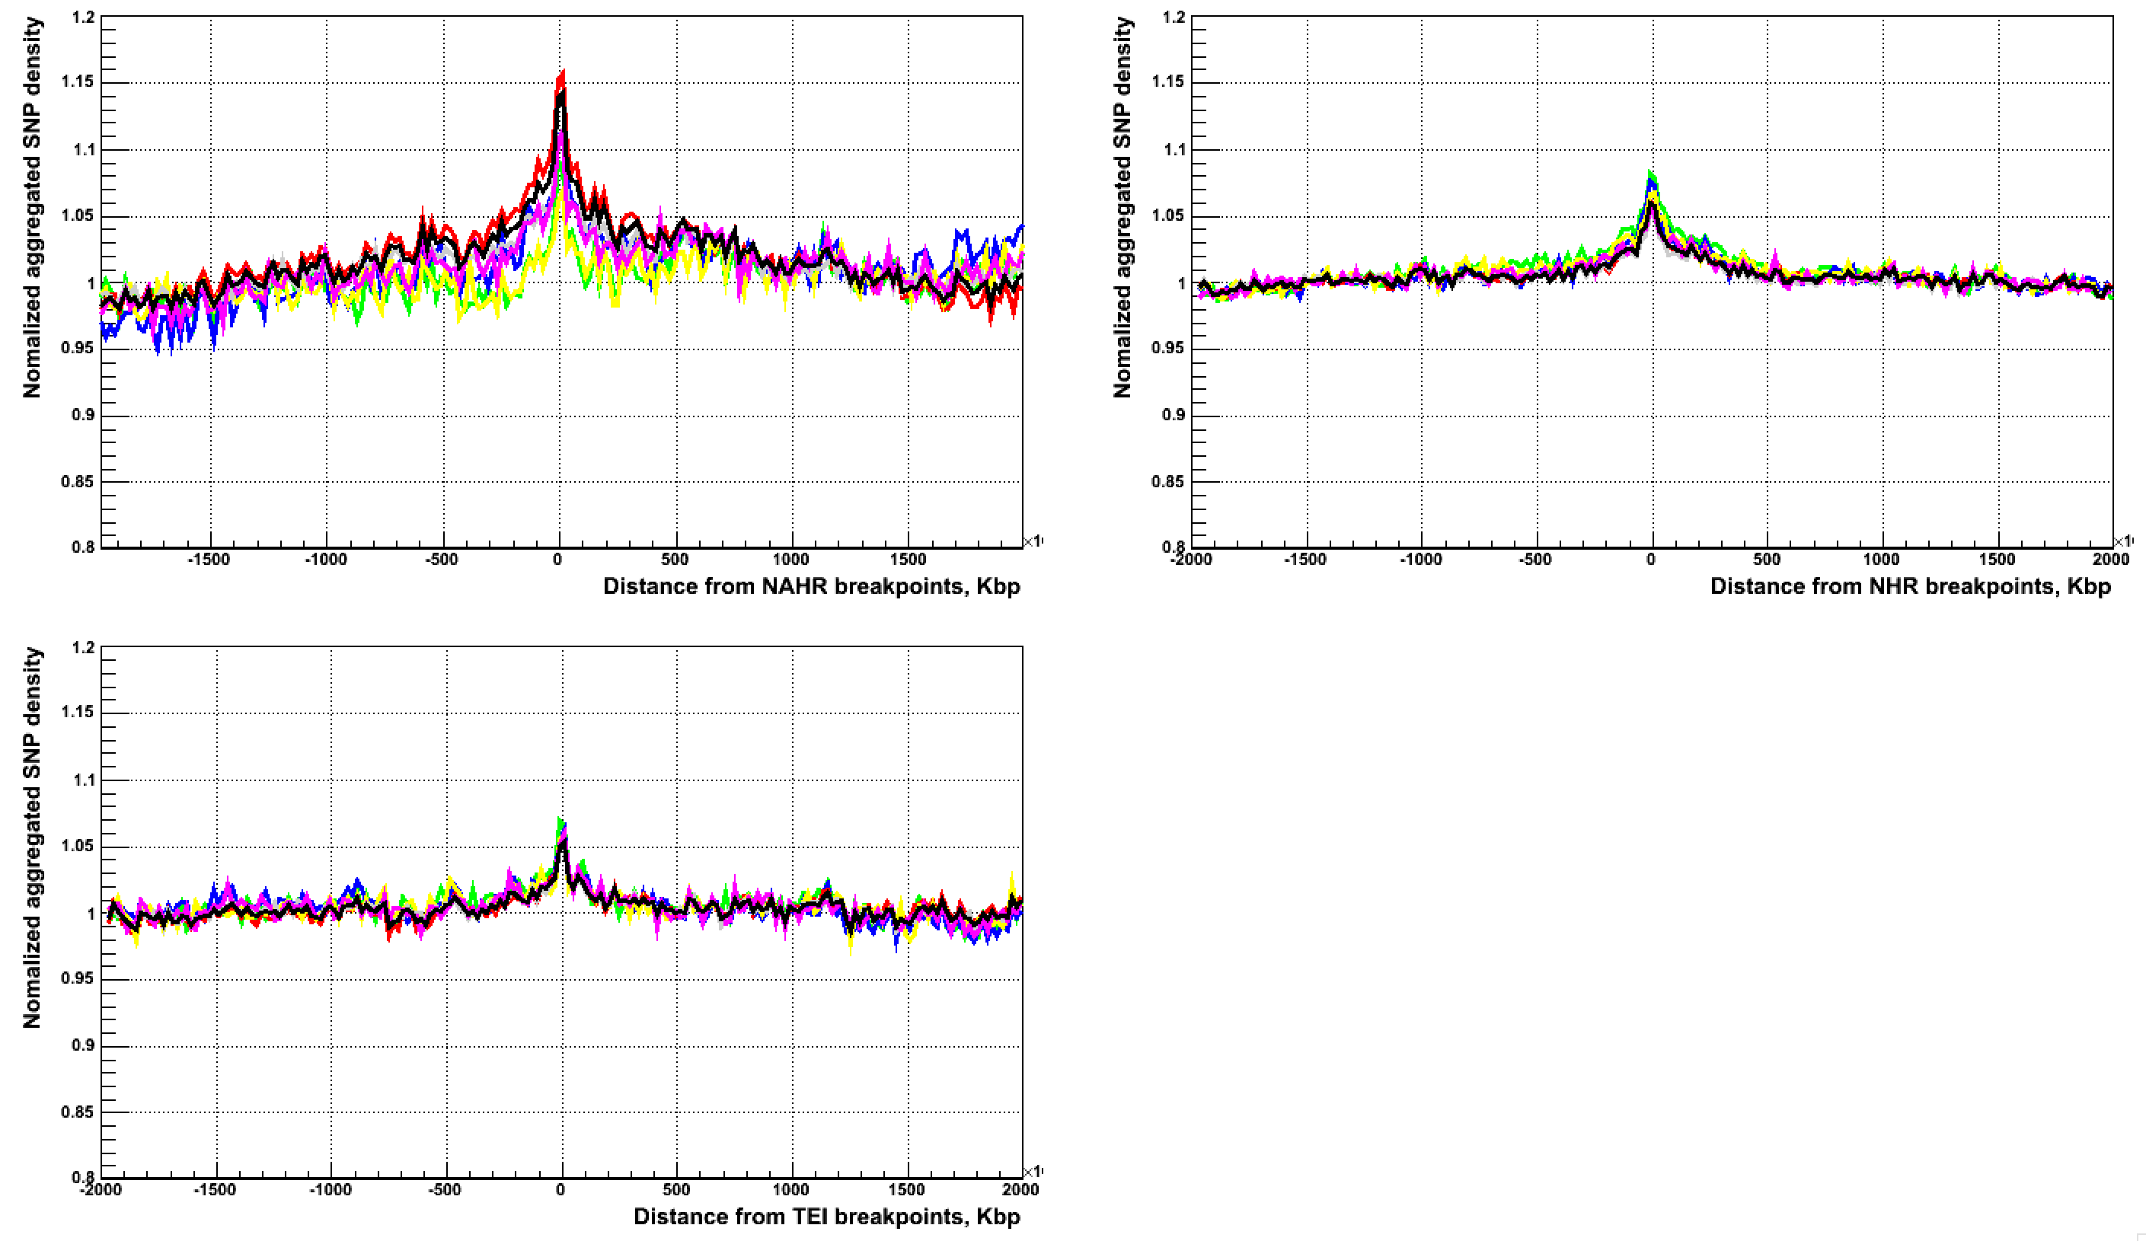
SNP aggregation corrected by mask and sequence content
All, CA, CG, CT, TA, TC, TG

Slide 4
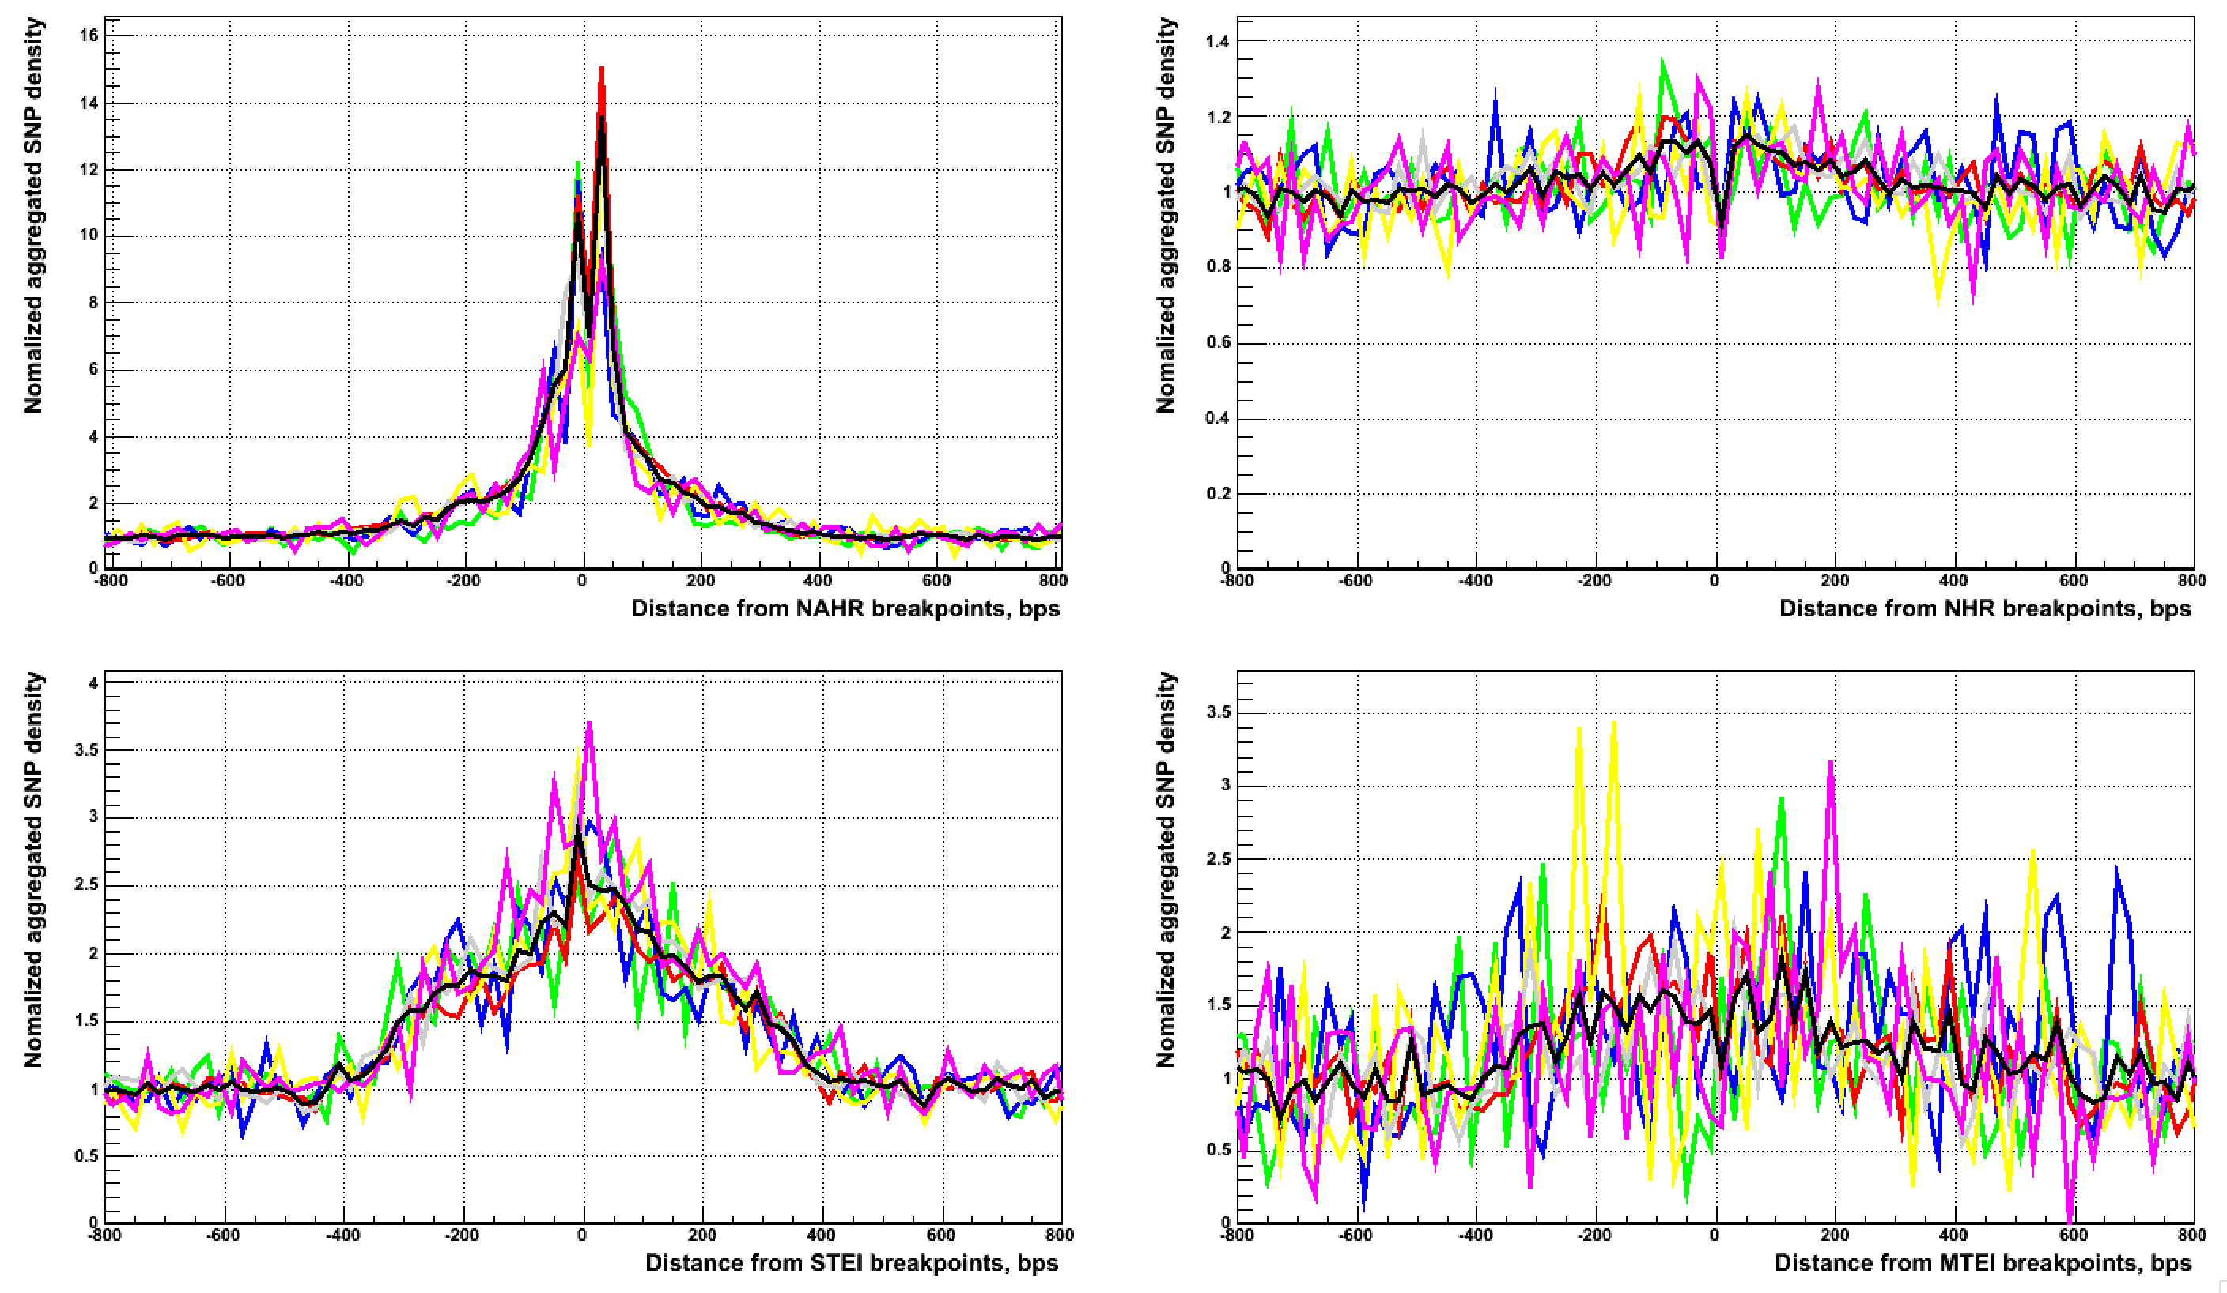
SNP aggregation
All, CA, CG, CT, TA, TC, TG

Slide 5
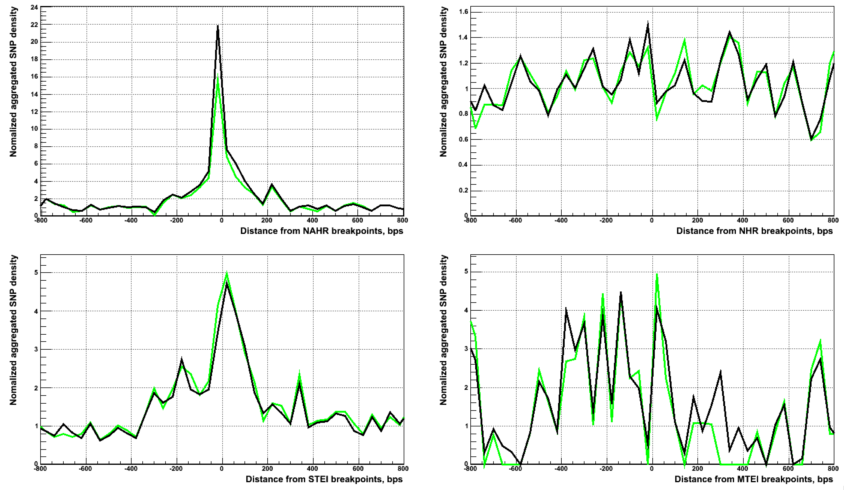
Indel aggregation
Indels 1 – 6 bps in length
Indels 1 bp in length

