Slide 1
SNP aggregation
Alexej Abyzov
October 8, 2013

Slide 2
Calculations
Use only P positions (i.e., pass all filters) from mask file
Correct for a fraction of non-P position when aggregating

Slide 3
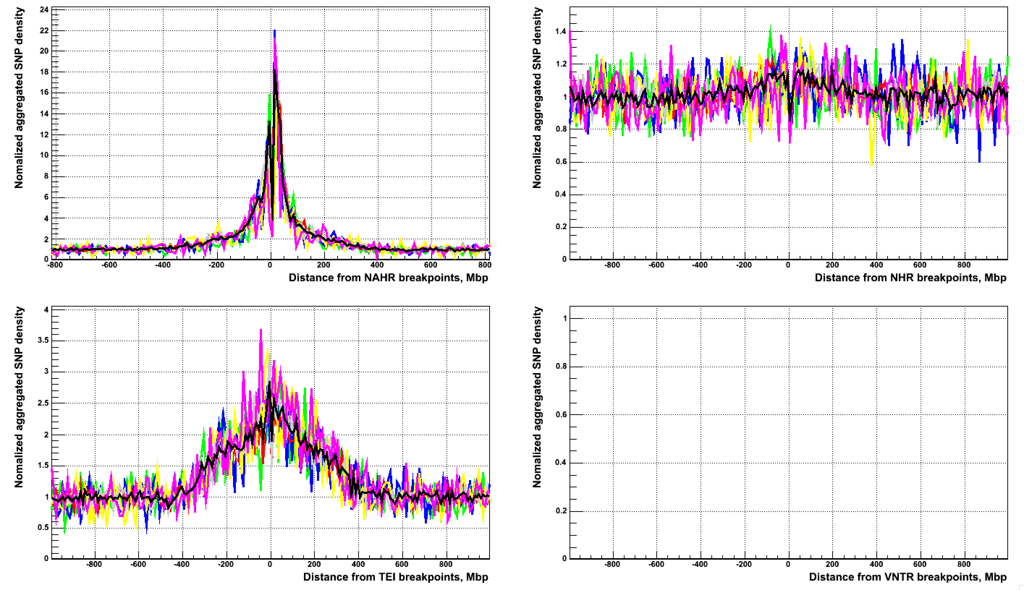
Confident bkpts
All, CA, CG, CT, TA, TC, TG

Slide 4
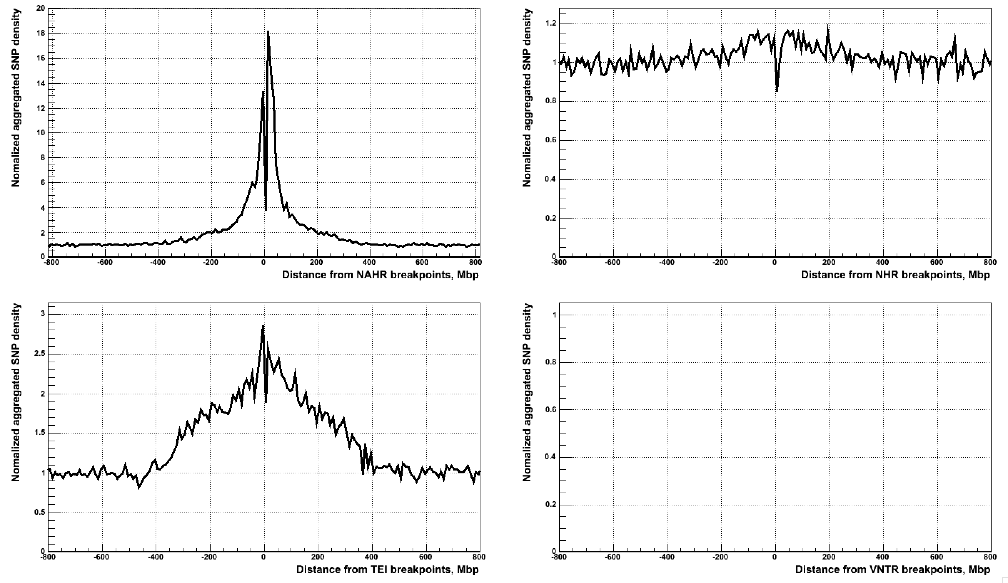
Confident bkpts

Slide 5
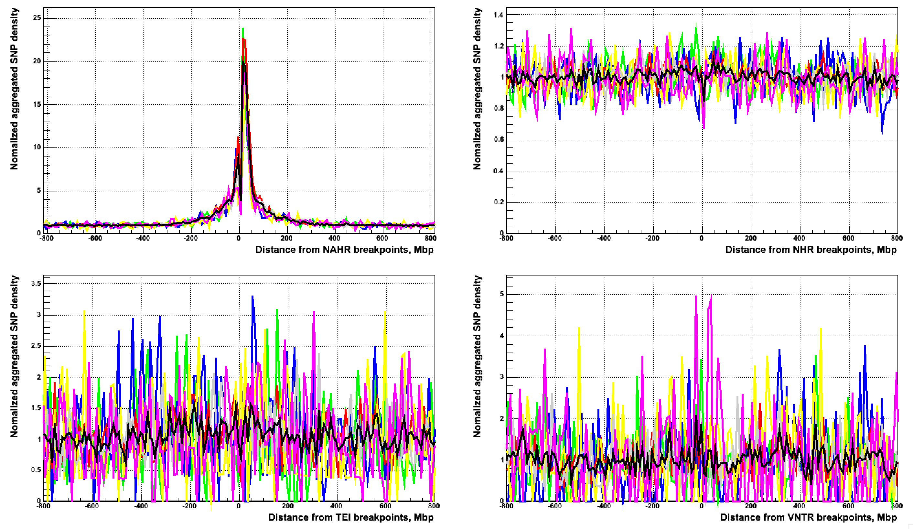
Integrated bkpts (phase 1)
All, CA, CG, CT, TA, TC, TG

Slide 6
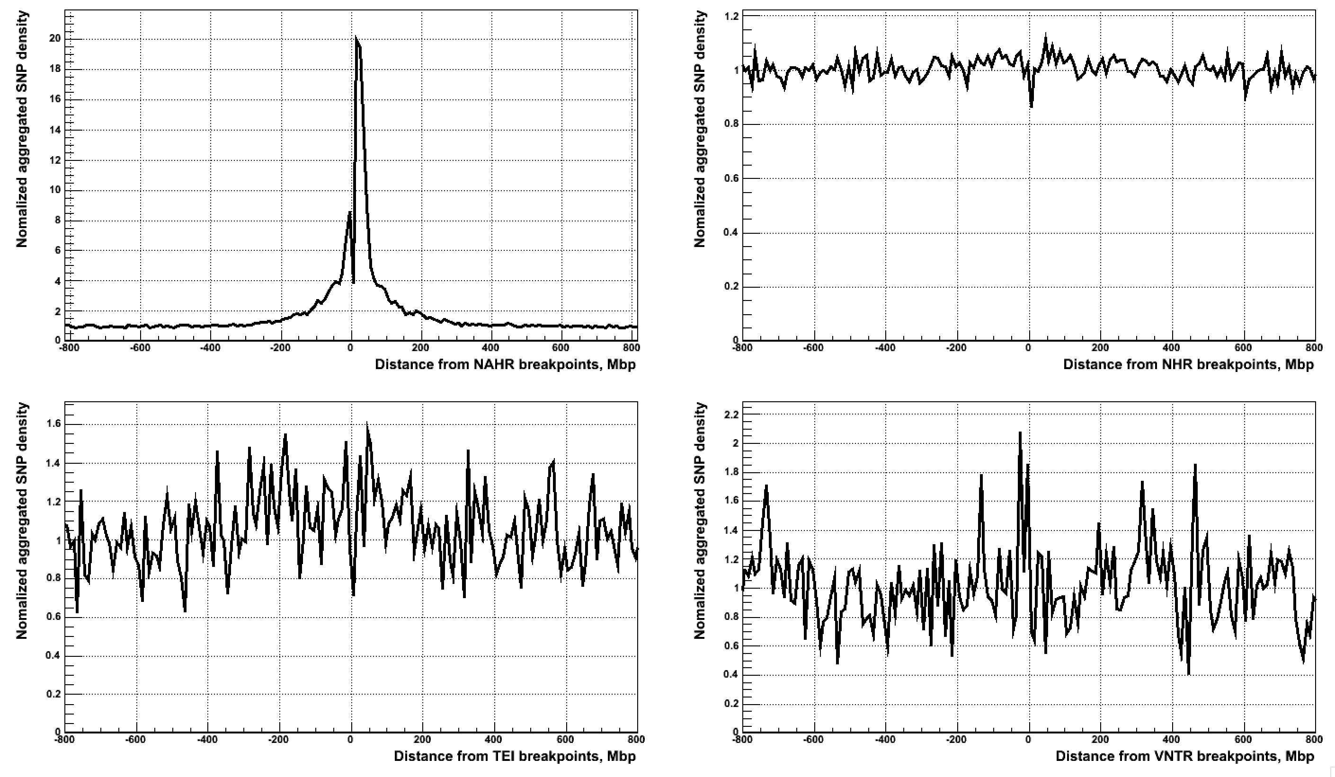
Integrated bkpts (phase 1)

Slide 7
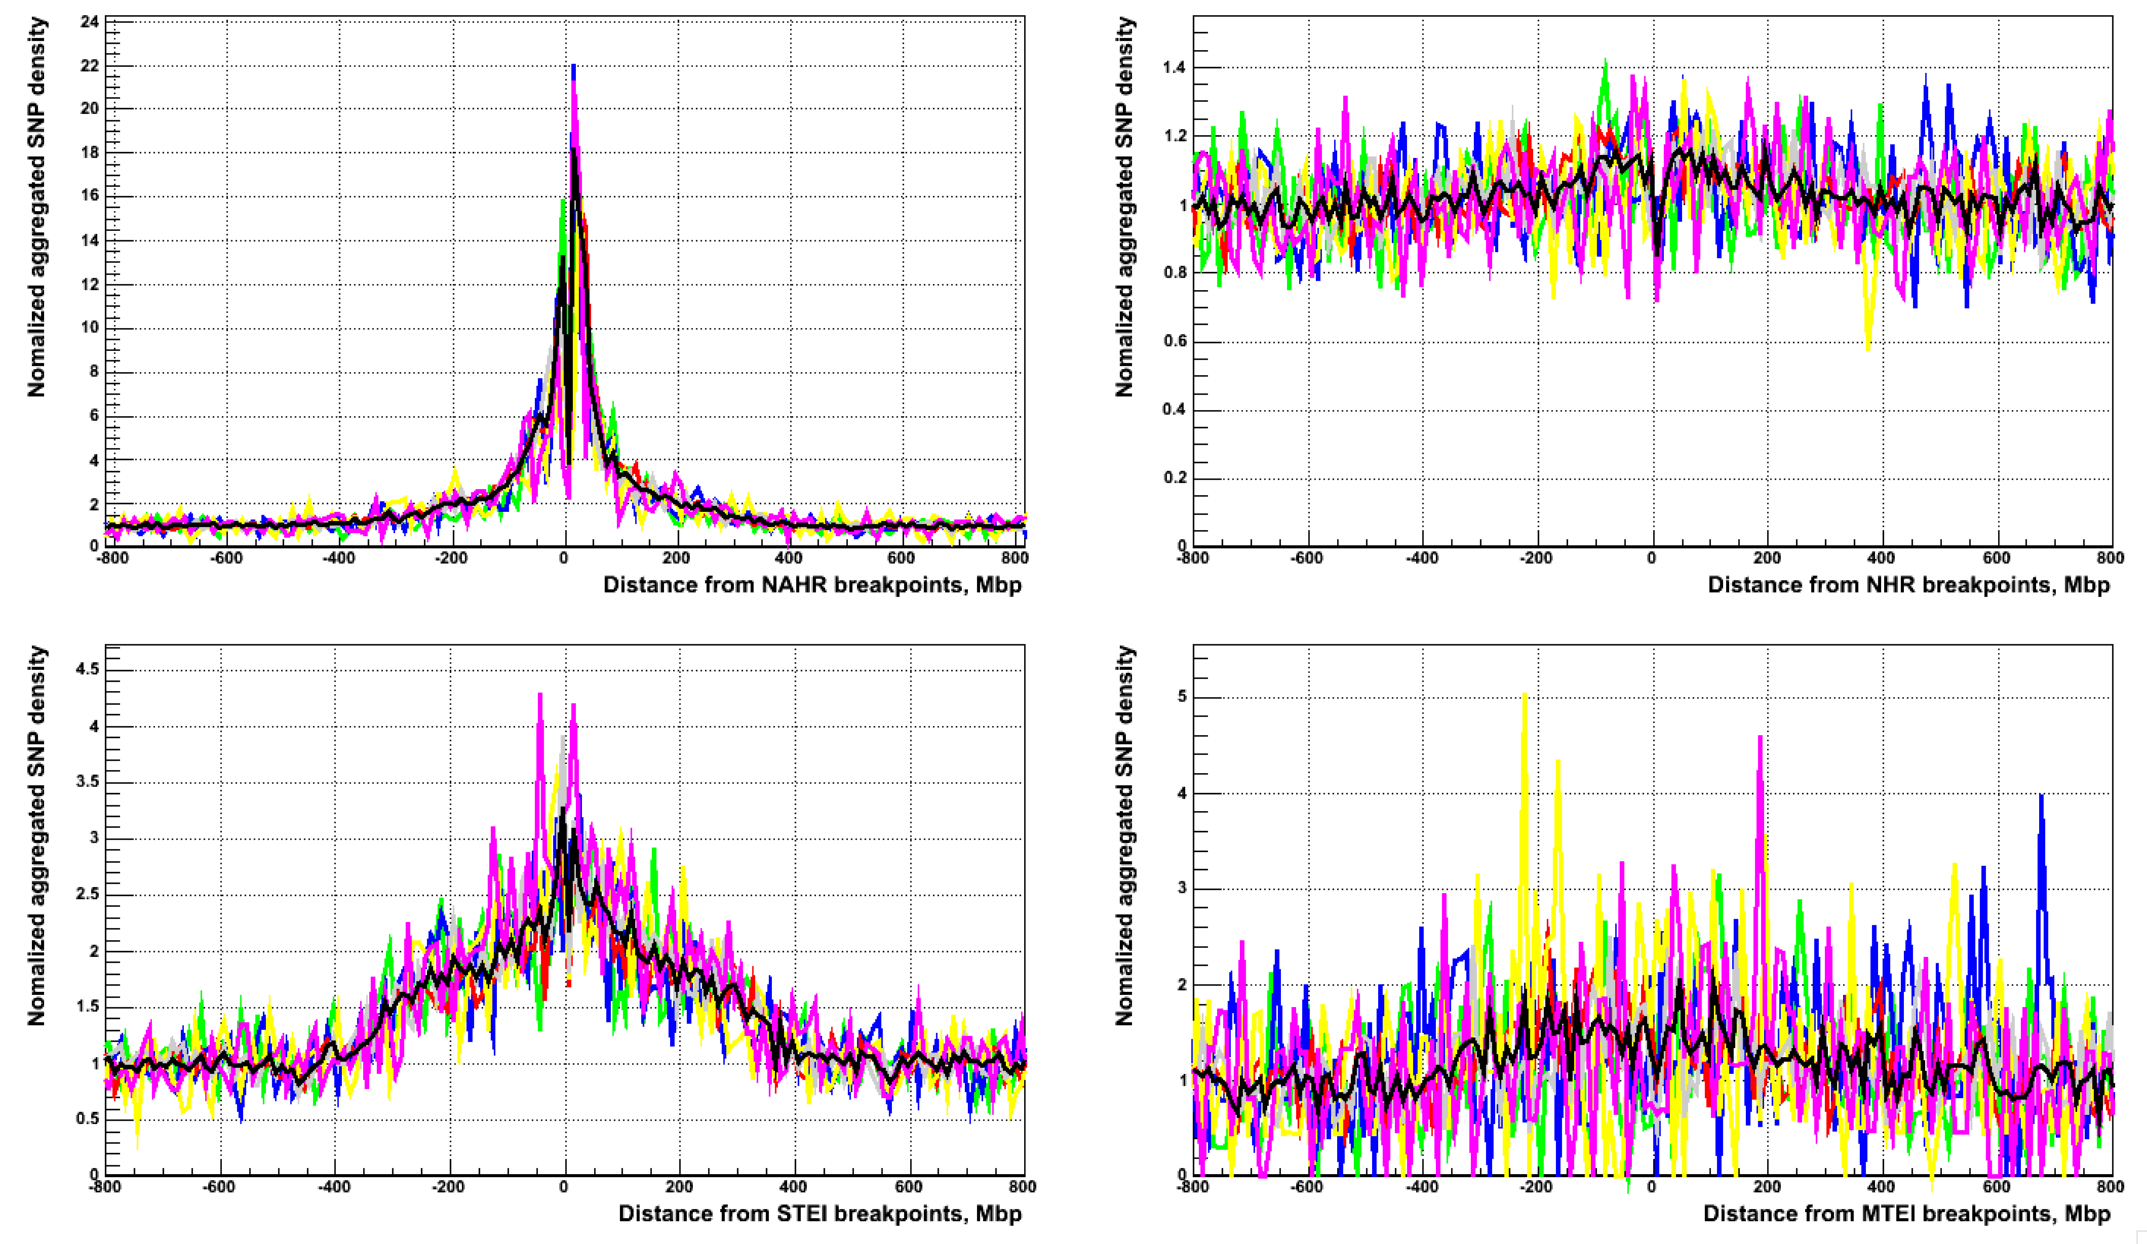
Confident bkpts (MTEI vs STEI)
All, CA, CG, CT, TA, TC, TG

Slide 8
Using data from OMNI array
There are 2,448,222 SNPs on OMNI array genotyped in 2141 samples
For analysis I selected SNPs having at least one heterozygous and at least on homozygous genotypes
These are presumably more confident sites
Total of 1,983,243 SNPs

Slide 9
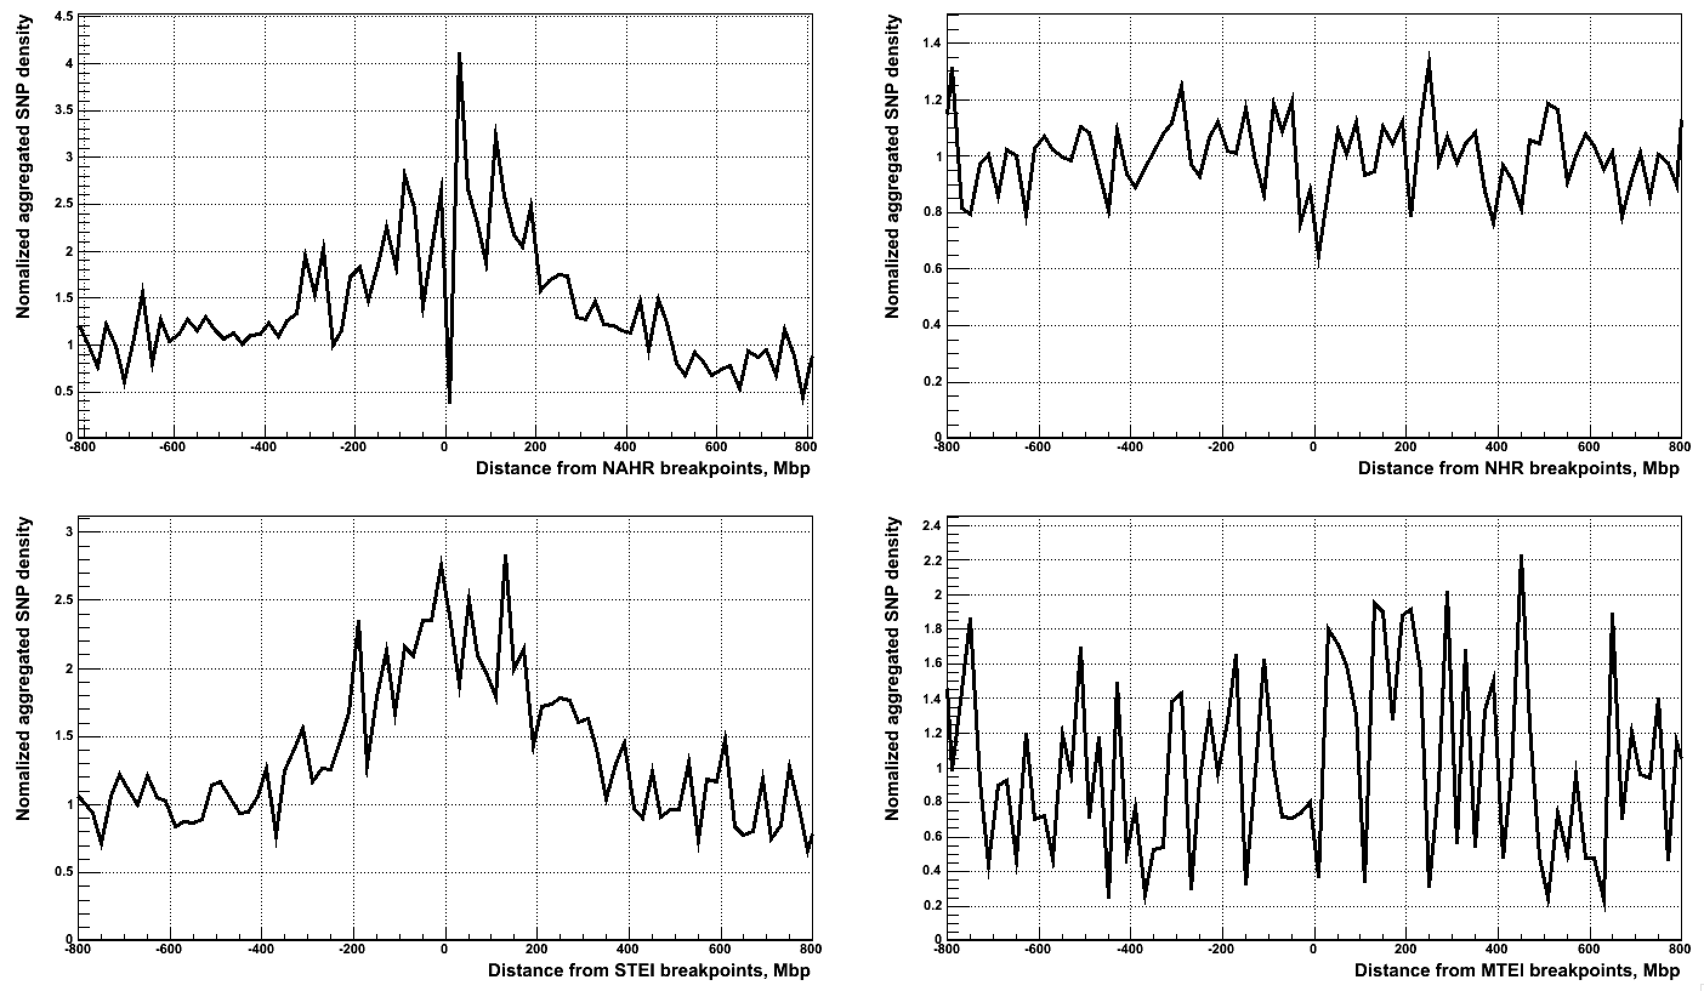
Confident bkpts with OMNI SNPs

Slide 10
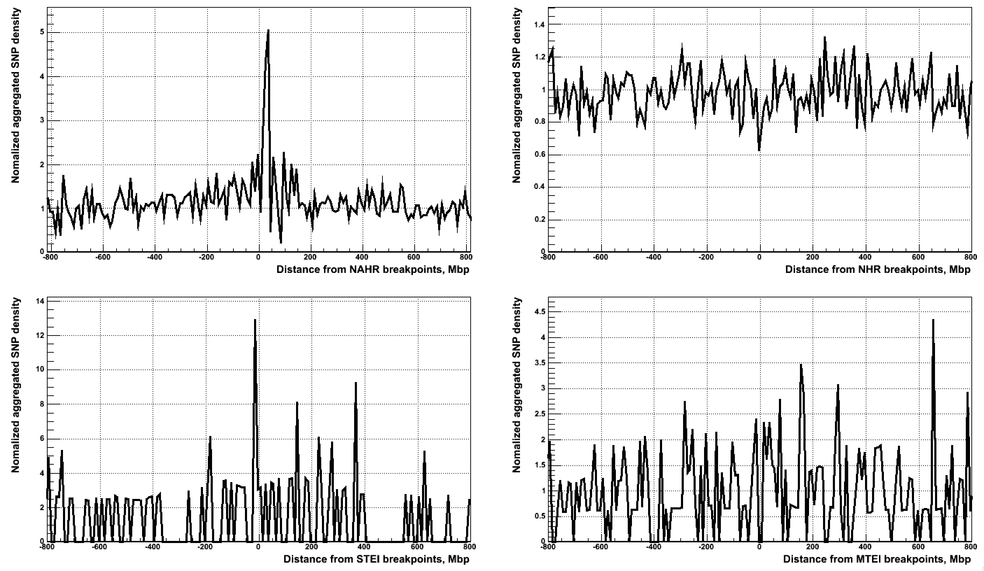
Integrated bkpts with OMNI SNPs

Slide 11
Using very good deletion sites
Select deletions that have p-val < 0.01 by IRS test
Confident set of bkpts
NAHR – 174 (15%) of 1167
NHR – 2509 (46%) of 5433
MTEI – 50 (22%) of 229
STEI – 10 (0.5%) of 2023
TEI – 60 (2.5%) of 2252
Integrated set of bkpts
NAHR – 1322 (67%) of 1978
NHR – 4678 (71%) of 6563
MTEI – 77 (42%) of 185
STEI – 9 (17%) of 53
TEI – 86 (36%) of 238

Slide 12
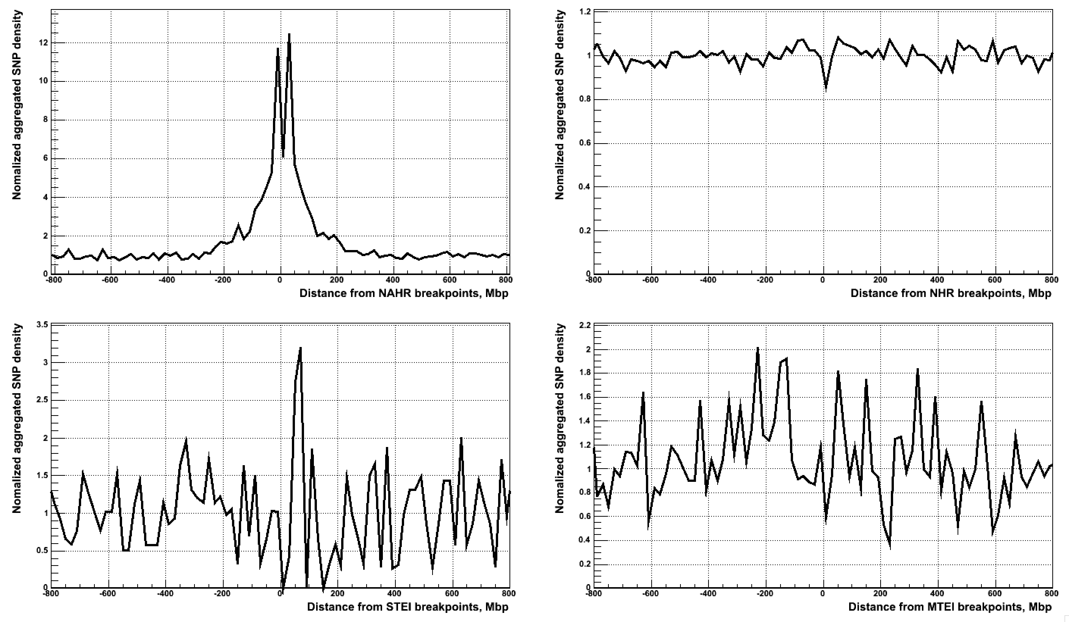
Confident bkpts – very good sites

Slide 13
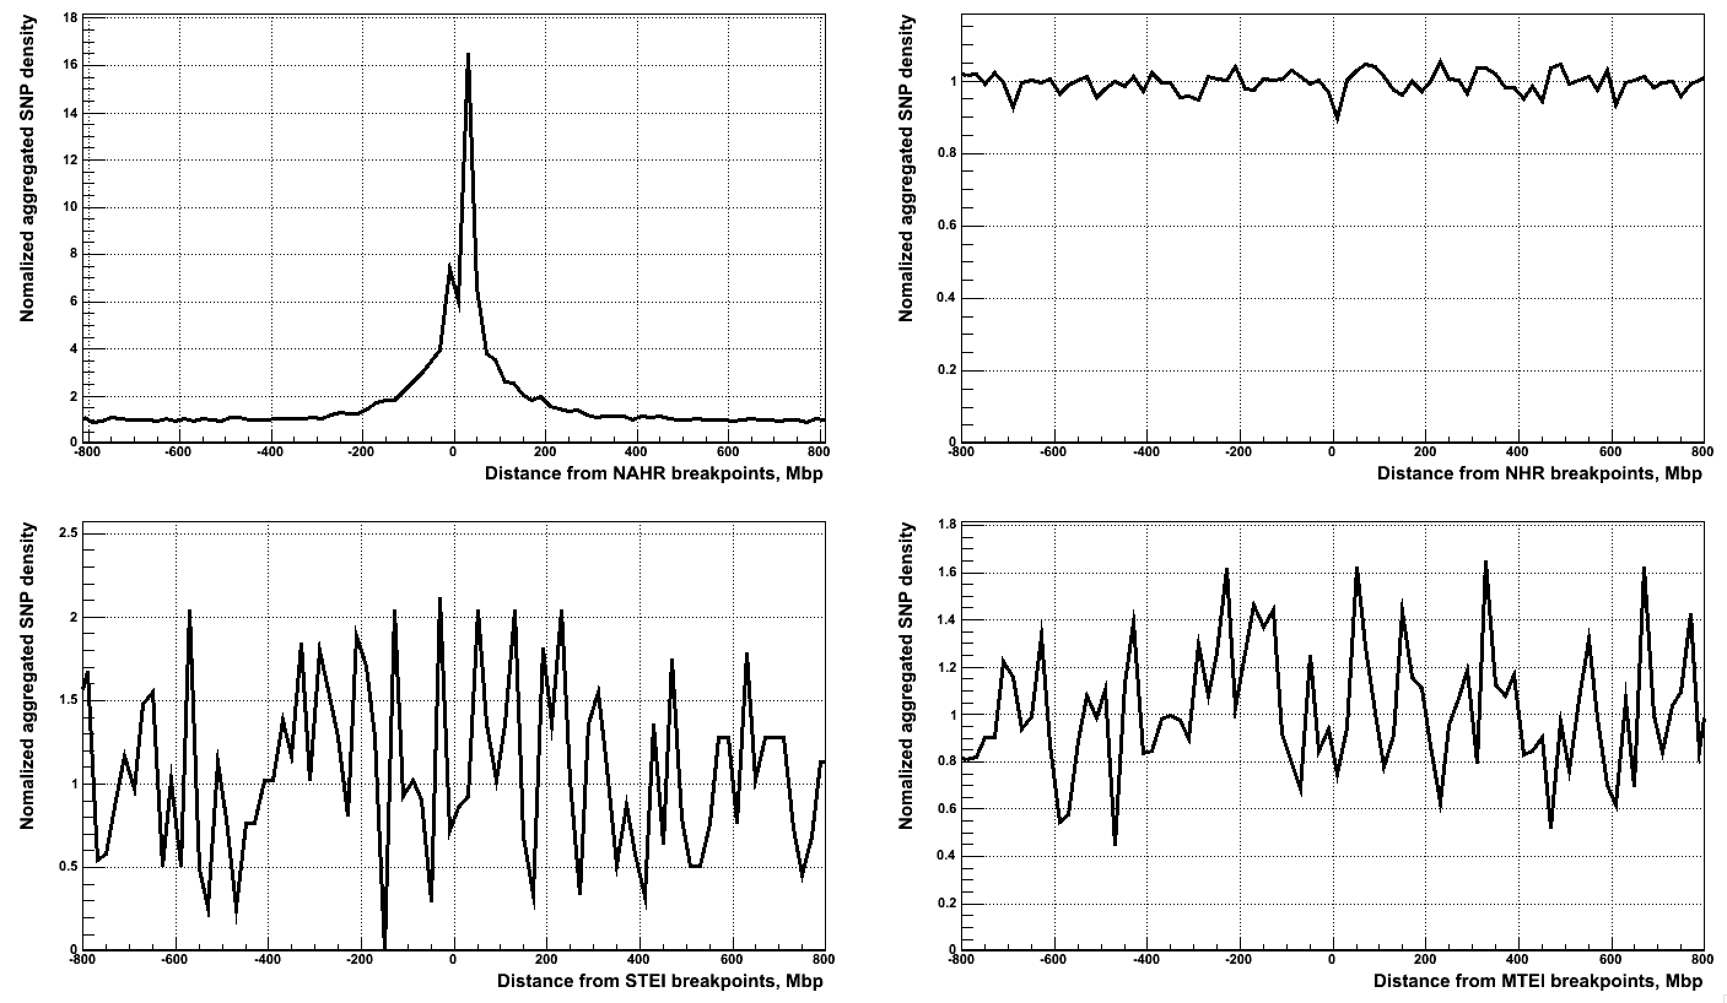
Integrated bkpts – very good sites

