Slide 1
SNP aggregation
Alexej Abyzov

Slide 2
Two breakpoint datasets
INTEGRATED – from integrated set of phase 1: 8,934 breakpoints
CONFIDENT – derived from additional analysis and validation: 8,943 breakpoints (no VNTR)
44.5% of breakpoints are identical

Slide 3
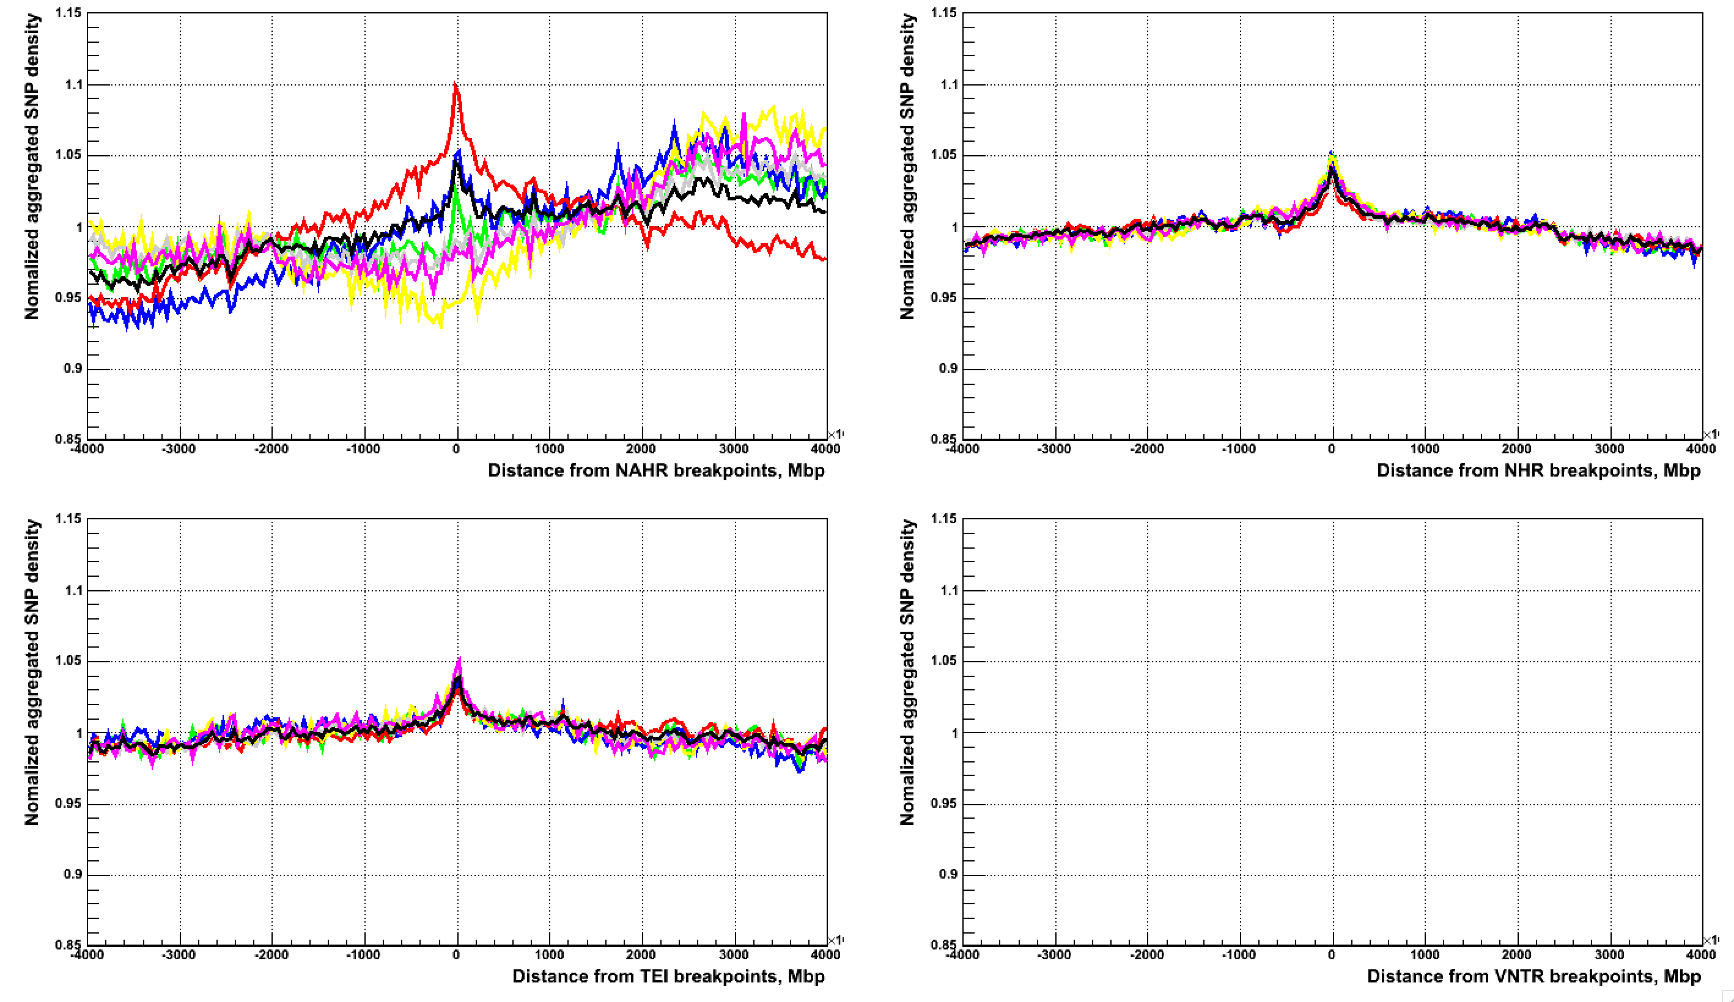
CONFIDENT (4 Mbps)
All, CA, CG, CT, TA, TC, TG

Slide 4
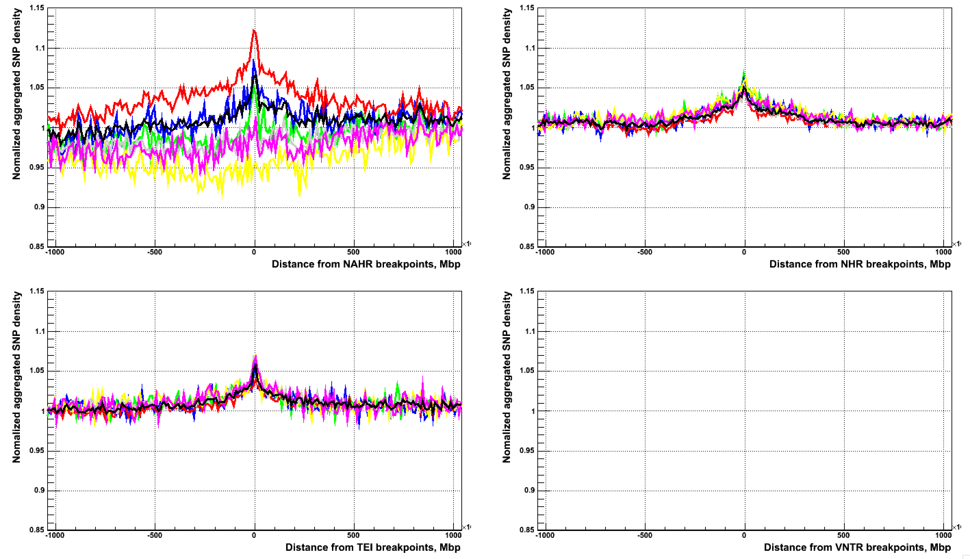
CONFIDENT (4 Mbps, zoom)
All, CA, CG, CT, TA, TC, TG

Slide 5
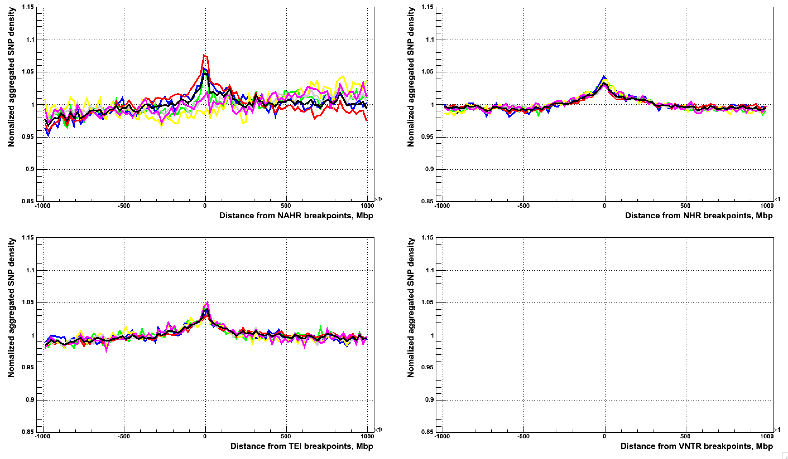
CONFIDENT (1 Mbps)
All, CA, CG, CT, TA, TC, TG

Slide 6
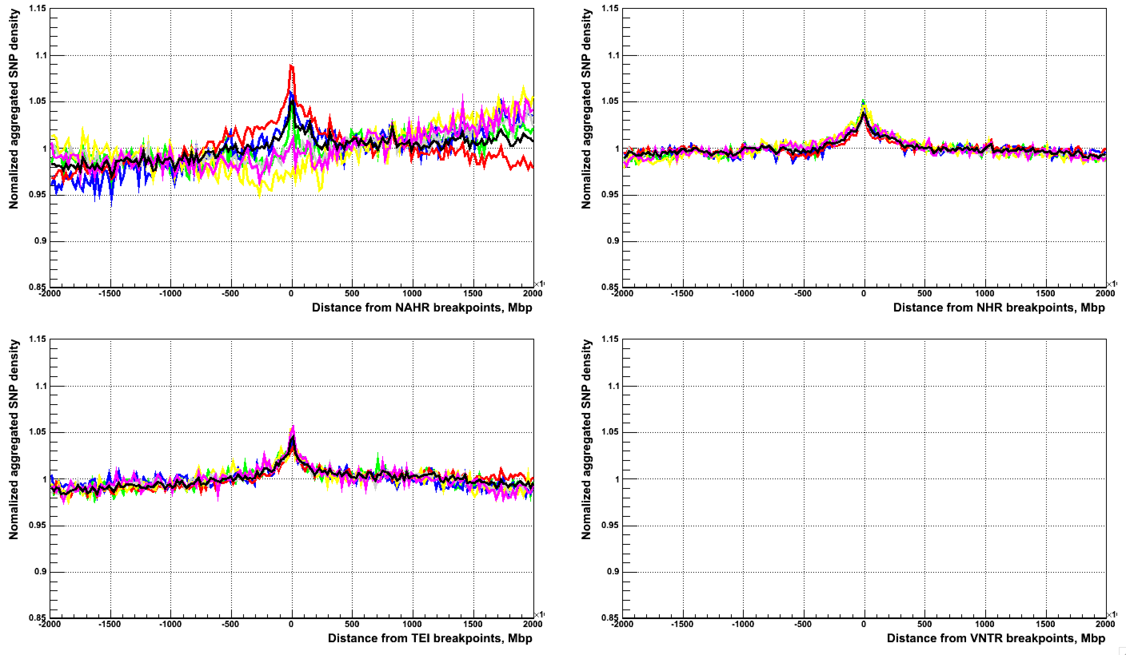
CONFIDENT (4 Mbps)
All, CA, CG, CT, TA, TC, TG

Slide 7
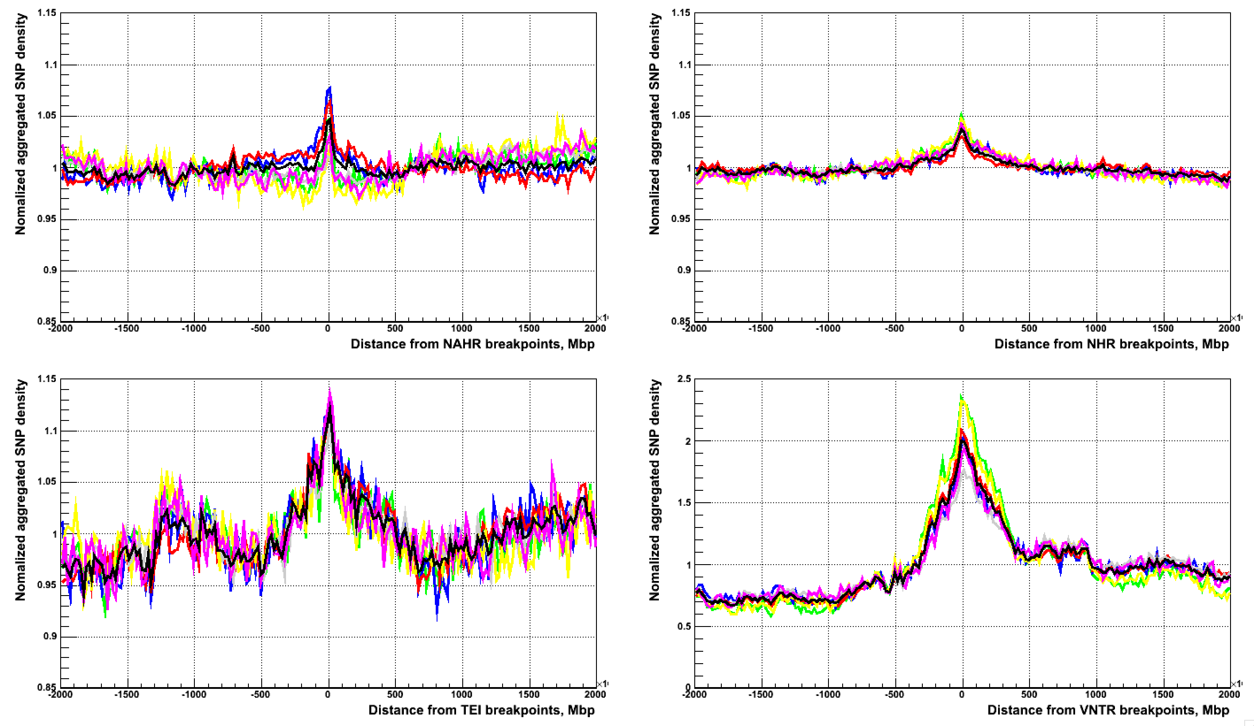
INTEGRATED (4 Mbps)

Slide 8
Conclusion
Possible bias in mutation rates associated with GC content

