Slide 1
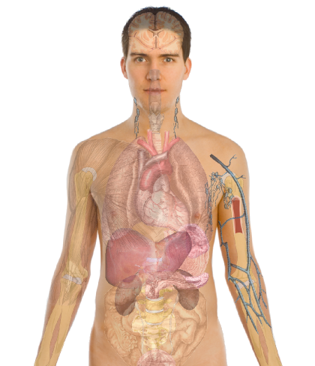
normal
tumor

Slide 4
normal
tumor

Slide 5
normal
tumor

Slide 6
normal
tumor

Slide 7
normal
tumor

Slide 8
normal
tumor

Slide 11
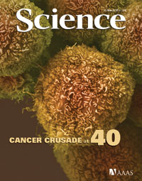
Personal Genomics
Cancer Genomics

Slide 12
Personal Genomics
Cancer Genomics

