Slide 2
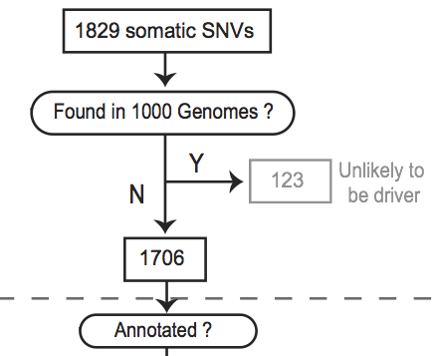
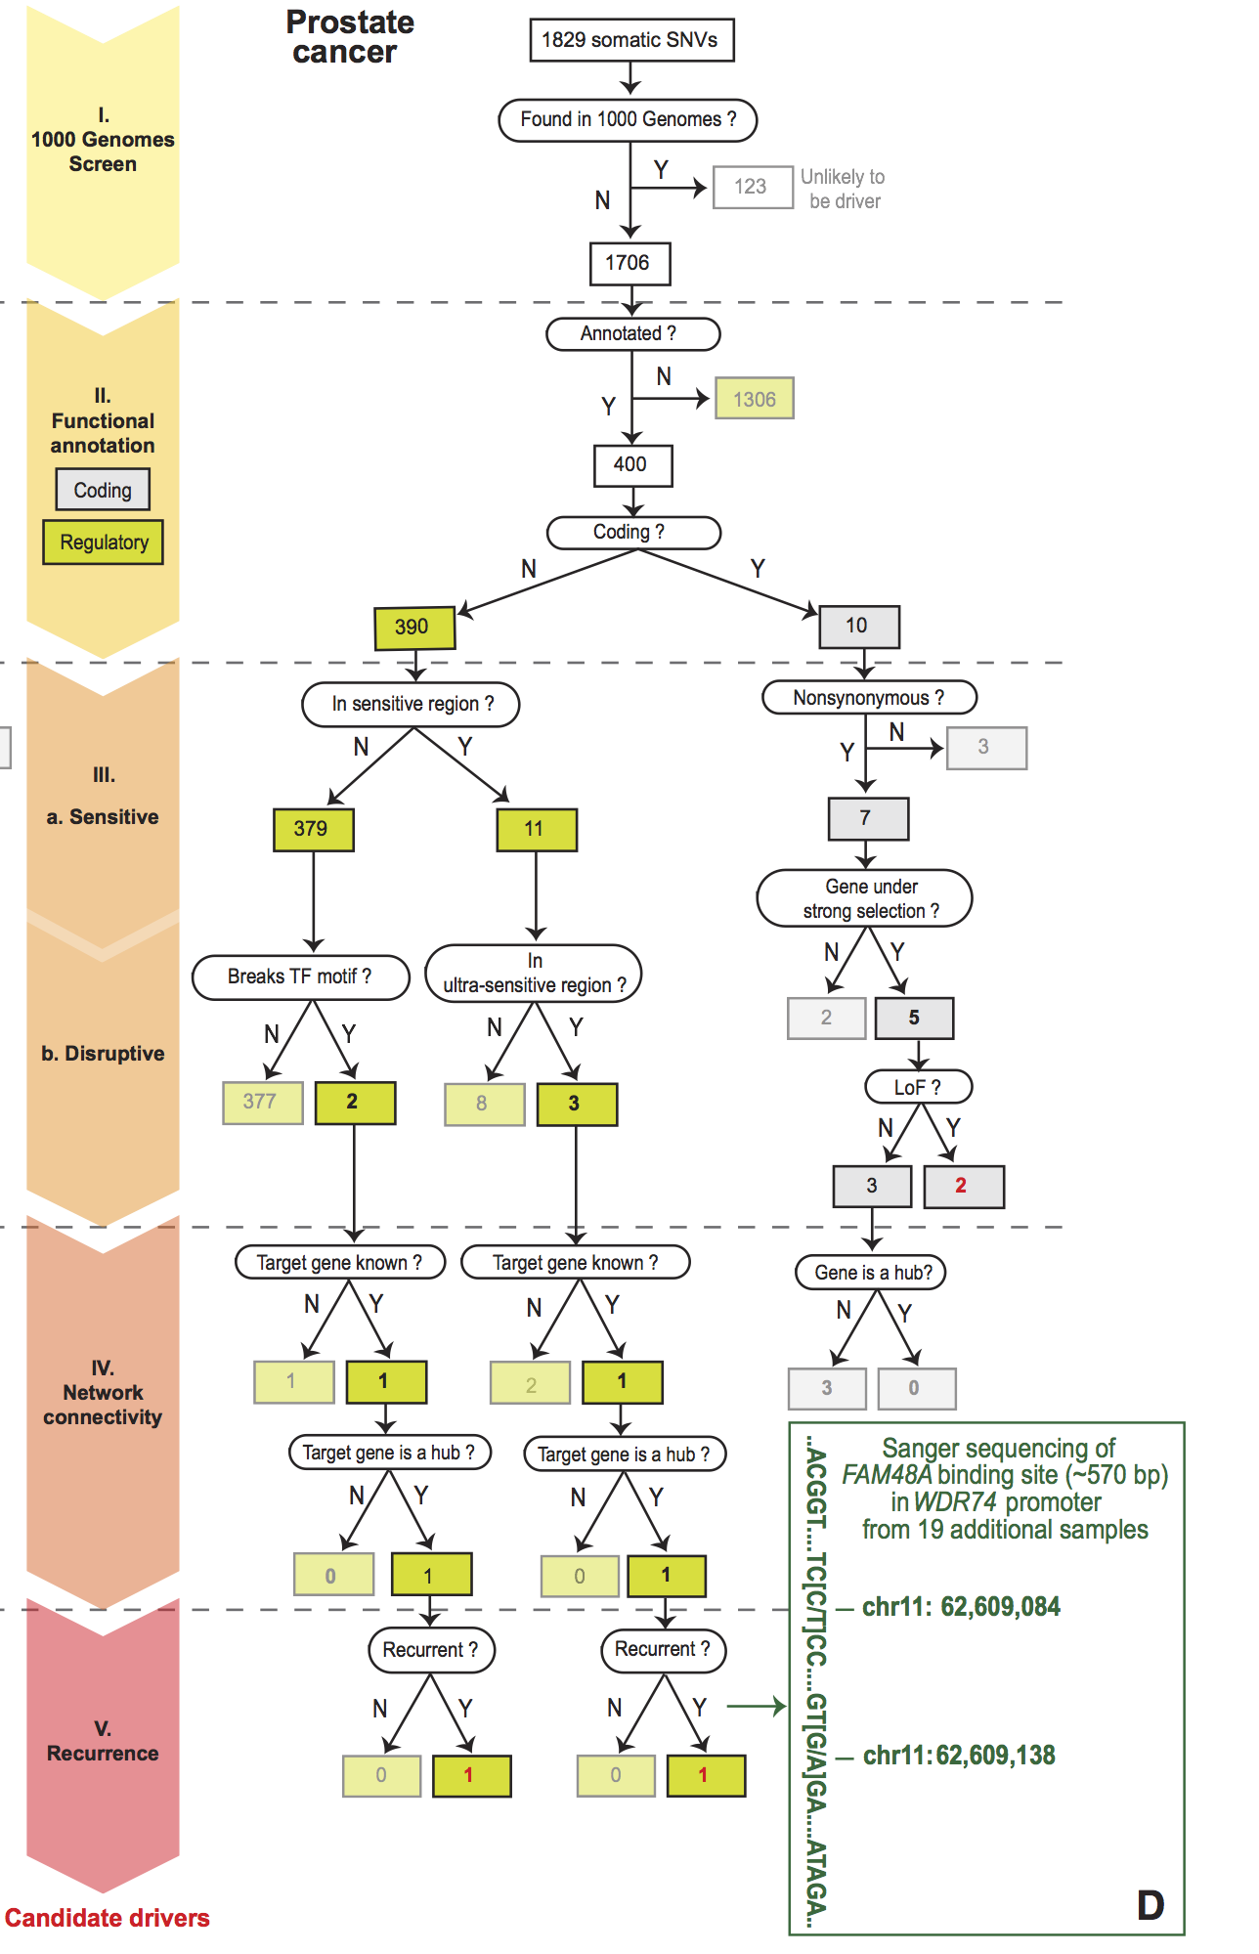
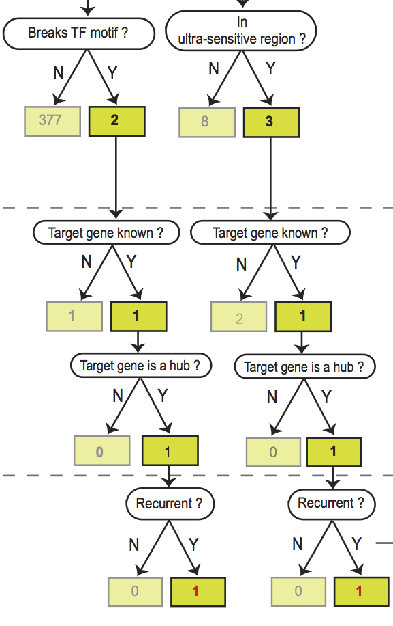
Flowchart for 7 Prostate Cancer Genomes (Berger et al. '11)

Slide 3
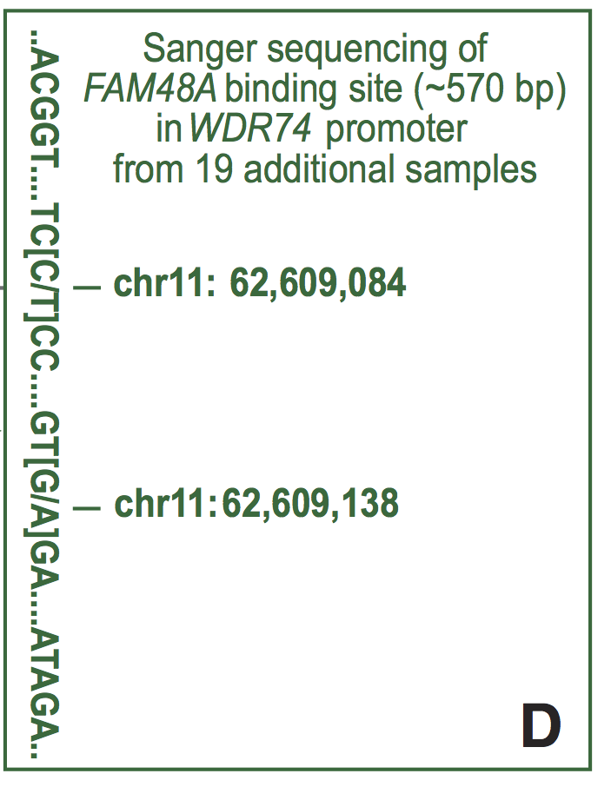
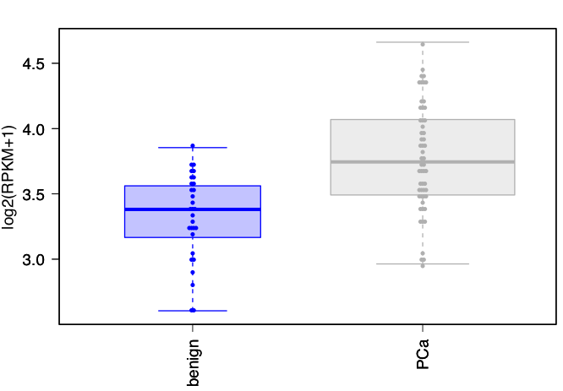
Identification of non-coding candidate drivers amongst somatic variants: Examples
Validation of a candidate driver identified in prostate cancer sample in WDR74 gene promoter
Sanger sequencing in 19 additional samples confirms the recurrence
WDR74 shows increased expression in tumor samples
benign
PCs

