Slide 1
First look at SNP aggregation around SV breakpoints
Alexej Abyzov
Sep 25, 2013

Slide 2
Chromatin aggregation

Slide 3
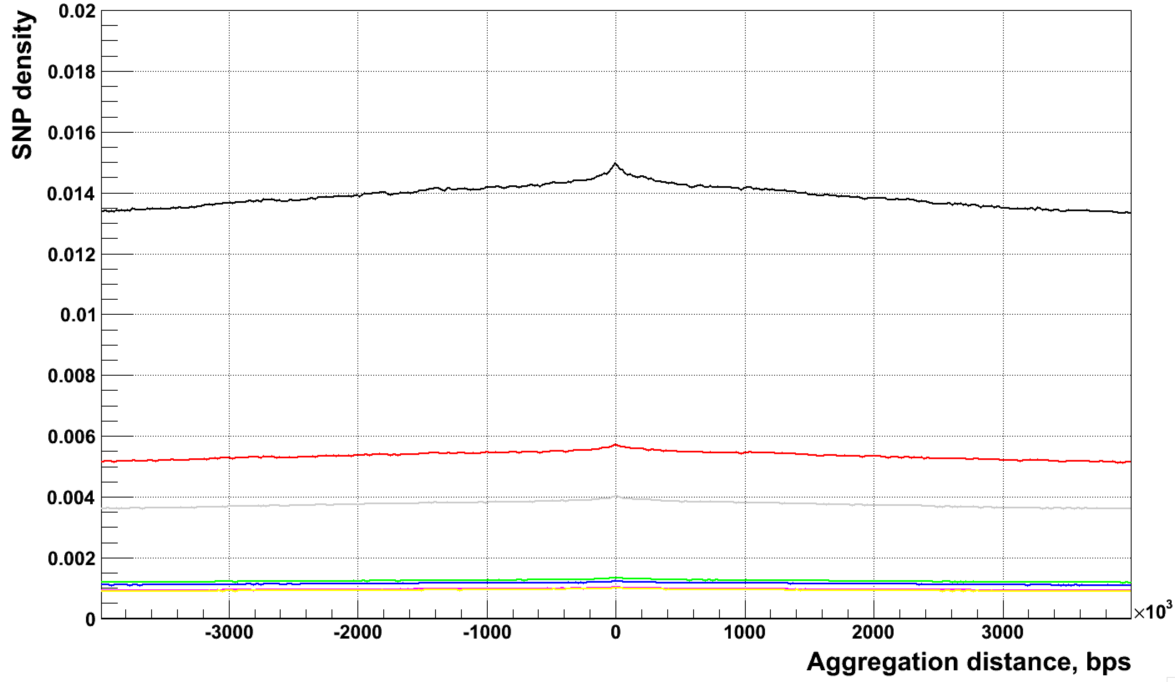
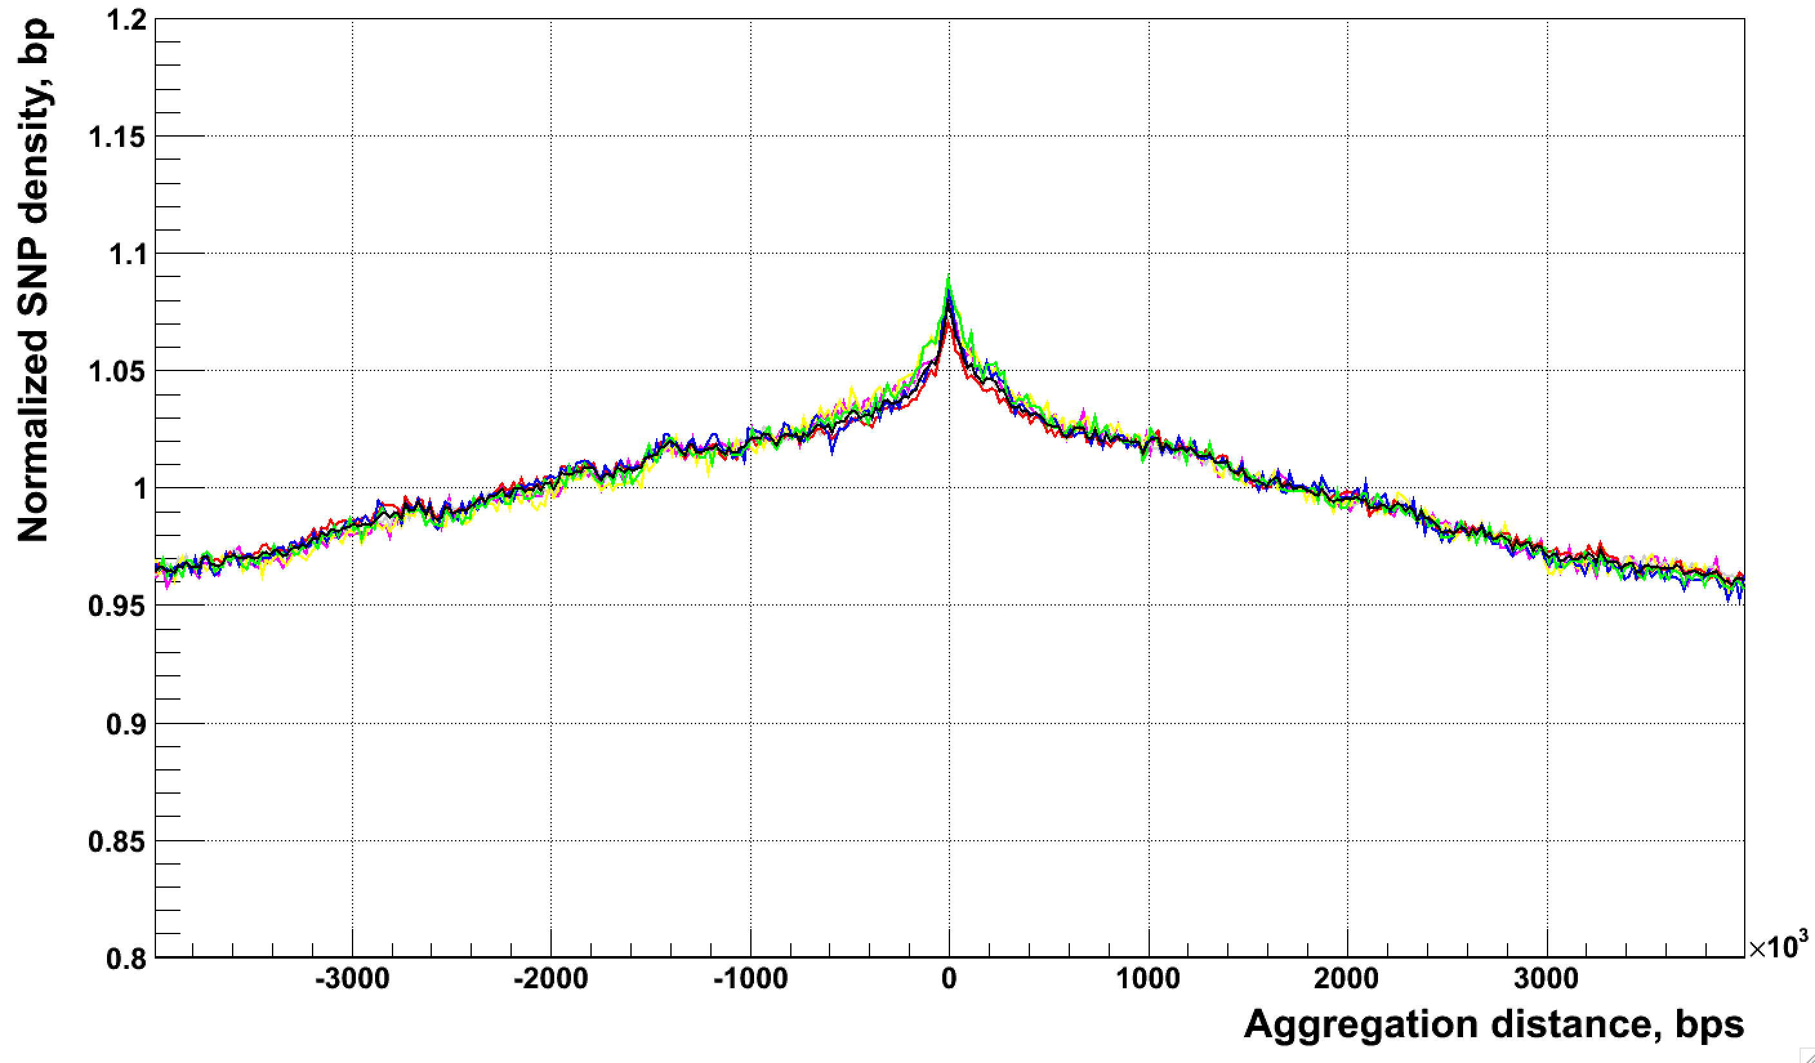
SNP aggregation around NH bkpts
Raw
All, CA, CG, CT, TA, TC, TG
Normalized

Slide 4
Issues with calculations
List of breakpoints is not entirely sorted
Need to make correction for genome accessibility
Extending chromosomes with 10M of N
Correcting by calculating the fraction N bases within aggregation window
Chromosome
Window
SV

Slide 5
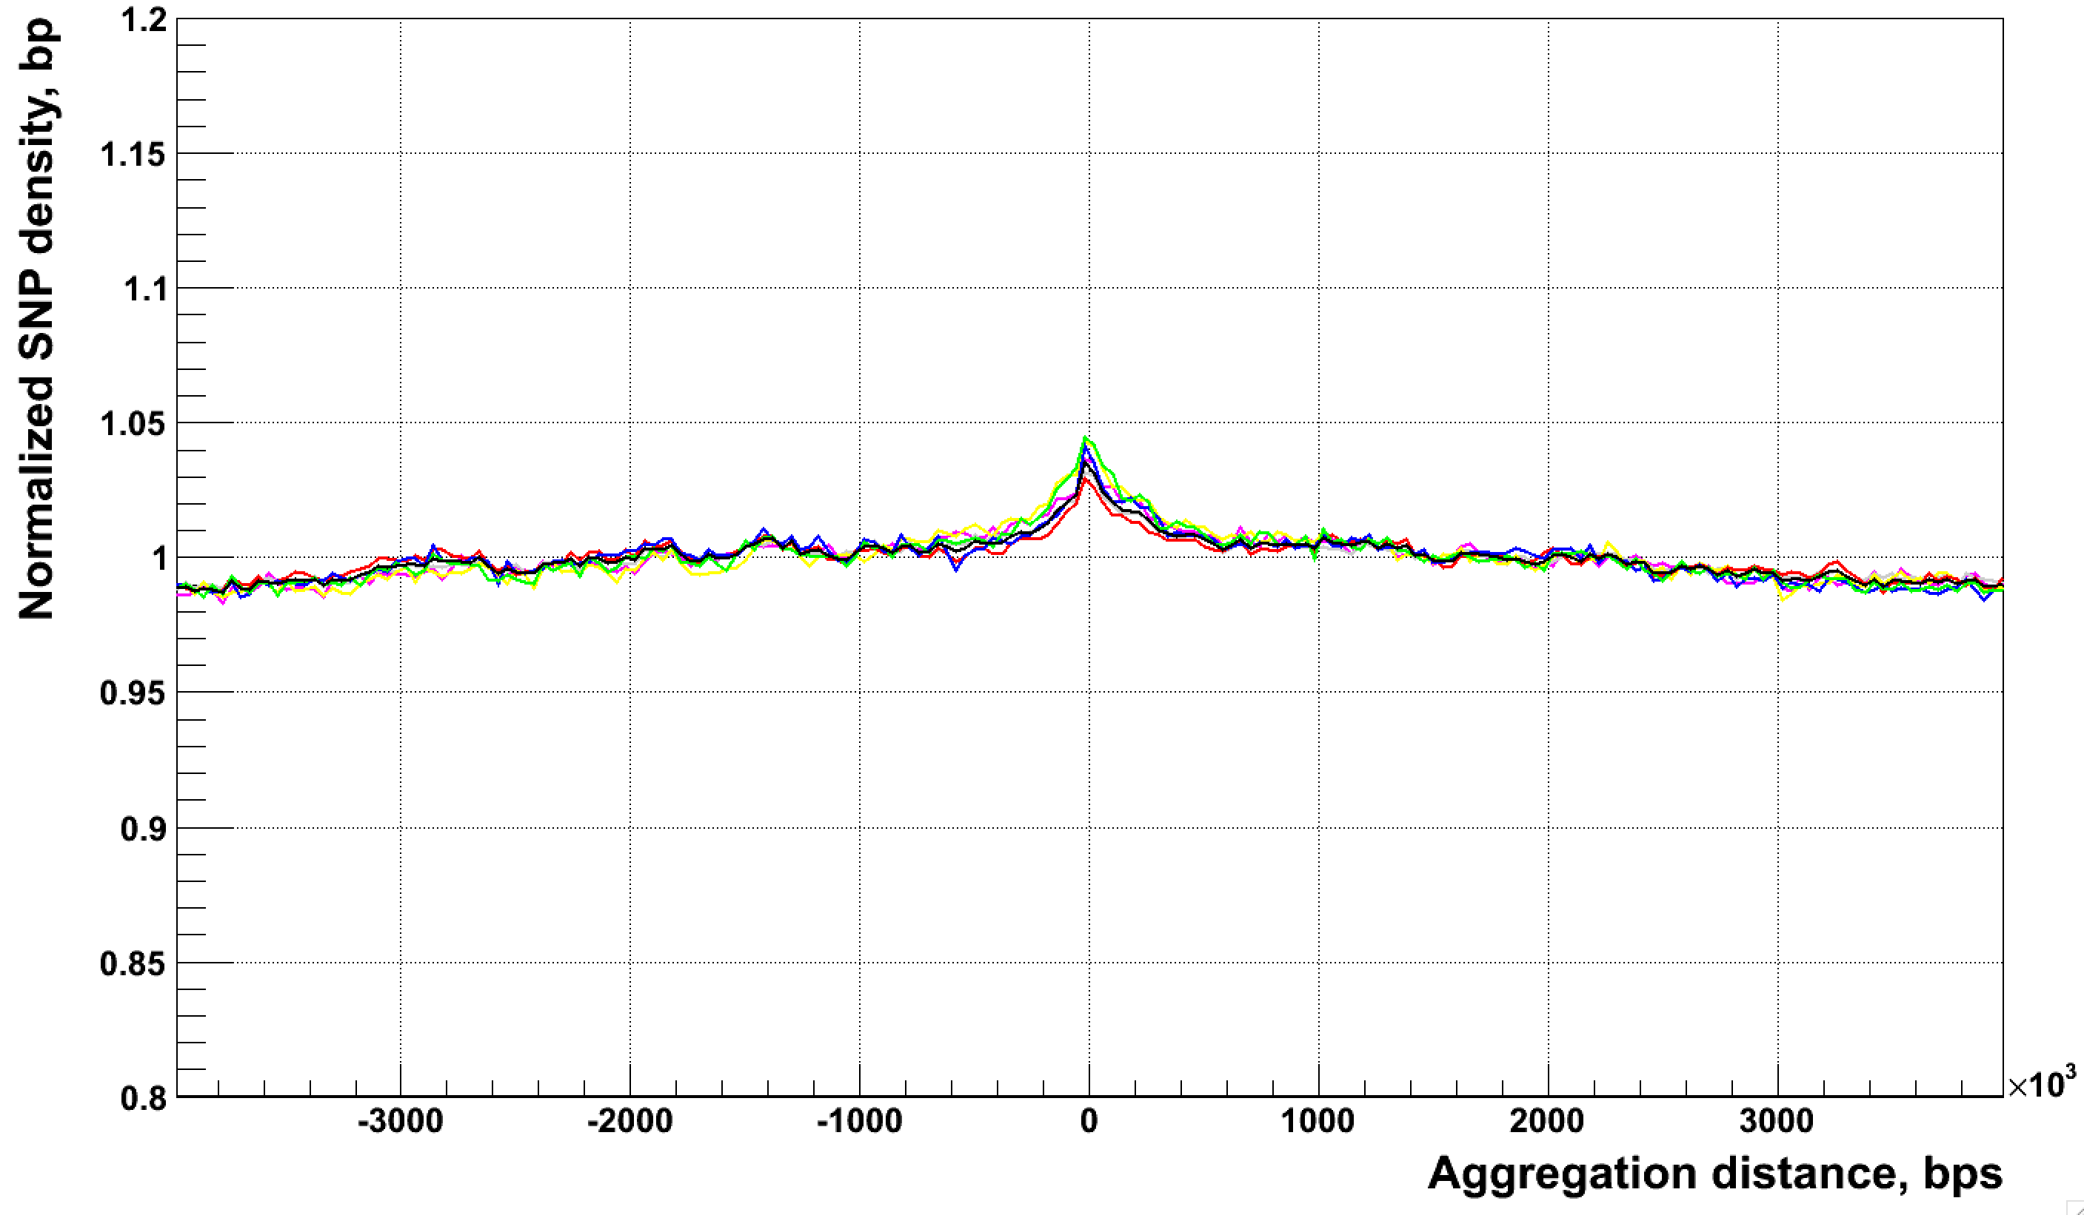
Corrected aggregation around NH bkpts
All, CA, CG, CT, TA, TC, TG
Corrected

Slide 6
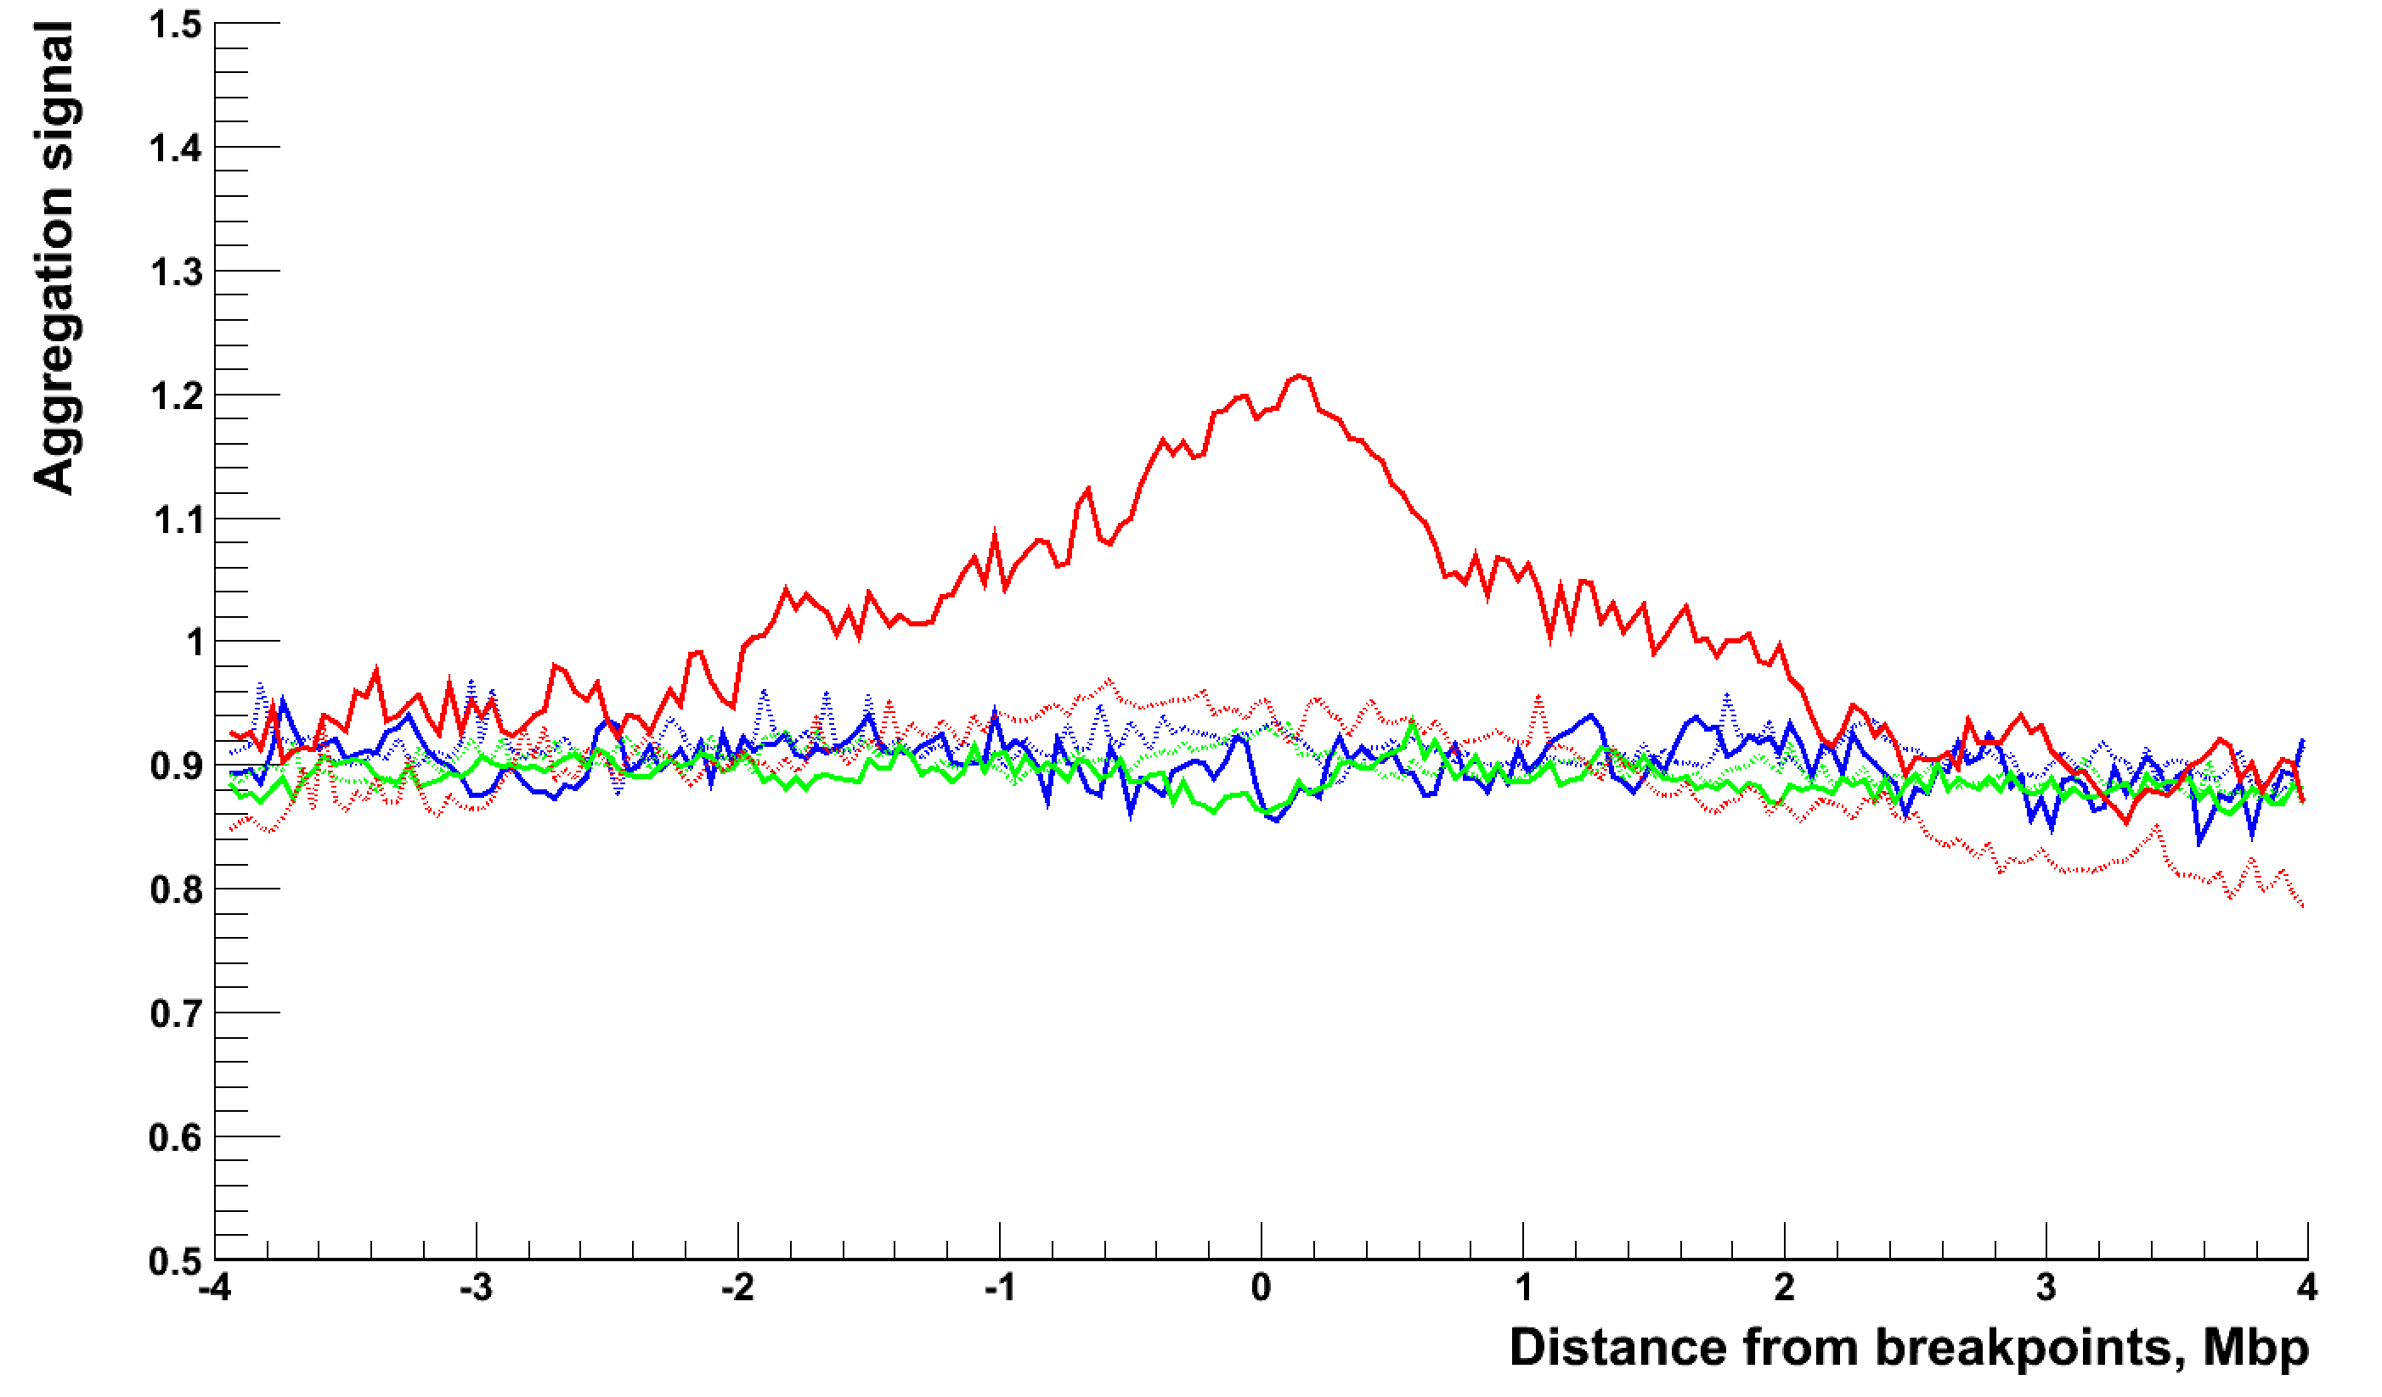
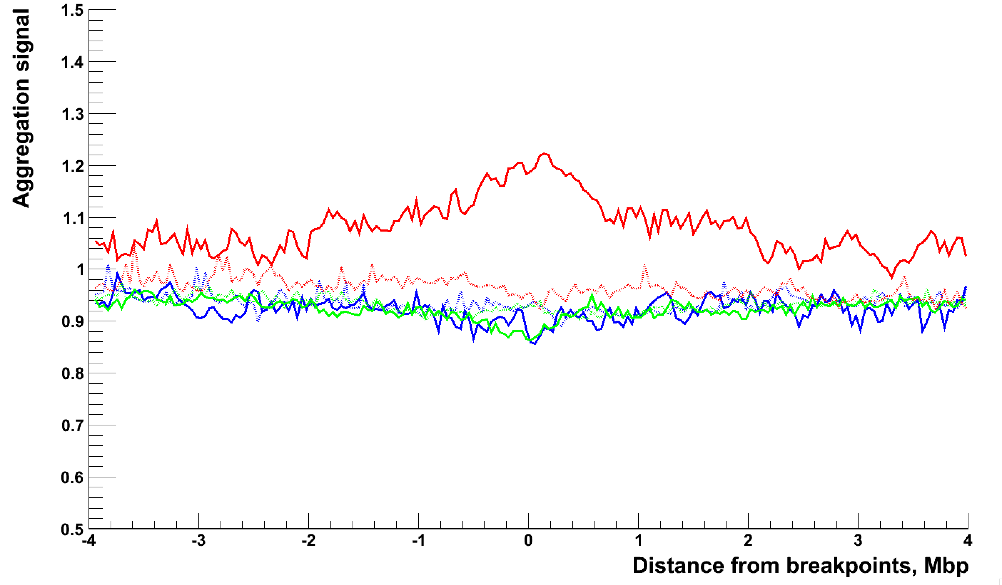
Chromatin aggregation
Raw
Corrected

Slide 7
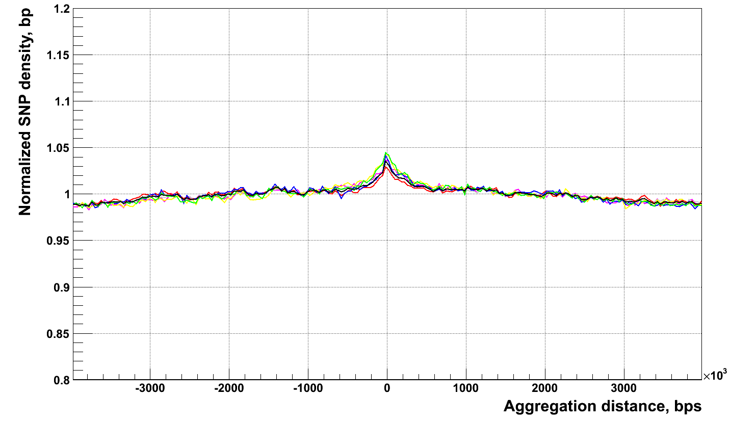
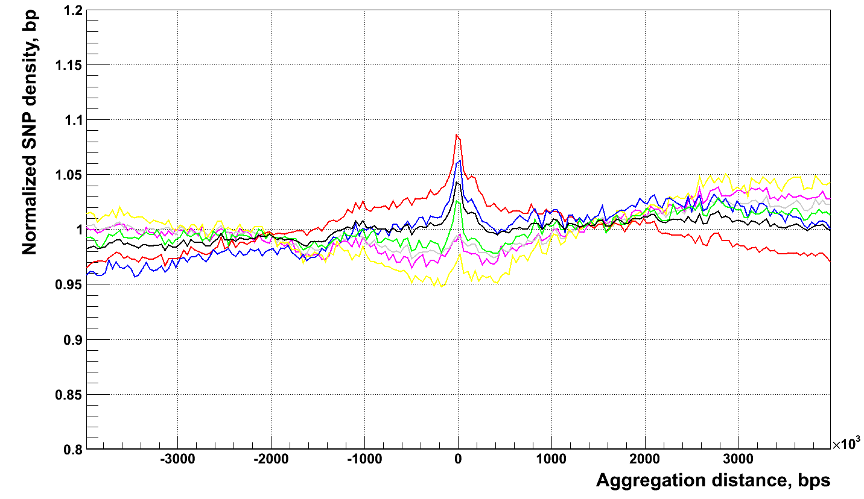
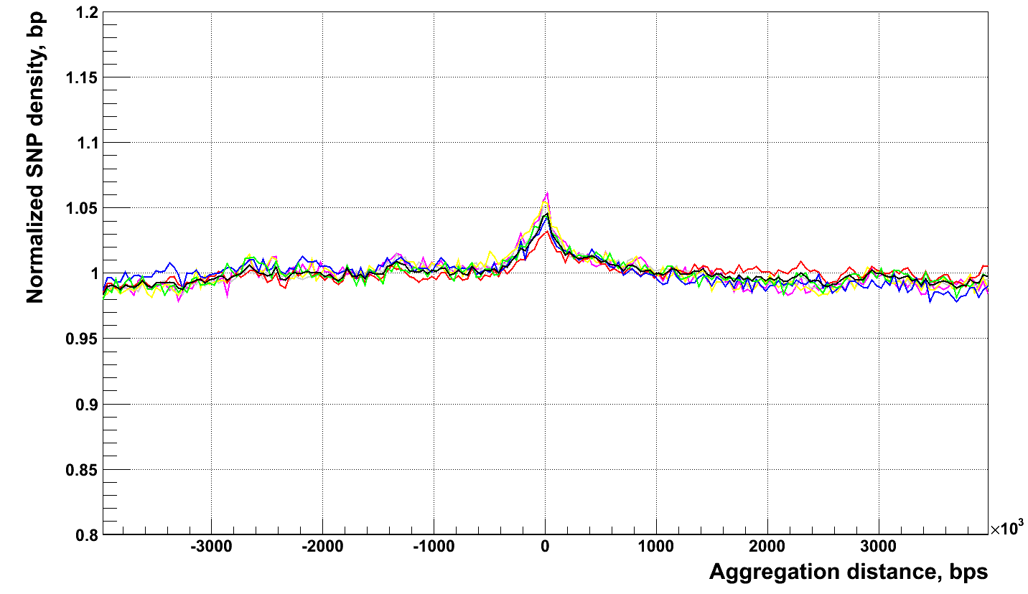
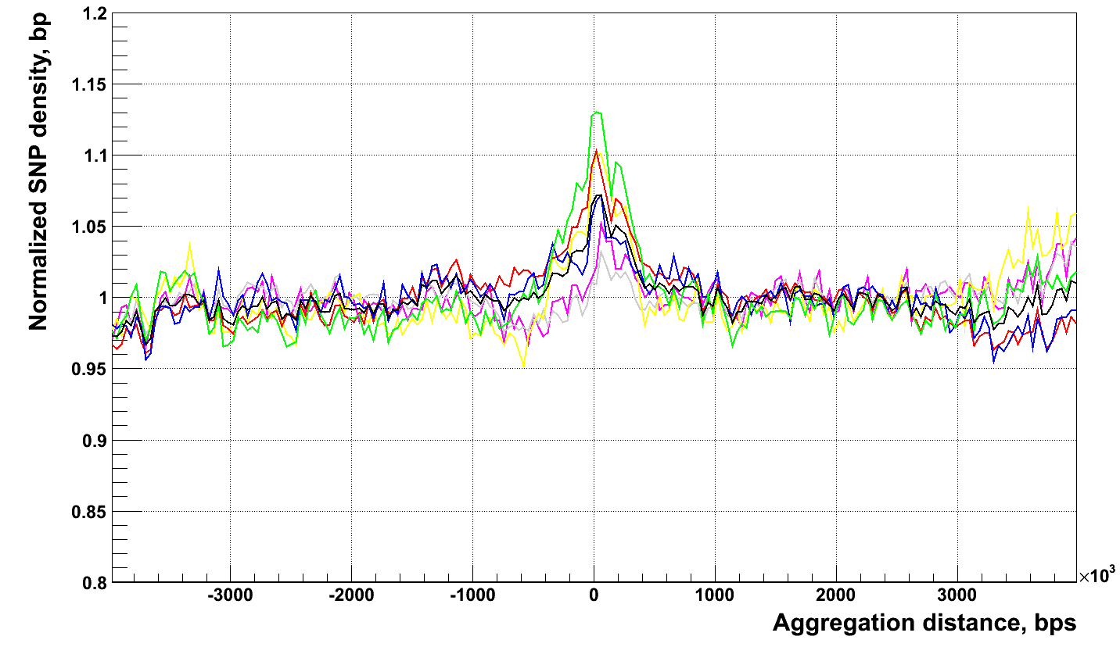
Aggregation around bkpts of different mechanisms
All, CA, CG, CT, TA, TC, TG
NH
NAHR
TEI
VNTR

