Slide 1
Fig. 1
Notes:
Adult circle should to be bigger;
Change to “Since Djebali et al. (2012)”, “Since Gravely et al. (2010)”, “Since Gerstein et al. (2010)”
Fly: 10x reads; 4x data sets
Ask for the real numbers from Ben (needs both data sets number and reads number) , LaDena (needs both data sets number and reads number) and Carie (needs read number)

Slide 2
 |  |  |  |  | Human |  |  | Worm |  |  | Fly
 |  |  |  |  | Elements | Genome Coverage |  | Elements | Genome Coverage |  | Elements | Genome Coverage
 |  |  |  |  |  | Kb | % |  | Kb | % |  | Kb | %
Sequenced Genome | mRNAs (exons) |  |  |  | 20,007 | 86,560 | 3.0 | 21,192 | 34,437 | 34.3 | 13,940 | 35,970 | 28.0
 | Pseudogenes |  |  |  | 11,216 | 27,089 | 0.95 | 881 | 1,343 | 1.3 | 145 | 155 | 0.12
 | Annotated ncRNAs |  |  |  | 22,154 | 17,770 | 0.62 | 41,466 | 2,611 | 2.6 | 2,155 | 3,279 | 2.6
 | Annotated ncRNAs | Comparable ncRNAs |  | miRNAs | 1,756 | 162 | 0.006 | 221 | 20 | 0.02 | 236 | 22 | 0.02
 |  |  |  | tRNAs | 624 | 47 | 0.002 | 609 | 45 | 0.04 | 314 | 22 | 0.02
 |  |  |  | snoRNAs | 1,521 | 168 | 0.006 | 141 | 16 | 0.02 | 287 | 34 | 0.03
 |  |  |  | snRNAs | 1,944 | 210 | 0.007 | 114 | 14 | 0.01 | 47 | 7 | 0.006
 |  |  |  | lncRNAs | 10,840 | 10,581 | 0.37 | 233 | 184 | 0.18 | 852 | 868 | 0.68
 | Regions excluding mRNAs, Pseudogenes and Annotated ncRNAs |  |  |  | 283,816 | 2,731,811 | 95.5 | 143,372 | 63,520 | 63.3 | 60,108 | 89,445 | 69.6
 |  | Transcription Detected (TARs) |  |  | 708,253 | 916,401 | 32.0 | 232,150 | 37,029 | 36.9 | 83,618 | 44,256 | 34.5
 |  |  | Supervised Predictions |  | 104,016 | 13,835 | 0.48 | 2,525 | 392 | 0.39 | 599 | 164 | 0.13
Fig. 2
Notes:
TARs

Slide 3
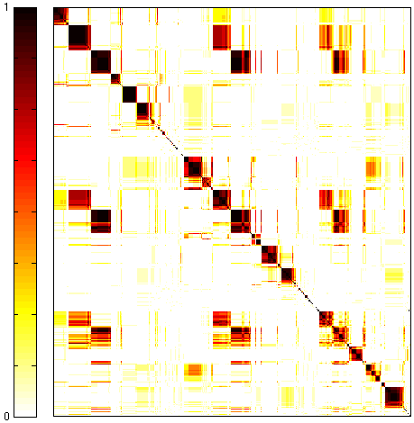
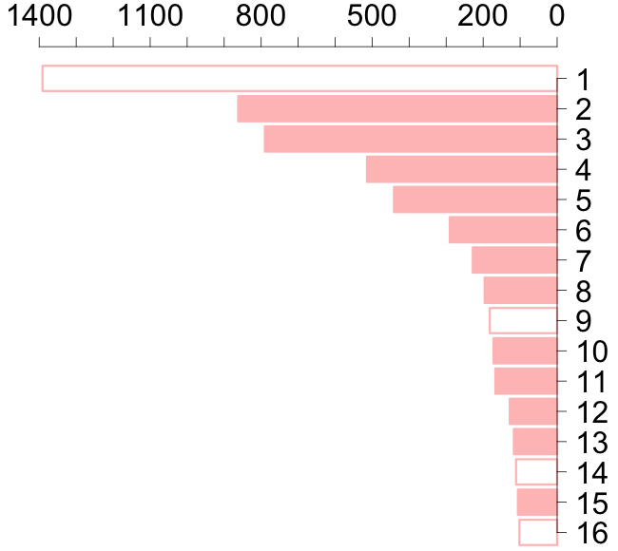
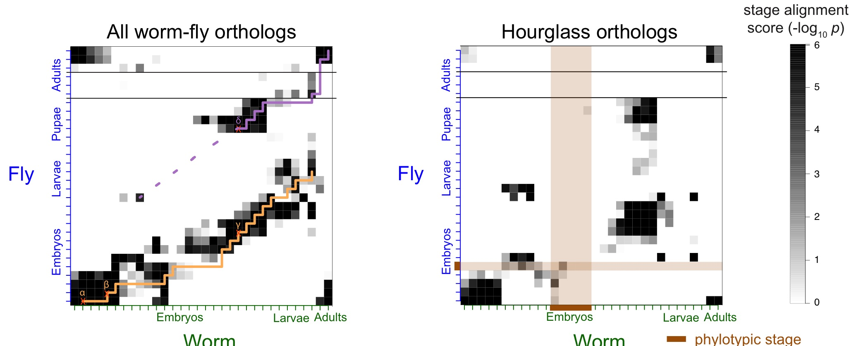
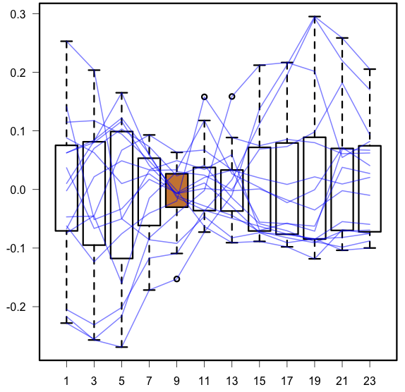
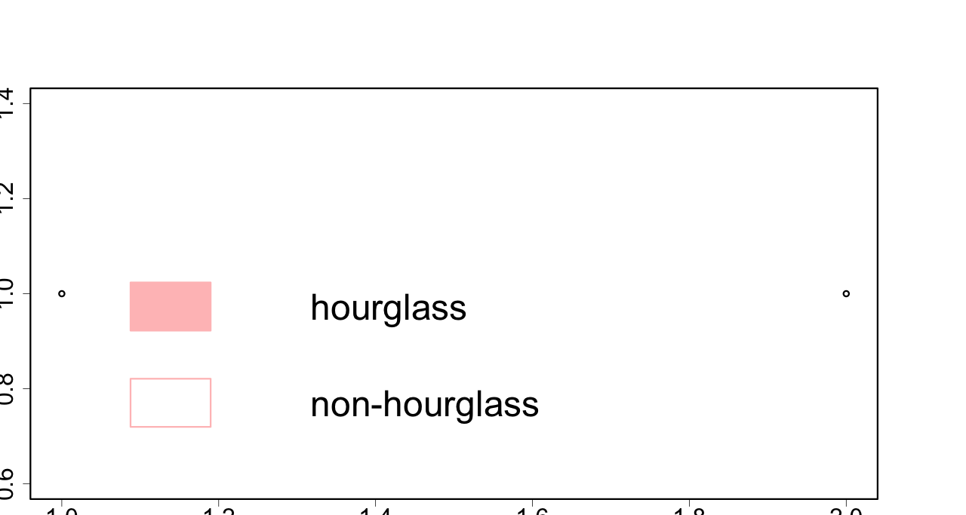
number of genes
Signal transduction, Cytoskeletal network
Morphogenesis specific, Epidermal growth factor
Histone pre-mRNA processing, Exportation from nucleus to cytoplasm
Topoisomerase, RNA POL II
Cell cycle control, Signal transduction
Ribosome
Protein translocase & folding, Negative regulators of G1 to S cell cycle phase
module
La autoantigen
Signal transduction, Integrins
Spliceosome
Ribosomal biogenesis, Larval growth specific, Embryonic Regulator
Cell cycle control DNA replication, Minichromosome maintenance
Cell cycle control
Transcription regulator, Chaperon, G10 protein
Small ribonucleoprotein particle protein
Proteasome
1
human
worm
fly
gene-gene co-association
Conservation of module across number of species
fly module
0
hourglass module
phylotypic stage
stage alignment score (-log₁₀p)
first set
stage
second set

Slide 4
number of genes
Signal transduction, Cytoskeletal network
Morphogenesis specific, Epidermal growth factor
Histone pre-mRNA processing, Exportation from nucleus to cytoplasm
Topoisomerase, RNA POL II
Cell cycle control, Signal transduction
Ribosome
Protein translocase & folding, Negative regulators of G1 to S cell cycle phase
module
La autoantigen
Signal transduction, Integrins
Spliceosome
Ribosomal biogenesis, Larval growth specific, Embryonic Regulator
Cell cycle control DNA replication, Minichromosome maintenance
Cell cycle control
Transcription regulator, Chaperon, G10 protein
Small ribonucleoprotein particle protein
Proteasome
1
human
worm
fly
gene-gene co-association
Conservation of module across number of species
fly module
0
hourglass module
phylotypic stage
stage alignment score (-log₁₀p)
first set
stage
second set

Slide 5
Try different layouts in following slides. Please ignore figure flaws!

Slide 6
number of genes
Signal transduction, Cytoskeletal network
Morphogenesis specific, Epidermal growth factor
Histone pre-mRNA processing, Exportation from nucleus to cytoplasm
Topoisomerase, RNA POL II
Cell cycle control, Signal transduction
Ribosome
Protein translocase & folding, Negative regulators of G1 to S cell cycle phase
module
fly module
La autoantigen
Signal transduction, Integrins
Spliceosome
Ribosomal biogenesis, Larval growth specific, Embryonic Regulator
Cell cycle control DNA replication, Minichromosome maintenance
Cell cycle control
Transcription regulator, Chaperon, G10 protein
Small ribonucleoprotein particle protein
Proteasome
1
stage
fly
worm
human
gene-gene co-association
Conservation of module across number of species
0
hourglass module
phylotypic stage
stage alignment score (-log₁₀p)
first set
second set

Slide 7
1
human
worm
fly
gene-gene co-association
fly module
Conservation of module across number of species
0
hourglass module
phylotypic stage
stage alignment score (-log₁₀p)
first set
second set
stage
number of genes
Signal transduction, Cytoskeletal network
Morphogenesis specific, Epidermal growth factor
Histone pre-mRNA processing, Exportation from nucleus to cytoplasm
Topoisomerase, RNA POL II
Cell cycle control, Signal transduction
Ribosome
Protein translocase & folding, Negative regulators of G1 to S cell cycle phase
module
La autoantigen
Signal transduction, Integrins
Spliceosome
Ribosomal biogenesis, Larval growth specific, Embryonic Regulator
Cell cycle control DNA replication, Minichromosome maintenance
Cell cycle control
Transcription regulator, Chaperon, G10 protein
Small ribonucleoprotein particle protein
Proteasome

Slide 8
1
human
worm
fly
gene-gene co-association
fly module
Conservation of module across number of species
0
hourglass module
phylotypic stage
stage alignment score (-log₁₀p)
first set
second set
stage
number of genes
Signal transduction, Cytoskeletal network
Morphogenesis specific, Epidermal growth factor
Histone pre-mRNA processing, Exportation from nucleus to cytoplasm
Topoisomerase, RNA POL II
Cell cycle control, Signal transduction
Ribosome
Protein translocase & folding, Negative regulators of G1 to S cell cycle phase
module
La autoantigen
Signal transduction, Integrins
Spliceosome
Ribosomal biogenesis, Larval growth specific, Embryonic Regulator
Cell cycle control DNA replication, Minichromosome maintenance
Cell cycle control
Transcription regulator, Chaperon, G10 protein
Small ribonucleoprotein particle protein
Proteasome

Slide 9
1
human
worm
fly
gene-gene co-association
fly module
Conservation of module across number of species
0
hourglass module
phylotypic stage
stage alignment score (-log₁₀p)
first set
second set
stage
number of genes
Signal transduction, Cytoskeletal network
Morphogenesis specific, Epidermal growth factor
Histone pre-mRNA processing, Exportation from nucleus to cytoplasm
Topoisomerase, RNA POL II
Cell cycle control, Signal transduction
Ribosome
Protein translocase & folding, Negative regulators of G1 to S cell cycle phase
module
La autoantigen
Signal transduction, Integrins
Spliceosome
Ribosomal biogenesis, Larval growth specific, Embryonic Regulator
Cell cycle control DNA replication, Minichromosome maintenance
Cell cycle control
Transcription regulator, Chaperon, G10 protein
Small ribonucleoprotein particle protein
Proteasome

Slide 10
A
Scaled Correlation of
Binding with Expression
C
Human
Worm
Fly
Human
Worm
Fly
B
Fig. 4

Slide 11
A
B
C
Human
Worm
Fly
Human
Worm
Scaled Correlation of
Binding with Expression
Fly
Fig. 4

