Slide 1
Mechanism and Applications of chromosome inactivation by Xist
Anurag Sethi
Journal Club
08/28/2013

Slide 2
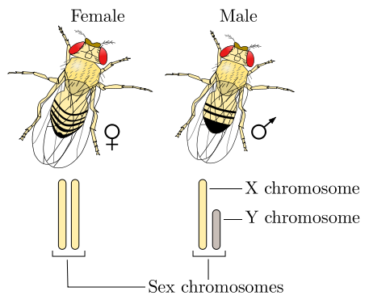
Sex chromosome imbalance
In females, there are two copies of the X chromosome while males have one copy of the X chromosome and one copy of the Y chromosome.
http://en.wikipedia.org/wiki/XY_sex-determination_system

Slide 3
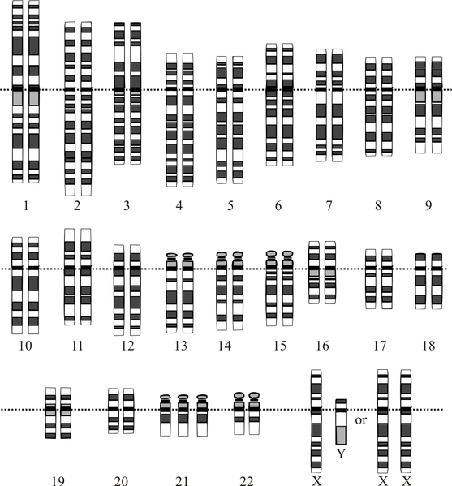
Uncompensated extra copies of chromosomes can cause diseases.
The genes in the extra copy of X-chromosome in women needs to be highly regulated.
http://en.wikipedia.org/wiki/Down_syndrome

Slide 4
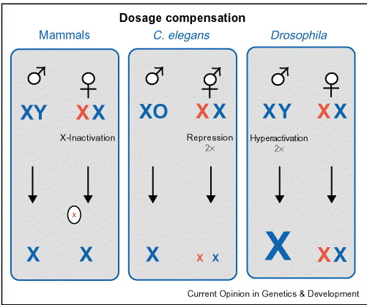
Different solutions have evolved for X-chromosome dosage compensation
Akhtar, Curr Opin Genetics & Devel., 2003.

Slide 5
Role of ncRNA in X-chromosome inactivation (XCI)

Slide 6
Xist is lncRNA that is involved in X-chromosome inactivation
X-inactive specific transcript (Xist) is a long noncoding RNA (lncRNA) that is responsible for X-chrmosome inactivation.
Brown, Cell, 1992.
Lee, Science, 2012.

Slide 7
Interplay between a number of ncRNA locii is responsible for XCI.
After X-chromosome counting, Tsix production reduces in one of the X-chromosomes and Xist production increases.
Lee, Science, 2012.

Slide 8
ncRNA provides the option for cis regulation
Lee, Science, 2012.

Slide 9
Mechanism for Xist spread during XCI

Slide 10
New technique developed to identify the location of ncRNA on genome
Biotinylated antisense probes are used to purify DNA regions that bind to Xist.
Engreitz, et al., Science, 2013

Slide 11
High resolution mapping of Xist on the inactive X chromosome in differentiated female cells.
Xist is highly enriched on the X chromosome (enrichment factors correlated with H3K27me3 and gene density through most of the chromosome).
Engreitz, et al., Science, 2013

Slide 12
High resolution mapping of Xist during initiation of XCI
Time resolved mapping of Xist helps identify the early sites of Xist enrichment on the X-chromosome. Early sites are consistent with the hopping model of XCI.
Engreitz, et al., Science, 2013

Slide 13
The initial sites of Xist enrichment are correlated to the sites in contact with the Xist genomic locus.
This supports the proximity transfer mechanism for Xist transfer.
Engreitz, et al., Science, 2013

Slide 14
Changing the genomic location of Xist shows a corresponding change in initial sites of Xist transfer
The initial sites of Xist transfer depend on the contact frequency of the locus at which Xist is expressed.
Engreitz, et al., Science, 2013

Slide 15
The A-repeat deletion of Xist cannot spread over the active regions of the X chromosome
The A-repeat deletion of Xist spreads across the chromosome but does not induce histone methylation.
Engreitz, et al., Science, 2013

Slide 16
Model for how Xist spreads on the X chromosome
Xist spreads from its locus based upon the contacts of the X-chromosome.
Xist recruits PRC2 and induces histone methylation on these locations.
Histone methylation causes changes in conformations which causes Xist to spread to new regions of the X-chromosome.
Engreitz, et al., Science, 2013

Slide 17
Clinical applications of Xist induced silencing

Slide 18
Scheme for inserting Xist transgene into chromosome 21
Jiang, et al., Nature, 2013.

Slide 19
Xist gets inserted into chromosome 21 and gets expressed after getting induced with doxycycline
Jiang, et al., Nature, 2013.

Slide 20
Xist induces heterochromatin modifications and condensed chromosome 21 Barr bodies
Jiang, et al., Nature, 2013.

Slide 21
Xist induction causes dosage compensation of genes in chromosome 21
Change in genetic expression
Jiang, et al., Nature, 2013.

Slide 22
Trisomy correction affects cell proliferation and formation of neural rosettes
Jiang, et al., Nature, 2013.

Slide 23
Summary
lncRNA plays an important role in local or global changes to gene expression.
lncRNA play an important role in cis regulation of gene expression.
lncRNA may be able to cause global changes in gene expression by spreading through chromosome contacts.
Targeted lncRNA insertion provide a new unexplored route for gene therapy.

