Slide 1
exRNA DMRR DIAC Specific Aims, Year 1 Milestones, and Interaction within DMRR/ERCP
DMRR call
Mon 23 Sept 2013

Slide 2
DIAC Team
Gerstein Lab
Mark Gerstein
Joel Rozowsky
Anurag Sethi
Cristina Sisu
Rob Kitchen
Daifeng Wang

Slide 3
DMRR DIAC Specific Aims
Aim 1: Develop methods and implement pipelines for endogenous exRNAs (en-exRNAs).
Aim 2: Implement a pipeline for the identification of exogenous exRNAs (ex-exRNAs).
Aim 3: Provide a pipeline to investigate the degree of conservation and secondary structure of the exRNAs.
Aim 4: Develop workflows to integrate exRNA profiles with functional genomics data and interpret them in network context.
Aim 5: Organize the Analysis Working Group (AWG), coordinate the consortium-wide analysis and the writing of the integrative analysis papers, and respond to the analysis needs of the consortium.

Slide 4
DMRR DIAC Goals and Milestones
• Within 6 months of award, the DIAC will produce a written outline (in collaboration with consortium members) of the overall data pipeline needs of the consortium and describe how the DIAC will work with consortium members to address those needs.
• Within 8 months of award, the DIAC will develop and implement initial versions of pipelines for exRNA-seq mapping that map sequence reads to relevant genomes. These tools and pipelines will be forwarded to the DCC for production of the exRNA Atlas database.
• Within 12 months of award, the DIAC will create a written outline (in collaboration with consortium members) of the overall analysis needs of the consortium and describe how the DIAC will be working with consortium members to address those needs. This outline should include a list of analysis tools and/or “apps” that are available or will be developed.
• Within 12 months of award, the DIAC will have developed an initial splicing library.

Slide 5
DMRR DIAC Aim 1
Aim 1: Develop methods and implement pipelines for endogenous exRNAs (en-exRNAs).
Quantify en-exRNA transcript expression level
Overlap en-exRNAs with annotated coding, non-coding, and miRNA loci
Determine en-exRNA splice / isoform structure
Investigate the degree to which exRNAs exhibit allelic effects or RNA editing.

Slide 6
DMRR DIAC Aim 2
Aim 2: Implement a pipeline for the identification of exogenous exRNAs (ex-exRNAs).
a) use as input to this pipeline exRNA-seq reads not assigned by the en-exRNA pipeline
b) map these reads to all other available organisms, from mammals to microbes
c) develop databases specifically designed to identify the microbes from which a transcript is derived

Slide 7
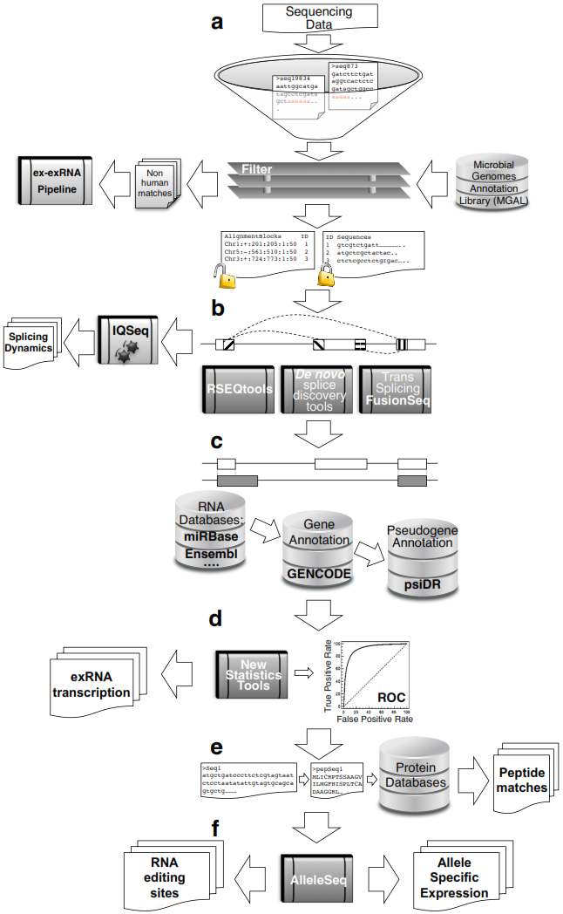
exRNA-Seq Processing Pipeline
Figure 1. An exRNA-seq pipeline.

Slide 8
DMRR DIAC Aim 3
Aim 3: Provide a pipeline to investigate the degree of conservation and secondary structure of the exRNAs.
Investigate phylogenetic distribution and evolutionary conservation of en-ex and ex-exRNAs.
Investigate en-exRNAs and ex-exRNAs from biophysical, structural, and evolutionary perspectives
Investigate efficiency of folding of vesicle-packaged en-exRNAs
Investigate whether the stability and/or the formation of nucleo-protein complexes requires such secondary structure

Slide 9
DMRR DIAC Aim 4
Aim 4: Develop workflows to integrate exRNA profiles with functional genomics data and interpret them in network context.
Integrate data from the ENCODE, Roadmap Epigenomics and GTEx consortia
Cluster exRNAs by expression profile across samples and compare how they correlate with corresponding normal human mRNAs
Organize exRNAs into co-expression networks, finding hubs and center points within these networks.
Predict target mRNAs for exRNAs potentially related to miRNAs
Measure exRNA functionality by integrating exRNA target predictions into co-expression networks.
Link exRNA networks to exRNA Knowledge Base, particularly the Cytoscape and Wiki Pathway components.
Search for exRNA sequence patterns that target them for export or to specific compartments in the extra-cellular domain (vesicle-mediated or outside of vesicles; complexed with proteins or other molecules.)

Slide 10
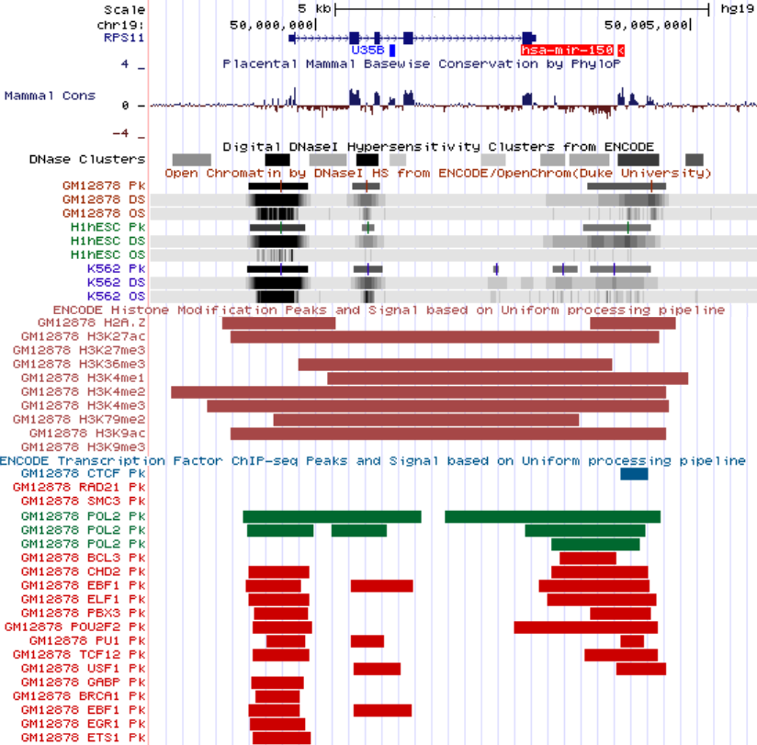
Characterization of non-coding RNAs
Figure 4. Mir-150 locus.

Slide 11
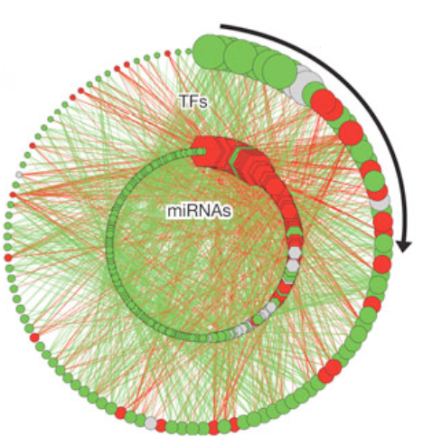
Decreasing out-degree for transcription factors
and miRNAs
Construct Regulatory Networks of exRNAs

Slide 12
DMRR DIAC Aim 5
Aim 5: Organize the Analysis Working Group (AWG), coordinate the consortium-wide analysis and the writing of the integrative analysis papers, and respond to the analysis needs of the consortium.
Export pipelines to the DCC for production of the exRNA Atlas database.
Lead the AWG and publish integrative analyses
Deliver analysis tools to the DCC for inclusion in the exRNA Toolset.
Distribute analysis tools as standalone software
Coordinate with the DCC and SOC on dissemination of all resources through the exRNA Atlas Portal.
Collect feedback from the ERCP and the community regarding tools and specific analysis needs and use the feedback to adjust our goals.

Slide 13
Open Questions for DIAC
Availability of representative RNA-Seq to develop exRNA-Seq pipelines.
Standards for consistency of RNA-Seq data generation
Read-length (paired-end vs single-end)
Depth of Sequencing
Spike-ins
Mapping strategies
Time scale for funding of Reference Profile Grant (RFA-RM-12-011)
Analysis Working Group?

