Slide 1
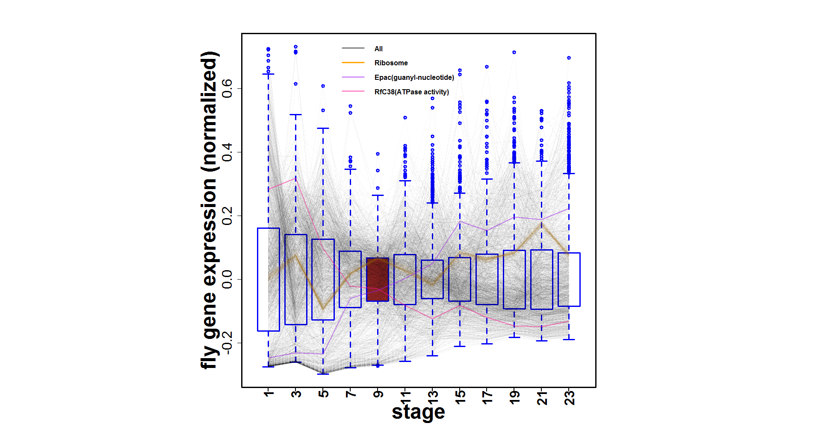
A
Conservation of module across number of species
C
phylotypic stage
human-worm-fly
1
worm-fly
19901 genes
worm-specific
gene-gene co-association
20377 genes
13623 genes
0
B

Slide 2
Fly genes in 16 modules

Slide 3
Fly genes in 12 hourglass modules

Slide 4
Fly eigengenes in 16 modules

Slide 5
Module | Worm | Fly | Human | 1-1-1 orthologs | ncRNAs (cor+anti-cor) |  |  | TARs (cor+anti-cor)
 |  |  |  |  | Human | Worm | Fly | Human | Worm | Fly
1 | 336 | 346 | 709 | 37 | 401+85 | 27+24 | 455+203 | 329+457 | 1726+188 | 253+300
2* | 158 | 159 | 197 | 58 | 804+148 | 5+14 | 237+189 | 954+216 | 43+969 | 131+992
3* | 65 | 65 | 66 | 45 | 549+24 | 14+14 | 190+173 | 217+325 | 10+1578 | 36+965
4* | 133 | 132 | 176 | 54 | 474+261 | 12+26 | 197+238 | 429+430 | 53+743 | 75+780
5* | 262 | 222 | 378 | 29 | 675+39 | 30+18 | 260+64 | 281+95 | 1333+216 | 652+72
6* | 55 | 52 | 65 | 25 | 634+46 | 14+22 | 109+139 | 634+216 | 30+4422 | 64+1184
7* | 269 | 253 | 268 | 135 | 1002+66 | 16+28 | 228+243 | 2229+582 | 137+4724 | 178+1940
8 | 35 | 37 | 30 | 17 | 86+28 | 18+13 | 40+43 | 55+112 | 3+3707 | 3+166
9* | 94 | 96 | 100 | 51 | 657+16 | 16+1 | 131+64 | 123+184 | 3+229 | 1+55
10* | 39 | 33 | 34 | 25 | 471+21 | 12+14 | 170+154 | 235+682 | 33+2116 | 30+1000
11* | 37 | 41 | 39 | 29 | 302+17 | 11+10 | 154+201 | 143+201 | 1+480 | 26+1251
12* | 42 | 38 | 48 | 19 | 185+5 | 7+20 | 79+185 | 522+25 | 23+3450 | 67+1513
13* | 75 | 80 | 73 | 17 | 607+15 | 13+17 | 160+203 | 422+362 | 2+1086 | 2+571
14 | 63 | 47 | 72 | 10 | 138+6 | 21+15 | 150+52 | 23+392 | 1147+65 | 4+249
15 | 41 | 38 | 32 | 18 | 159+6 | 7+21 | 104+115 | 189+53 | 34+2987 | 56+898
16* | 56 | 58 | 53 | 42 | 702+12 | 7+6 | 167+182 | 219+74 | 8+447 | 40+1027

