Slide 1
Variation in retroduplications (pseudogenes) within human population: summary and future directions
Alexej Abyzov

Slide 2
Paired-ends
Read sequencing
Studied genome
Deletion
Insertion
Tandem
duplication
Inversion
MEI
Reference genome
Read mapping
Mobile
element
sequence
library
Split-read
…
Read sequencing
Studied genome
Deletion
Insertion
Tandem
duplication
Inversion
MEI
Retroduplications
Reference genome
Read mapping
Read-depth
Genotyping
Read sequencing
Studied genome
Deletion
Duplication
Deletion
Insertion
Reference genome
Mapped read count
Breakpoint
sequence
library
…
Notes:
Insertions/deletion are extreme reference bias.

Slide 3
Retroduplication variation (RDV)
mRNA
Gene
Retroduplications
Reference
…
Person 1
…
Person 2
…
Known retroduplication
Person 3
…
. . .
Reference
…
Person 1
…
Person 2
…
Novel retroduplication
Person 3
…
. . .
mRNA
Abyzov et al., in press

Slide 4
Gene
Novel retroduplication
Read pairs
1 2 3 4
…
…
Reference
Alignment to
the reference
…
3
Evidence
from alignment
Unaligned reads
Aligned
reads
Splice-junction library
…
4
Evidence
from cluster
1
Abyzov et al., in press
…
1
2 3 4
Evidence from
read depth
Zero level
Notes:
Split-read and paired-end approaches

Slide 5
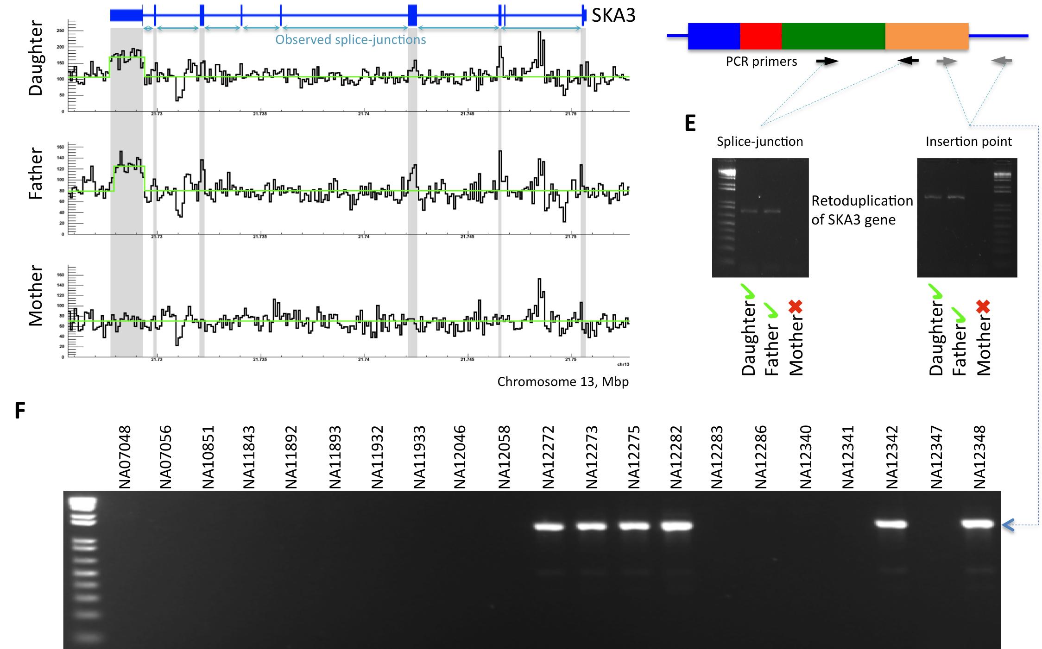
NA12878 (CEU)
Parent gene with predicted novel retroduplication | Additional support |  |  | PCR validation
 | Read depth support | Insertion point support | Found in Venter genome
CDC27 | Yes |  | Yes | UN
BCLAF1 | Yes |  | Yes | UN
LAPTM4B | Yes | Yes |  | Yes
MTCH2 |  |  |  | Yes
CBX3 | Yes | Yes | Yes | Yes
TMEM66 | Yes | Yes |  | Yes
TDG | Yes | Yes | Yes | Yes
BOD1 |  |  |  | Yes
CACNA1B |  | Yes |  | Yes
SKA3 | Yes | Yes |  | Yes
AP3S1 | Yes |  | Yes | Yes
AC131157 |  |  |  | N/A
AL590623 | Centromere
Populations
6-11 per person!
Abyzov et al., in press

Slide 6
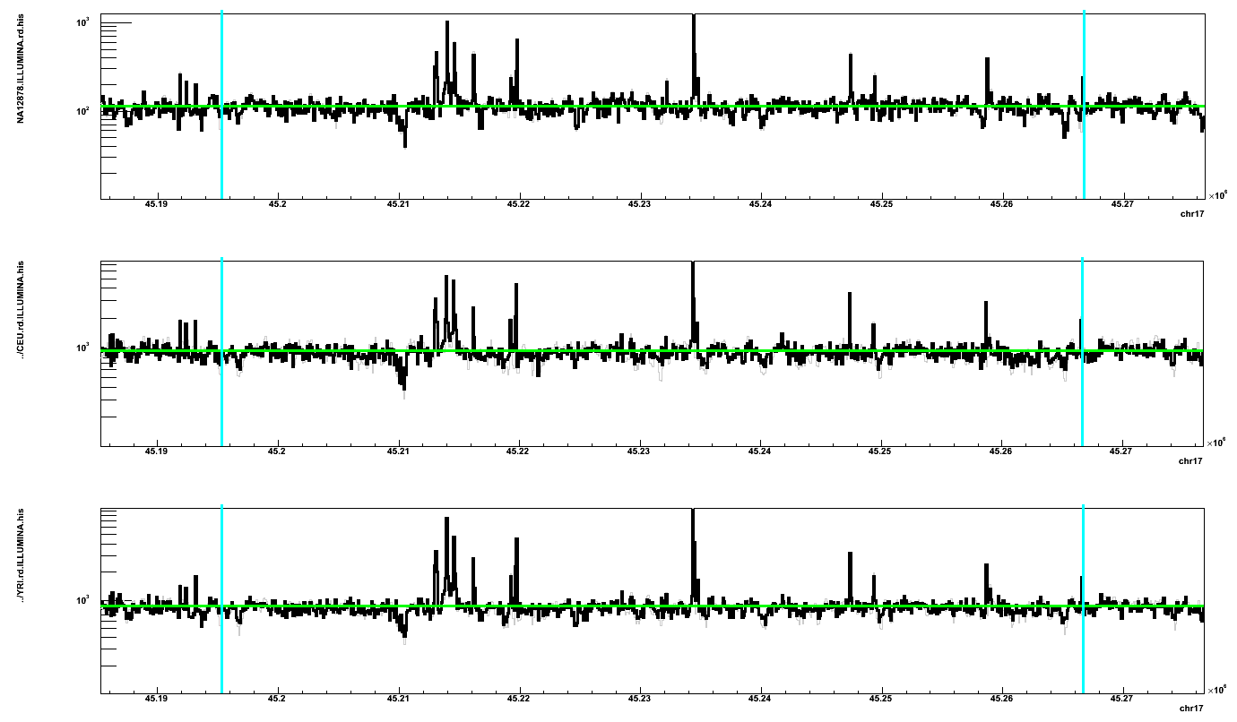
Supported slice-junctions
CDC27 gene
Known exons
Possible unknown exons
88 YRI samples 80 CEU sample NA12878 (CEU)
Chromosome 17, Mb
Histone marks
by ENCODE

Slide 7
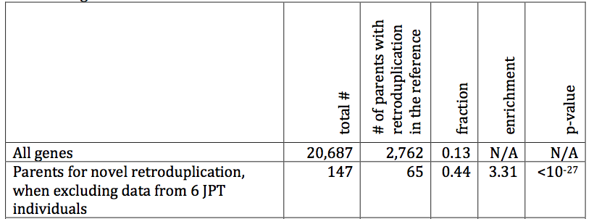
Buy one get one free!
Abyzov et al., in press

Slide 8
Hypothesis
Retrotransposition is coupled to cell division

Slide 9
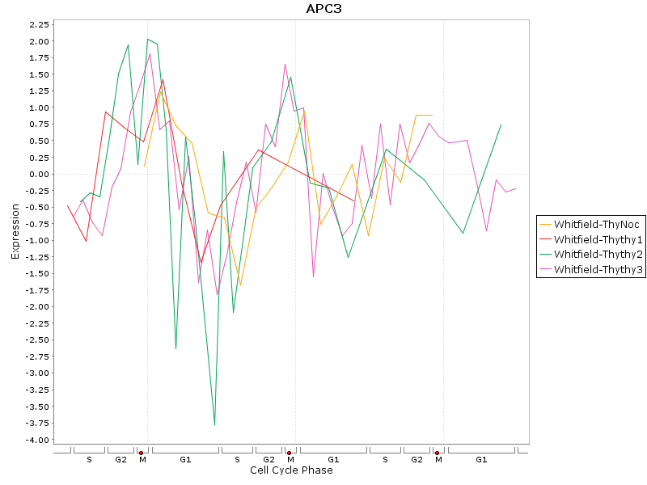
Periodic expression of CDC27 gene

Slide 10
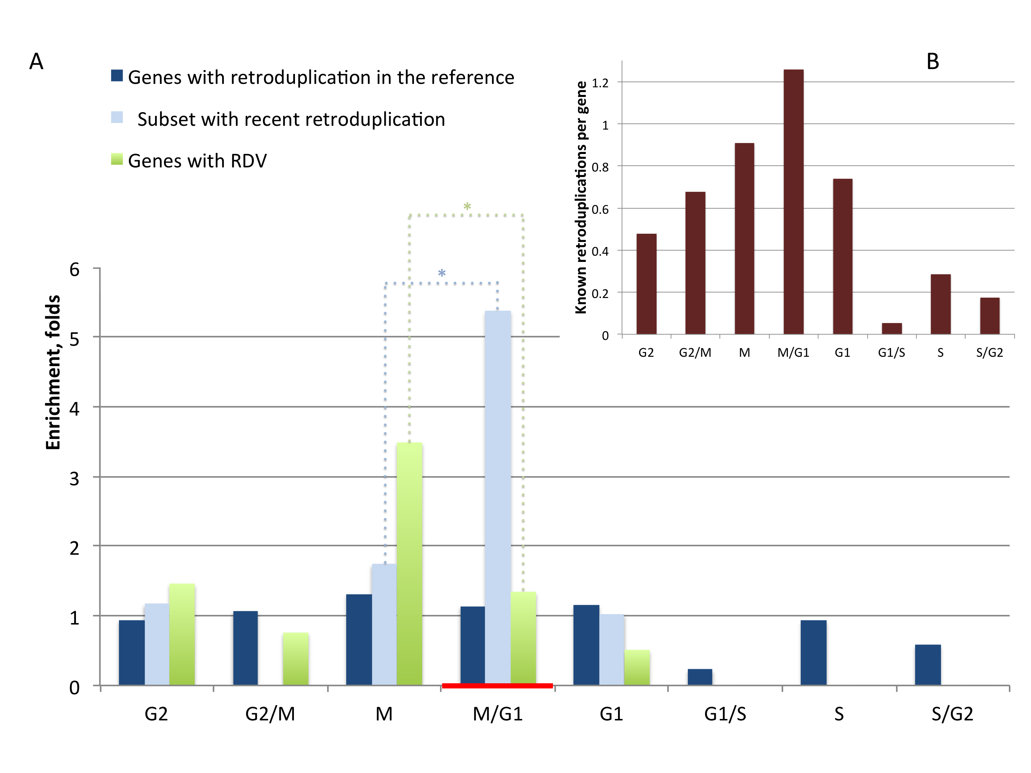
Hypothesis: retrotransposition is coupled to cell division (in germline)
Abyzov et al., in press

Slide 11
Future direction
Can be applied to exome data
Multiple (dozen of thousand) exome data are available
Various analyses
Can perform population based studies like with other variants
Can study features and properties of retrotransposition (e.g., distribution across genome, insertion sites)
Functional relevance (e.g., expressed not expressed)
Technical tasks
Adopt existing pipeline for exome data
Develop genotyping procedure
Identification of insertion sites
…
Perform discovery on apes and monkey and compare to human

Slide 12
Retroduplication variation (RDV)
mRNA
Gene
Retroduplications
Reference
…
Person 1
…
Person 2
…
Known retroduplication
Person 3
…
. . .
Reference
…
Person 1
…
Person 2
…
Novel retroduplication
Person 3
…
. . .
mRNA
Abyzov et al., in press

