Slide 1
CNVnator on phase III data
Alexej Abyzov & Mark Gerstein
Yale University

Slide 2
Processing
Calling per samples
Iteratively adjust bin size to have mean/sd > 4
Consider bins of 500, 1000, and 1500 bps
Samples that don’t satisfy the condition are skipped (=94)
Apply standard CNVnator procedure
Calling
Genotyping
Filtering
Around gaps in the reference genome
RD signal
Fraction of q0 reads
RP support
Using IRS to get a sense of quality

Slide 3
NA12878 (CEU)
98 samples with calls/genotypes in CEU population
272 deletions
204 pass filter
101 ascertained by IRS
12 have p-value > 0.5
89 have p-value < 0.5
96 duplications
58 pass filter
30 ascertained by IRS
2 have p-value > 0.5
28 have p-value < 0.5

Slide 4
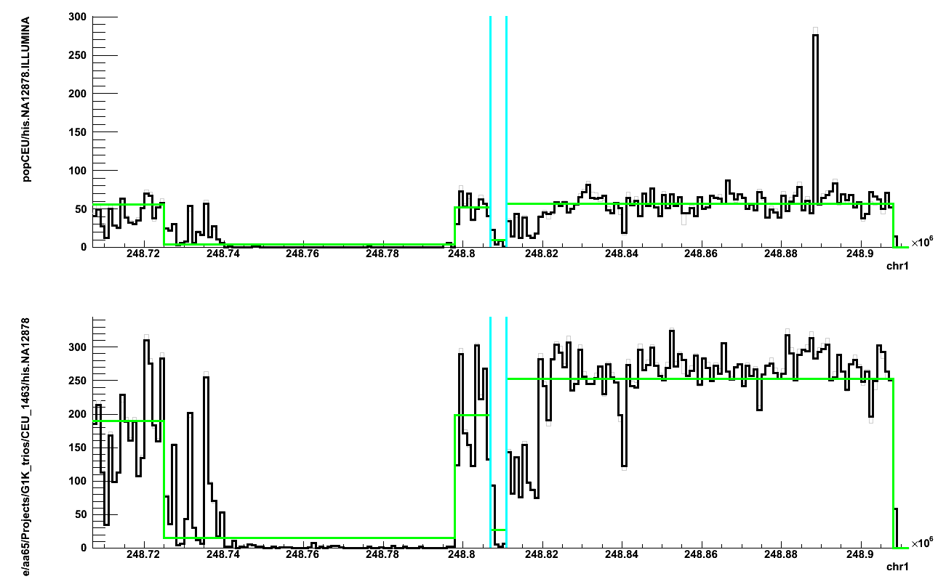
chr1:248807001-248811000 del in 69 (70%) samples
False positive?
HiSeq
MiSeq

Slide 5
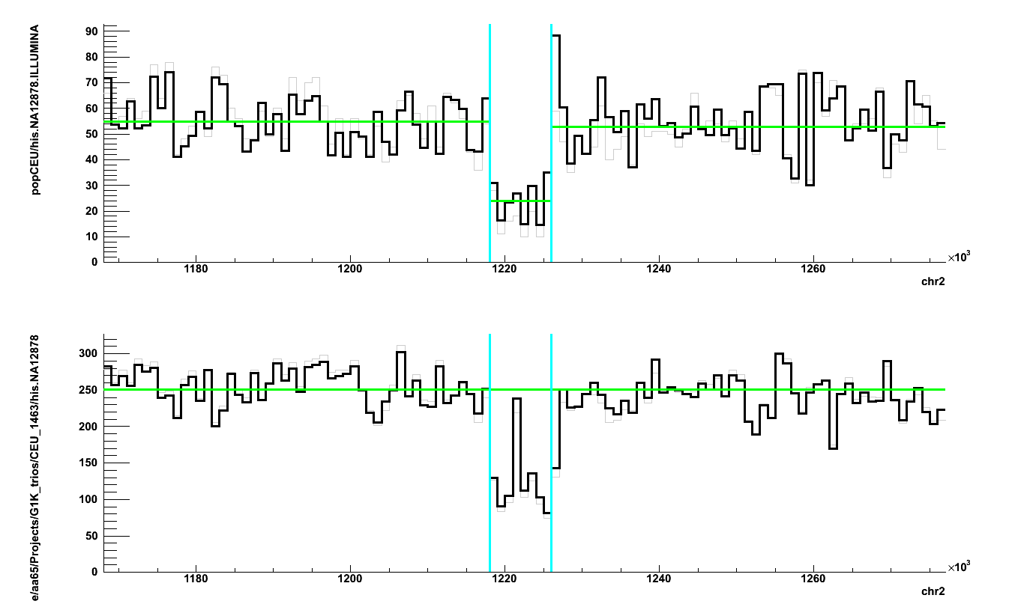
chr2:1218001-1226000 del in 86 (88%) samples
HiSeq
MiSeq

Slide 6
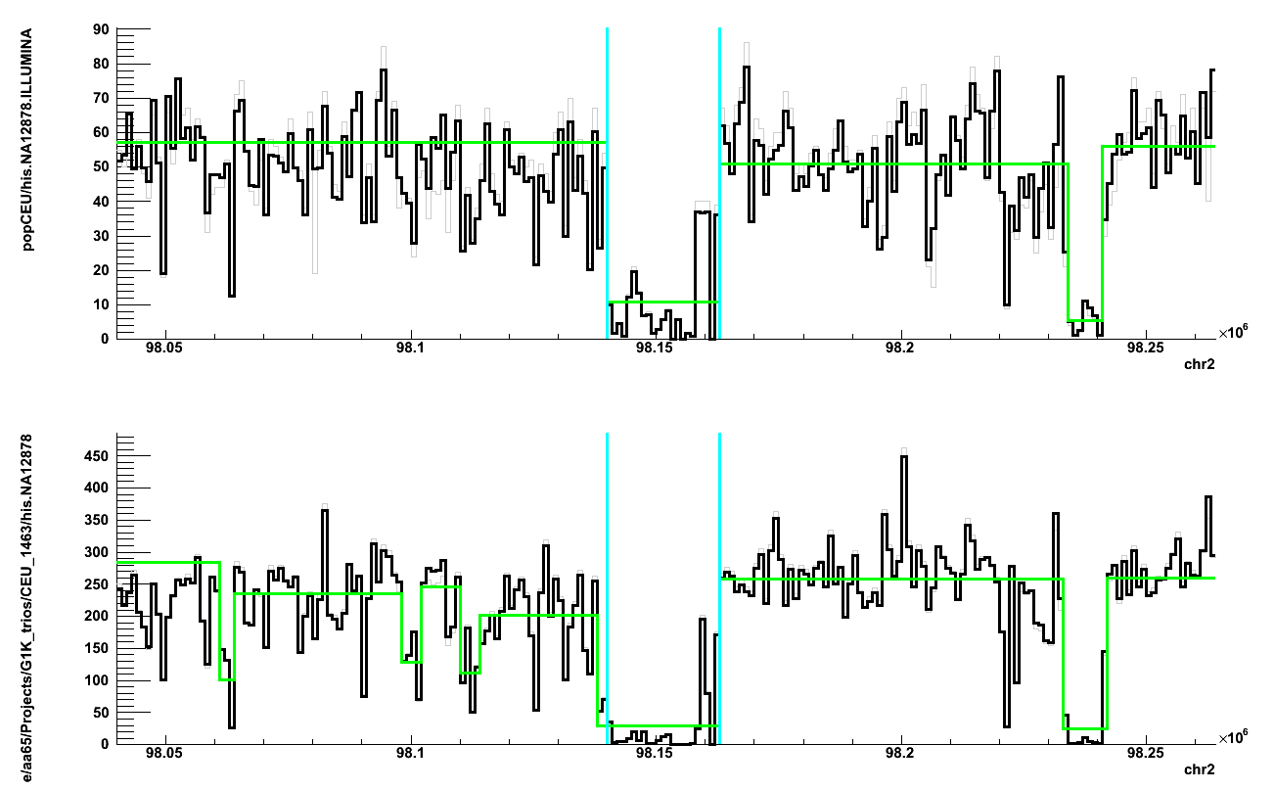
chr2:98140001-98163000 del in 75 (76%) samples
HiSeq
MiSeq

Slide 7
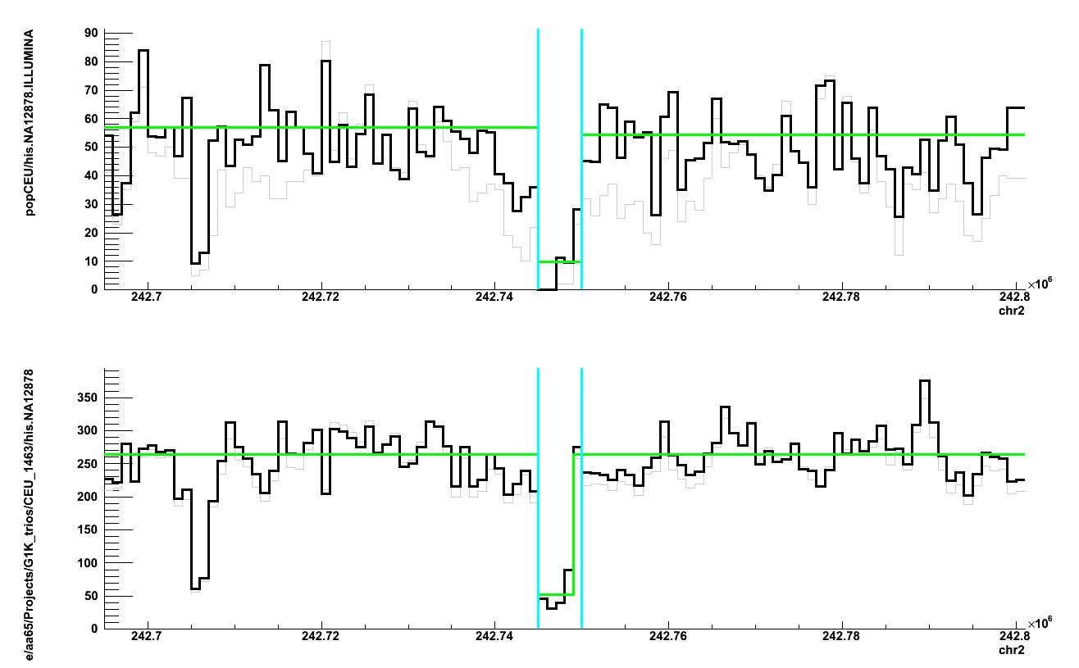
chr2:242745001-242750000 del in 98 (100%) samples
HiSeq
MiSeq

Slide 8
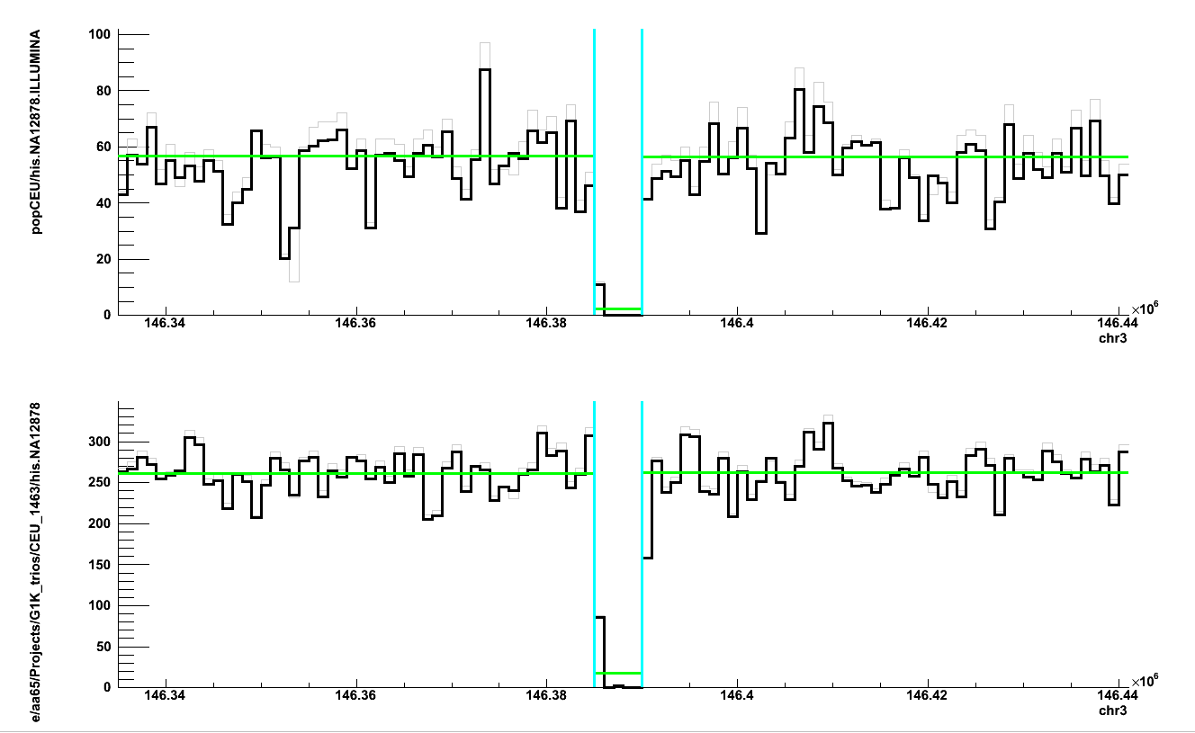
chr3:146385001-146390000 del in 88 (90%) samples
HiSeq
MiSeq

Slide 9
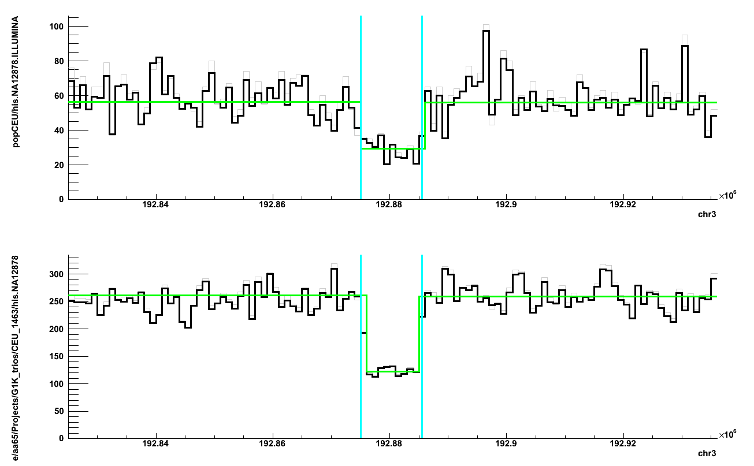
chr3:192875046-192885514 del in 87 (89%) samples
HiSeq
MiSeq

Slide 10
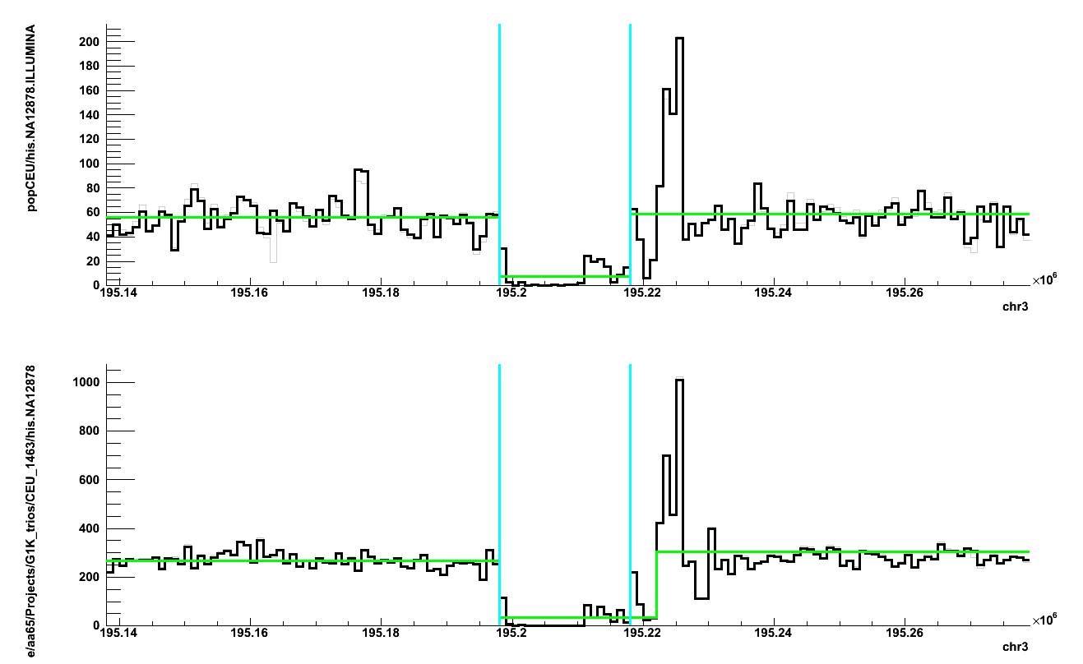
chr3:195198001-195218000 del in 76 (77%) samples
HiSeq
MiSeq

Slide 11
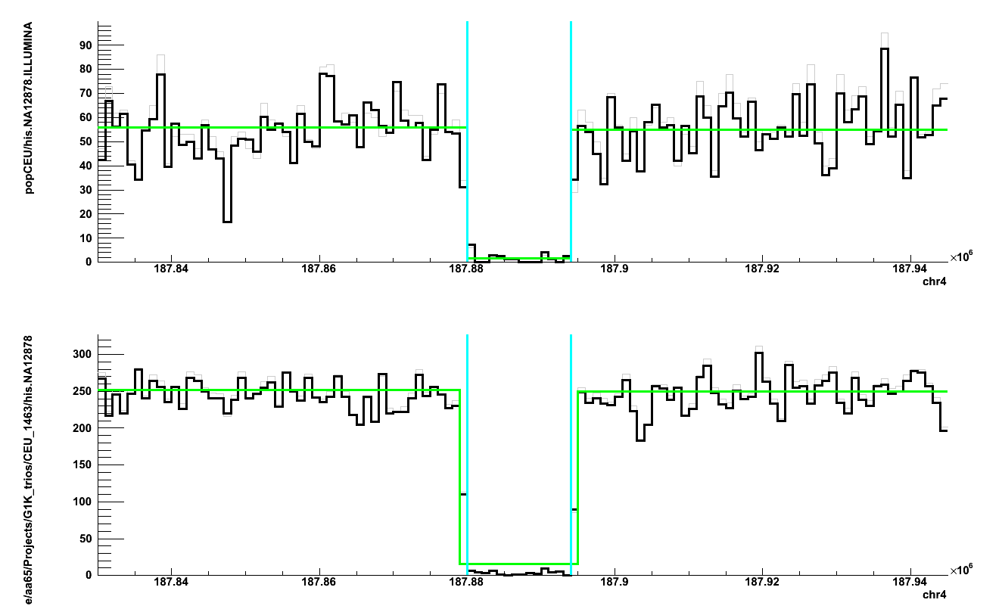
chr4:187880001-187894000 del in 83 (85%) samples
HiSeq
MiSeq

Slide 12
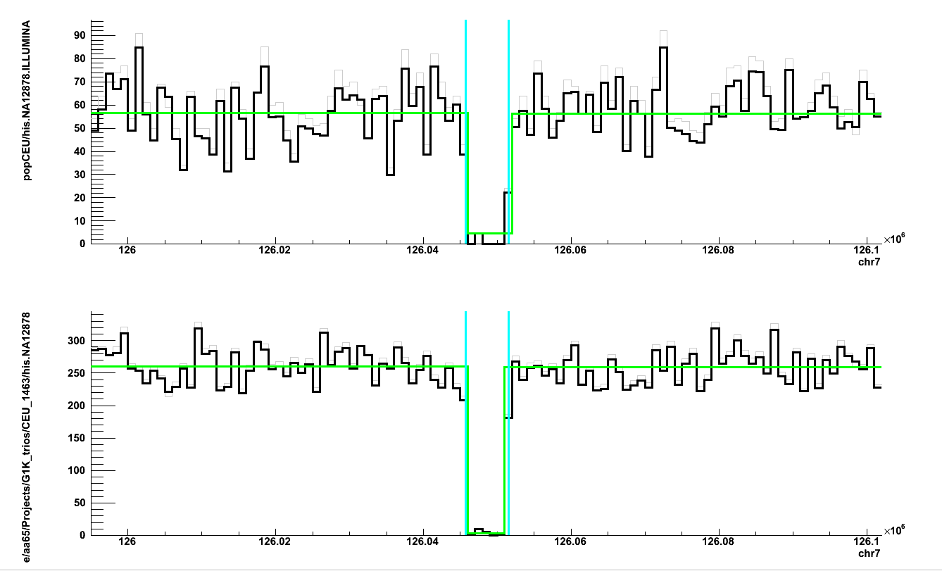
chr7:126045733-126051546 del in 70 (71%) samples
HiSeq
MiSeq

Slide 13
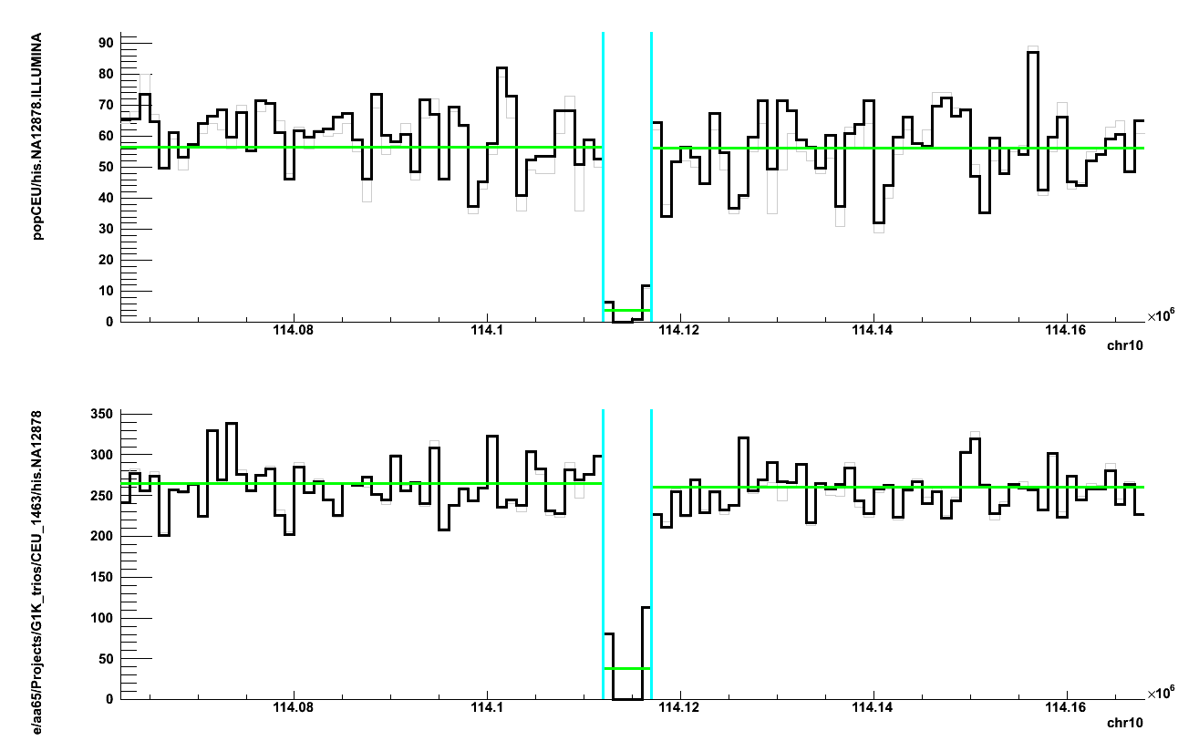
chr10:114112001-114117000 del in 69 (70%) samples
HiSeq
MiSeq

Slide 14
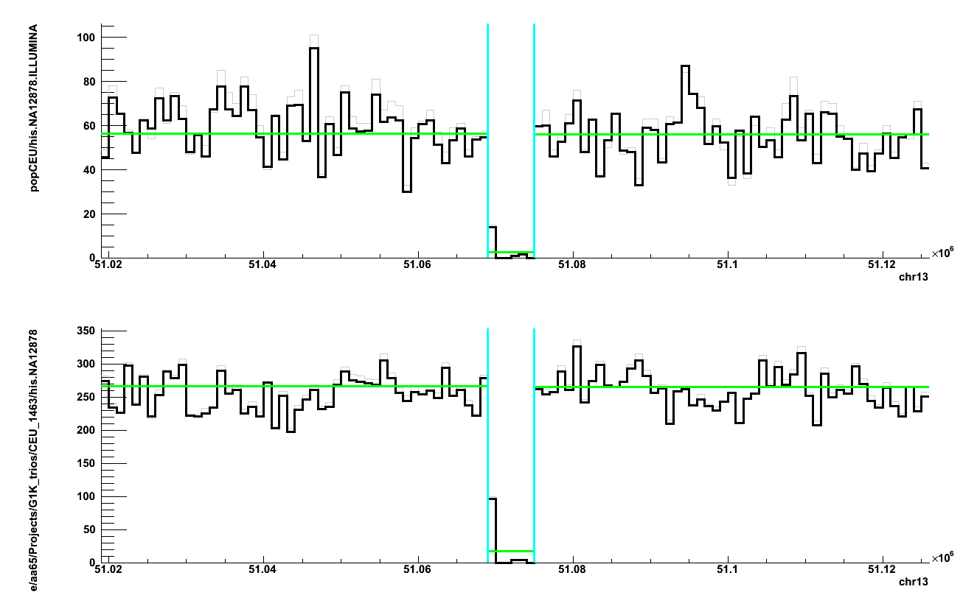
chr13:51069001-51075000 del in 93 (95%) samples
HiSeq
MiSeq

Slide 15
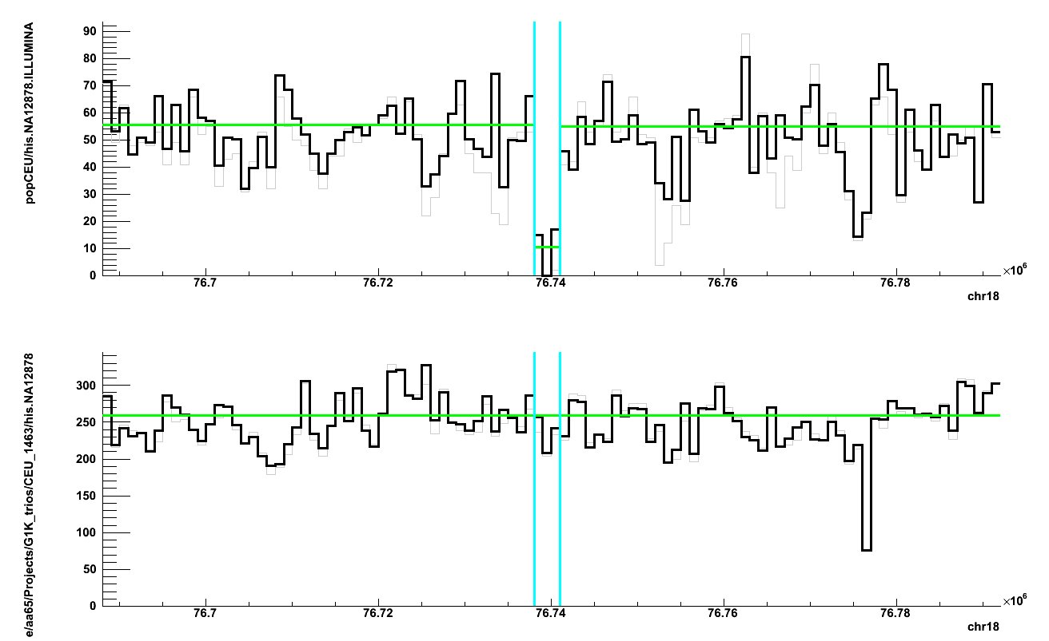
chr18:76738001-76741000 del in 58 (59%) samples
HiSeq
False positive
MiSeq

Slide 16
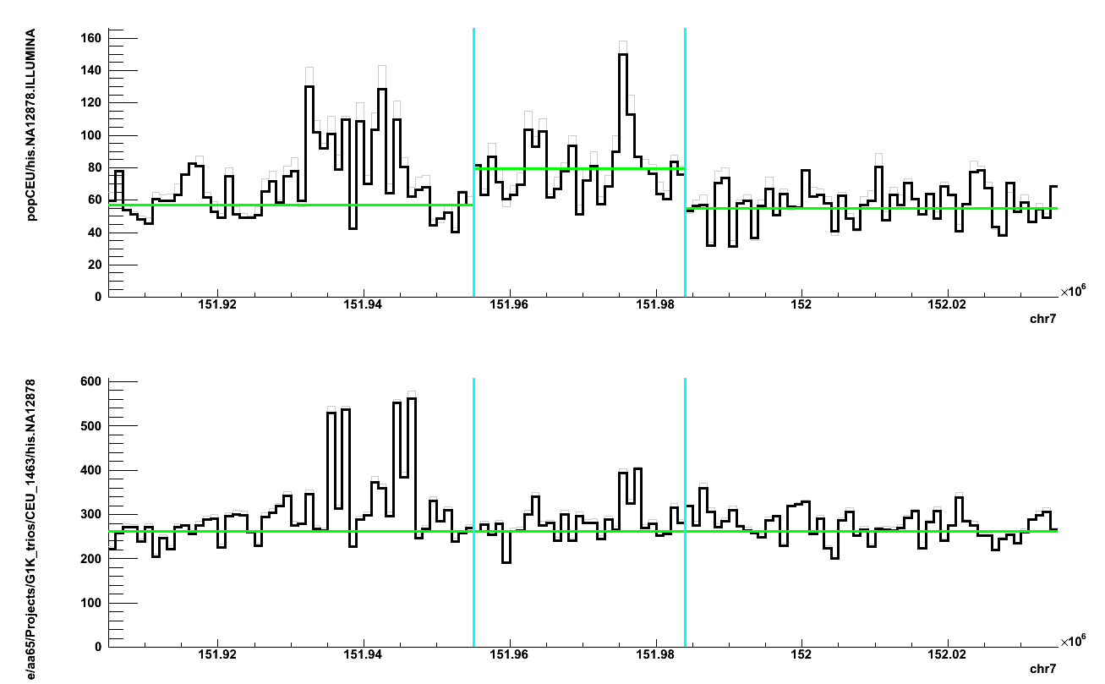
chr7:151955001-151984000 dup in 42 (43%) samples
HiSeq
False positive
MiSeq

Slide 17
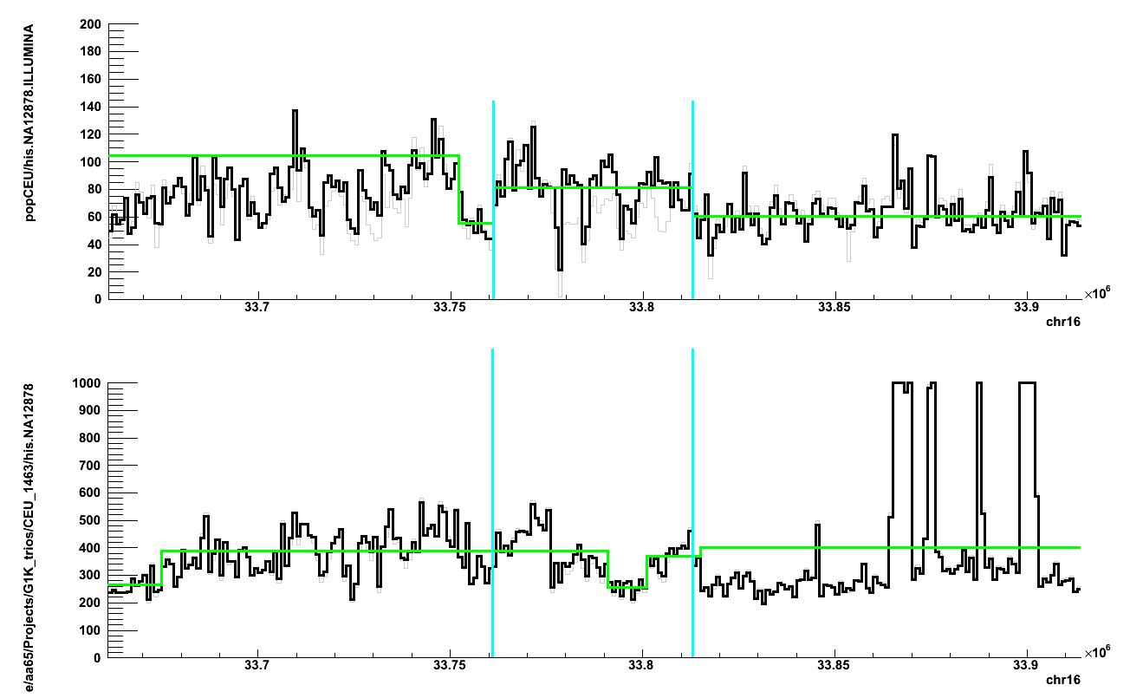
chr16:33761001-33813000 dup in 32 (33%) samples
HiSeq
False positive
MiSeq

Slide 18
NA12878
For deletions IRS seems to be biased against frequent events
For duplications IRS seems to be fine (possibly, because there are not frequent duplications)
~4% of deletion calls seem to be FP
~10% of duplication calls seem to be FP

Slide 19
On populations
Samples from the following populations don’t have probes on omni array:
BEB, ESN, GWD, ITU, MSL, PJL, STU

Slide 20
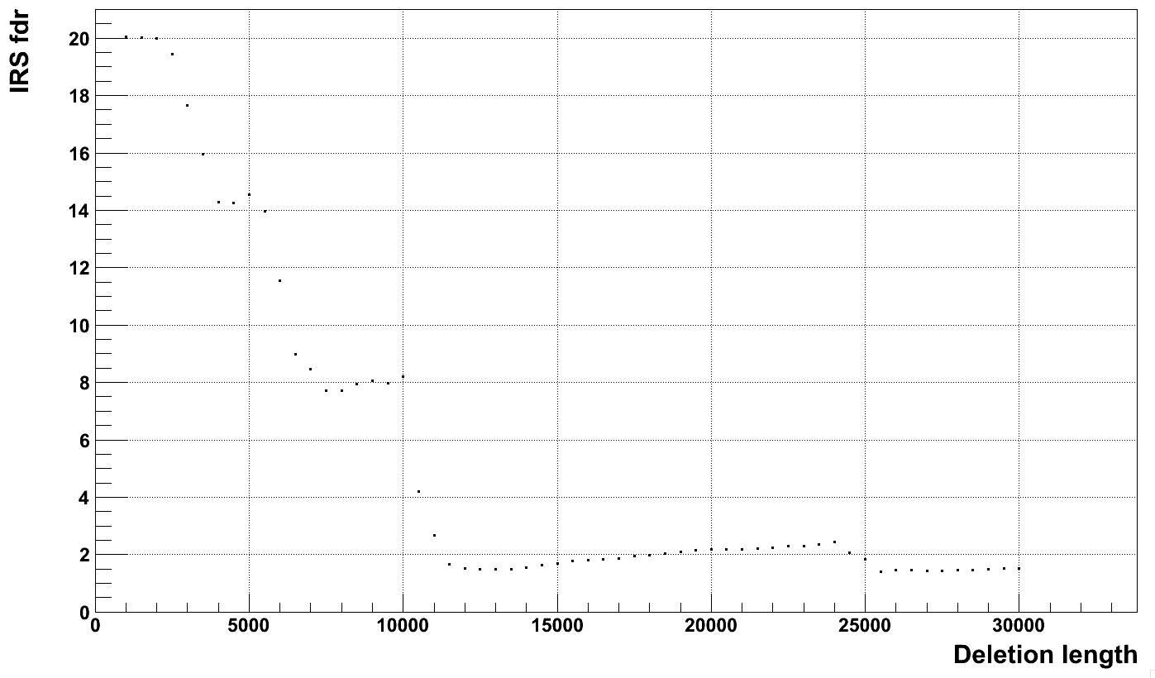
IRS fdr for deletions with PE
~70% of dels with p-val > 0.5
overlap dels with p-val < 0.5

Slide 21
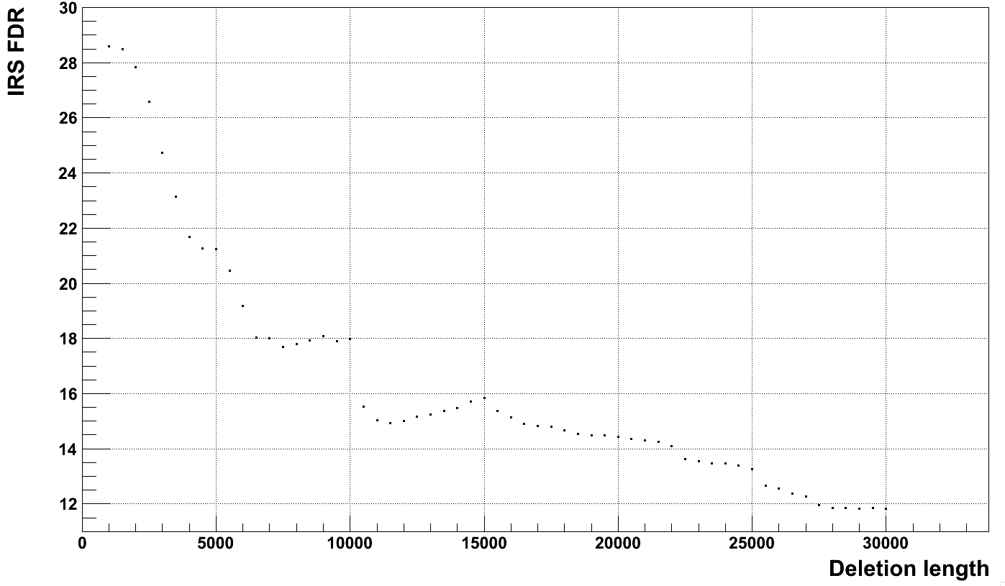
IRS fdr for deletions with q0 < 0.5

Slide 22
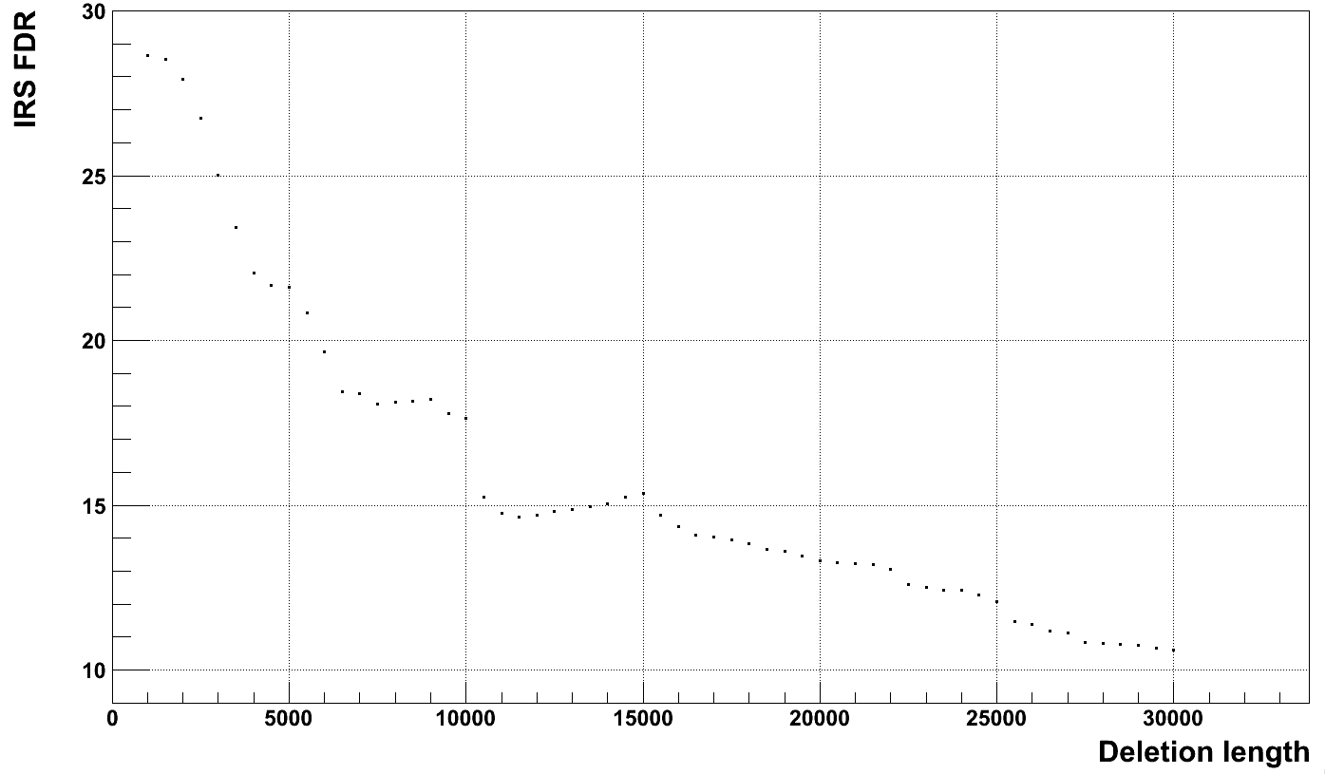
IRS fdr for deletions with consideration of RD and q0

Slide 23
Filtering & merging
Filtering
q0 < 0.5 && len > 6 kpb
rd*(1 + q0) < 0.75 && len > 10 kbps for del
rd*(1 – q0) > 1.25 && len > 10 kbps for dup
with PE support && len > 4 kpbs
with IRS p-value < 0.01
Merging
80% reciprocal overlap
p-val_{irs}=min(p-val of merged calls)
CONF
PASS

Slide 24
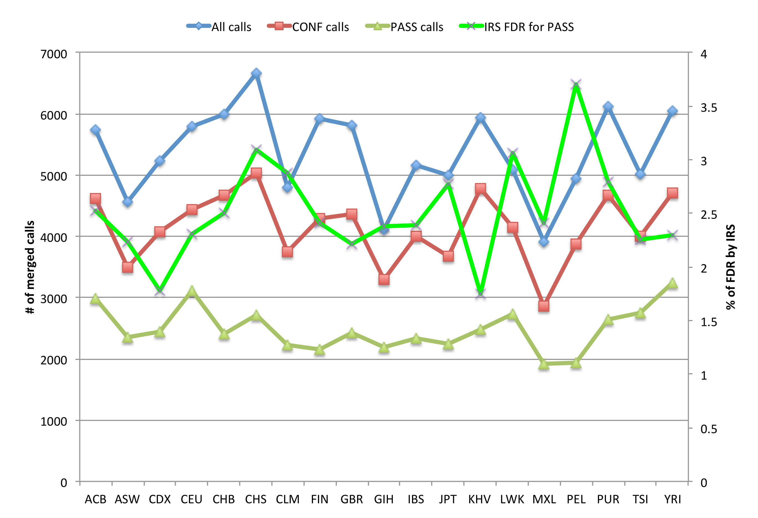
Merged by population

Slide 25
Next
Additional filtering of bad samples, i.e. those that seem to have high overall FDR
Filtering refinement
Merging all calls?

