Slide 1
Pgenes of GENCODE Cancer Genes

Slide 2
Data
Sanger Cancer Genes
418 genes manually annotated for their involvement in cancer
GENCODE/Pseudopipe pgenes
Focus on GENCODE
Transcription data from ENCODE cell lines
Analyzed by Baikang

Slide 3
Are pgenes enriched for cancer gene parents?
YES: Fisher’s exact p-value = 7*10⁻⁶

Slide 4
Are cancer genes enriched for being pgene parents?
YES: Fisher’s exact p-value = 10⁻⁶

Slide 5
Are cancer pgenes enriched for being transcribed?
yes, but more mildly: Fisher’s exact p-value = 0.003

Slide 6
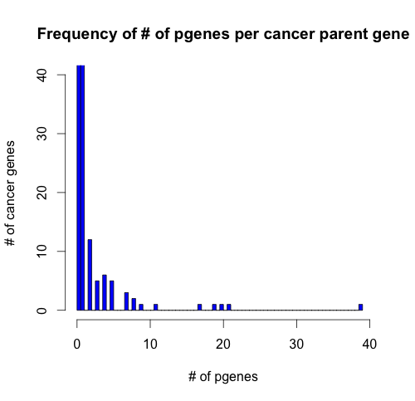
Distribution of pgenes across cancer gene parents

Slide 7
Cancer genes with many pgenes
DUX4 11
SET 17
COX6C 19
CIC 20
RPL22 21
Ribosomal protein
5 transcribed pgenes
NPM1 39
Nucleophosmin, involved in exRNA
4 transcribed pgenes

Slide 8
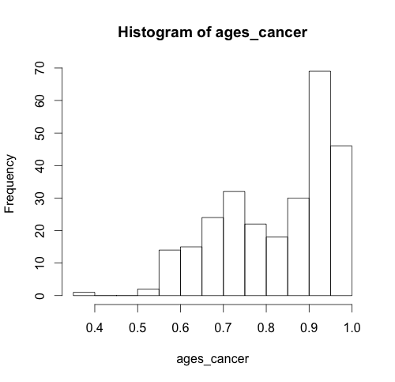
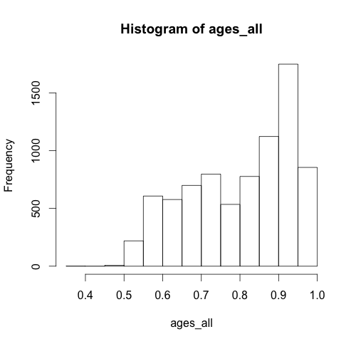
Ages of cancer pgenes

Slide 9
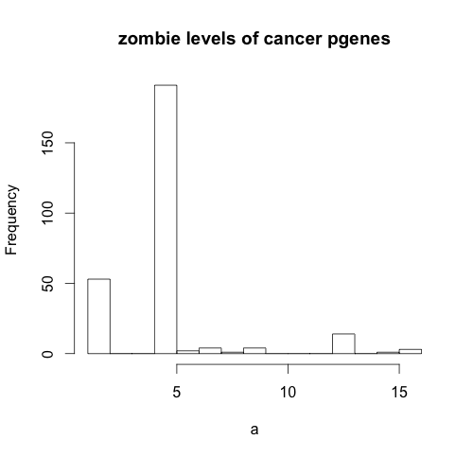
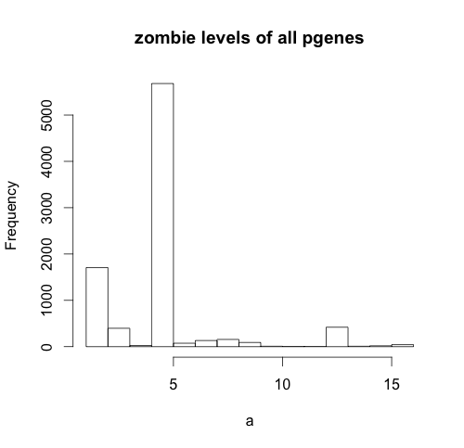
Zombie levels of Cancer Pgenes
Cancer pgenes are not more active than other pgenes (p = 0.14)

Slide 10
Highly Active Cancer Pgenes
Pgene | Parent | Expression Correlation | Age
ENST00000531139.1 | SRSF8 (splicing factor) | 0.25 | 0.84
ENST00000474389.1 | acyl-coA synthase | 0.38 | 0.84
ENSG00000171862.5 | PTEN | 0.84 | 0.99 (UTR match is perfect)
ENSG00000116251.5 (no pol2 binding) | RPL22 | 0.71 | 0.92

Slide 11
Are pseudogenes ceRNAs (like PTENp1)?
ceRNA = competing endogenous RNA
pgene titrates miRNA away from mRNA
Must have reasonably high expression level, relative to parent gene

Slide 12
Future directions
Variation data
Are cancer pgenes more conserved?
Is there a relationship between activating cancer mutations in parent and inactivating mutation in pgene?
Chromatin/TF marks
Are cancer pgenes enriched for active chromatin marks?
Expression
Look at levels of expression, not just cutoff
More cancer lines/differential expression in cancer vs. normal?
Notes:
----- Meeting Notes (8/27/13 17:55) -----
-Also orthologs in mouse/macaque and see if they also have pgenes
-

