Slide 1
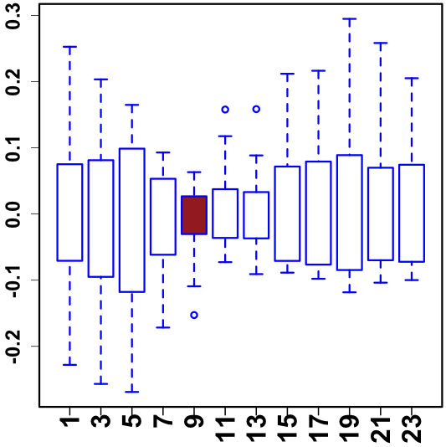
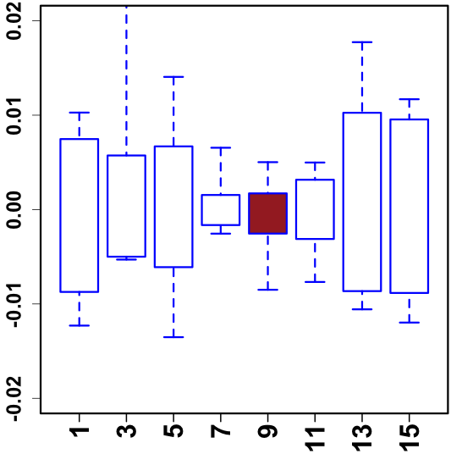
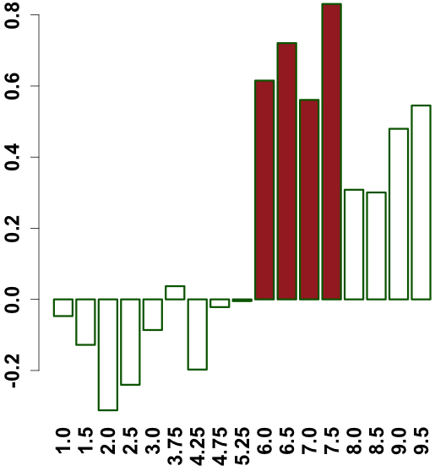
A
Conservation of module across number of species
C
phylotypic stage
human-worm-fly
1
worm-fly
19901 genes
worm-specific
gene-gene co-association
Expression across modules in fly
20377 genes
Expression of a module across 6 fly species
13623 genes
0
B
Median expression correlation across modules in worm
Stage (hour)

Slide 2
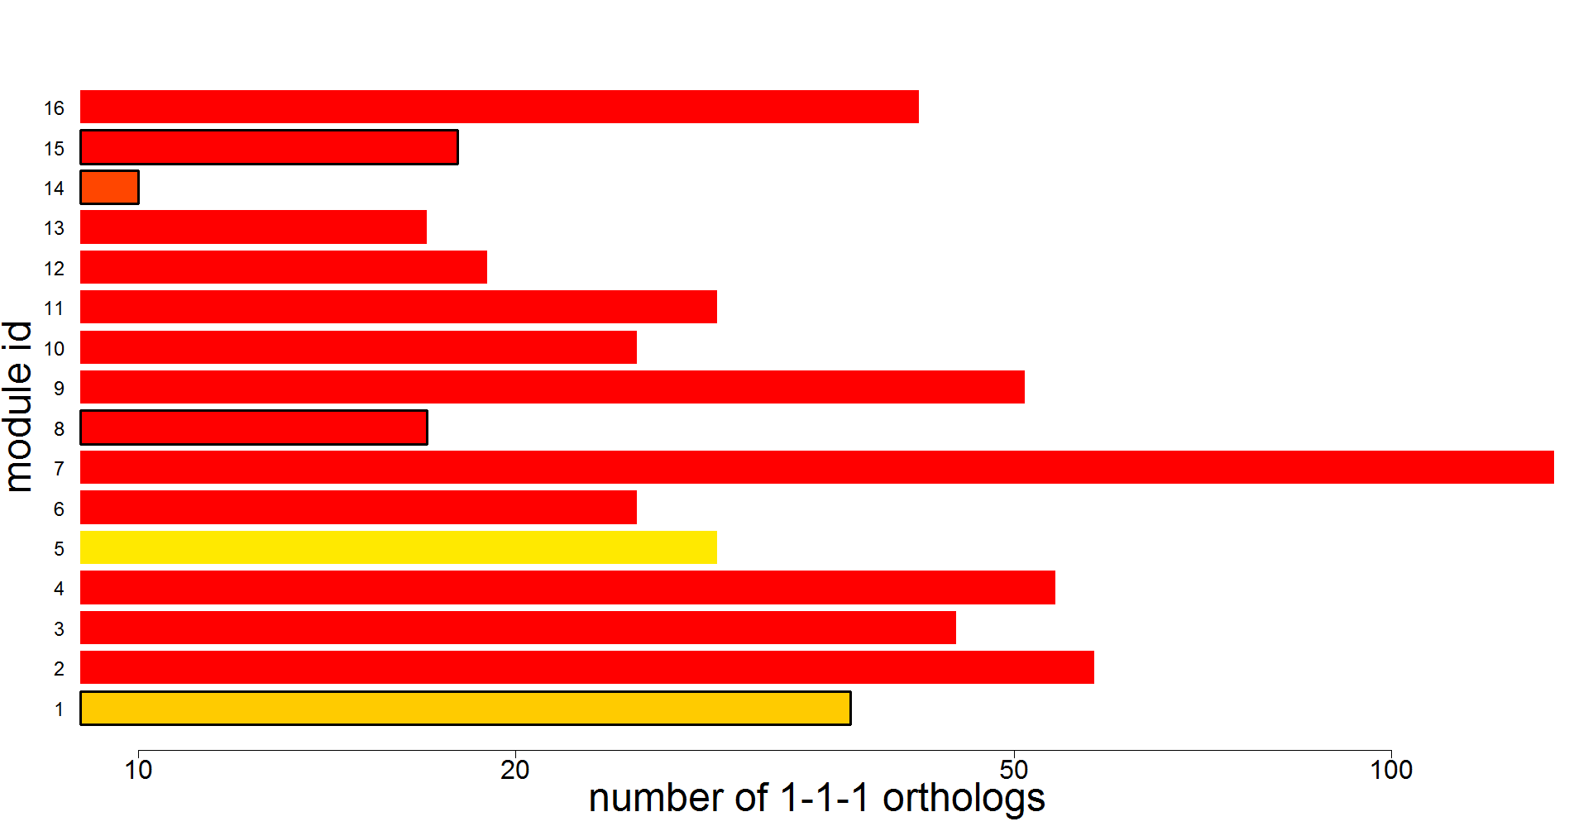
p-value of 1-1-1 ortholog enrichment
non hourglass module
ncRNA processing
nervous system development
cilium assembly
mitochondrion
DNA replication
peptidyl-histidine
splicing
ribosome
protein catabolic process
RNA processing
regulation of cell cycle
neurotransmitter biosynthetic process
ubiquitin binding
neurogenesis
RNA methyltransferase activity
morphogenesis

Slide 3
