Slide 1
Humans & Other Organisms - a pseudoStory
Cristina Sisu
BP, SB, JJL, YZ
15th August 2013
Pseudogene Slide Pack

Slide 2

The Circle of Life?

Slide 3
The Circle of pseudoLife.
Gene
Pseudogene
DEAD Genomic Element
Exclusion from the genome
ALIVE ncGenomic Element
Proto Gene
ncRNA
Regulatory
Circuit

Slide 4
Approach
Annotation
Activity
Function
Pseudopipe
Manual annotation
Pseudogenesis
Localization
Activity features
  Transcription
  Pol2
  Chromatin
Family & Orthology
Pseudogene biology
Conservation
Coexpression

Slide 5
Annotation

Slide 6
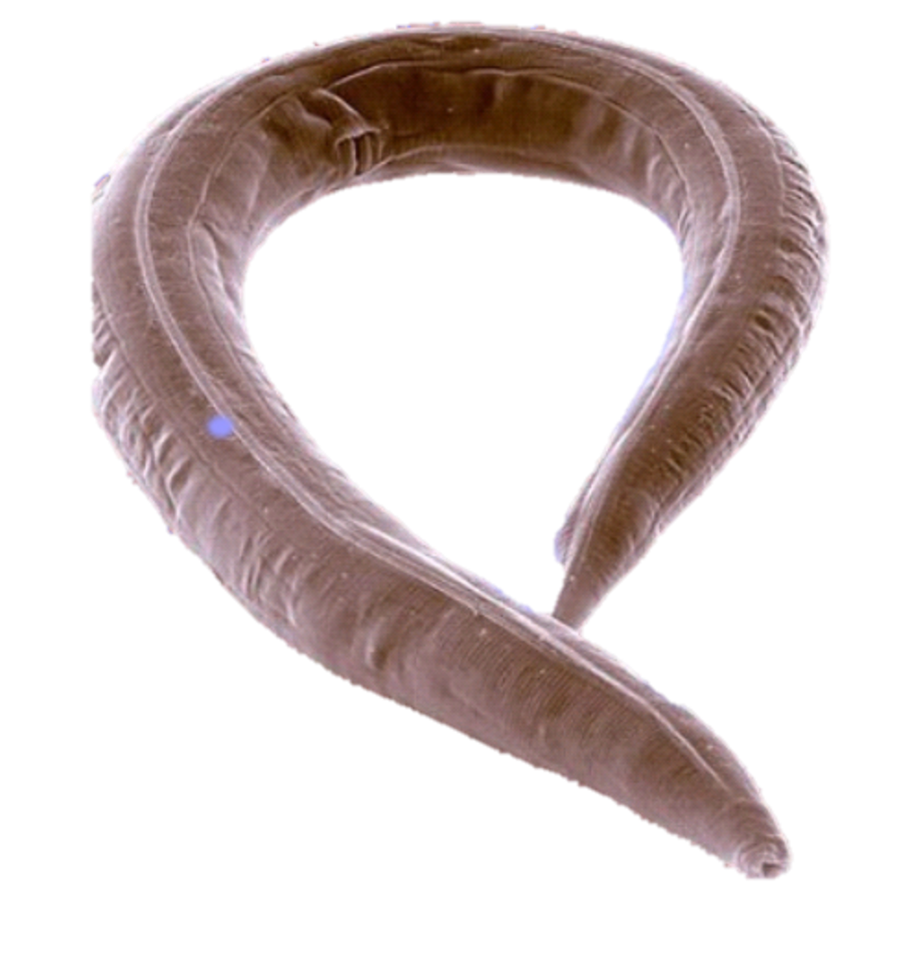
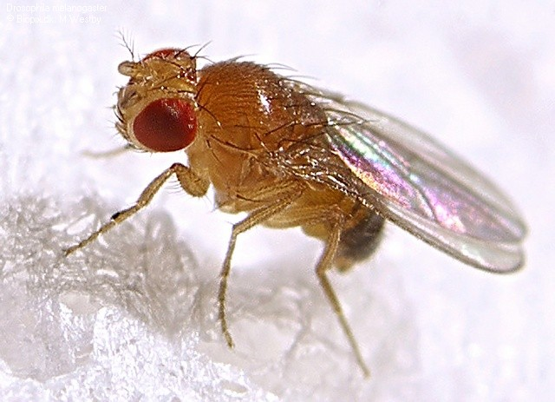
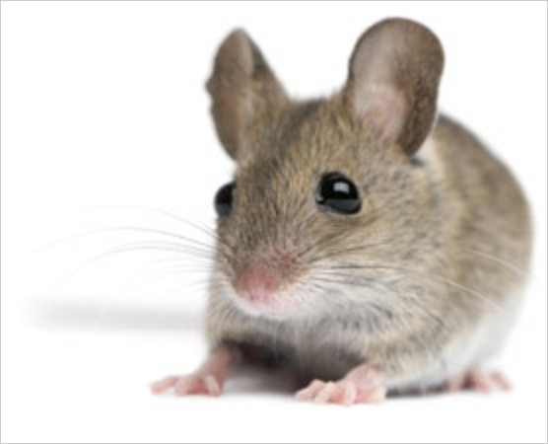
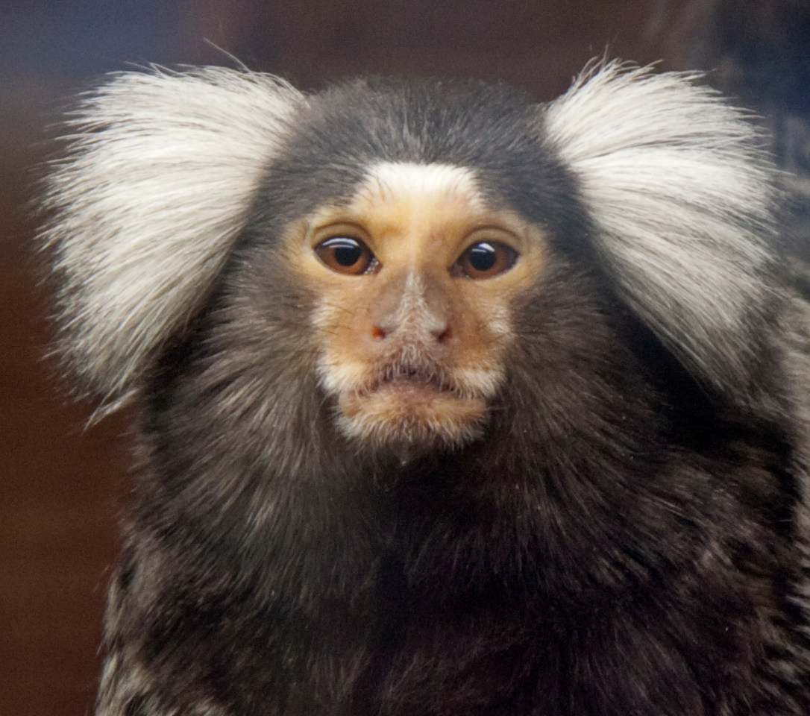
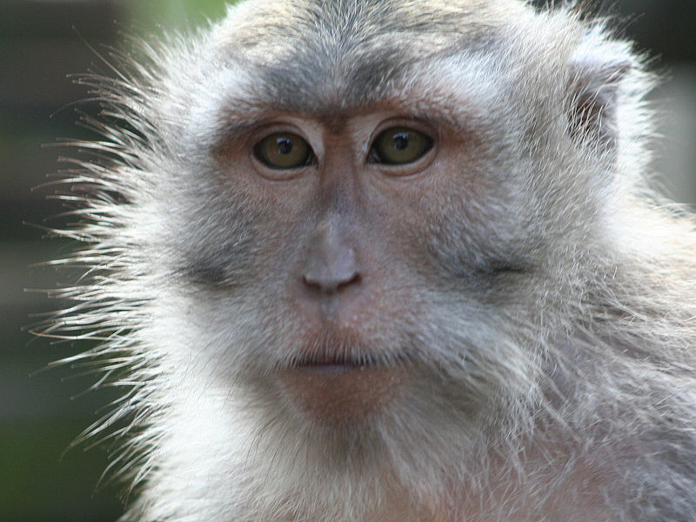
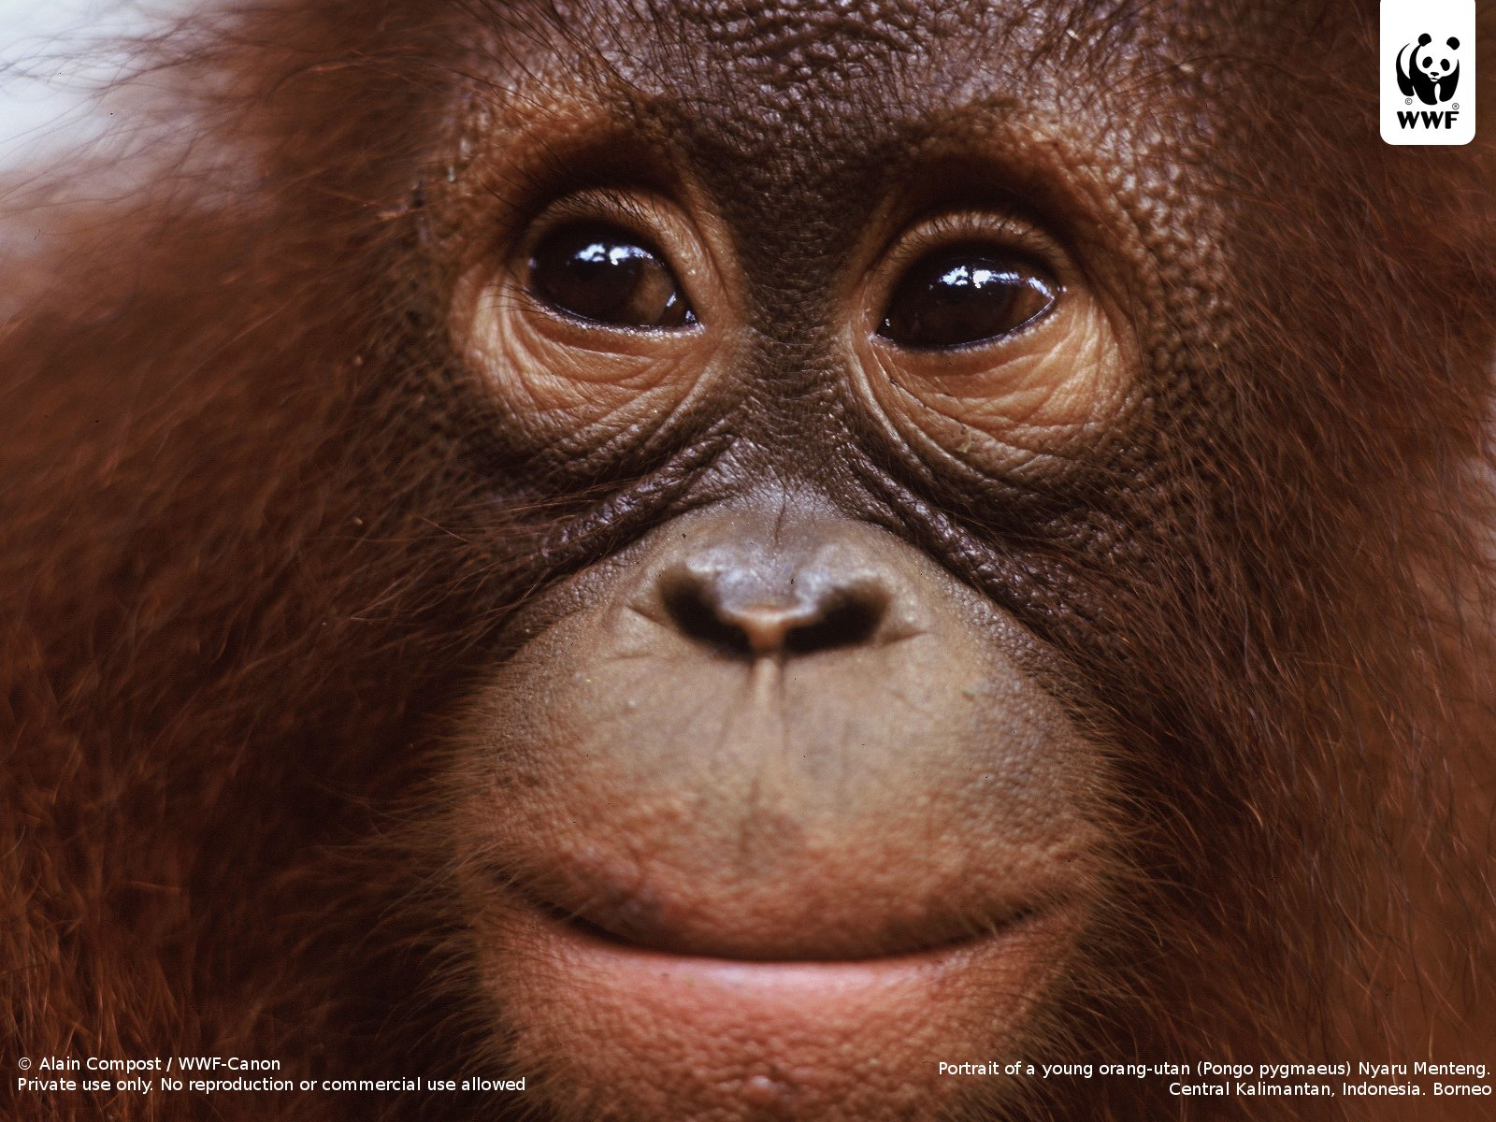
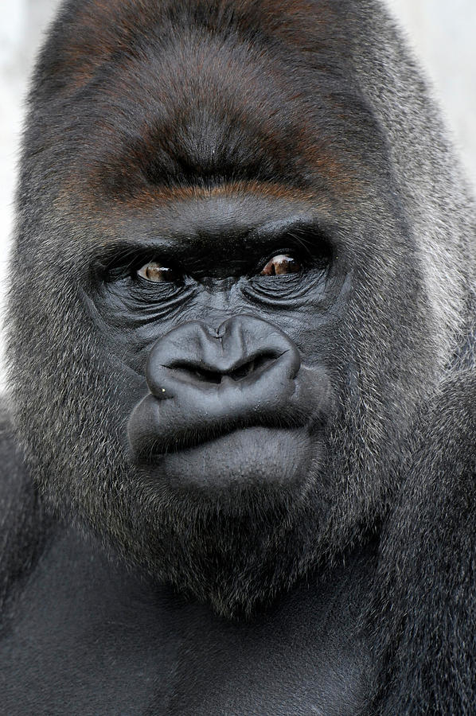
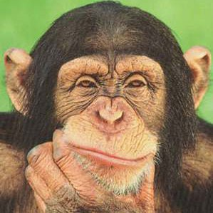
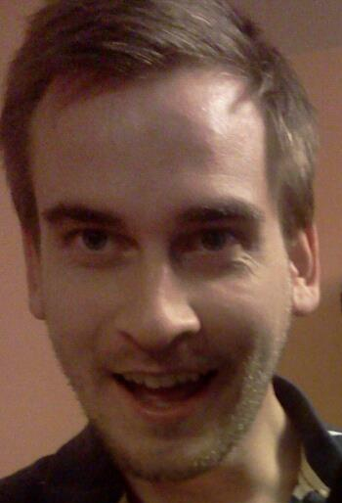
Data Availability
Human, Worm & Fly – manual & automated annotation
Chimp, Gorilla, Orangutan, Macaque, Marmoset & Mouse – PseudoPipe Annotation
Worm
Fly
Marmoset
Macaque
Orangutan
Chimpanzee
Mouse
Gorilla
Human

Slide 7
Biotype Distribution
Organism | #Pgenes
Human | 11216
Chimp | 14933
Gorilla | 16330
Orangutan | 16861
Macaque | 13435
Marmoset | 29668
Mouse | 15887
Worm | 911
Fly | 145
Duplicated
Processed
Other*

Slide 8
Biotype Distribution
UPDATE
NEW
UPDATE
NEW
Duplicated
Non Duplicated
Organism | #Pgenes
Human | 11216
Chimp | 14933
Gorilla | 16330
Orangutan | 16861
Macaque | 13435
Marmoset | 29668
Mouse | 15887
Worm | 911
Fly | 145
Notes:
----- Meeting Notes (15/08/2013 16:56) -----
redo with calculating the false positive for human and extrapolate for the mammals

Slide 9
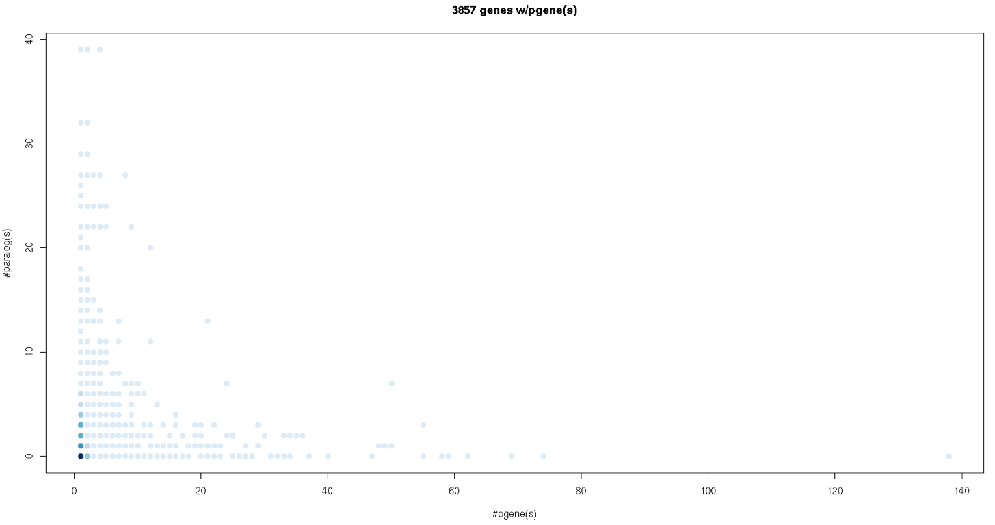
Parent/Pgene/Paralog
- Human -
UPDATE
NEW
JJL Presentation
Notes:
----- Meeting Notes (15/08/2013 16:56) -----
highlight parts of the slide

Slide 10
Repeats
UPDATE
NEW
PSSD pgenes created by repeats
repeat exaptation in : new ncRNAs, new exons, retro-genes
regulatory elements, species/lineage-specific sequences enrich for certain repeats
JJL Presentation

Slide 11
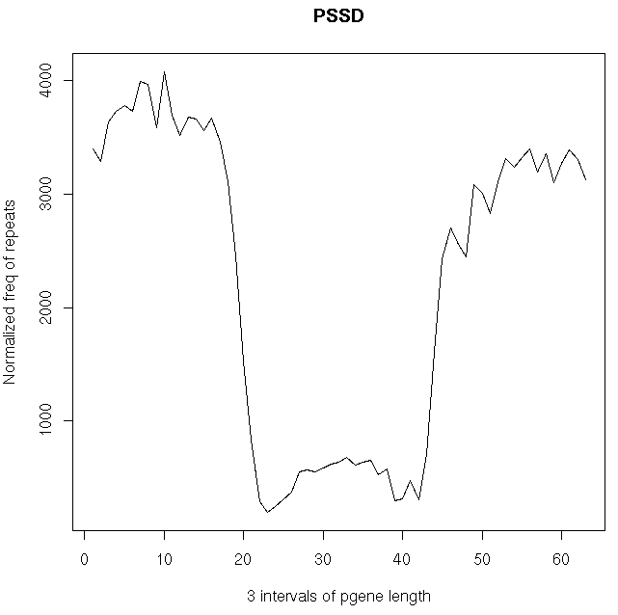
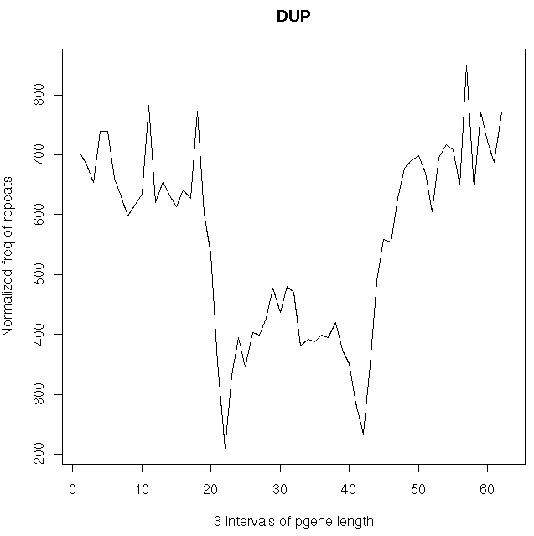
UPDATE
NEW
JJL Presentation

Slide 12
UPDATE
NEW
RNA type | #transcripts | #transcripts w/ repeat | %transcripts w/ repeat | %seq w/repeat
lincRNA | 3129 | 2563 | 0.819 | 31.261
miRNA | 1771 | 1108 | 0.626 | 56.241
pseudogene | 15614 | 4655 | 0.298 | 7.011
PSSD pgene | 9691 | 2318 | 0.239 | 5.214
DUP pgene | 2429 | 515 | 0.212 | 2.531
protein-coding | 122955 | 63063 | 0.513 | 6.498
CDS | 84405 | 17615 | 0.209 | 1.279
UTR | 82302 | 38645 | 0.470 | 11.301
JJL Presentation

Slide 13
Biotype Timeline
Human
Worm
Fly
Chimpanzee
Gorilla
Orangutan
Macaque
Marmoset
Mouse

Slide 14
Biotype Timeline
UPDATE
NEW
Human
Worm
Fly
Chimpanzee
Gorilla
Orangutan
Macaque
Marmoset
Mouse
Notes:
----- Meeting Notes (15/08/2013 16:56) -----
redo slide and reconcile the chimp
fraction
maybe just the number
human, average primate, mouse, worm, fly

Slide 15
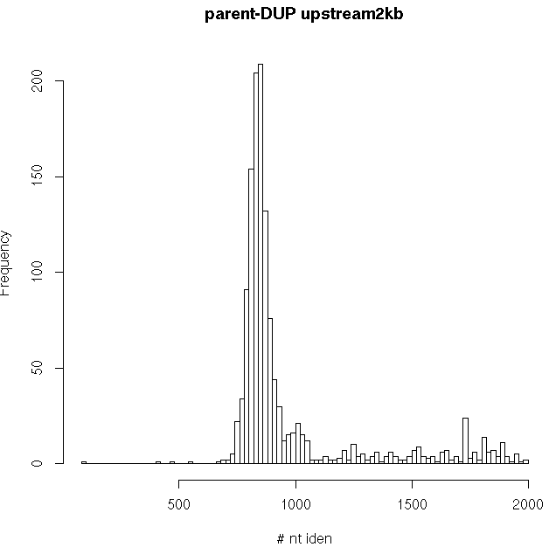
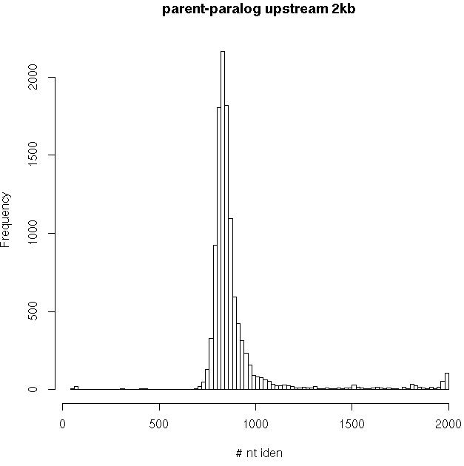
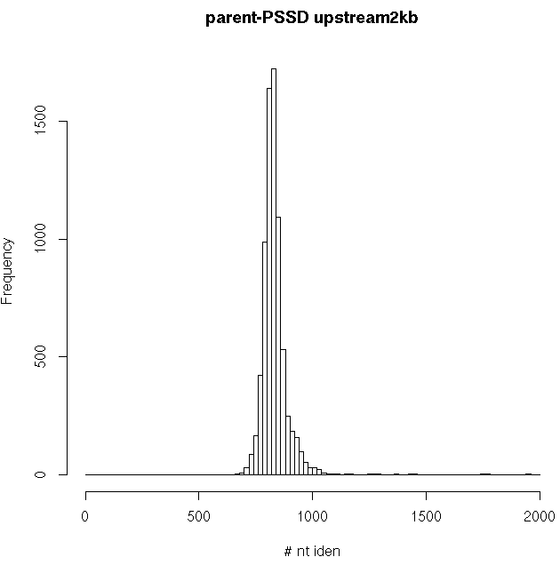
UPDATE
NEW
JJL Presentation
Notes:
----- Meeting Notes (15/08/2013 16:23) -----
redo graphs for dup in old, median, recent
do the binning for parallogs as well

Slide 16
Observations
Mammals have a higher number of processed to duplicated pseudogenes
The burst of retro-transposition events 40 Mya is human specific
Chimp, Gorilla, & Orangutan – dramatic decrease in young processed pseudogenes
Macaque, Marmoset, & Mouse – slight increase in recent processed pseudogenes

Slide 17
Chromosomal Localization
Chromosome ends are 2x15% of the chromosome length
Chromosome middle is 2x15% of the chromosome length around the centromeric region or the physical middle of the chromosome
Mammals
Worm
Fly

Slide 18
Observations
Mammals show an uniform distribution of pseudogenes along the chromosome arms
Worm pseudogenes are located preferentially in the telomeric regions
Fly pseudogenes are found grouped near the chromosome center

Slide 19
Pseudogene-Parent Chromosomal Co-residence
UPDATE
NEW
The chromosomal co-residence is non-random in human & mouse
ToDo: - check the co-residence for primates & worm, fly see if the trend is maintained ….
YZ Presentation

Slide 20
Co-localization as Function of Distance (25 k )
UPDATE
NEW
Human
Worm
Fly
To Do’s: test the preference of up-stream or down-stream of the localization of pgenes
YZ Presentation

Slide 21
Inter- & Intra-chromosomal Pseudogene Exchange (Human)
UPDATE
NEW
3by3: Pearson's Chi-squared test & Fisher’s Exact Test: p-value < 2.2e-16.
2by2 (X, Y only): Fisher’s Exact Test: p-value < 2.2e-16.
Sample es1mat: odds ra1o ≈ 208.
Y chromosome very seldom exports to other chromosomes
X is an exporter
YZ Presentation

Slide 22
Inter- & Intra-chromosomal Pseudogene Exchange (Worm)
UPDATE
NEW
Fisher’s Exact Test: p-value = 6.293e-06.
Sample estimate: odds ratio ≈ 23.
YZ Presentation

Slide 23
Inter- & Intra-chromosomal Pseudogene Exchange (Fly)
UPDATE
NEW
Fisher’s Exact Test: p-value = 2.376e-16.
Y chromosome very seldom exports to other chromosomes. (Y is not parent source.)
YZ Presentation

Slide 24
Inter- & Intra-chromosomal Pseudogene Exchange (Mouse)
UPDATE
NEW
3by3: Pearson's Chi-squared test & Fisher’s Exact Test: p-value < 2.2e-16.
Y chromosome very seldom exports to other chromosomes.
YZ Presentation

Slide 25
Observations (1)
UPDATE
NEW
In both human and mouse, co-residence is not random.
  In human, Y is exceptionally significant.
In human, pseudogene type is an important contributor determining co-residence.
  DUP pgenes tend to reside on the same chromosome with the parents, compared to PSSD pgenes.
  Transcribed/Not plays a weaker role.
Exchange between sex chromosomes and autosomes
  In both human and mouse, Y chromosome very seldom exports to other chromosomes.
YZ Presentation

Slide 26
Observations (2)
UPDATE
NEW
14unique human parent TranscriptIDs on Y, trace back to genes, among which:
  CDY1, USP9Y, RBMY1A1 and TSPY1 have high number of pseudogenes.
  All four (highly) expressed in testis, i.e. germline tissue (based on RNA-seq Body Map).
➔Correlation between parent gene expression level and number of pseudogenes.
More detailed investigation:
Other genes with low Freq.ParentTranscriptID have not been checked.
PSSD and DUP are not separated
YZ Presentation

Slide 27
Pseudogenesis

Slide 28
Defects Accumulation
Distribution of pseudogene defects as function of pseudogene age
7 age groups based on the % sequence similarity to parents:
  0 – 40 (group 0), 40 – 50 (group 1), 50 – 60 (group 2), 60 – 70 (group 3), 70 – 80 (group 4), 80 – 90 (group 5), 90 – 100(group 6)
Average defect frequency = # Defects/ #Pseudogene

Slide 29
Pseudogenes Defects
 | Ins |  | Del |  | Shift |  | Stop
 | DUP | PSSD | DUP | PSSD | DUP | PSSD | DUP | PSSD
Human | 4.213185 | 4.560006 | 4.163955 | 5.479605 | 1.768836 | 2.623619 | 2.291524 | 2.298925
Chimp | 6.148605 | 4.612527 | 6.05473 | 5.733621 | 2.561798 | 2.607775 | 2.680681 | 2.343125
Gorilla | 6.409406 | 5.04378 | 5.712413 | 5.669686 | 2.364302 | 2.565066 | 2.479568 | 2.416214
Urangutan | 6.150227 | 5.0309 | 5.891948 | 5.606683 | 2.630533 | 2.666527 | 2.626699 | 2.372483
Marmoset | 8.747703 | 5.29696 | 6.729323 | 6.27028 | 3.632832 | 2.664584 | 2.922723 | 1.991828
Mouse | 6.15115 | 5.116645 | 7.797919 | 7.593726 | 2.943045 | 2.86735 | 2.980285 | 2.204353
Fly | 9.586667 | 6.217391 | 10.30667 | 15.13043 | 1.44 | 1.173913 | 1.213333 | 0.8695652
Worm | 28.67733 | 22.92971 | 6.029207 | 8.996805 | 2.070932 | 1.591054 | 2.812239 | 2.13738
There is a gradual increase in the number of ins/del defects from Human to Worm
Consistent distribution of defects in mammals

Slide 30
Duplicated
Processed
Insertion
Shift
Deletion
Stop

Slide 31
Observations
All the mammals show a gradual increase in the number of defects with age
There are no obvious differentiations between processed and duplicated pseudogenes
Fly pseudogene defects are enriched in deletions – consistent with the high deletion rate observed in fly genome
Worm shows a preference for accumulating insertions in the pseudogene sequence

Slide 32
Activity

Slide 33
Activity Features
Data availability for Human, Worm, and Fly, & limited resources for the other mammals
Transcription
Presence of Pol2 binding sites in the upstream region
Active chromatin:
  Histone marks
  Chromatin segmentation
Active TF binding sites in the upstream region

Slide 34
Transcription
Calculate RPKM for each pseudogene using uniquely mapped reads
  filtered out pseudogene regions with mappability < 1
  discarded the pseudogene regions shorter than 100 bp
Organism dependent RPKM cut-off
  human: 2 – according to previous validations 15% transcribed pseudogenes
  ***1441 transcribed pseudogenes
Assumption:
  the transcription of protein coding genes in human, worm and fly has similar distributions
The normalization derived from protein coding genes is applied to pseudogenes
  worm 5.7 ***150 transcribed pseudogenes
  fly 10.8 ***23 transcribed pseudogenes

Slide 35
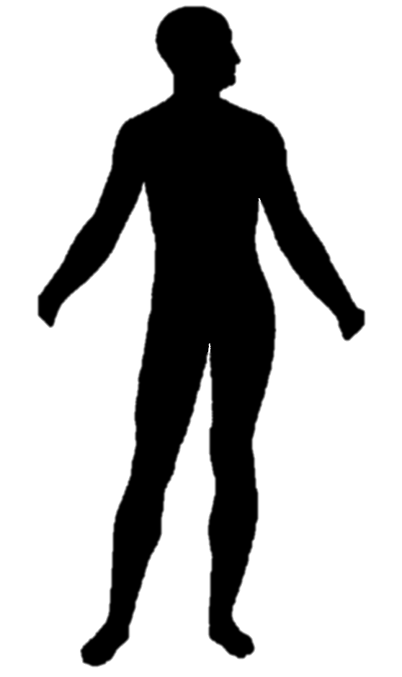
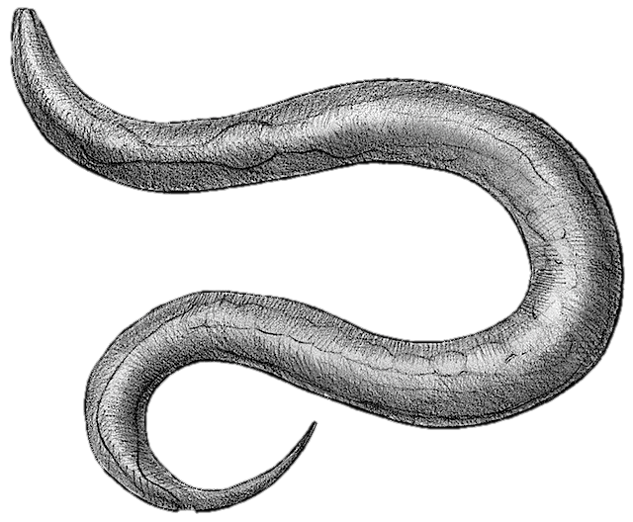
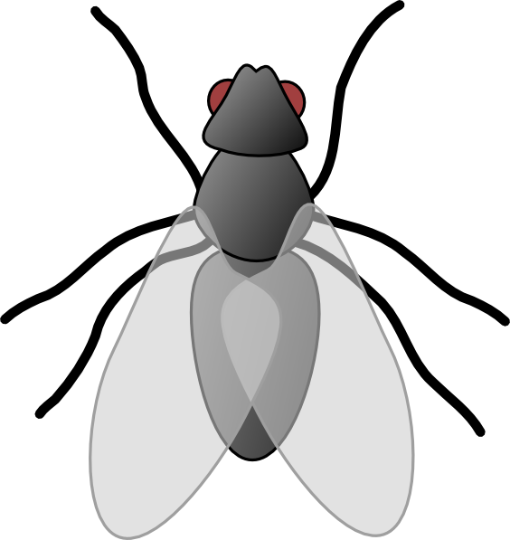
Pseudogene Activity
Total
11216
911
145
Distribution
1248
147
7467
2011
30*
77*
124*
421*
3
16
13
93
Biotype
Transcription Evidence
1441
9775
150
761
23
122
Pol II
Binding
150
1291
275
9500
69
81
132
629
20
3
62
60
Open
Chromatin
121
29
1048
243
227
48
7104
2396
43
26
14
67
25
107
45
584
12
8
0
3
29
33
9
51
TF
Binding
88
33
21
8
54
994
9
234
146
81
32
16
113
6991
15
2381
32
11
17
9
9
5
43
24
18
7
74
33
25
20
308
276
7
5
7
1
0
0
2
1
20
9
8
25
3
6
5
46
Activity
Level
A
Z (8747)
D
A
Z (603)
D
A
Z (92)
D
Human
Worm
Fly
Processed
Duplicated
Other
Yes
No
Active
Zombie
Dead
Organisms specific features?
Human -> Open Chromatin
Worm -> TF
Fly -> Pol2
A
Z
D

Slide 36
Upstream Analysis
UPDATE
NEW
H3K27ac
7 human cell lines
JJL Presentation

Slide 37
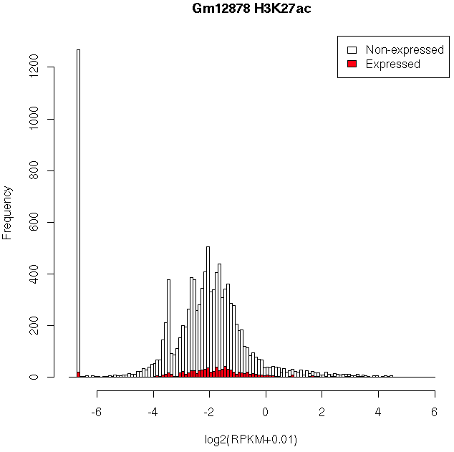
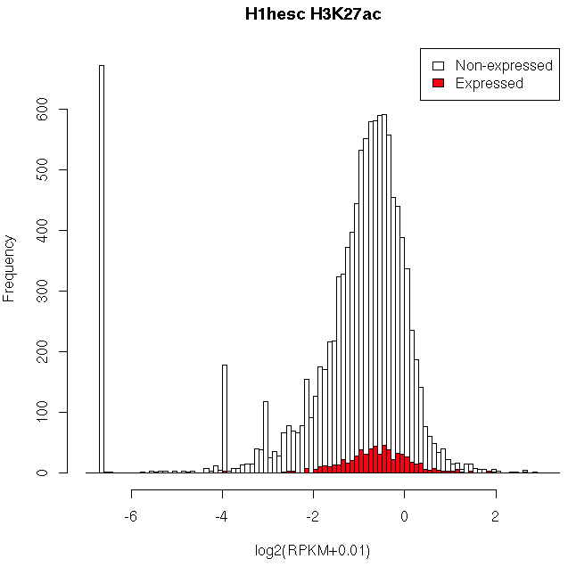
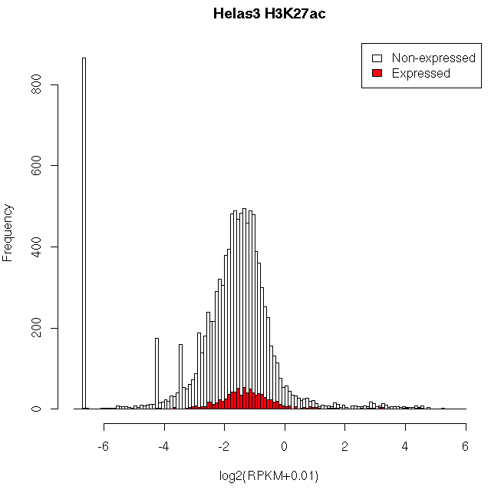
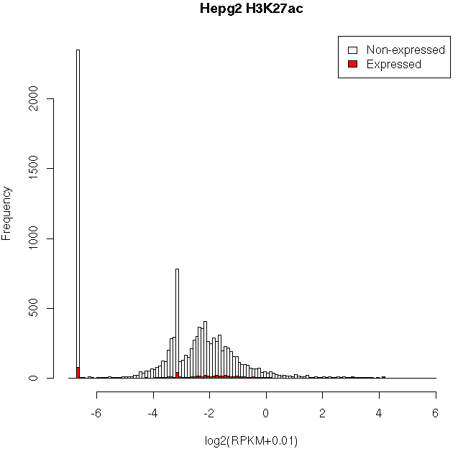
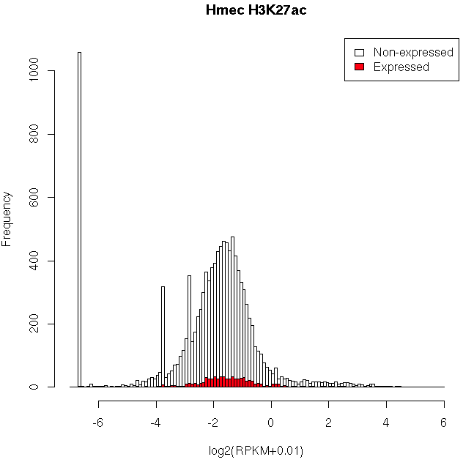
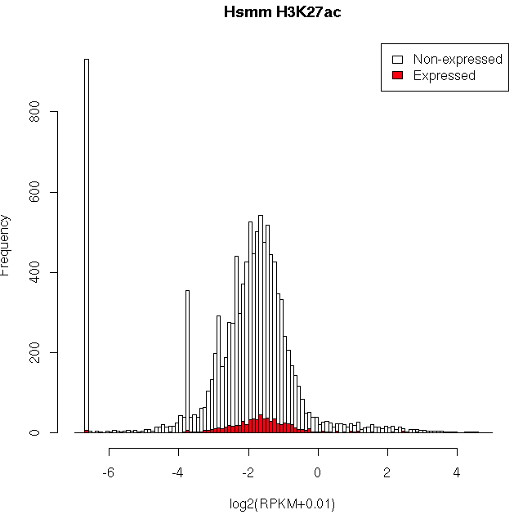
UPDATE
NEW
JJL Presentation

Slide 38
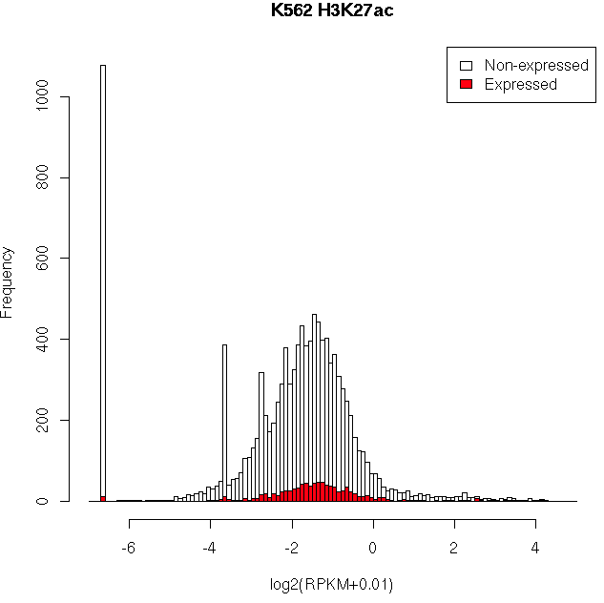
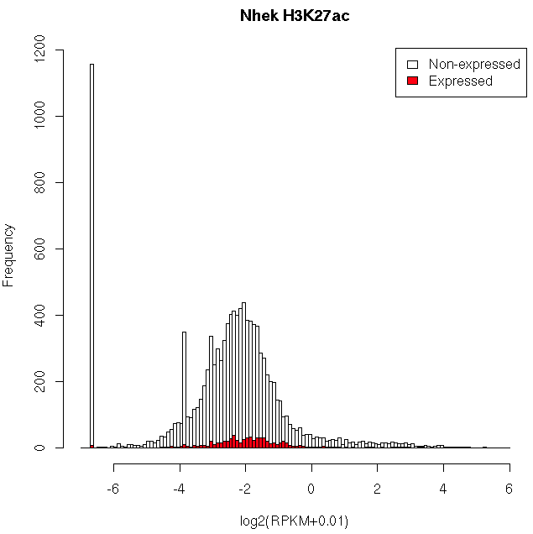
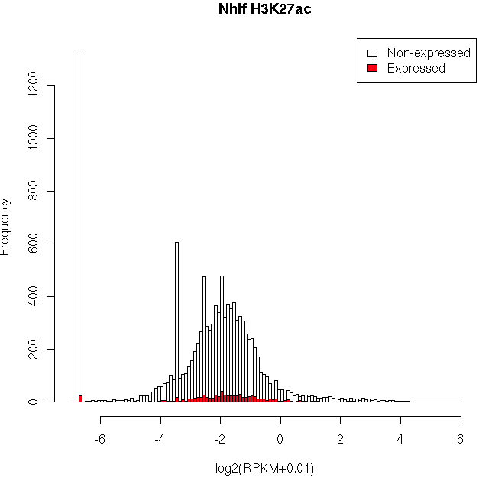
UPDATE
NEW
JJL Presentation

Slide 39
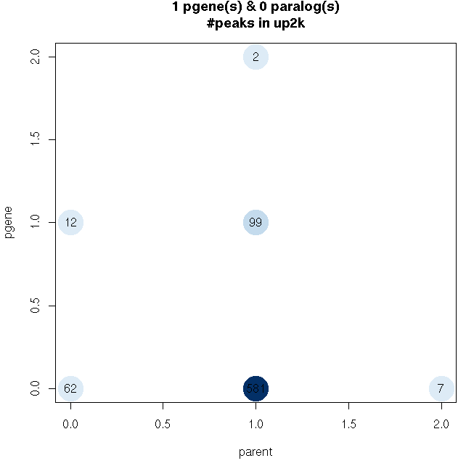
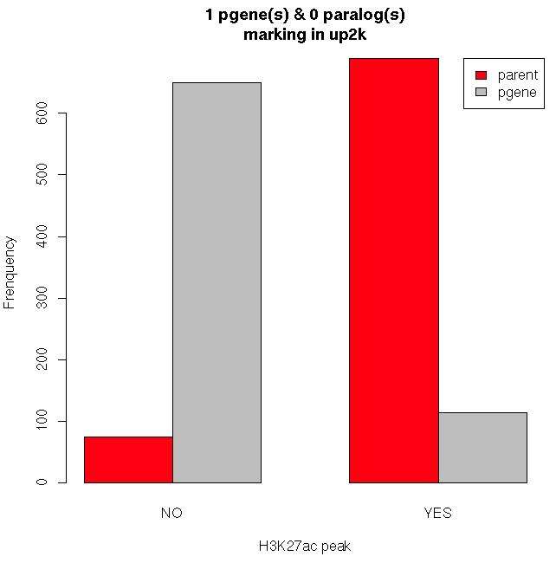
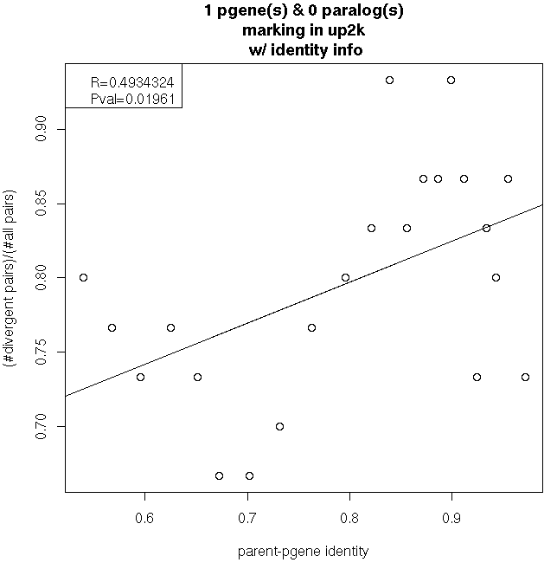
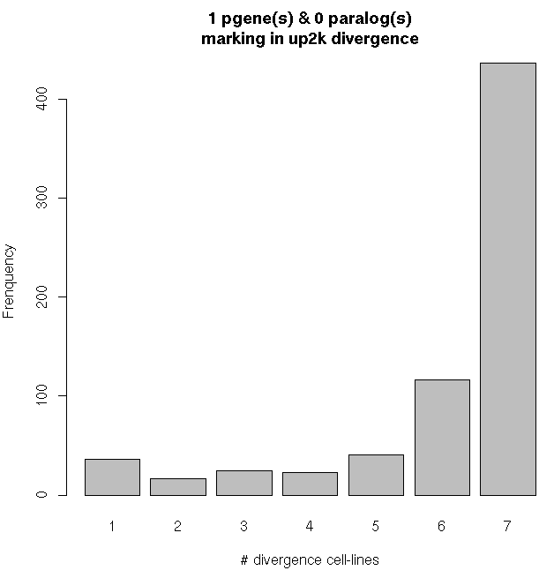
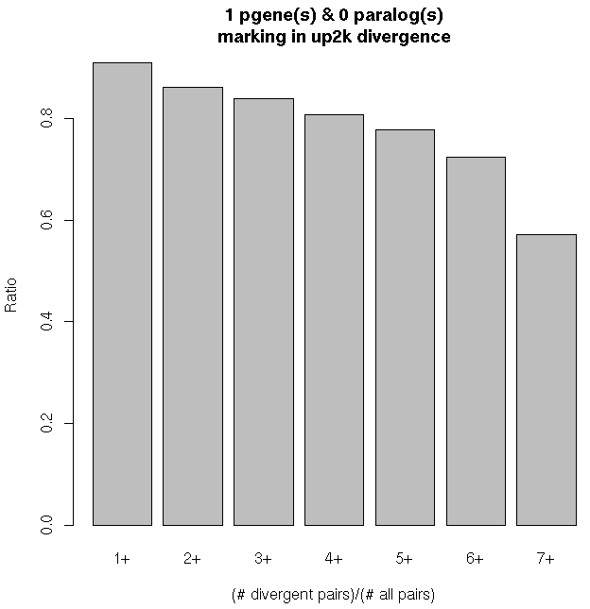
Results H3K27ac(7 cell-lines) - human
UPDATE
NEW
JJL Presentation

Slide 40
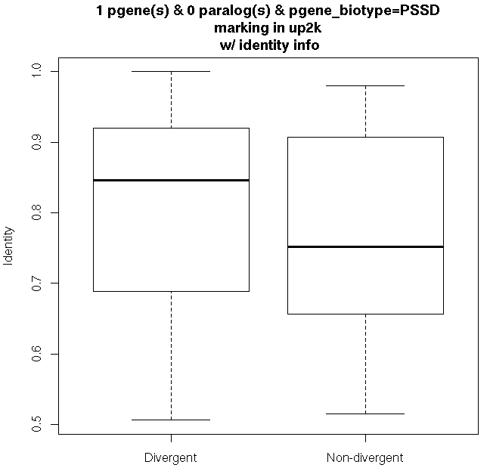
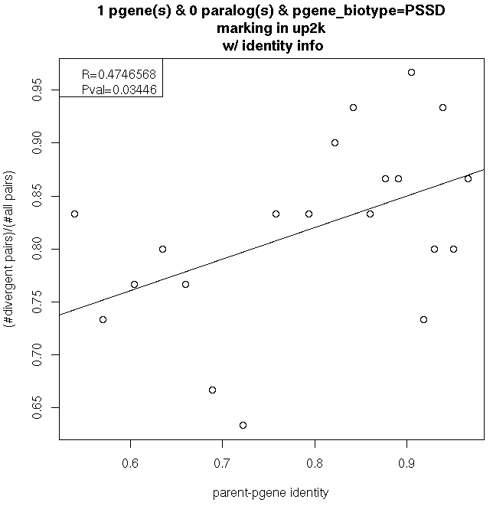
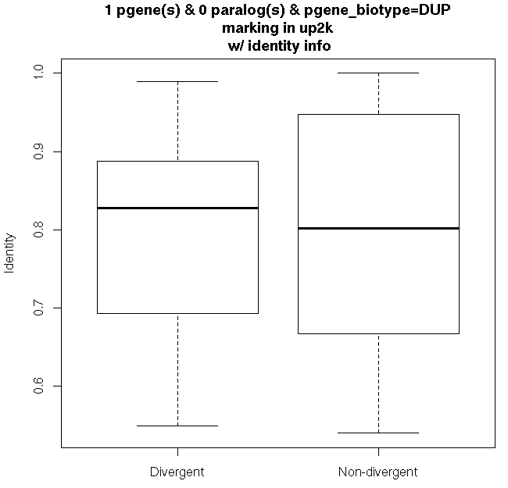
UPDATE
NEW
JJL Presentation

Slide 41
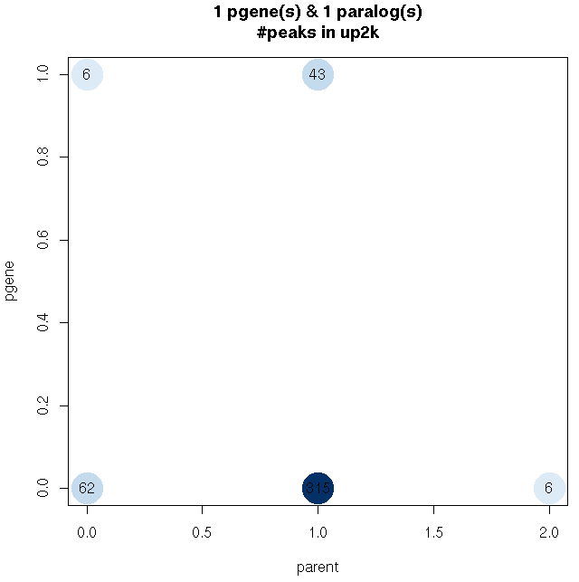
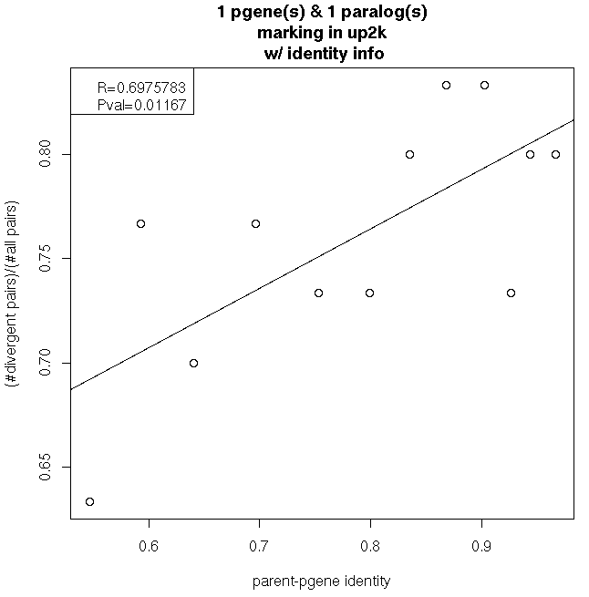
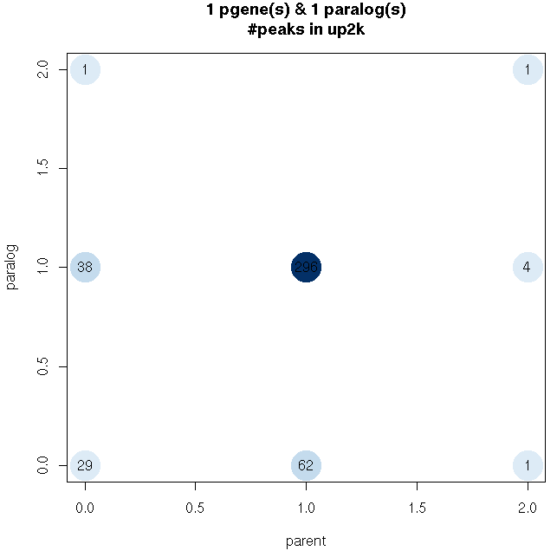
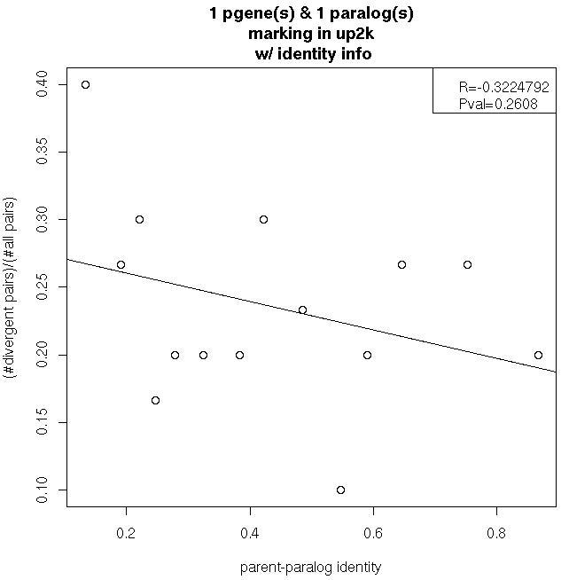
UPDATE
NEW
JJL Presentation

Slide 42
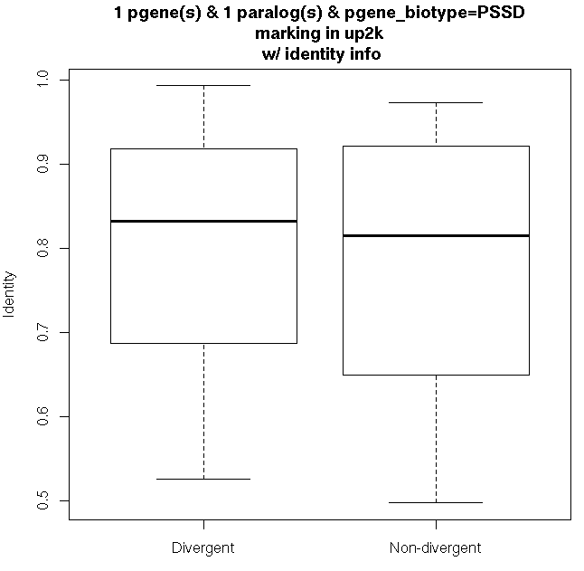
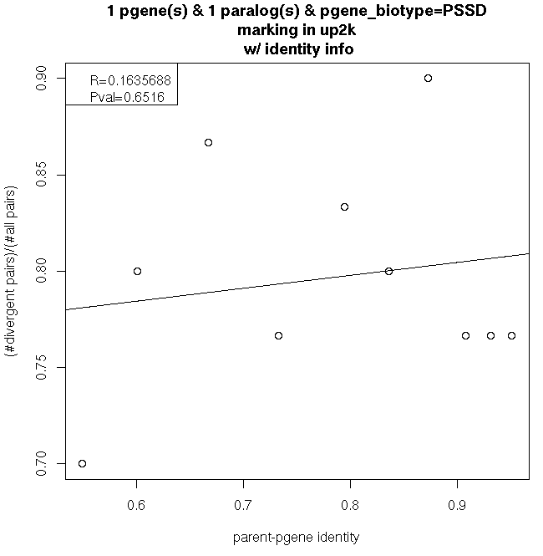
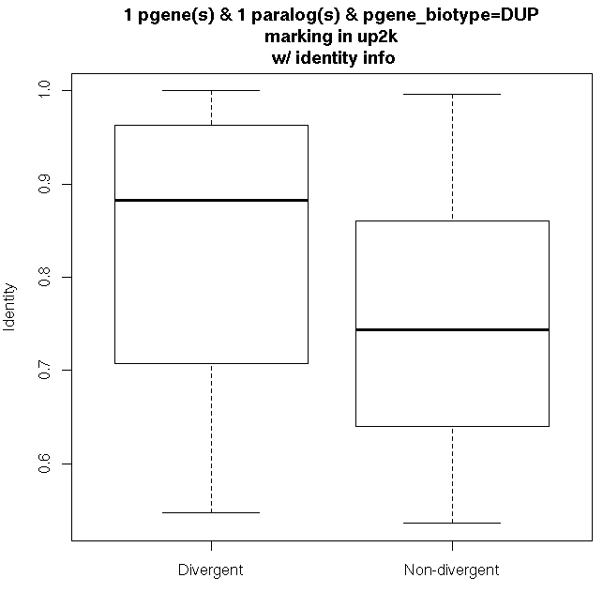
UPDATE
NEW
JJL Presentation

Slide 43
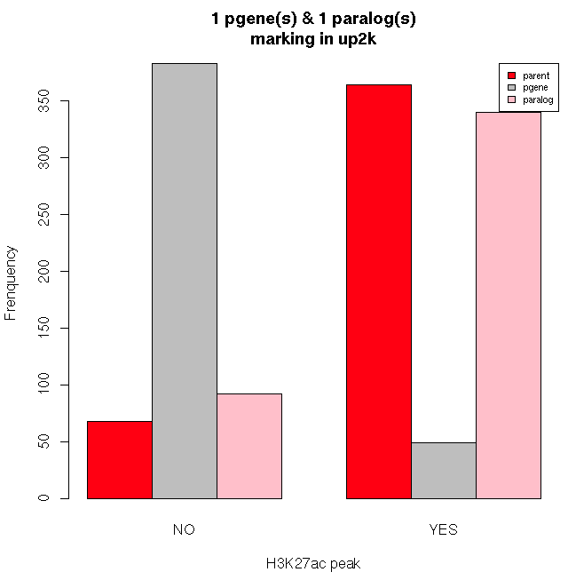
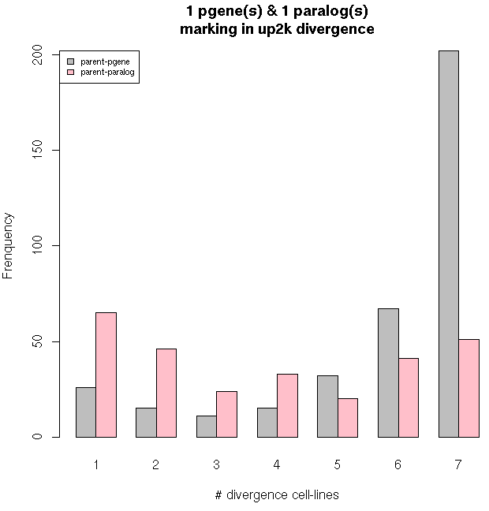
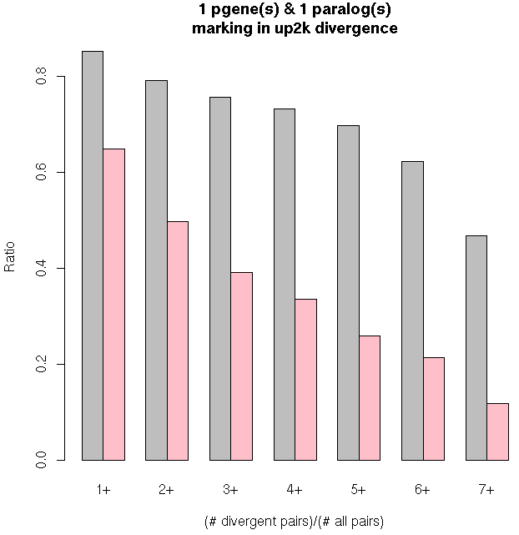
UPDATE
NEW
JJL Presentation

Slide 44
Upstream Activity and “Gene” Sequence Identity
UPDATE
NEW
H3K27ac
Correlation of 15 cell-lines
JJL Presentation

Slide 45
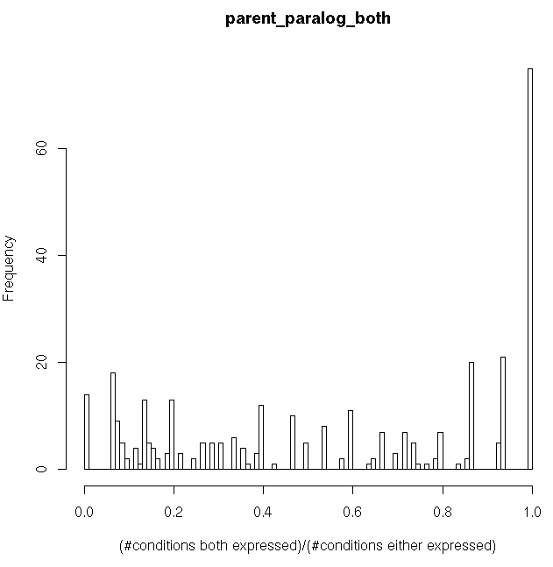
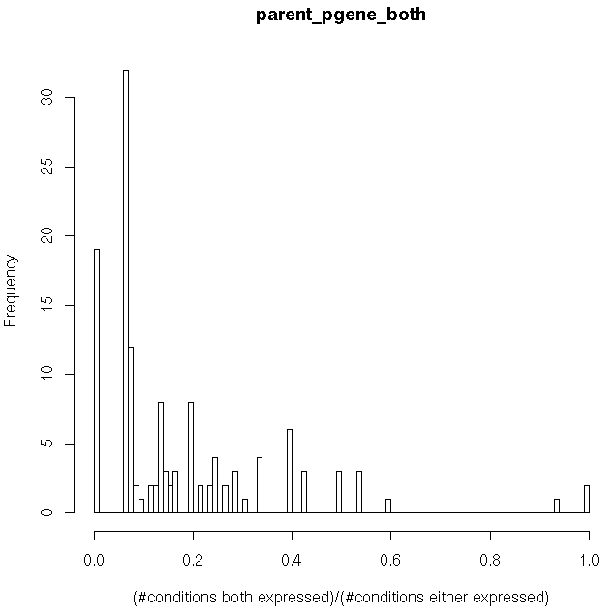
UPDATE
NEW
Upstream 2kb_rpkm>1 | both | parent | dup | neither
parent/pgene | 131 | 253 | 11 | 37
parent/paralog | 336 | 048 | 31 | 17
JJL Presentation

Slide 46
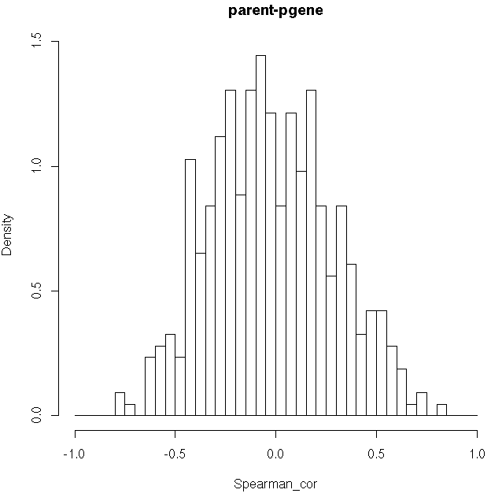
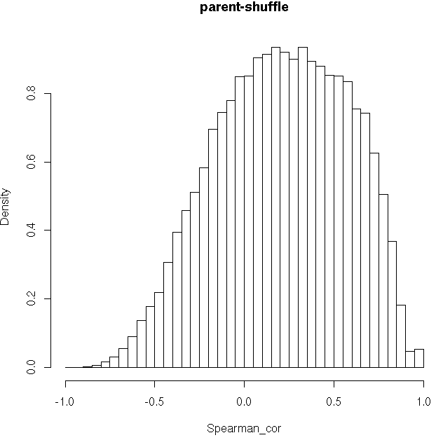
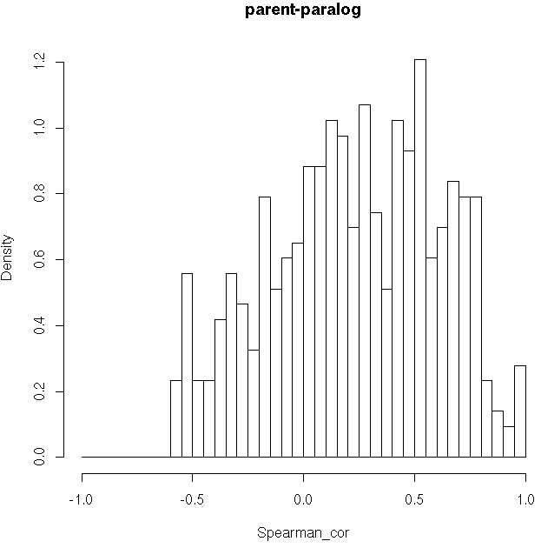
UPDATE
NEW
H3K27ac(15 cell-lines) - human
    1 pgene(s) & 1 paralog(s)
1. mean(parent/pgene)=-0.01850467
2. mean(parent/paralog)=0.2313773
3. mean(parent.shuffle)=0.2089326
1 VS 2 p-value < 2.2e-16
1 VS 3 p-value < 2.2e-16
2 VS 3 N.S.
JJL Presentation

Slide 47
SDs
UPDATE
NEW
Any overlap:
1366 parent/pgene/SD pairs (877 unique parents, 1270 unique pgenes, 1343 unique SDs)
731 parent/paralog/SD pairs (267 unique parents, 563 unique paralogs, 665 unique SDs)
Elements completely within SD:
173 parent/pgene/SD pairs (113 unique parents, 171 unique pgenes, 169 unique SDs)
304 parent/paralog/SD pairs (148 unique parents, 300 unique paralogs, 272 unique SDs)
29 w/ paralog and pgene in the same SD
26 parents w/ pgene/paralog/SD pairs
JJL Presentation

Slide 48



UPDATE
NEW
1. mean(parent/pgene)=0.514294
2. mean(parent/paralog)=0.531474
3. mean(all)=0.2907756
1 VS 2 NS.
1 VS 3 p-value < 2.2e-16
2 VS 3 p-value < 2.2e-16
JJL Presentation

Slide 49


UPDATE
NEW
1. mean(parent/pgene)=0.2649977
2. mean(parent/paralog)=0.377068
JJL Presentation

Slide 50



UPDATE
NEW
1. mean(parent/pgene)=0.9531538
2. mean(parent/paralog)=0.9530127
3. mean(all)=0.9351564
1 VS 2 NS.
1 VS 3 p-value = 1.538e-15
2 VS 3 p-value = 4.044e-15
JJL Presentation

Slide 51
Family
Fly |  | 3 | 2 | 5 | 2 |  |  |  | 3 |  |  | 7 |  | 1 |  |  |  |  |  | 2 |  | 3 |  |  |  |  |  |  |  |  |  | 30 | 10 | 9
Worm |  |  | 1 | 1 |  |  |  |  | 2 |  |  | 1 |  |  |  |  | 2 |  |  | 3 |  | 10 | 24 | 26 | 74 | 46 | 23 | 20 | 17 | 13 | 11
Human | 414 | 235 | 180 | 176 | 171 | 144 | 132 | 132 | 93 | 86 | 82 | 69 | 68 | 64 | 60 | 59 | 58 | 48 | 48 | 44 | 43 | 12 | 2 | 1 |  |  |  |  |  |  |  | 7 | 6
Type | 7tm | RRM | IG | TF | IG | Ribo | TF | Ribo | Kin | Ribo | Ribo | H | Ribo | Ribo | Ribo | Ribo | Kin | Ribo | Ribo | Ploop | Ribo | Kin | 7tm | 7tm | 7tm | 7tm | Ubiq | 7tm | 7tm | 7tm | 7tm | SAP | Motor | Kin
No similarity in the pseudogene complement of the 3 organisms
e.g. RpS6

Slide 52
Orthology
UPDATE
NEW
UPDATE
NEW
Gene
550
2
3
-
6
-
5
Pseudogene
2113
6
8
-
6
-
9

Slide 53
Observations
We can identify a set of highly active and potentially functional pseudogenes using 4 activity features
~ 3% of pseudogene are “active” in human, worm and fly
Pseudogene parenthood is not shared across different species and is organisms specific

Slide 54
Pseudogenes & Proteomics
UPDATE
NEW
Data:
  From RNA-seq data:
    Highly transcribed unannotated regions (TARs)
    Pseudogenes, exp. Transcribed
      Tissue-specific data available
      Some cancer-specific data available in literature
  From MSMS data:
    Spectra from multiple cell lines and tissues (cancer tissues)
  Reference genome:
    hg19
    Diploid NA12878
Aim:
  Evidence of translation?
  Tissue/cell line-specific translation?
  Sex-specific translation in different tissues?
  Any feature related to cancer?
YZ Presentation

Slide 55
Tissue/cell line-specific scheme
UPDATE
NEW
Raw MS spectra
Mapping
ORF libarary built from TARs and Pgenes
Spectra-peptide matches using known ref. proteome
All spectra-ORF matches
Comparison
Unique (not known protein),
Unambiguous peptide identification,
High matching score, control FDR,
Confident ORF (with >=2 peptides)
Filtering criteria
YZ Presentation
Categorization
Overlap with protein-coding genes?
What region? esp. for pgenes.
Alternative splicing?

Slide 56
Results
UPDATE
NEW
All Pgene/TAR/ncRNA-custom BLASTdb matches
  http://archive.gersteinlab.org/yanzhang/worm_AllVsMS_fdr05.xlsx
  FDR < 0.05, sorted by names
  4 decoy
  155 pgenes
  56 TARs
  0 ncRNA predictions (“incRNA”)
YZ Presentation

Slide 57
Functional Pseudogenes

Slide 58
Known Functional Pseudogenes
Literature survey
  Human PTENP1
  Mouse L 32 ribosomal protein pseudogene (rpL32-4A)
  Fly Su(Ste)
“Functional” pseudogene share common features to genes
  Expression
  Activity features (Pol2, TFs, active chromatin)
  Evolutionary similarity
  Upstream sequence similarity
How did the functional pseudogenes evolve?
Is functionality maintained across related species?
Are functionality trends transferable between species?

Slide 59
Evaluation Pipeline
Case studies in Human and Worm
Evolution analysis
  Pseudogenes evolved in one of the organisms after speciation and remained a gene in the other
  Pseudogenes appeared before speciation
  Pseudogenes evolved in both organisms after speciation from 2 paralogous genes
Pseudogenes
Activity features
NO
Expression
correlation
Yes
Other
Age
Orthology
Evolution
Functional Pseudogene

Slide 60
Is the Pseudogene Activity an Artifact of a Dying Gene?
Co-expression correlation between:
  Parent & Paralog
  Active genes & Pseudogene
Parent Gene - Paralogs
Pseudogene - Parent
Old
Young
Old
Young

Slide 61
Coexpression vs Activity
Dead
Zombie
Active
Dead
Zombie
Active
No specific trend observed
Expression of most human pseudogenes is positively correlated with the parent gene expression
Worm active pseudogenes have little to no coexpression correlation with their parents

Slide 62
Case Study
Based on correlation of coexpression with parent gene and the age of the pseudogene there are 5 cases:
  High coexpression & high sequence similarity - > regulatory potential & under selection ?
  High coexpression & low sequence similarity - > regulatory– compare with other organisms
  Low coexpression & high sequence similarity - > artifact of a dying gene
  Low coexpression & low sequence similarity - > functional – non-regulatory – acquires new functionality
  Anti – correlated - > functional – regulatory & under selection ?
Human: 88 full activity features => 69 with parent coexpression information
Worm : 32 active pseudogenes

Slide 63
Human

Slide 64
Human - ENST00000447117.1
Parent: ENST00000371953.3 (chr10:89622870-89731687:1)
Transcribed Processed Pseudogene
Chr9:33675435-33676649:-1
Sequence similarity = 98%
Correlation coexpression = 0.84 , pval=2.81e-7
Activity features √
Orthology:
  3 orthologs in worm – no pgenes
  Low similarity < 30%
PTEN-P1

Slide 65
Human - ENST00000420457.1
Parent ENST00000373545.3 (chrX:71798664-71934167:-1)
Processed pseudogene
Chr1: 91358549-91359169:-1
Sequence similarity = 80%
Coexpression correlation = 0.93, pval= 0
Activity features √
Orthology:
  1 ortholog in worm – no pseudogenes
Phosphorylase kinase, alpha 1 pseudogene 1

Slide 66
Human - ENST00000412105.1
Parent ENST00000382172.3 (chr13:24304328-24463558:-1)
Duplicated pseudogene
Chr13: 21872398-21880512:+1
Sequence similarity = 62%
Coexpression correlation = 0.21, pval= 0.23
Activity features √
Orthology:
  1:1 ortholog in worm – Y67H2A.7 – 1 pseudogene - K08E7.10 (ambiguous – most likely duplicated)
  K08E7 – 72% sequence similarity to parent
  Shares 52% sequence similarity
  => pseudogenes developed independently after the speciation
  1:1 ortholog in fly – FBgn0033038 – no pseudogene
Mitochondrial intermediate peptidase pseudogene 3

Slide 67
Worm

Slide 68
Worm - Y63D3A.11
Parent Y63D3A.9 (chrI: 14,083,036-14,084,186)
Probably duplicated pseudogenes
chrI:14085676-14086673
Sequence similarity = 80%
Coexpression correlation = 0.91, pval = 0
Activity features √
Orthology:
  No orthologs within human / fly
Paralogs:
  5 within species paralogs -> chr II
  No correlated pseudogenes
Comparison with other worm species:
  Pseudogene not preserved
Fbox-93

Slide 69
Observations
Using the selection criteria we are able to identify know functional pseudogenes
Functionality is preserved within a specie however, it does not extends to other organisms
Human is too distant to worm and fly to show any conservation of functional pseudogenes across these species.
C. elegans pseudogenes are not conserved across other nematodes.
New! Some human pseudogenes are conserved across other primates.

Slide 70
Conservation

Slide 71
Analysis
Data source: 1000 Genome Phase 1
  Low coverage
  Exome
SNPs in exonic regions of ~4000 parent protein coding genes
  21107 exome
  44773 low coverage
Two approaches:
  SNP density (SNPs/Mb)
  Rare allele frequency
Upstream region:
  UTR exons for each parent gene
  UTR exons within 2kb of upstream/downstream region of each pseudogene

Slide 72
Coding Genes

Slide 73
Pseudogenes

Slide 74
Selection Criteria
Use Low Coverage SNPs:
  Threshold = 4 for protein coding genes
  Threshold = 4 -> 881 pseudogenes under selection
  Threshold = 3 -> 1074 pseudogenes under selection
  Threshold = 2 -> 1609 pseudogenes under selection
  Threshold = 1 -> 2188 pseudogenes under neutral selection
  Threshold < 1 -> 8879 pseudogenes under selection

Slide 75


Phase I data
Transcribed
Non Transcribed

Slide 76


per Activity Type
Active
Zombie
Dead

Slide 77
Observations
SNP density method is not statistically robust for identifying conserved pseudogenes
Pseudogenes as a whole are enriched in rare alleles

Slide 78
On-going work
Primate pseudogene evolution, activity and conservation
Activity data for chimp and mouse -> compare the level of highly active pgenes in human, primates, mammals, worm, fly (Joel)

Slide 79

Thank you!
Mark
Baikang
Jasmine
Michael
Joel
Suganthi
Daifeng
Yan
Jing
Yao
Gersteinlab

Slide 80


Slide 81
Human

Slide 82
Worm

Slide 83
Fly

Slide 84
HW

Slide 85
HF

Slide 86
WF

Slide 87
HWF

