Slide 1
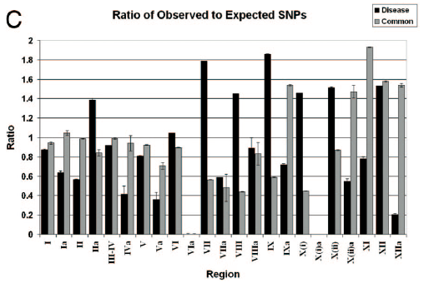
JC, DC – cont.

