Slide 1
Humans & Other Organisms - a pseudoStory
Cristina Sisu
7th August 2013
Gerstein Lab
(gmtg)

Slide 2

The Circle of Life?

Slide 3
The Circle of pseudoLife.
Gene
Pseudogene
DEAD Genomic Element
Exclusion from the genome
ALIVE ncGenomic Element
Proto Gene
ncRNA
Regulatory
Circuit

Slide 4
Approach
Annotation
Activity
Function
Pseudopipe
Manual annotation
Pseudogenesis
Localization
Activity features
  Transcription
  Pol2
  Chromatin
Family & Orthology
Pseudogene biology
Conservation
Coexpression
Notes:
In order to be able to identify the “interesting” pseudogenes we need to follow a detective approach ?

Slide 5
Annotation

Slide 6
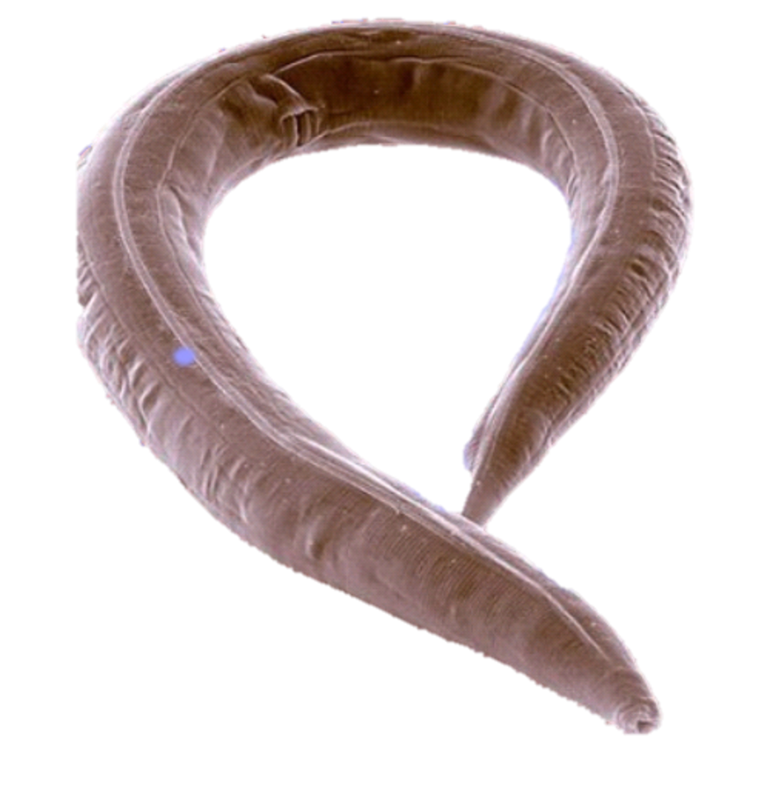
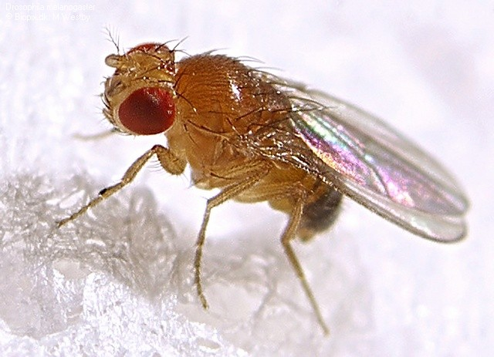
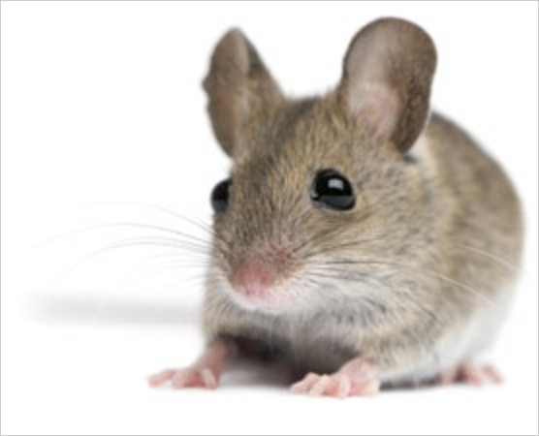
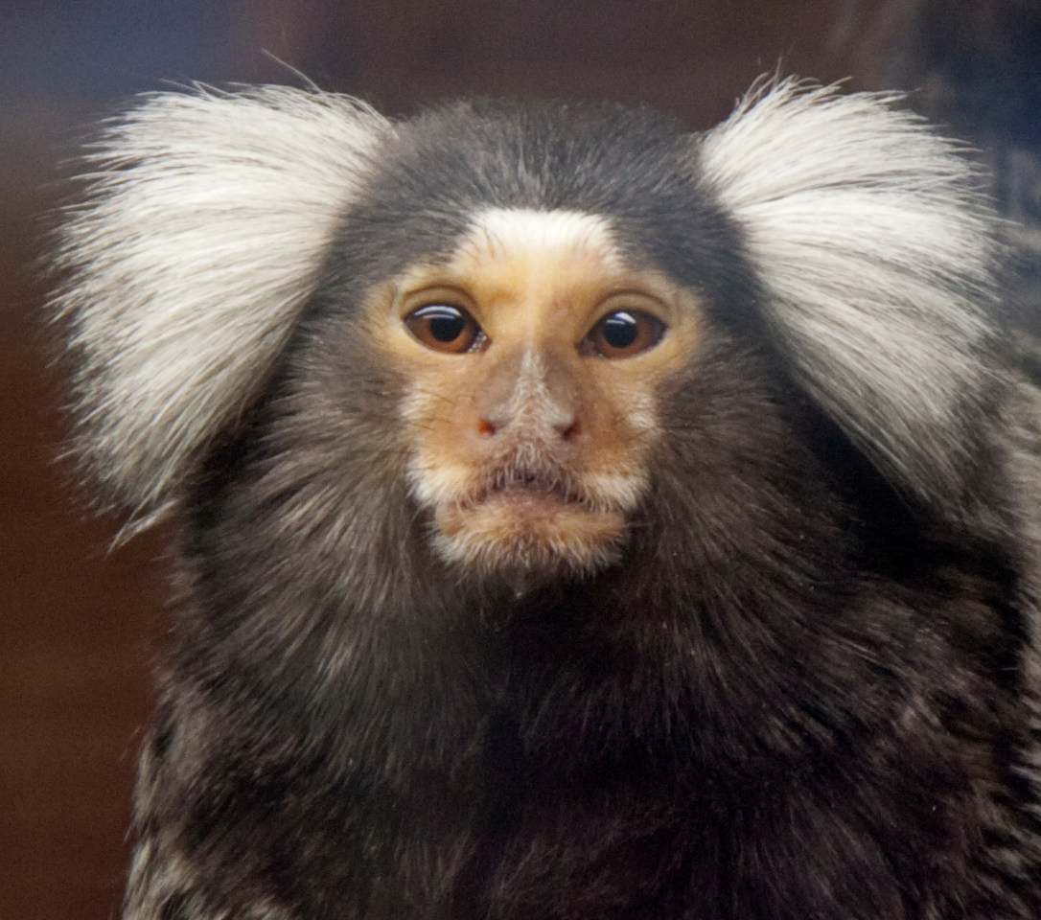
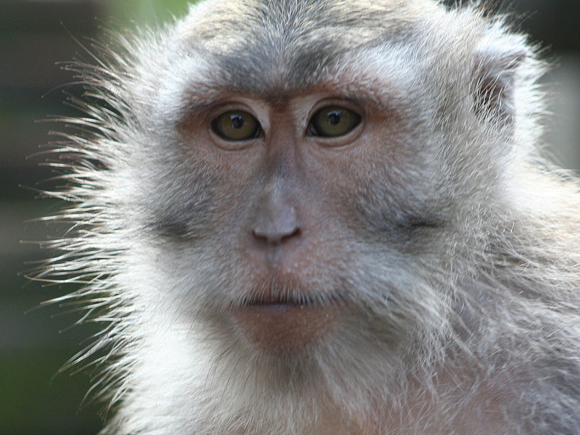
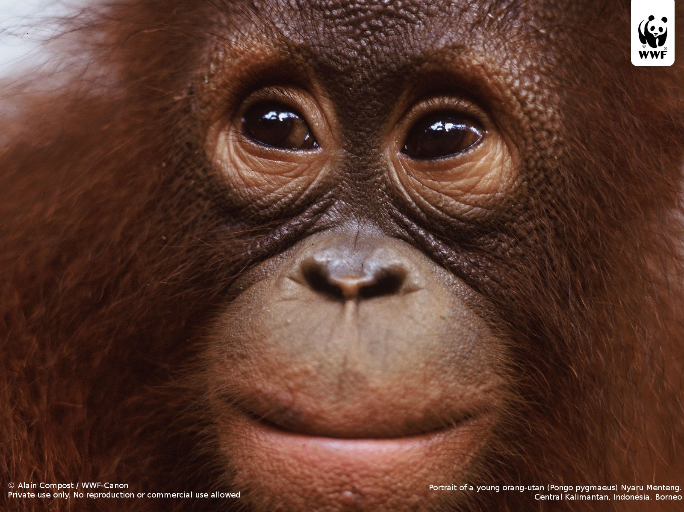
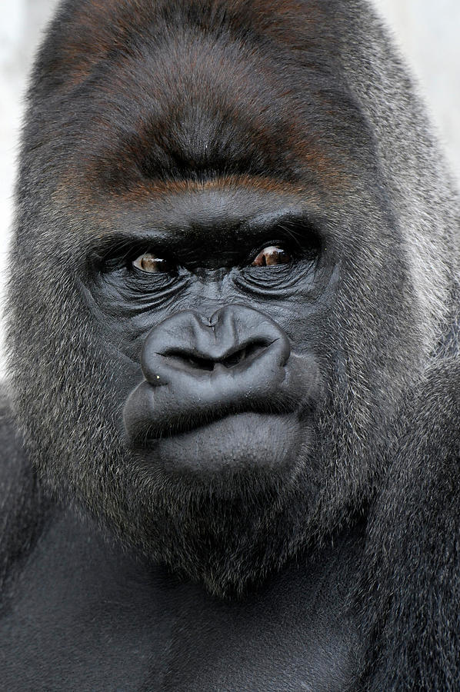
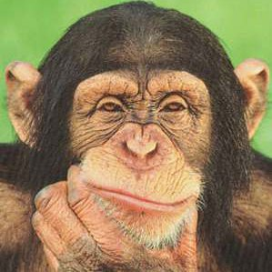

Data Availability
Human, Worm & Fly – manual & automated annotation
Chimp, Gorilla, Orangutan, Macaque, Marmoset & Mouse – PseudoPipe Annotation
Worm
Fly
Marmoset
Macaque
Orangutan
Chimpanzee
Mouse
Gorilla
Human

Slide 7
Biotype Distribution
Organism | #Pgenes
Human | 11216
Chimp | 14933
Gorilla | 16330
Orangutan | 16861
Macaque | 13435
Marmoset | 29668
Mouse | 15887
Worm | 911
Fly | 145
Duplicated
Processed
Other*
Notes:
Question? Is the burst of retroteanspoition event a human characteristic or not?

Slide 8
Biotype Timeline
Human
Worm
Fly

Slide 9
Biotype Timeline
Human
Worm
Fly
Chimpanzee
Notes:
----- Meeting Notes (07/08/2013 11:21) -----
retrotransposed elemets

Slide 10
Biotype Timeline
Human
Worm
Fly
Chimpanzee
Gorilla

Slide 11
Biotype Timeline
Human
Worm
Fly
Chimpanzee
Gorilla
Orangutan

Slide 12
Biotype Timeline
Human
Worm
Fly
Chimpanzee
Gorilla
Orangutan
Macaque

Slide 13
Biotype Timeline
Human
Worm
Fly
Chimpanzee
Gorilla
Orangutan
Macaque
Marmoset

Slide 14
Biotype Timeline
Human
Worm
Fly
Chimpanzee
Gorilla
Orangutan
Macaque
Marmoset
Mouse
Notes:
----- Meeting Notes (07/08/2013 11:21) -----
compare with retrotrasnposable elements

Slide 15
Observations
Mammals have a higher number of processed to duplicated pseudogenes
The burst of retro-transposition events 40 Mya is human specific
Chimp, Gorilla, & Orangutan – dramatic decrease in young processed pseudogenes
Macaque, Marmoset, & Mouse – slight increase in recent processed pseudogenes

Slide 16
Chromosomal Localization
Chromosome ends are 2x15% of the chromosome length
Chromosome middle is 2x15% of the chromosome length around the centromeric region or the physical middle of the chromosome
Mammals
Worm
Fly

Slide 17
Observations
Mammals show an uniform distribution of pseudogenes along the chromosome arms
Worm pseudogenes are located preferentially in the telomeric regions
Fly pseudogenes are found grouped near the chromosome center

Slide 18
Pseudogenesis

Slide 19
Defects Accumulation
Distribution of pseudogene defects as function of pseudogene age
7 age groups based on the % sequence similarity to parents:
  0 – 40 (group 0), 40 – 50 (group 1), 50 – 60 (group 2), 60 – 70 (group 3), 70 – 80 (group 4), 80 – 90 (group 5), 90 – 100(group 6)
Average defect frequency = # Defects/ #Pseudogene

Slide 20
Pseudogenes Defects
 | Ins |  | Del |  | Shift |  | Stop
 | DUP | PSSD | DUP | PSSD | DUP | PSSD | DUP | PSSD
Human | 4.213185 | 4.560006 | 4.163955 | 5.479605 | 1.768836 | 2.623619 | 2.291524 | 2.298925
Chimp | 6.148605 | 4.612527 | 6.05473 | 5.733621 | 2.561798 | 2.607775 | 2.680681 | 2.343125
Gorilla | 6.409406 | 5.04378 | 5.712413 | 5.669686 | 2.364302 | 2.565066 | 2.479568 | 2.416214
Urangutan | 6.150227 | 5.0309 | 5.891948 | 5.606683 | 2.630533 | 2.666527 | 2.626699 | 2.372483
Marmoset | 8.747703 | 5.29696 | 6.729323 | 6.27028 | 3.632832 | 2.664584 | 2.922723 | 1.991828
Mouse | 6.15115 | 5.116645 | 7.797919 | 7.593726 | 2.943045 | 2.86735 | 2.980285 | 2.204353
Fly | 9.586667 | 6.217391 | 10.30667 | 15.13043 | 1.44 | 1.173913 | 1.213333 | 0.8695652
Worm | 28.67733 | 22.92971 | 6.029207 | 8.996805 | 2.070932 | 1.591054 | 2.812239 | 2.13738
There is a gradual increase in the number of ins/del defects from Human to Worm
Consistent distribution of defects in mammals
Notes:
----- Meeting Notes (18/07/2013 12:56) -----
look at splice leader in Worm
----- Meeting Notes (07/08/2013 11:21) -----
chemoreceptor
olafactory
comp worm and human

Slide 21
Duplicated
Processed
Insertion
Shift
Deletion
Stop

Slide 22
Observations
All the mammals show a gradual increase in the number of defects with age
There are no obvious differentiations between processed and duplicated pseudogenes
Fly pseudogene defects are enriched in deletions – consistent with the high deletion rate observed in fly genome
Worm shows a preference for accumulating insertions in the pseudogene sequence

Slide 23
Activity

Slide 24
Activity Features
Data availability for Human, Worm, and Fly, & limited resources for the other mammals
Transcription
Presence of Pol2 binding sites in the upstream region
Active chromatin:
  Histone marks
  Chromatin segmentation
Active TF binding sites in the upstream region

Slide 25
Transcription
Calculate RPKM for each pseudogene using uniquely mapped reads
  filtered out pseudogene regions with mappability < 1
  discarded the pseudogene regions shorter than 100 bp
Organism dependent RPKM cut-off
  human: 2 – according to previous validations 15% transcribed pseudogenes
  ***1441 transcribed pseudogenes
Assumption:
  the transcription of protein coding genes in human, worm and fly has similar distributions
The normalization derived from protein coding genes is applied to pseudogenes
  worm 5.7 ***150 transcribed pseudogenes
  fly 10.8 ***23 transcribed pseudogenes

Slide 26
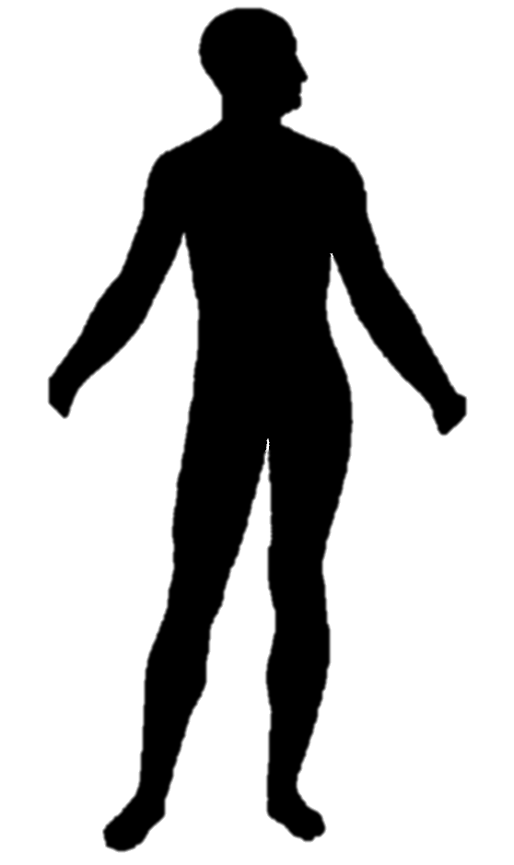
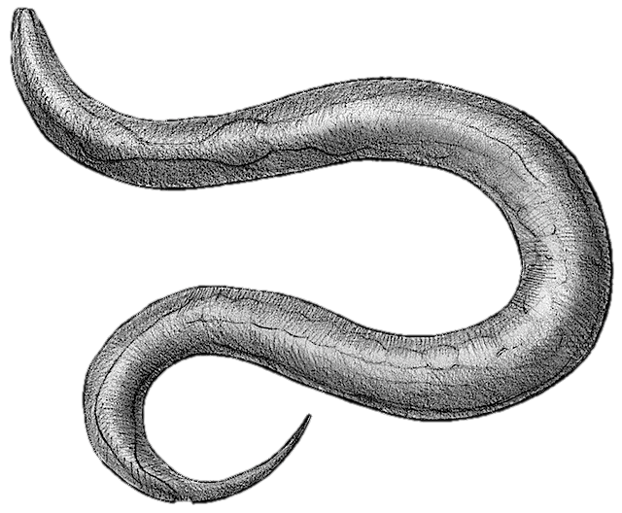
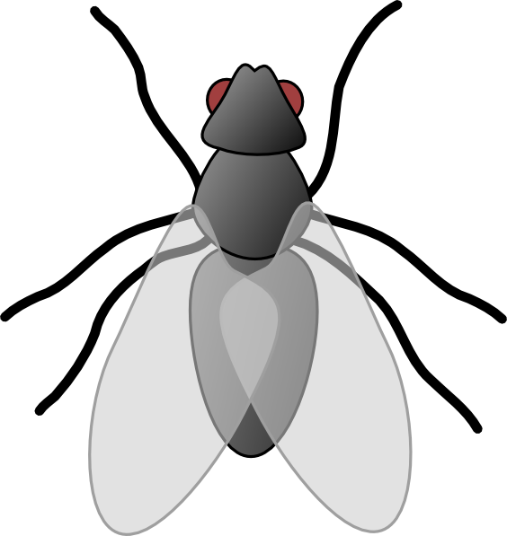
Pseudogene Activity
Total
11216
911
145
Distribution
1248
147
7467
2011
30*
77*
124*
421*
3
16
13
93
Biotype
Transcription Evidence
1441
9775
150
761
23
122
Pol II
Binding
150
1291
275
9500
69
81
132
629
20
3
62
60
Open
Chromatin
121
29
1048
243
227
48
7104
2396
43
26
14
67
25
107
45
584
12
8
0
3
29
33
9
51
TF
Binding
88
33
21
8
54
994
9
234
146
81
32
16
113
6991
15
2381
32
11
17
9
9
5
43
24
18
7
74
33
25
20
308
276
7
5
7
1
0
0
2
1
20
9
8
25
3
6
5
46
Activity
Level
A
Z (8747)
D
A
Z (603)
D
A
Z (92)
D
Human
Worm
Fly
Processed
Duplicated
Other
Yes
No
Active
Zombie
Dead
Organisms specific features?
Human -> Open Chromatin
Worm -> TF
Fly -> Pol2
A
Z
D
Notes:
Are these features share across other species? Do we learn anything about the individual genomes from this comparison?

Slide 27
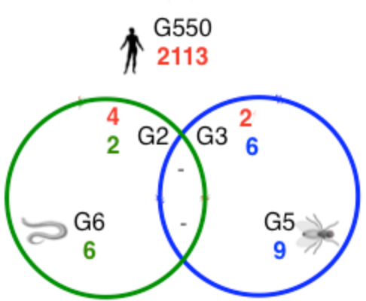
Family & Orthology
Fly |  | 3 | 2 | 5 | 2 |  |  |  | 3 |  |  | 7 |  | 1 |  |  |  |  |  | 2 |  | 3 |  |  |  |  |  |  |  |  |  | 30 | 10 | 9
Worm |  |  | 1 | 1 |  |  |  |  | 2 |  |  | 1 |  |  |  |  | 2 |  |  | 3 |  | 10 | 24 | 26 | 74 | 46 | 23 | 20 | 17 | 13 | 11
Human | 414 | 235 | 180 | 176 | 171 | 144 | 132 | 132 | 93 | 86 | 82 | 69 | 68 | 64 | 60 | 59 | 58 | 48 | 48 | 44 | 43 | 12 | 2 | 1 |  |  |  |  |  |  |  | 7 | 6
Type | 7tm | RRM | IG | TF | IG | Ribo | TF | Ribo | Kin | Ribo | Ribo | H | Ribo | Ribo | Ribo | Ribo | Kin | Ribo | Ribo | Ploop | Ribo | Kin | 7tm | 7tm | 7tm | 7tm | Ubiq | 7tm | 7tm | 7tm | 7tm | SAP | Motor | Kin
No similarity in the pseudogene complement of the 3 organisms
e.g. RpS6

Slide 28
Observations
We can identify a set of highly active and potentially functional pseudogenes using 4 activity features
~ 3% of pseudogene are “active” in human, worm and fly
Pseudogene parenthood is not shared across different species and is organisms specific

Slide 29
Functional Pseudogenes

Slide 30
Known Functional Pseudogenes
Literature survey
  Human PTENP1
  Mouse L 32 ribosomal protein pseudogene (rpL32-4A)
  Fly Su(Ste)
“Functional” pseudogene share common features to genes
  Expression
  Activity features (Pol2, TFs, active chromatin)
  Evolutionary similarity
  Upstream sequence similarity
How did the functional pseudogenes evolve?
Is functionality maintained across related species?
Are functionality trends transferable between species?

Slide 31
Evaluation Pipeline
Case studies in Human and Worm
Evolution analysis
  Pseudogenes evolved in one of the organisms after speciation and remained a gene in the other
  Pseudogenes appeared before speciation
  Pseudogenes evolved in both organisms after speciation from 2 paralogous genes
Pseudogenes
Activity features
NO
Expression
correlation
Yes
Other
Age
Orthology
Evolution
Functional Pseudogene

Slide 32
Is the Pseudogene Activity an Artifact of a Dying Gene?
Co-expression correlation between:
  Parent & Paralog
  Active genes & Pseudogene
Parent Gene - Paralogs
Pseudogene - Parent
Old
Young
Old
Young

Slide 33
Coexpression vs Activity
Dead
Zombie
Active
Dead
Zombie
Active
No specific trend observed
Expression of most human pseudogenes is positively correlated with the parent gene expression
Worm active pseudogenes have little to no coexpression correlation with their parents

Slide 34
Case Study
Based on correlation of coexpression with parent gene and the age of the pseudogene there are 5 cases:
  High coexpression & high sequence similarity - > regulatory potential & under selection ?
  High coexpression & low sequence similarity - > regulatory– compare with other organisms
  Low coexpression & high sequence similarity - > artifact of a dying gene
  Low coexpression & low sequence similarity - > functional – non-regulatory – acquires new functionality
  Anti – correlated - > functional – regulatory & under selection ?
Human: 88 full activity features => 69 with parent coexpression information
Worm : 32 active pseudogenes

Slide 35
Human

Slide 36
Human - ENST00000447117.1
Parent: ENST00000371953.3 (chr10:89622870-89731687:1)
Transcribed Processed Pseudogene
Chr9:33675435-33676649:-1
Sequence similarity = 98%
Correlation coexpression = 0.84 , pval=2.81e-7
Activity features √
Orthology:
  3 orthologs in worm – no pgenes
  Low similarity < 30%
PTEN-P1

Slide 37
Human - ENST00000420457.1
Parent ENST00000373545.3 (chrX:71798664-71934167:-1)
Processed pseudogene
Chr1: 91358549-91359169:-1
Sequence similarity = 80%
Coexpression correlation = 0.93, pval= 0
Activity features √
Orthology:
  1 ortholog in worm – no pseudogenes
Phosphorylase kinase, alpha 1 pseudogene 1

Slide 38
Human - ENST00000412105.1
Parent ENST00000382172.3 (chr13:24304328-24463558:-1)
Duplicated pseudogene
Chr13: 21872398-21880512:+1
Sequence similarity = 62%
Coexpression correlation = 0.21, pval= 0.23
Activity features √
Orthology:
  1:1 ortholog in worm – Y67H2A.7 – 1 pseudogene - K08E7.10 (ambiguous – most likely duplicated)
  K08E7 – 72% sequence similarity to parent
  Shares 52% sequence similarity
  => pseudogenes developed independently after the speciation
  1:1 ortholog in fly – FBgn0033038 – no pseudogene
Mitochondrial intermediate peptidase pseudogene 3
Notes:
----- Meeting Notes (07/08/2013 11:21) -----
compare the conservation of the US in the special case
add the epxression patter for psedoseq
regulatory network - compare the centrality to the parent

Slide 39
Worm

Slide 40
Worm - Y63D3A.11
Parent Y63D3A.9 (chrI: 14,083,036-14,084,186)
Probably duplicated pseudogenes
chrI:14085676-14086673
Sequence similarity = 80%
Coexpression correlation = 0.91, pval = 0
Activity features √
Orthology:
  No orthologs within human / fly
Paralogs:
  5 within species paralogs -> chr II
  No correlated pseudogenes
Comparison with other worm species:
  Pseudogene not preserved
Fbox-93

Slide 41
Observations
Using the selection criteria we are able to identify know functional pseudogenes
Functionality is preserved within a specie however, it does not extends to other organisms
Human is too distant to worm and fly to show any conservation of functional pseudogenes across these species.
C. elegans pseudogenes are not conserved across other nematodes.
New! Some human pseudogenes are conserved across other primates.
Notes:
3’ uTR and 5’ UTR processed pgenes
Pseudo PolyA sequences – 5000 processed pgenes 3’ UTR intact compare with parents
Homolgy model –special to identify

Slide 42
Conservation

Slide 43
Analysis
Data source: 1000 Genome Phase 1
  Low coverage
  Exome
SNPs in exonic regions of ~4000 parent protein coding genes
  21107 exome
  44773 low coverage
Two approaches:
  SNP density (SNPs/Mb)
  Rare allele frequency
Upstream region:
  UTR exons for each parent gene
  UTR exons within 2kb of upstream/downstream region of each pseudogene
Notes:
1046438 SNPs in all protein coding genes

Slide 44
Coding Genes

Slide 45
Pseudogenes

Slide 46
Selection Criteria
Use Low Coverage SNPs:
  Threshold = 4 for protein coding genes
  Threshold = 4 -> 881 pseudogenes under selection
  Threshold = 3 -> 1074 pseudogenes under selection
  Threshold = 2 -> 1609 pseudogenes under selection
  Threshold = 1 -> 2188 pseudogenes under neutral selection
  Threshold < 1 -> 8879 pseudogenes under selection

Slide 47
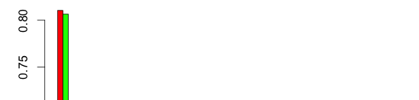
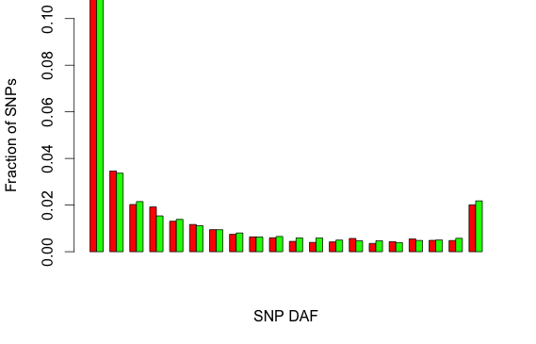
Phase I data
Transcribed
Non Transcribed

Slide 48
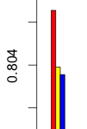
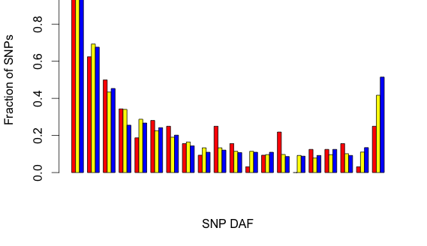
per Activity Type
Active
Zombie
Dead

Slide 49
Observations
SNP density method is not statistically robust for identifying conserved pseudogenes
Pseudogenes as a whole are enriched in rare alleles giving indication that pseudogenes are under selection pressure

Slide 50
On-going work
Primate pseudogene evolution, activity and conservation

Slide 51

Thank you!
Mark
Baikang
Jasmine
Michael
Suganthi
Daifeng
Yan
Jing
Yao
Gersteinlab

