Slide 1
GenomeSeek

Slide 2
GenomeSeek: Identify Genotype from Expression Data
How much information does expression data contain about
Privacy
Given corpus of functional genomics data, how much can we identify about genome of the person?
How much information does variation in one genome “encode” into transcriptome?
Different from the expression differences caused by different conditions.
The inherent difference in expression between people that does not change over time
Information theoretic approach:
Mutual information between genotype and the expression distributions
Similar to eQTL identification:
A more general thought process, i.e., genome-wide application
Different problem: Identify a set of variants and features of expression that can be used to estimate the genotype from transcriptome data.

Slide 3
GenomeSeek: The extent of the relationship between genotypes and expression
Expression: GEUVADIS data, 462 individuals
Gencode v10 protein coding genes (20007 genes)
Use the first 20 principal components (95% of the variance is accounted for) of expression matrix
Projected the gene expressions on the PCs
462x20 matrix for expressions.
Genotypes: 1kG, 421 individuals
Could not find the genotypes 41 individuals in G
Used only SNPs in gencode v10 promoters
30,000 SNPs
Each SNP is converted to 0/1: Reference/Alternate

Slide 4
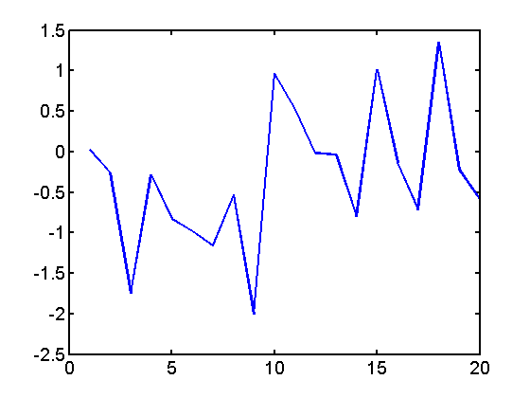
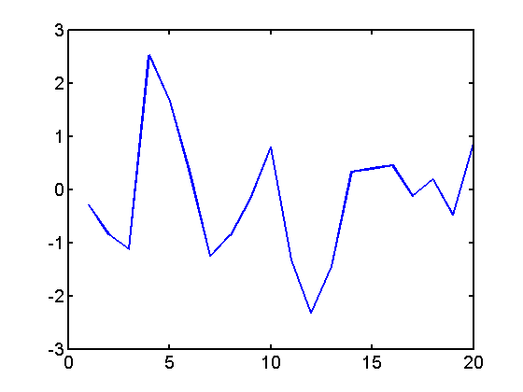
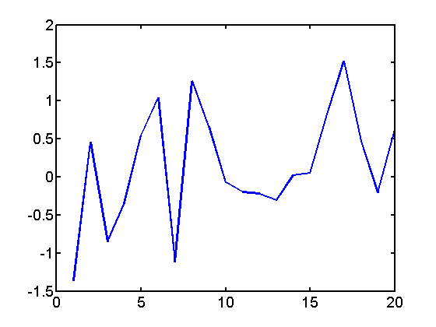
GenomeSeek: The extent of the relationship between genotypes and expression
Genotype
Expression
G_1
G_2
G_421
For each SNP, compute the MI
between the SNP state and expression

Slide 5
GenomeSeek: Shuffle the genomes
Shuffled
Genotypes
Expression
G_10
G_22
Shuffle genotypes for 200 times
G_36
For each SNP, compute the MI
between the SNP state and expression

Slide 6
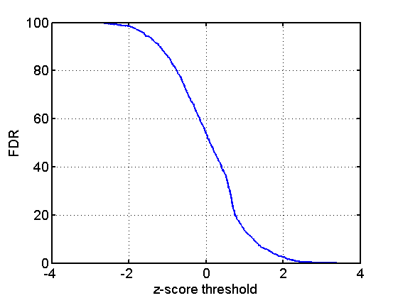
GenomeSeek: Shuffle the genomes
True negatives: For each SNP, shuffle the genomes 10 times use the shuffled genomes as true negatives to estimate FDR
Threshold of 2: 2.5% (2.5%)
Threshold of 3: 0.1% (0.5%)

