Slide 1
Another strategy to make functional consistent orthology prediction
Gang Fang
Gerstein lab 07/18/2013

Slide 2
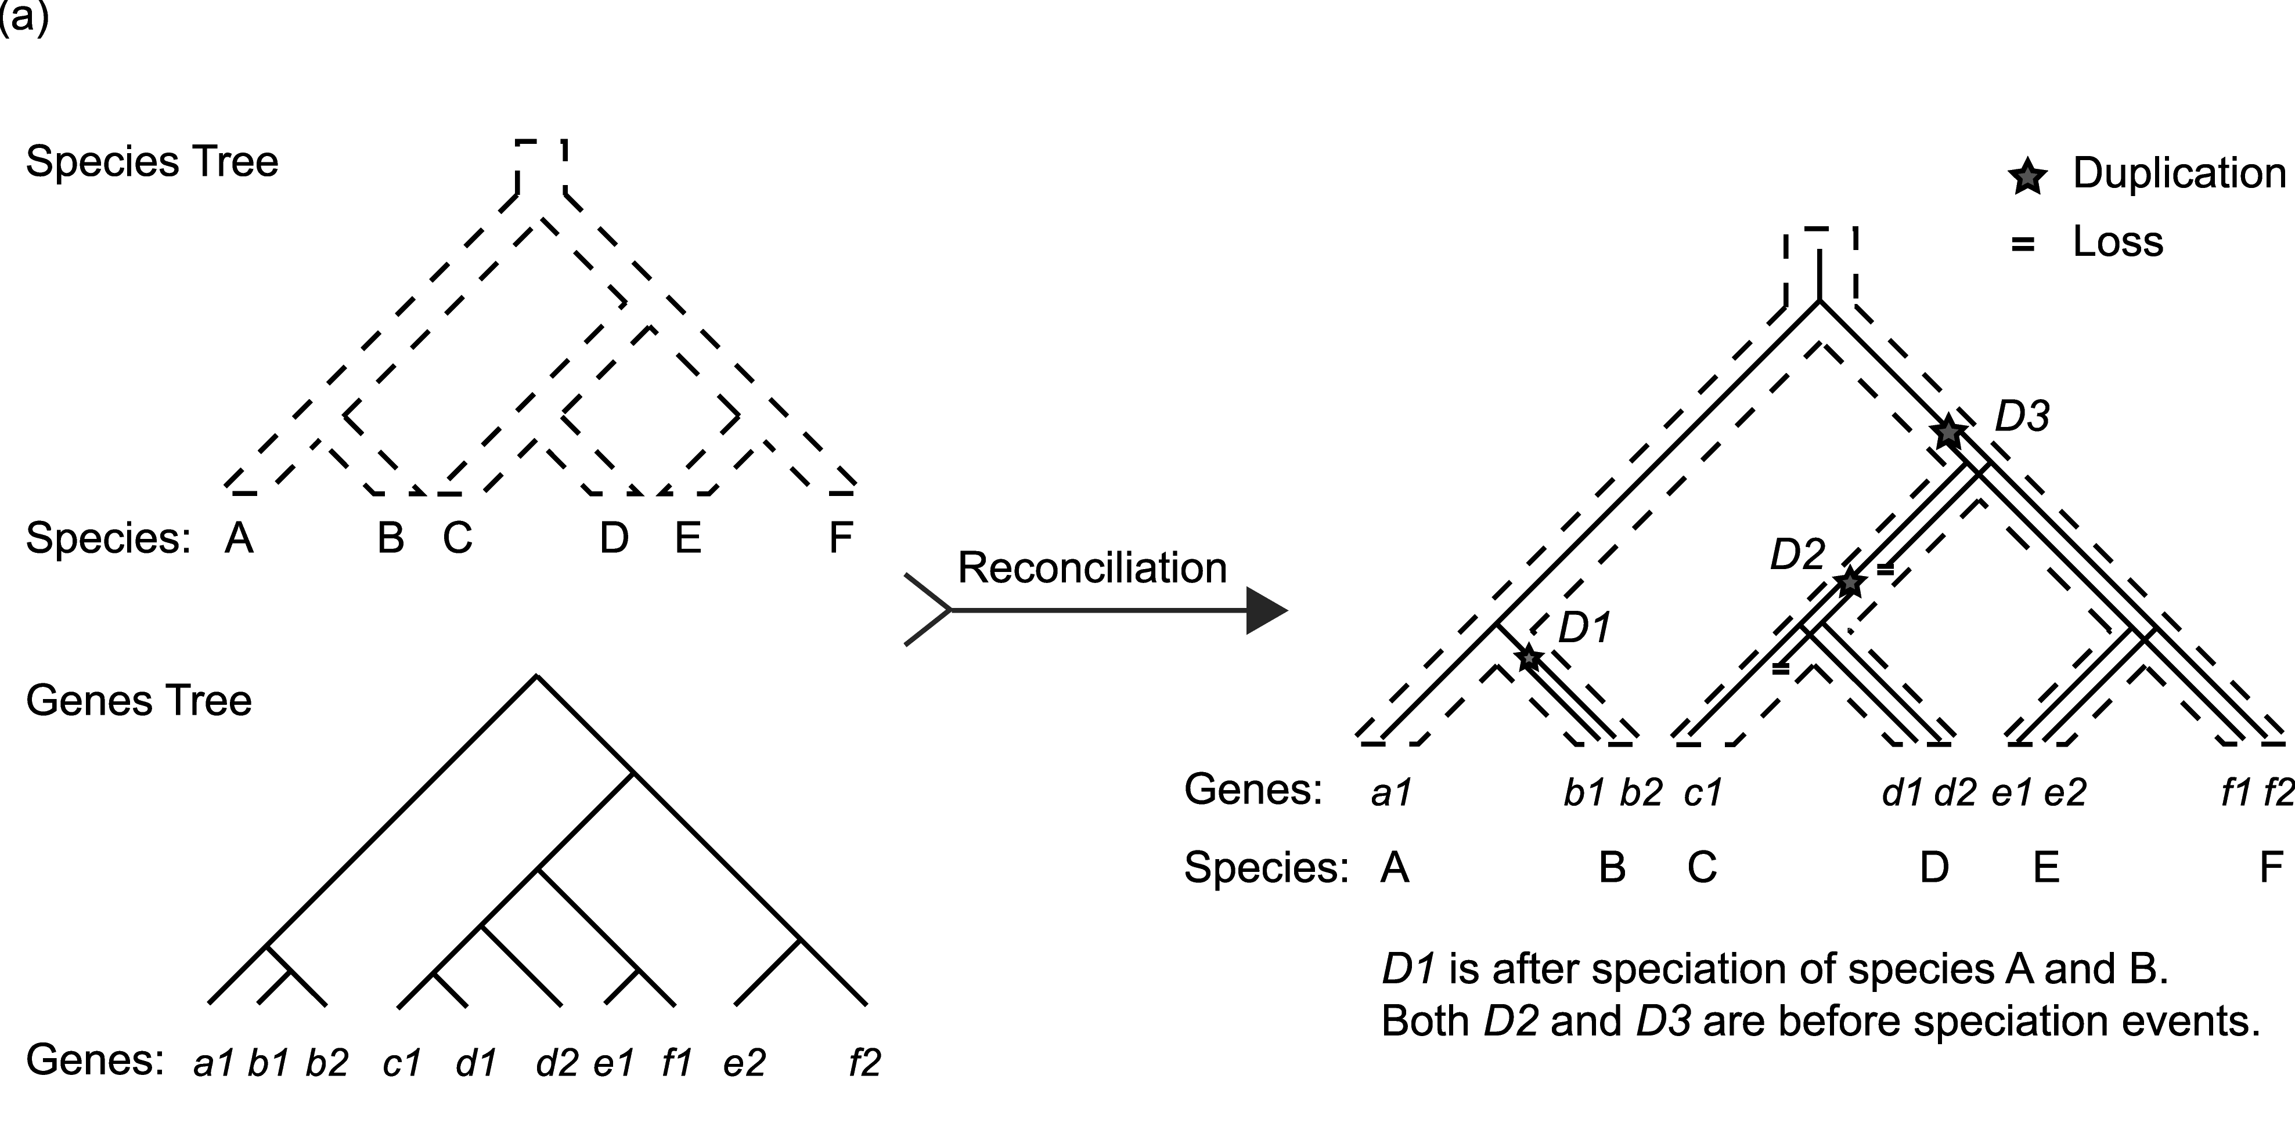
Review of existing orthology identification methods
1. Tree-Based methods (TreeFam)
Gang Fang et al, PLoS CB 2010
Question: Where to cut the tree to make ortholog groups?
Answer: Empirical cutoff.

Slide 3
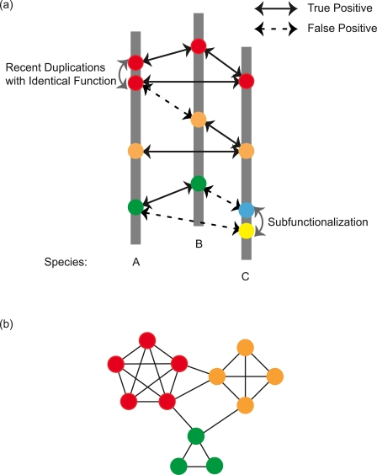
Methods review – cont’d
2. BBH-Based methods (COG, InParanoid, eggNOG)
Question: How to tackle false positives?
Answer: Various strategies, but all are based
on empirical cutoffs
So far the best choice, with a clear biology
function oriented theory. But the model is
over simplified.
Real case examples:
dnaA and ftsZ both have “recent duplications” in some species. If user needs to apply this strategy on un-annotated genomes, they may reach “weird” results.
Gang Fang et al, PLoS CB 2010

Slide 4
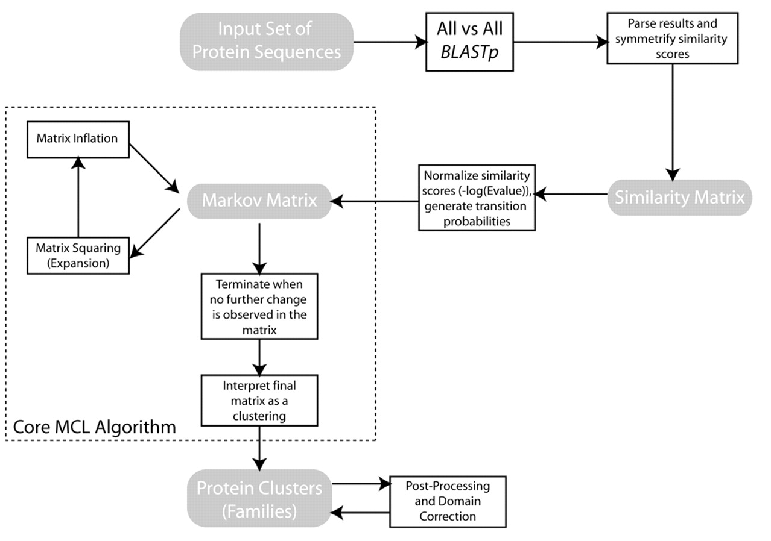
Methods review – cont’d
3. Clustering-Based methods (OrthoMCL, Ensembl Compara)
Pro: 1) unsupervised, 2) it has
biological meaning
Cons: 1) E-value
2) Assume all proteins
are subject to the same
strength of selection
pressure.
-log(E-value)

Slide 5


MCL based on –log(E value)
The E-value of a given alignment depends on three things; the alignment itself, the length (and composition) of the query sequence, and the total length (and composition) of the sequences in the database. The first step in calculation is the scoring of the alignment, described above, to produce a raw score, S. This score is based on an arbitrary scoring system and must be normalized (Karlin & Altschul, 1990, Dembo, Karlin & Zeitouni, 1994) to give a score S' via:
where λ and K are parameters that characterize the expected distribution of S for the scoring system used.
The normalized score, S', has units of bits, and allows for the calculation of actual probabilities. An expectation value, E for the alignment is calculated as:
where m is the length of the database, n is the length of the query sequence and S' is the normalized score from above.

Slide 6
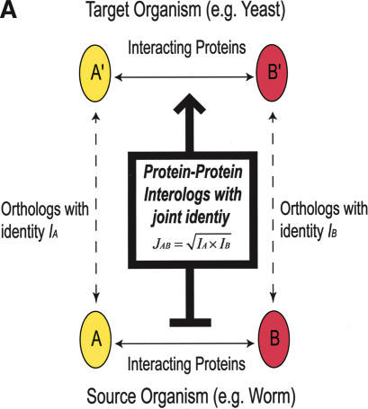
Methods review – cont’d
4. Benchmarking ortholog identification methods using functional genomics data
Question: How to define function?
Case 1: tRNA has function to initiate virus replication
tRNA-derived RNA fragments: A new family of regulatory molecules controlling respiratory syncytial virus replication. (P1401)
The Journal of Immunology, 2013, 190, 57.12
Case 2: two lysyl-tRNA sysnthetases in E. coli
Differential regulation of two genes encoding lysyl-tRNA synthetases in Escherichia coli: lysU-constitutive mutations compensate for a lysS null mutation.
Mol Microbiol. 1992 Jul;6(13):1739-45.
“protein-protein interactions can be transferred when a pair of proteins has a joint sequence identity >80% or a joint E-value <10(-70). “
Yu H, Luscombe NM, Lu HX, Zhu X, Xia Y, et al. (2004) Annotation transfer between genomes: protein-protein interologs and protein-DNA regulogs. Genome Res 14: 1107-1118.
Notes:
tRNA, The Journal of Immunology, 2013, 190, 57.12

Slide 7
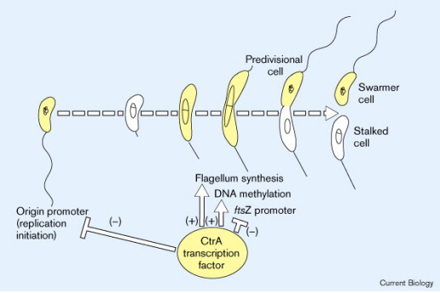
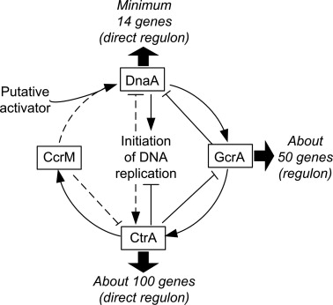
ctrA as example
CB Volume 9, Issue 13, 1 July 1999, Pages R493–R496
Plasmid Volume 67, Issue 2, March 2012, Pages 76–87

Slide 8
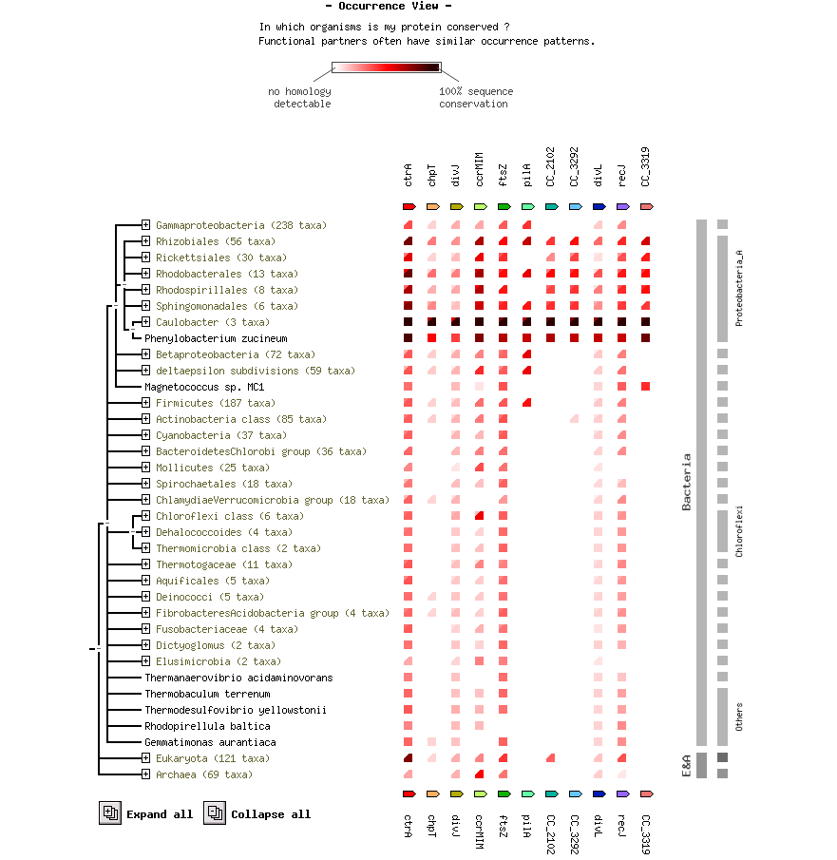
ctrA as an example
Orthology prediction:
From: STRING 9.0
http://string-db.org

Slide 9
Protein function: continuous or discrete evolutionary process

Slide 10
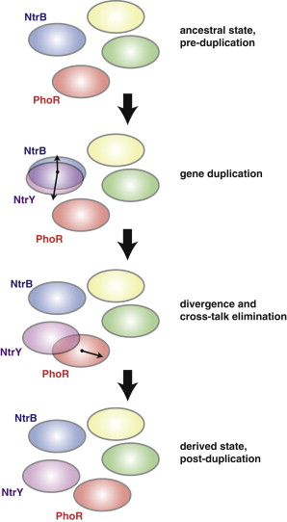
Quick evolution after sub- or neo-functionalization
Cell. 2012 Jul 6;150(1):222-32. doi: 10.1016/j.cell.2012.05.033.
Adaptive mutations that prevent crosstalk enable the expansion of paralogous signaling protein families.
Capra EJ, Perchuk BS, Skerker JM, Laub MT.
Department of Biology, Massachusetts Institute of Technology, Cambridge, MA 02139, USA.
Notes:
Adaptive Divergence of Duplicated Signaling Pathways Involves the Elimination of Crosstalk
Ovals represent the set of response regulators recognized by a histidine kinase, as determined by its specificity residues (see also Figure 5). The NtrB-NtrC pathway is shown duplicating to produce the paralogous system NtrY-NtrX. As these pathways diverged, the specificity of NtrY overlapped that of PhoR, necessitating a change in PhoR specificity to yield the derived state with insulated pathways.

Slide 11
If discrete, we may have a way to identify functional consistent orthologs
Amino acids substitutions per se are sure to be “continuous”, but substitutions are “randomly” preserved?
- No.
Gene fusion/fission/xenolog recombination/Chi-sequence
- “discrete”.
Kumar P, Henikoff S, Ng PC (2009) Predicting the effects of coding non-synonymous variants on protein function using the SIFT algorithm. Nature protocols 4: 1073-1081
Ng PC, Henikoff S (2001) Predicting deleterious amino acid substitutions. Genome research 11: 863-874
Fang G, Bhardwaj N, Robilotto R, Gerstein MB (2010) Getting started in gene orthology and functional analysis. PLoS computational biology 6: e1000703
Smith GR (2012) How RecBCD enzyme and Chi promote DNA break repair and recombination: a molecular biologist's view. Microbiology and molecular biology reviews : MMBR 76: 217-228

Slide 12
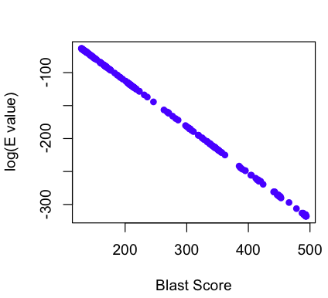
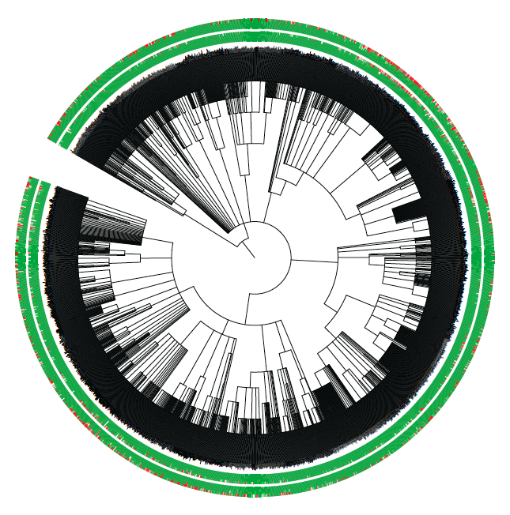
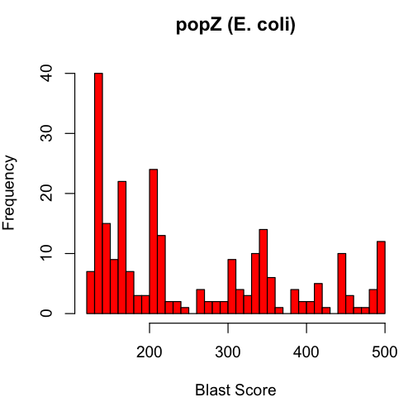
How to get it? -- phylogeny
GreenGenes 16s Tree
PopZ (E. coli)
greengenes.lbl.gov
8.4 M 16s rRNA

Slide 13
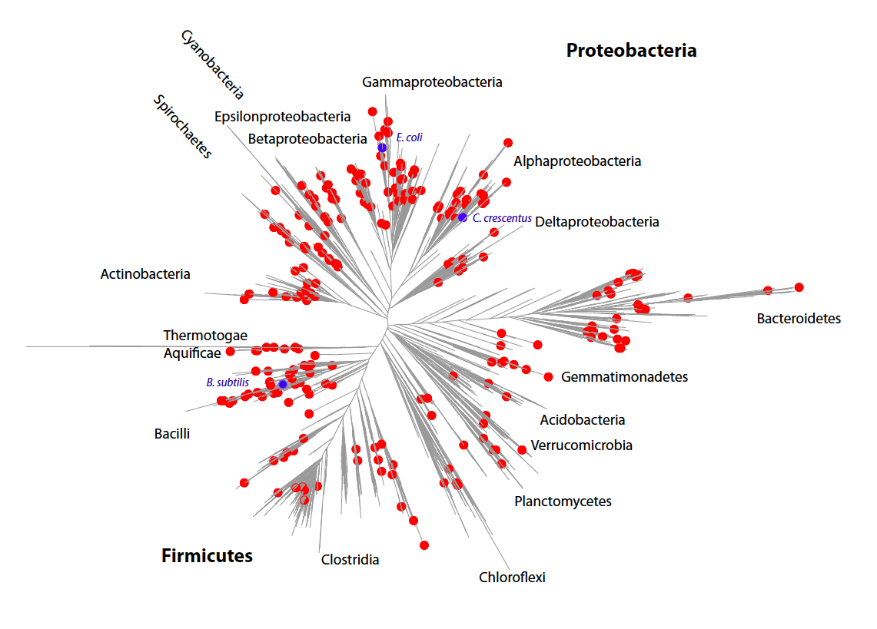
256 clades representing 2,300 species

Slide 14
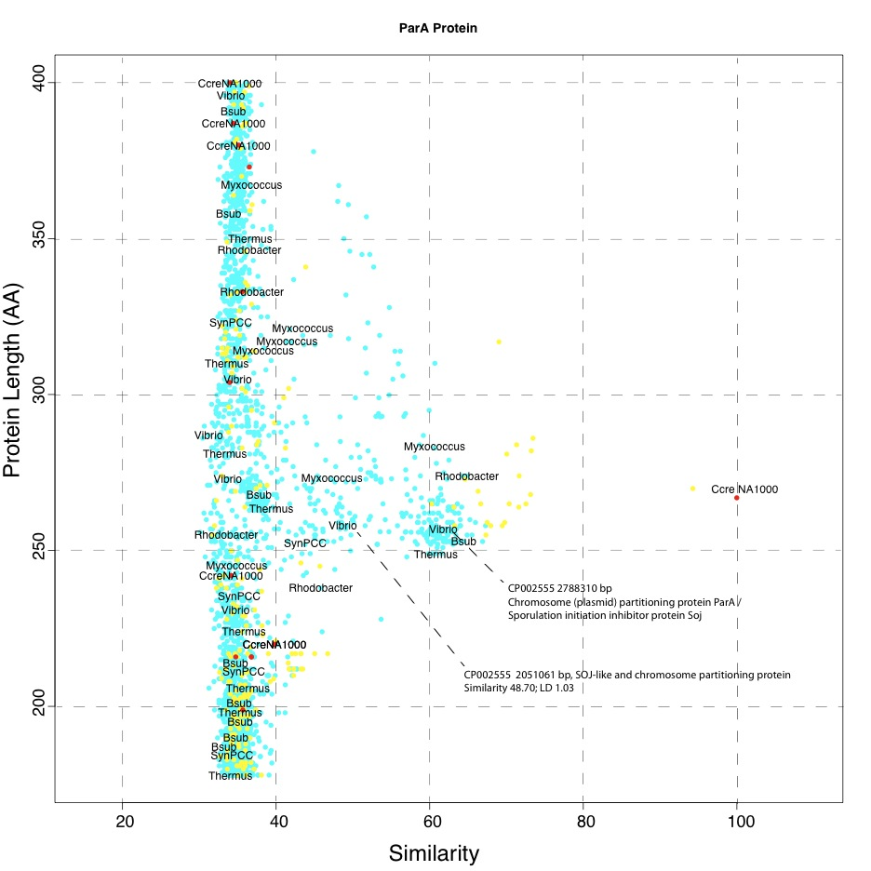
2D Protein Sequence Similarity Map (2D-PSSM)

Slide 15
ATPase and histidine kinases are known as the “trouble makers”
“There are several large clusters in the current collection with complex relationships between members. Two of these, namely the adenosine triphosphatase (ATPase) components of ABC transporters and histidine kinases, each include over 100 members. It is likely that subsequent detailed analysis of these large groups (for example, by phylogenetic tree methods) will result in their split into several distinct COGs, especially when more genomes are available. “
-Koonin, 1997

Slide 16
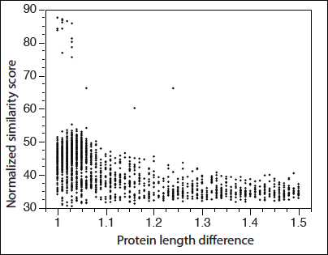
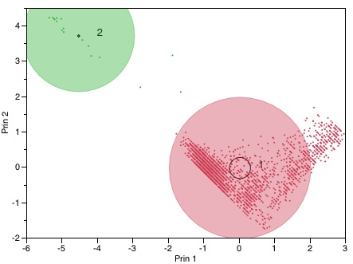
Gaps are there
CtrA
Phylogenetic tree is carefully selected.

Slide 17
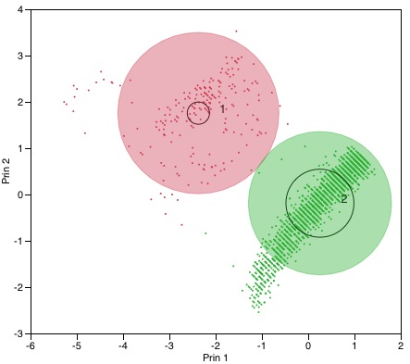
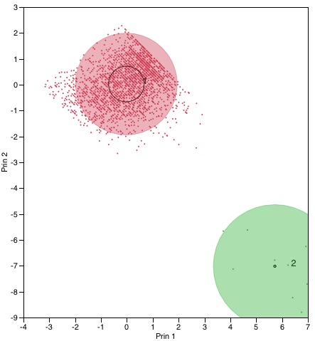
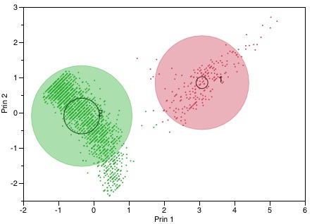
All give reasonable results
FtsZ
PopZ
DnaA

Slide 18
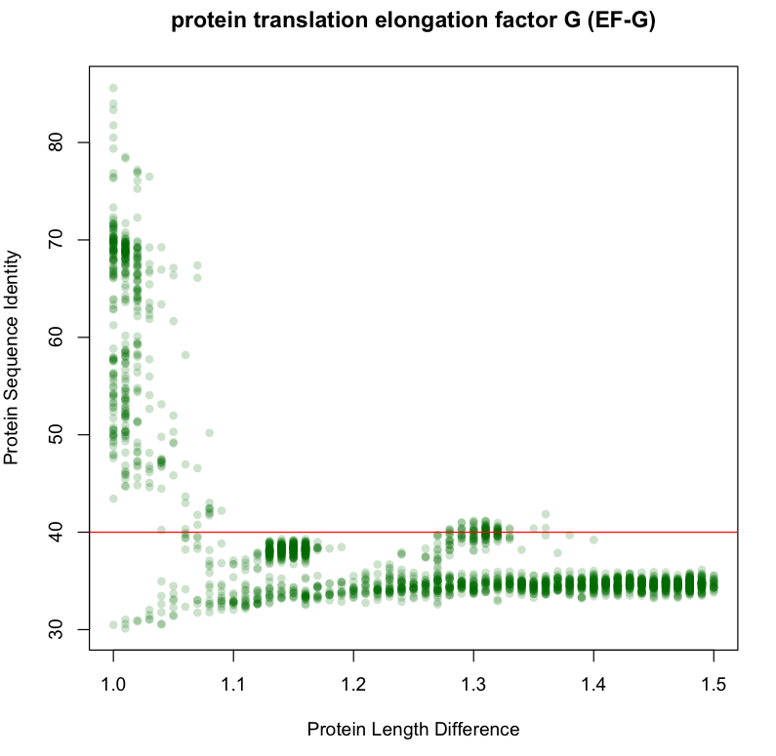
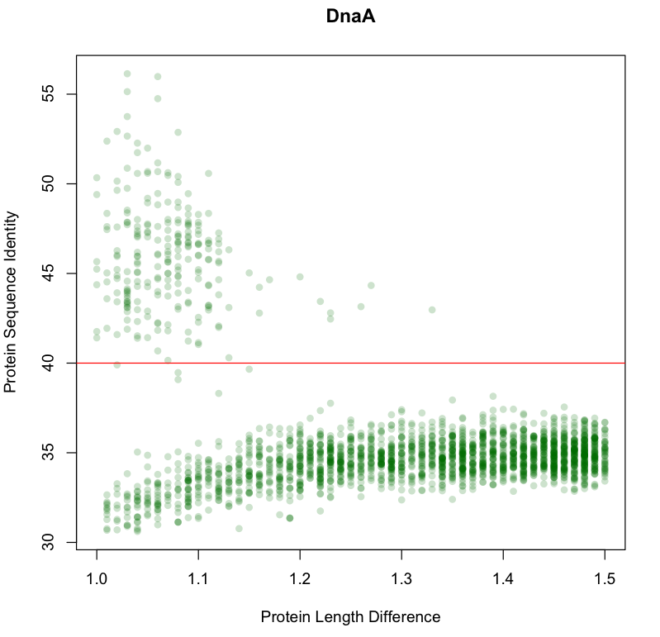
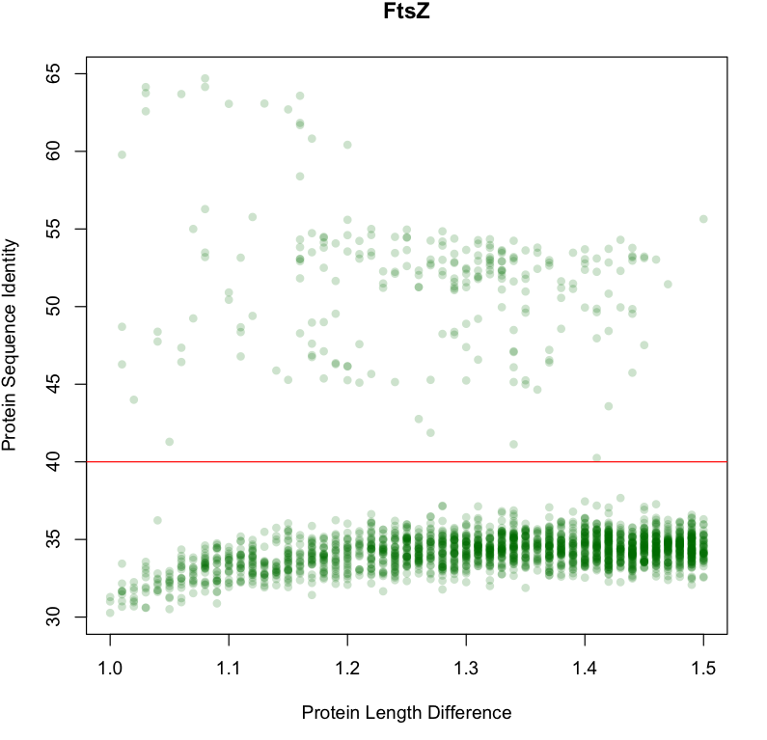
Comparing to protein families with strong selection pressures
Selective pressures applied to different protein families are different

Slide 19
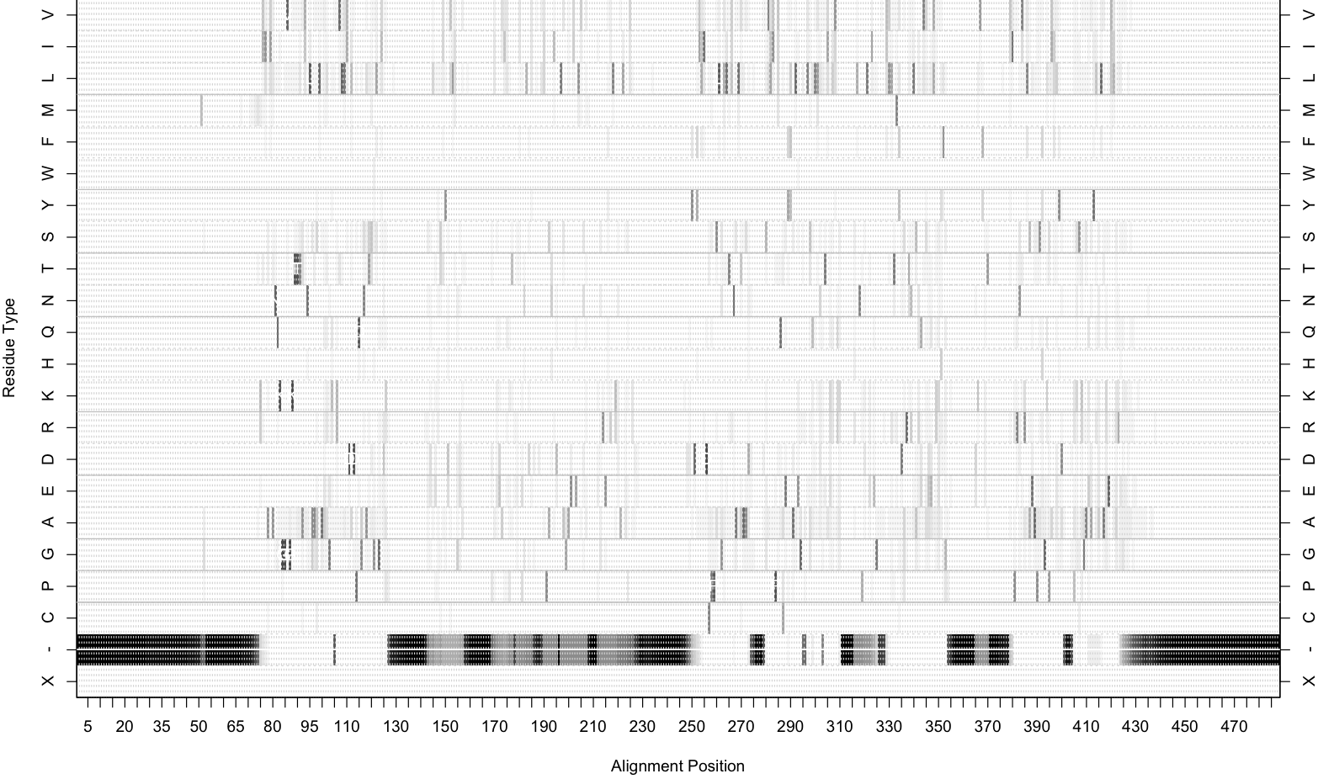
PopZ as an example: Gap agrees with Jump

Slide 20
A few more questions being under investigation
Where are the horizontally transferred genes?
Kmean vs BIC vs outliers
Plant and Fungal proteins

Slide 21
Thank you!

