Slide 1
Mining ENCODE publications

Slide 2
ENCODE related papers
581 ENCODE-funded Publications
291 Publications from non-ENCODE Authors using ENCODE data
Parsing Pubmed XML files (Thanks to Eric Pan)
PMID
Year
Journal
Authors
Abstract
Affiliations
Title
ENCODE data keywords from Mike Pazin (non-ENCODE only)

Slide 3
Number of papers by years

Slide 4
How do ENCODE data influence?
Data types (very general from Mike Pazin’s notes for non-ENCODEs)
TF
RNA
Histone modification
DNase
FAIRE
Chromatin states
Methylation

Slide 5
Networks
Publication network
papers are connected by co-authors
Author network
authors are connected by publications
or connected by 3rd party resource like LinkedIn, Facebook
ENCODE data diffusion/influence over those networks
e.g., random walk to predict data flowing

Slide 6
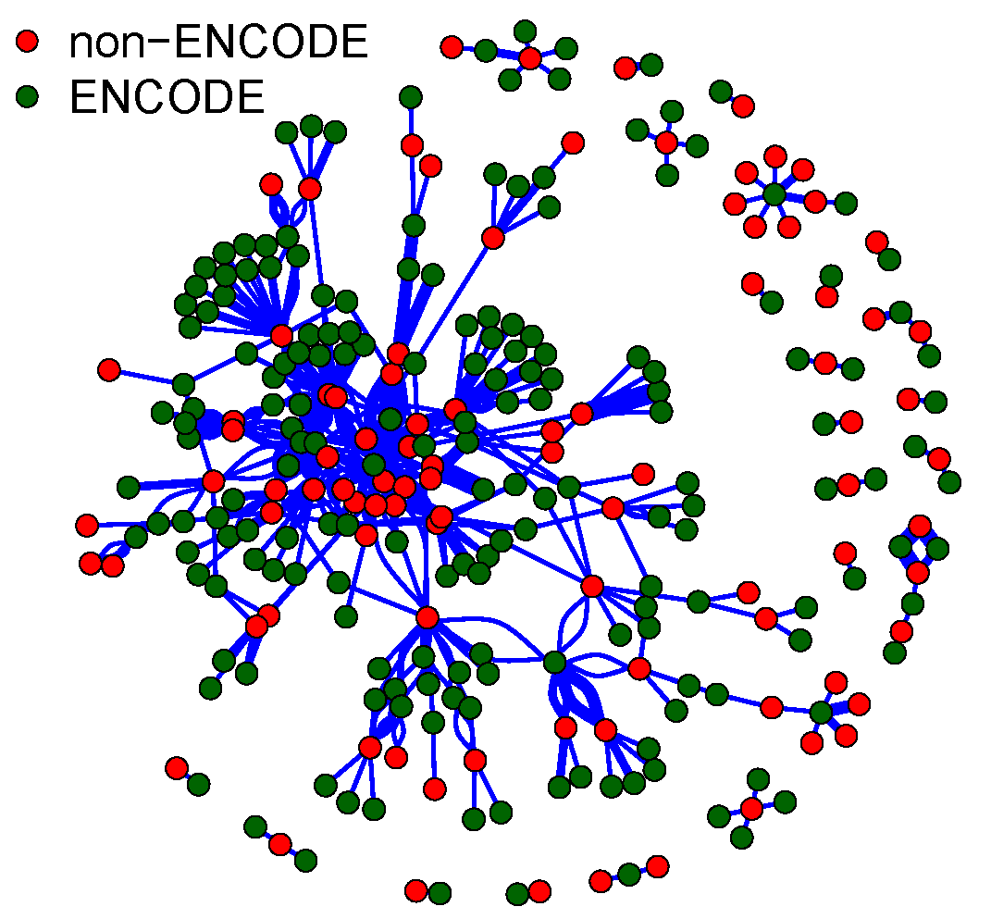
Publication network
95 out of 291 non-ENCODE papers have co-authors with ENCODE papers

Slide 7
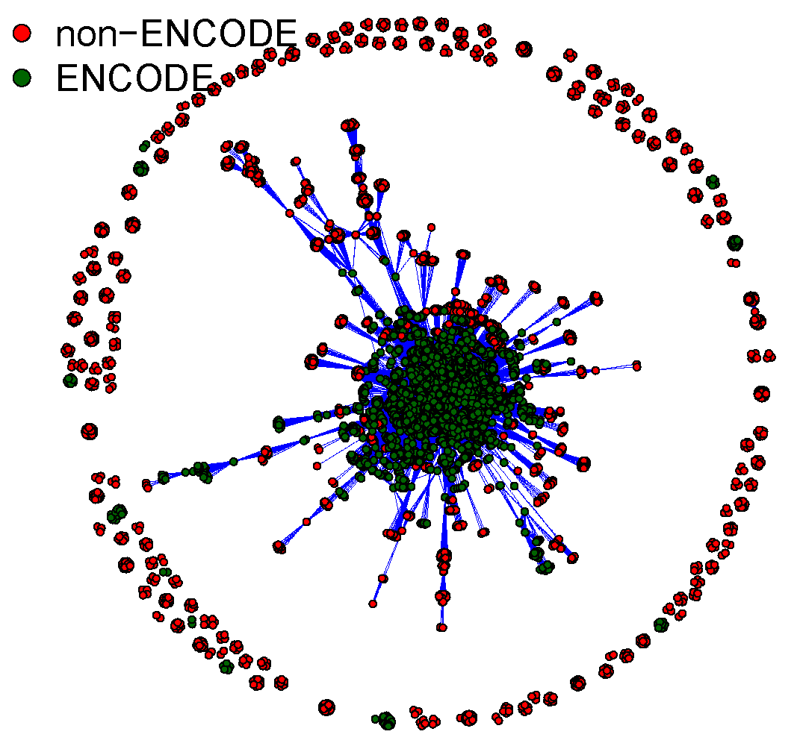
Author network
2409 authors in non-ENCODE papers
2268
141
2799
2940 authors in ENCODE papers

Slide 8
Authors in both ENCODE and non-ENCODE papers

