Slide 1
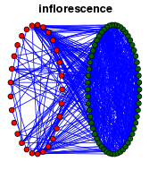
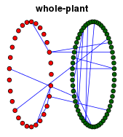
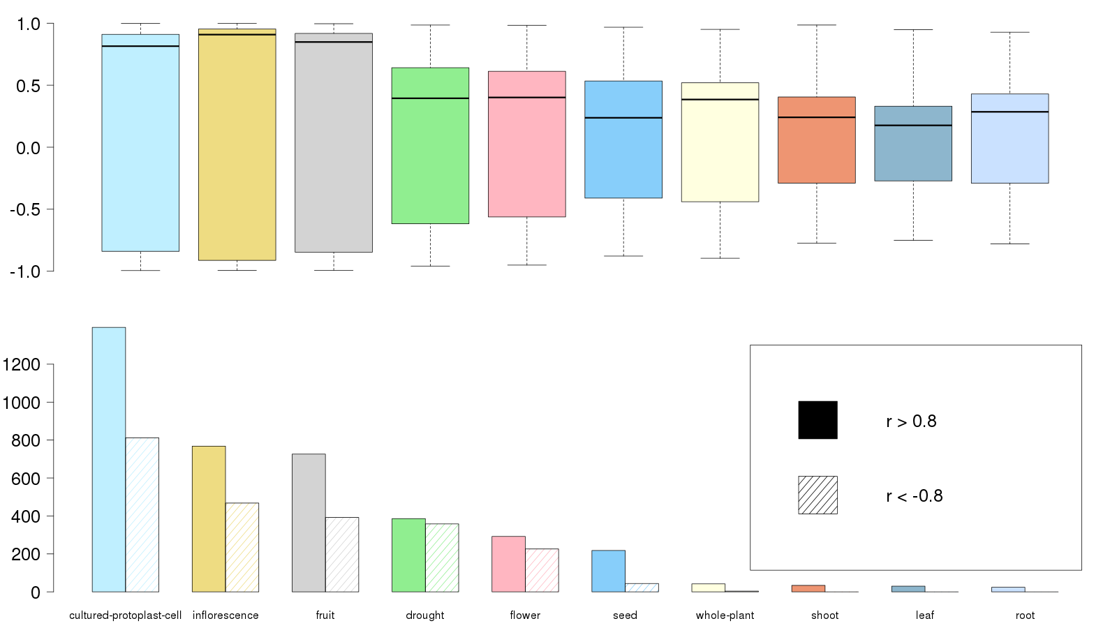
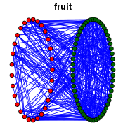
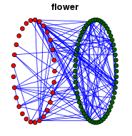
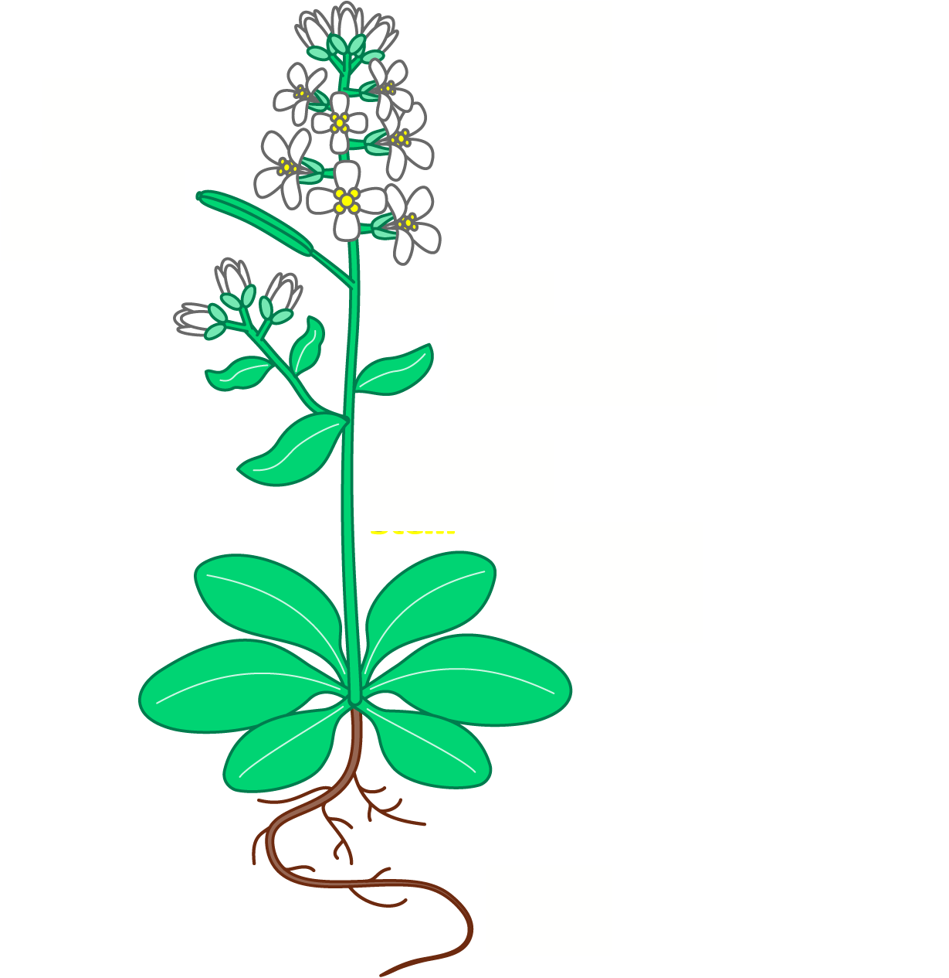
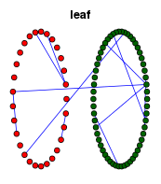
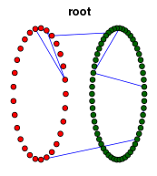
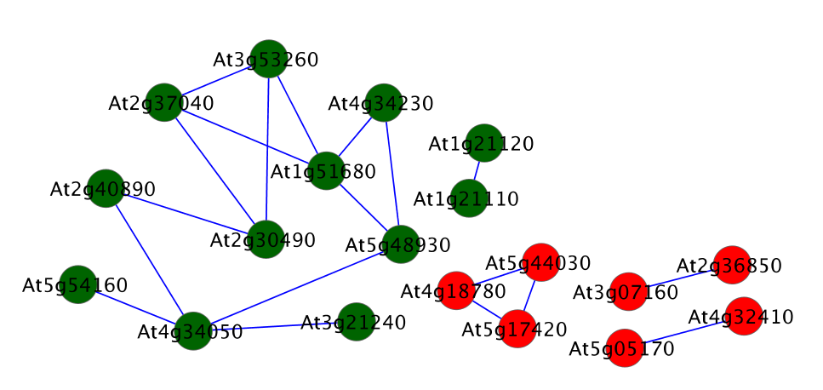
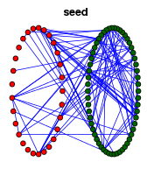
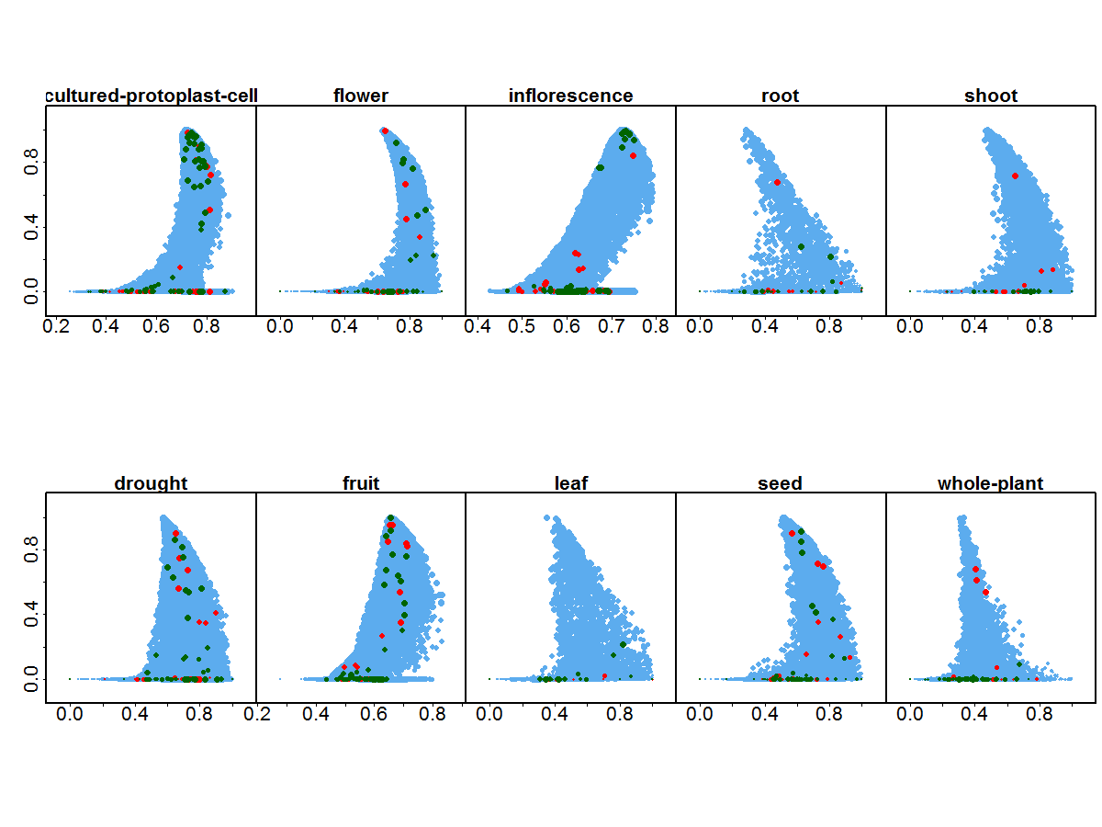
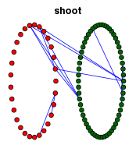
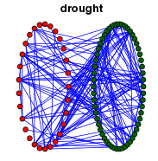
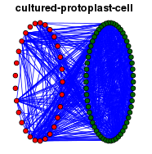
Tissue-specific gene co-expression network analysis for cell wall and monolignol biosynthesis genes in Arabidopsis
Abstract (short): In this study, we analyzed the bio-fuel related genes in cell wall and monolignol biosynthesis along with their network characteristics in gene co-expression networks (GCNs) for ten tissue types in Arabidopsis. The GCN along with related network analysis provides a systematic way to understand genomic functions. Also, the co-expressed genes are very likely to work similarly as functional modules in a GCN. We used KBase co-expression tools to construct GCNs. First, we identified the tissues that bio-fuel genes function coordinately or independently via clustering the degree of bio-fuel gene co-expression in their GCNs (bi-clustering genes and tissues). Second, we found their GCN neighbors along with their enriched GO terms. Third, we found consistently co-expressed bio-fuel genes across tissues. Finally, we identified the bio-fuel genes that played globally important and locally specific genomic functions in corresponding tissues. Therefore, our analysis established a computational framework to research novel bio-fuel genes/functions, especially for other species such as Poplar.
Methods
Results
Co-expressions of bio-fuel genes (CWB/MLB) across tissues
Daifeng Wang^{1,2},
Eric Pan³,
Gang Fang^{1,2},
Sunita Kumari⁵,
Fei He⁷,
Doreen Ware^{5,6} ,
Sergei Maslov⁷,
Mark Gerstein^{1,2,4}
Select a tissue in Arabidopsis
(e.g., seed, flower, et al.)
KBase expression service
Tissue-specific gene co-expression networks
Cultured Protoplast Cell
Inflorescence
Fruit
Drought
Flower
Seed
Whole plant
Shoot
Leaf
Root
Tissue (# of samples) |  | Inflorescence(5) | whole-plant (32)
Co-expression network of
Enriched GO terms of neighbors | CWB | protein-glutathionylation
 | MLB
Cell wall biosynthesis genes
KBase Commands:
coex_pipeline.py
Gene expression table
(~22k genes across samples)
Monolignol biosynthesis genes
coex_filter
ANOVA
Log-odd ratios
Filtering
(optional) – highly differentially expressed genes
Pearson correlation>0.8,
p value < 0.01
Pearson correlations between CWB&MLB genes
¹ Department of Molecular Biophysics and Biochemistry,
² Program in Computational Biology and Bioinformatics,
³ Department of Biomedical Engineering ,
⁴ Department of Computer Science, Yale University.
⁵ Cold Spring Harbor Laboratory.
⁶ United States Department of Agriculture-Agricultural Research Service.
⁷ Brookhaven National Laboratory.
KBase co-expression pipeline
coex_net
Correlation
WGCNA
Gene co-expression network
Fruit(6)
Flower(29)
coex_cluster
Hierarchical
WGCNA
Clustering
Gene co-expression
modules
Gene co-expression
network
(Pearson correlation>0.8,
p value < 0.01)
# of CWB/MLB gene pairs with r>0.8 or r<-0.8
KBase co-expression pipeline instruction:
Enable executable permissions
$ chmod a+x coex_pipeline.py
$ chmod a+x coex_*.r
Specify the working directory using the flag: –d DIRECTORY
The pipeline produces FOUR files by default
--filter_output datafilter.csv
--network_output coexpression_network_edge_list.csv
--hclust_output coex_module_h.csv
--wgcna_output coex_module_w.csv
You can also suppress any operation using the following flags
--skip_filter
--skip_network
--skip_cluster2_hclust
--skip_cluster2_wgcna
Use $ ./coex_pipeline.py –h to see all of the options
Select bio-fuel genes –
Cell wall biosynthesis (CWB), Monolignol biosynthesis (MLB)
1 2 3 4 5 6 7 8 9 10
Leaf(194)
Co-expressed bio-fuel genes at ≥ 5 tissues
Root(76)
Phenylalanine ammonia lyase
Network Analysis
Clustering coefficient
Eigenvector Centrality
Neighboring genes
Degree
Co-expression relationship
enriched GO terms
bi-clustering across tissues
local influence
local important function
local cliquishness
tissue-specific function
globally influence
general important function
O-methyltransferase
CoA ligase
Glucan Synthase-like
Cinnamyl alcohol dehydrogenase
Cellulose Synthase
References:
Weighted gene co-expression network analysis (WGCNA), BMC Bioinformatics 2008, 9:559
Arabidopsis Plant Cell Wall Biosynthesis Gene Families http://www.arabidopsis.org/browse/genefamily/cellwall.jsp
Identiﬁcation of candidate genes in Arabidopsis and Populus cell wall biosynthesis using text-mining,co-expression network analysis and comparative genomics, Plant Sci. 2011 Dec;181(6):675-87
Co-expression of cell wall-related genes: new tools and insights, Front Plant Sci. 2012;3:83
Genome-scale identification of cell-wall related genes in Arabidopsis based on co-expression network analysis, BMC Plant Biol. 2012 Aug 9;12:138
Arabidopsis picture from http://genocon.org/assignment-2012/assignment-a/
Seed(87)
Gene network characteristics
Prediction of novel bio-fuel related genes/pathways across tissues
Shoot(109)
Funding: This work was funded as part of the Department of Energy Systems Biology Knowledgebase (KBase, www.kbase.us) supported by the U.S. Department of Energy, Office of Science, Office of Biological and Environmental Research Genomic Science Program under Contract DE-AC02-06CH11357
Big globally influential
CWB&MLB genes
Strong locally cliquish
CWB&MLB genes
Eigenvector Centrality
Running the following command from the command line:
./coex_pipeline.py ‑d cultured‑protoplast‑cell ‑i data.csv ‑‑filter_p 0.0001 ‑‑filter_method a ‑‑sample_index sample_id.csv ‑‑filter_output datafilter.csv ‑‑corr_threshold 0.8 ‑‑network_output edge_list.csv ‑‑min_module_size 50 ‑‑max_median_k 2000 ‑‑hclust_output coex_module_h.csv ‑‑wgcna_output coex_module_w.csv
Drought(27)
cultured-protoplast-cell(7)
Given the following folder structure:
Produces the following:
CURRENT_DIRECTORY
├───coex_pipeline.py
├───coex_filter.r
├───coex_network.r
├───coex_cluster.py
├───coex_cluster2.py
├───arabidopsis
├───cultured-protoplast-cell
├───data.csv
├───sample_id.csv
├───datafilter.csv
├───edge_list.csv
├───coex_module_h.csv
├───coex_module_w.csv
CURRENT_DIRECTORY
├───coex_pipeline.py
├───coex_filter.r
├───coex_network.r
├───coex_cluster.py
├───coex_cluster2.py
├───arabidopsis
├───cultured-protoplast-cell
├───data.csv
├───sample_id.csv
Example
Clustering Coefficient
all genes

