Slide 1
The Genotype-Tissue Expression (GTEx) Project
To study the relationship between genetic variation and gene expression in human tissues.

Slide 2
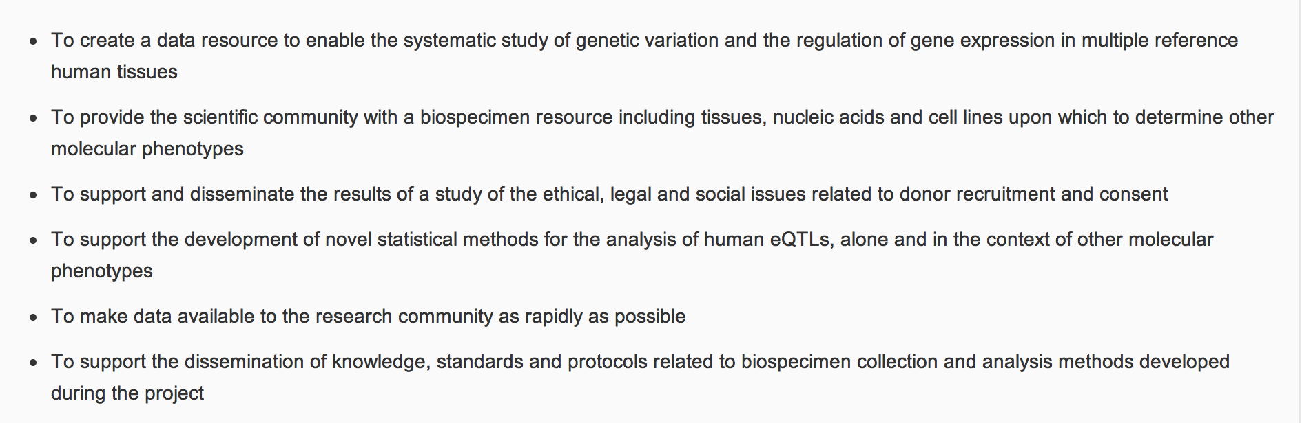
Goals

Slide 3
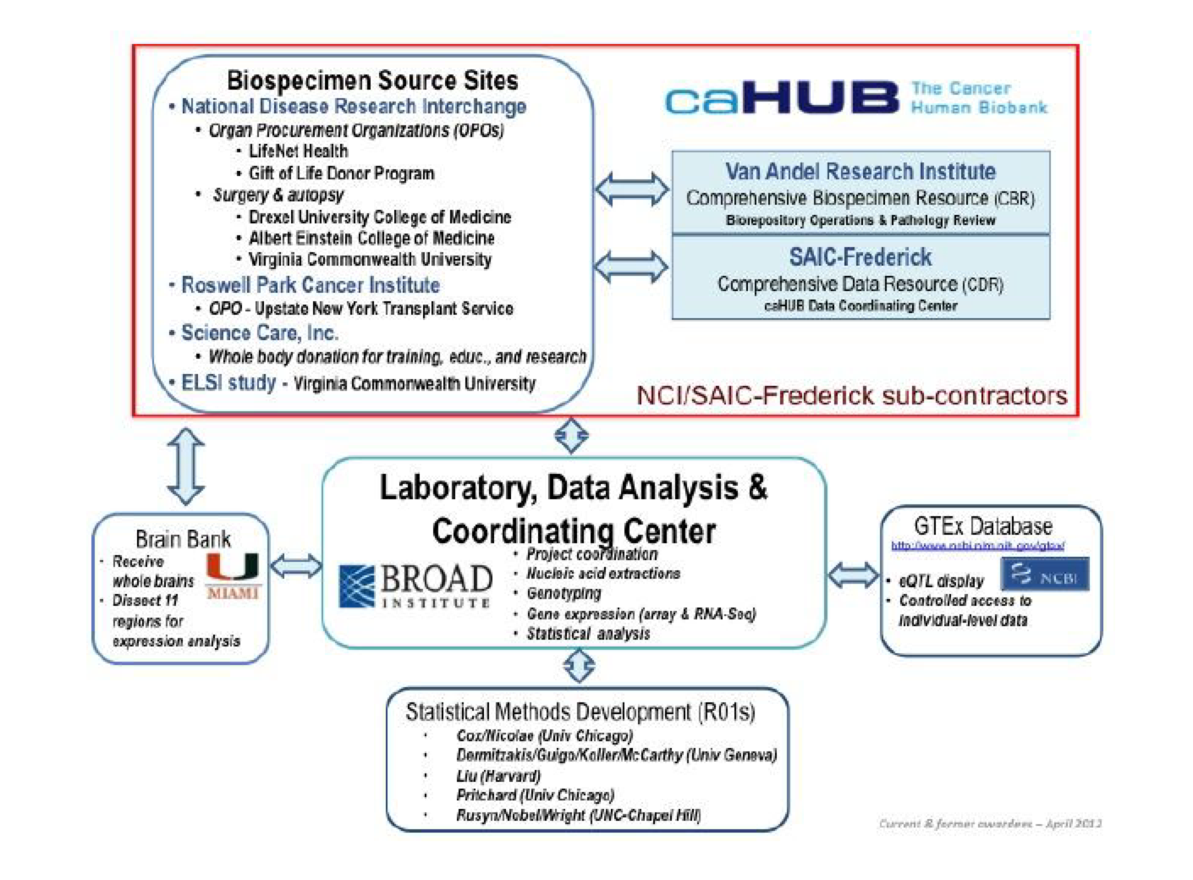

Slide 4
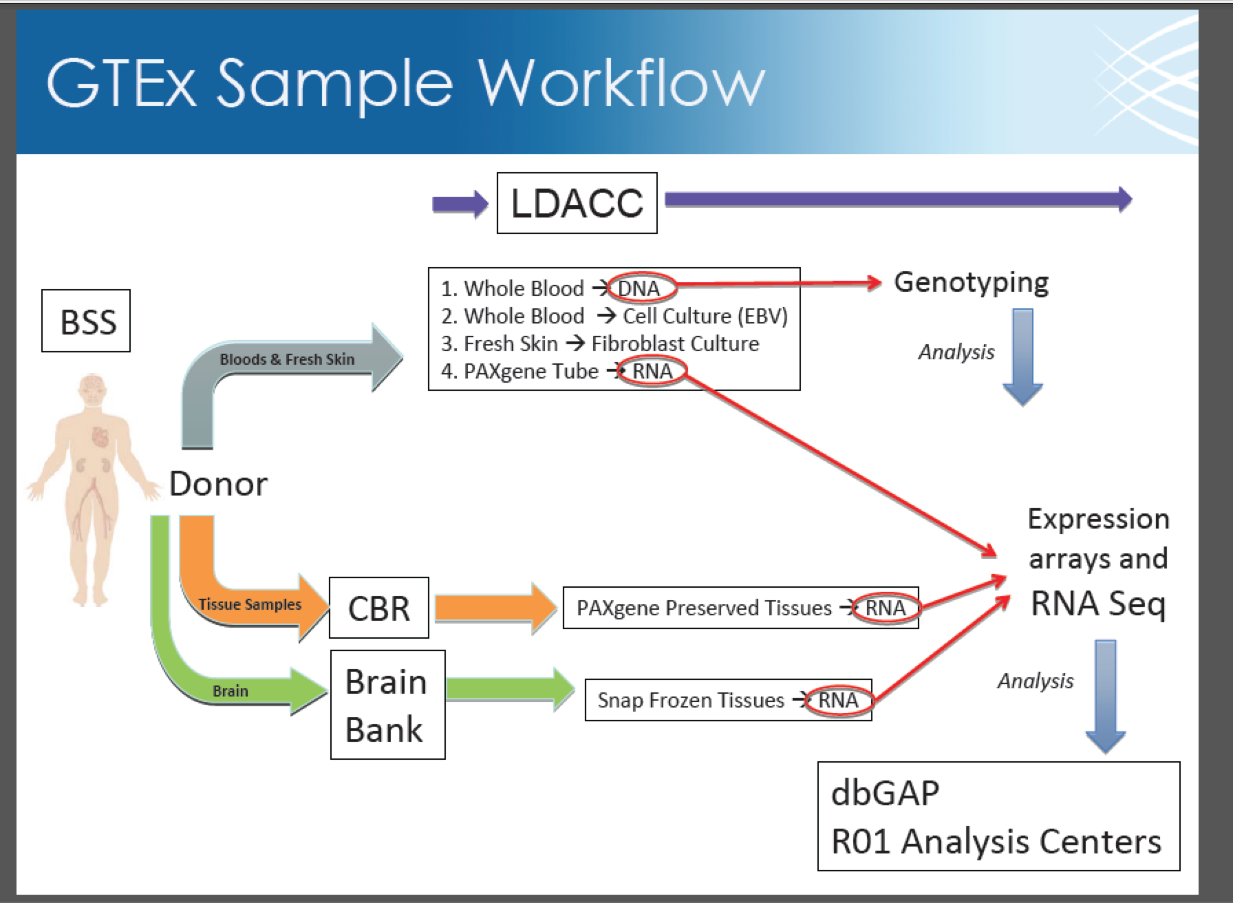
Notes:
Biospecimen source sites, lab data analysis and coordinating center, Organized by Cancer Human Biobank, Comprehensive Biospecimen Resource, a Comprehensive Data Resource,

Slide 5
Study Inclusion/Exclusion Criteria
21 ≤ Age (years) ≤ 70
18.5 < BMI < 35
Time between death and tissue collection less than 24 hours
No whole blood transfusion within 48 hours prior to death
No metastatic cancer
No chemotherapy or radiation therapy within the 2 years prior to death
Generally unselected for presence or absence of diseases or disorders, except for potentially communicable diseases that disqualify someone to donate organs or tissues would also be disqualifying for GTEx.

Slide 6
Overview
Samples are from biobanked tissues
Goal is to establish a database of genotype-gene expression relationships based on 900 donor samples.
PAXgene, alcohol-based fixative for the tissues in 0.2 – 0.5 gram aliquots.
Tissue processing includes histopathologic review, FPPE paraffin embedding, RNA extraction.

Slide 7
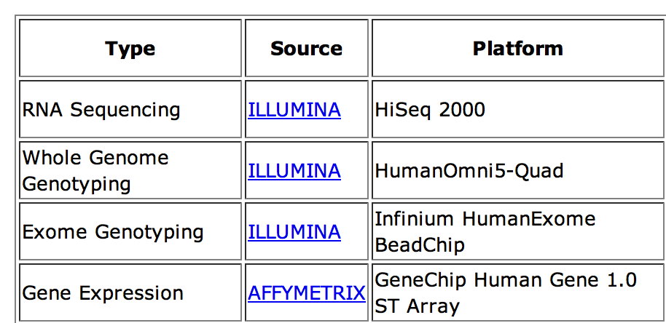
Molecular Data

Slide 8
Pilot Phase
2.5 years, completed in Jan 2013
Genotype data from 190 individuals
1,814 total tissues (47 tissues sites)
Profiled by RNA-Seq to a median depth of 80 million aligned reads

Slide 9
Power Analysis
Power to detect eqtls depends
Number of donors
The eQTL effect size
The presence of noise, as well as the significance threshold selected, which is chosen on the basis of the number of hypotheses tested.
Notes:
By treating RNA expression levels as quantitative traits, eQTLs will be identified as sites containing genetic variation that correlate with changes in RNA expression.

Slide 10
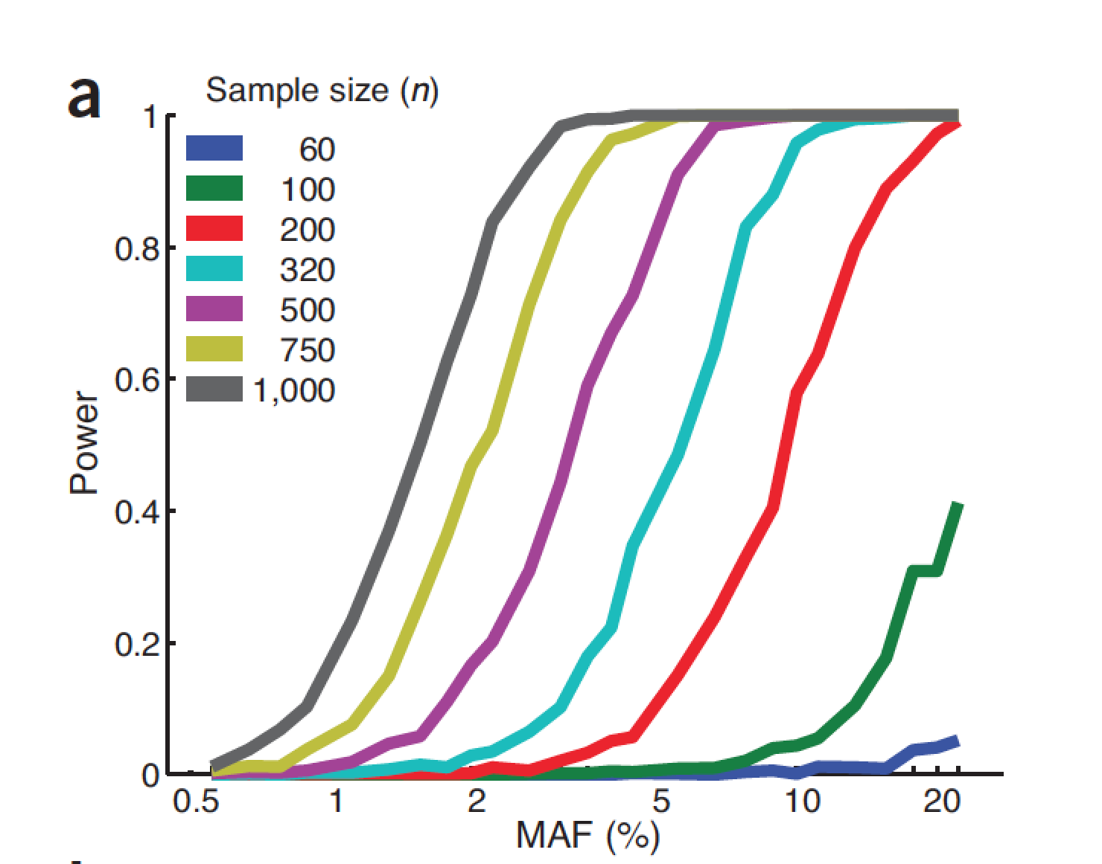
Power To Detect eqtls
Notes:
Effect of sample size and MAF to detect cis-eqtls. α = 0.05/200,000, reflecting Bonferroni correction for 200,000 hypotheses based on 20,000 genes and anaverage of 10 non-redundant SNPs in the region
±100 kb of each gene.

Slide 11
GTEx Project Community Meeting
The Broad Institute on June 18th, 2013
16 talks, missed 2.5 talks
250 attendees, many from pharma/biotech

Slide 12
Dermitzakis:eQTLs in GTEx data
Comprehensive list of eQTLs. 1000s of eQTLs in each tissue
Estimated the degree of overlap among tissues, talked about methods development for eQTL discovery, tissue comparisons, and effect size estimation
Discovering eQTL in one tissue increased by probing many tissues
Most eQTLs are either shared or specific, intermediate sharing is less. Probability for a SNP to be active in all nine tissues is 0.56. Probability of being active in a single tissue is just 0.03.
Notes:
Unique mapping, 6 max mismatches, linear regression, 1MB radius around TSS, 5% FRD (Storey), Also looked around 100kB window, David DeLuca, Firehose Gtex, 5,000-10000 cis eQTLs, 5X> depth than Pickrell/Montgomery. Intersect GTEx with GWS, ENCODE, Epigenomcs Roadmap. Will mis some eQTLs due to strict thresholds

Slide 13
Roderic Guigo: The Human Trancriptome Across Tissues And Individuals
Aim: Reference distbribution of gene expression levels
15,000 – 20,000 genes in most tissues. Blood and testis two outliers ( fewer genes expressed in blood, testis more genes expressed)
5 genes are highly expressed accounting for 50% of transcription in blood
2,000-3,000 lncRNAs, 12,000 pgenes expressed
Testis expresses twice the number of lncrnas than other tissues
Lncrnas and pgenes are tissue-specific compared to coding genes
In general, one isoform dominates the expression when there are 2 isoforms.
Aprroximately half of the annotated isoforms are expressed for most genes in one tissue.
In blood, 3 isoforms are expressed equally, whereas in the rest one major isoform seen for one example.
Splicing QTLs: Altrans (Drematzikis lab method), looks for inclusion level of exon-exon junction
eqtl seeker (Roderic’s group)
Two methods identify different kinds of events ( ALtrans more for exon skipping events)
Splicing eQTL affects splice pattern, may/may not affect expression level, emphasized results are preliminary
Notes:
2 factor annova to estimate variances
interindividual variability of gene expression in all tissues. Xist expressed in females, rp5-1164c1.2 : chr 20 lncrna Asian-specific higher expression. Exon skipping, gwas hit for Alzheimer, no known e-qtl

Slide 14
Michael Weale: The Impact Of SNPs Within Probe Sequence On Expression eQTL Studies
Arrays are Cheap, HT suited for eQTL studies, easier to interpret than RNA-Seq (LRKK2 low expressed )
PiP problem with arrays
Based on 1000G/ESP6500, identified common variants in CEU in the probe sequence of two commonly used microarray panels.
Assessed impact of PiP in cerebellum and frontal cortex tissues in 438 healthy individuals on the number of declared cis-QTLs.
5.5% of probes map to ref genome polymorphisms but account for 90% of brain eQTL hits
False positive eQTL in MAPT due to PiP (Trabzunii ert al )HMG, 2012
Pip-finder tool bitly.com/pipfinder, existing and new eQTL data should be checked
RNASeq alignments moving towards personal diploid genome
Notes:
Polymorphisms in target mRNA sequence can affect binding to probe sequence leading to false +ve and false –ve eQTLs with any other SNPs in LD.
UK Brain expression Consortium Exon-level expression, Affy human exon 1st

Slide 15
Barbara Engelhardt: Replication of cis- and trans-eQTLs across cell types
Identified cis-eQTLs from 11 studies on 7 cell-types.
Quantified cell-type specificity of eQTLs across studies
Integrated eQTL with ENCODE data
Predicted cell type specific eQTL based on a classifier. (paper coming out in Plos gen).
Study size and replicate arrays account for >95% of the variability in fraction of genes showing an eQTL
Replicate studies or deeper coverage will lead to discovery of more eQTLs.
Notes:
Gene-correlation networks, co-regulated genes, regulated by a specific genetic variant
Dictionary learning

Slide 16
Yaniv Erlich: Expression STRs Reveals a new layer of eQTLs
Mendelian diseases with STR repeats
Unstable tandem repeats in promoter confer transcriptional evolvability
eSTRs PIG3, NOS2A, MMP9, EGFR
Genome-wide survey of STRs based on 1000G
8-% polymorphic with MAF> 1%
Greater no. of STRs in introns vs exons
~3000 signifcant expression STRs. (don’t remember what data, mentioned both RNA-Seq and array data to correlate STR variation and expression, I think Geuvadis)
Creation of z-dna as one possible mechanism for STRs being eSTR.
Notes:
STRs can modulate expression by the formation of secondary structures. STRs are 2-6 bp. Regressing conditioned on SNPs to show STR is not just tagging a causal SNP. Back mutation higher in STRs , so LD not as high as you would see with linked SNPs
Genome-wide survey of expression STRs

Slide 17
Joao Fadista: Prediction of individual level genotypes based on GTEx gene expression
Nordic transplantation units (network for islet transplantation).
Used top eQTLs from 89 human pancreatic islets
Bayesian method to predict SNP genotypes from 19 GTEx samples for which gene expression has been made public (note genotypes only available through dbGap)
Matrix-eqtl (R package)
Average posterior probability of 89% for individual genotype prediction.
Limitations of current methods of deidentification, can identify sample mix up
However prediction works well with common variants, not rare/private: so probably not useful by itself for individual identification
Eric Schadt , Sangsoon Woo: Bayesian method Nat Genetics, 2012?
Notes:
, centralized tissue bank, so many different people may work on same sample

Slide 18
Stephen Montogomery: High Resolution Allele-Specific Expression Across Multiple Tissues
Analyzed allele-specific expression in one sample (10 tissues collected post-mortem)
Even with 15 million RNA-seq reads, 52.2% of sites have depth less than 30 and therefore have lowered ability to confidently label as ASE
Deep and targeted allelic sequencing of variants of unknown signif
Analysis of 50, loss-of-function Stop sites, 74 private and predicted deleterious i. The LoF variant is lowly expressed across the tissues
Identified tissue-specific ASE in genes with rare, deleterious nsSNPs
Allelic heterogeneity in different tissues (coding SNPs based on exome sequencing), also heritable based on an analysis of a 3 generation 17-member CEPH family
A set of gold standard eQTLs that can be used to identify the multi-tissue impact of rare and deleterious variants
Notes:
Wei Sun, Biometrics, genotypic +alleleic info improves power to discover eqtl.
Informs private and rare regulatory variation
Jacob Degner, Bioinformatics 2009 (Mappping bias)

Slide 19
Tuuli: ASE in GTEx, quantifying regulatory variation in personalized transcriptomes
167 individuals, 45 tissues, total 1658 samples
Thyroid has higher eqtl as well higher ASE ( more regulatory variation)
Only 20% of cases you will be able to assess ASE
Quantifying tissue-specificity
10% chance of being expressed and also exhibit ASE in different tissues
ASE different in different individuals
eQTL genotypes are not great predictors of individual phenotype even at the cellular level
Notes:
More SNPs in thyroid,m ost analyses sampling are done to exactly 30 reads in order to avoid coverage issues. Note: only relatively highly expressed, perhaps ubiquitously expressed, genes can be analyzed.

Slide 20
Manuel Rivas: Transcriptome analysis of functional impact of LoF variants
Resource for annotation of LoF, annotate SNPs from exome based on expression data
Assessing NMD via ASE
Transcript isoform quantifications using FLUX
Exome chip data vs Gtex (only 40% will be LOF in all tissues)
Analyzing muscle –specific for a disorder: Good to look at the dominant form that is expressed in muscle (LMNA example, only 2 isoforms expressed in muscle)
Correlated effect of NMD with gene expression
# of exons, distance from donor splice junction, no. of alternative transcripts, 3:-UTR size
Heterogeneity of NMD signals across all tissues

Slide 21
Sherlock the crime fighter
Eric Damazon
Hypertension: NO GWAS signal in WTCCC. Now add in adipose eqls and you start to see a signal
GTex to look at disease classes: Autoimune disorders,
MAGIC consortium: HOMA-IR
PGC (psychiatric genetic consortium)
GIANT consortium
ADHD: 2000 genetic studies, no GWAS significant.. Start adding tissue eqtls. You see tissue-specific enrichments
PheGenI: NHGRI catalog, Google
Eqtl provide a way of linking noncoding loci to a target gene
Eqtl-based assignment disagrees with proximity-assigned genes (300/475) based on PheGenI

Slide 22
Jason Wright (Vineeta Agarwala)
9p21 non-coding region has lots of nc associations for cnacer, diabetes, heart disease etc..
In vitro enhancer screen
9p21-t2d physically interacts with CDKN2A and CDKN2B promoters
TALENs
CRISPR/ Feng Zhang lab

Slide 23
Daniel MacArthur: How to use GTEx data for identifying disease variant
RNASEQ for genomic diagnosis of rare muscle diseases
~500 rare missense, ~ 100 rare in known disease genes, 1-2 de novo
Narrowing down causal variants: Segregation, filter by frequency , annotation
Expression helped, isoform-specific example
More highly expressed genes seem to be more conserved
Nemaline myopathy
IBAS score (Kasper Lage), networks clusters to identify causal variant.
Notes:
Gene expression data and PPIs are used to inform the clinical exome sequencing. IBAS protein-protein interaction score and way to score placement within a PPI network.

Slide 24
Luke Ward: Integrating GTex with ENCODE + Roadmap
Functional maps of genome for annotation
Evolutionary signatures for coding/nc , microrna, motifs.
Chromatin signatures
Activity signatures,
Many mapped tisses in GTex and roadmap epigenome
Peak shifting permutation for enrichment analyses
Constitutive eqtl… same in most tissues except in a few
Enrichment of SNP in distal enhancer(look up Manolis Kellis paper, cell-type specific)
Enhancer enrichment, methyl –qtl enrichment for GWAS based diseases/SNPs

Slide 25
Discussion
Community resource
How to improve it?
Access to the eqtl list, a flat file
Are you going to do WG sequence? Exome sequence will be done. Piolt project for whole genome sequencing
Do we have EMR report, not highest quality, lot of clinical data (accessible only though dbGap)
Foetal samples? Development disorders? Foetal in development versus postnatal brains/isoforms very different
Bones/other joints: expanding to other tissues
Have you considered using iPS cells instead of donors?
Linkage structure, can you provide.
1800 RNA-Seq data, can you give protocol for doing RNA-Seq for other studies? How deep, how long etc..
going to 900 patients/25000 tissues

