Slide 1
SeekPeak Benchmarks

Slide 2
SeekPeak Benchmarks
Datasets:
ENCODE 2, GM12878 pooled replicates
h3k36me3, h3k4me3, h3k4me1, h3k27me3

Slide 3
h3k36me3, h3k4me3: Longest regions between expressed exon over gene bodies
For each gene, compute rpkm for each exon
Threshold at rpkm > 1
For each gene, use the beginning of leftmost exon to end of rightmost one as ground truth for h3k36me3 peaks
FN rate: Fraction of ground truth coverage not in peaks
FP rate: Fraction of peaks outside ground truth

Slide 4
SeekPeak Benchmarks
How do we generate a golden dataset?
Divide genome into 500 bp windows
Compute the binomial p-value for chip enrichment of signal in each window
ENCODE 2, GM12878 pooled replicates
h3k36me3, h3k4me3, h3k4me1, h3k27me3
Assume the windows with p-value smaller than 10^-5 are definitely enriched and should be called in a peak region
Set these regions as true positives to estimate sensitivity

Slide 5
H3k36me3, h3k4me3: Longest regions between expressed exon over gene bodies
Overlapping H3k36me3 peaks | FP Rate | FN rate
SeekPeak | 0.150 | 0.311
PeakRanger | 0.034 | 0.550
SPP | 0.042 | 0.542
BCP | 0.106 | 0.363
SICER | 0.066 | 0.440
Overlapping H3k36me3 peaks | # Overlapping Expressed gene promoters (11389)
SeekPeak | 9425
PeakRanger | 9372
SPP | 9446
BCP | 9321
SICER | 9430

Slide 6
# of TP windows overlapping with peaks called by each method
 | H3k4me3 (195,350) | H3k4me1 (336,467) | H3k36me3 (360,434) | H3k27me3 (212,009)
SeekPeak | 162,559 | 314,691 | 347,970 | 157,032
PeakRanger | 156,844 | 330,082 | 336,620 | 104,011
SPP | 167,263 | 313,535 | 340,849 | 156,322
BCP | 156,184 | 295,678 | 342,721 | 72,184
SICER | 161,471 | 307,865 | 342,839 | 145,652
# of peaks called by each method
 | H3k4me3 | H3k4me1 | H3k36me3 | H3k27me3
SeekPeak | 52,301 | 67,428 | 14,681 | 13,972
PeakRanger | 48,043 | 143,933 | 117,861 | 72,341
SPP | 46,688 | 88,970 | 75,675 | 106,085
BCP | 26,166 | 40,452 | 10,190 | 9,313
SICER | 37,395 | 67,531 | 33,817 | 48,675

Slide 7
Total coverage of peaks in bps called by each method
 | H3k4me3 | H3k4me1 | H3k36me3 | H3k27me3
SeekPeak | 147,579,172 | 353,247,166 | 448,892,332 | 539,640,811
PeakRanger | 110,209,600 | 304,318,400 | 275,866,850 | 82,068,450
SPP | 133,265,044 | 252,992,805 | 278,092,847 | 179,958,012
BCP | 137,110,000 | 279,924,400 | 393,830,600 | 320,539,800
SICER | 142,216,605 | 256,710,869 | 349,352,583 | 240,121,325
H3k27me3/h3k36me3 complImentarity
 | Fraction of h3k36me3 and h3k27me3 overlap
SeekPeak | 0.0041
PeakRanger | 0.0069
SPP | 0.0018
BCP | 0.0230
SICER | 0.0058

Slide 8
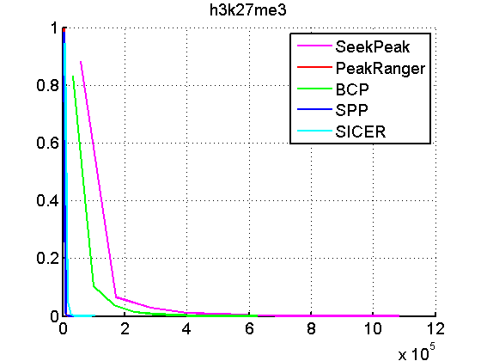
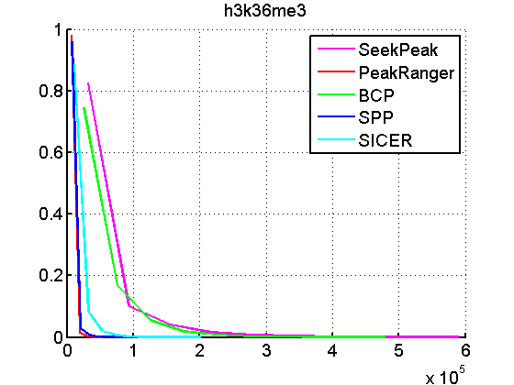
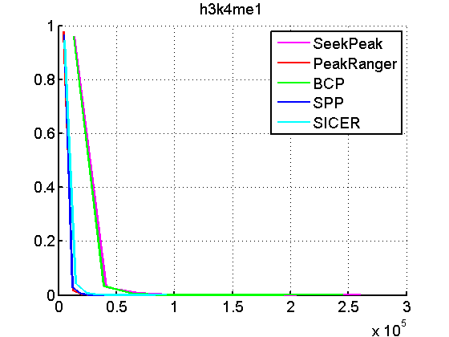
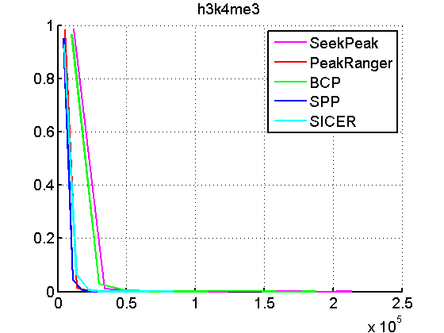
Peak Length Distributions

