Slide 1
SeekPeak

Slide 2
A more general peak calling: Multiscale peak calling
ChIP-seq track is smoothed with larger windows with increasing scales
Lower scales: More details
More punctate peaks
Higher scales: Smoother data
Broader peaks
The peaks that survive high number of scales are merged together to build the broad peaks
The ends of the peaks are pruned by:
Thresholding with threshold identified with 5% FDR from Poisson model
P-value minimization
Each peak is scored with a binomial test with respect to control and q-values are computed with BH correction
If control is not available, a control is generated from the ChIP signal

Slide 3
Multi-scale peak calling: Scale-varying Filtering
Filter data with Gaussians of changing widths

Slide 4
Multi-scale peak calling
General workflow:
Select broad/punctate mode
Do multiscale filtering starting from
Identify the peaks that stay for
Prune the ends with respect to 5% FDR thresholding
Prune the ends with respect to p-value minimization
Compare with the original PeakSeq: The algorithm is same when used with one

Slide 5
SeekPeak: Broad peak calling
Applied to ENCODE h3k36me3 (activating) and h3k27me3 (repressor) tracks for K562 from Broad.
PeakSeqX:
H3k36me3: 12,143 peaks (relaxed: 34,991 peaks)
208,624,251 bases
H3k27me3: 13,391 peaks (relaxed: 52,221 peaks)
246,506,410 bases
MACS2 (broad peak calling mode)
H3k36me3: 79,045 peaks
109,913,134 bases
H3k27me3: 54,226 peaks
46,714,777 bases
Coverage of expressed genes (RPKM>10) is 185,586,850 bases

Slide 6
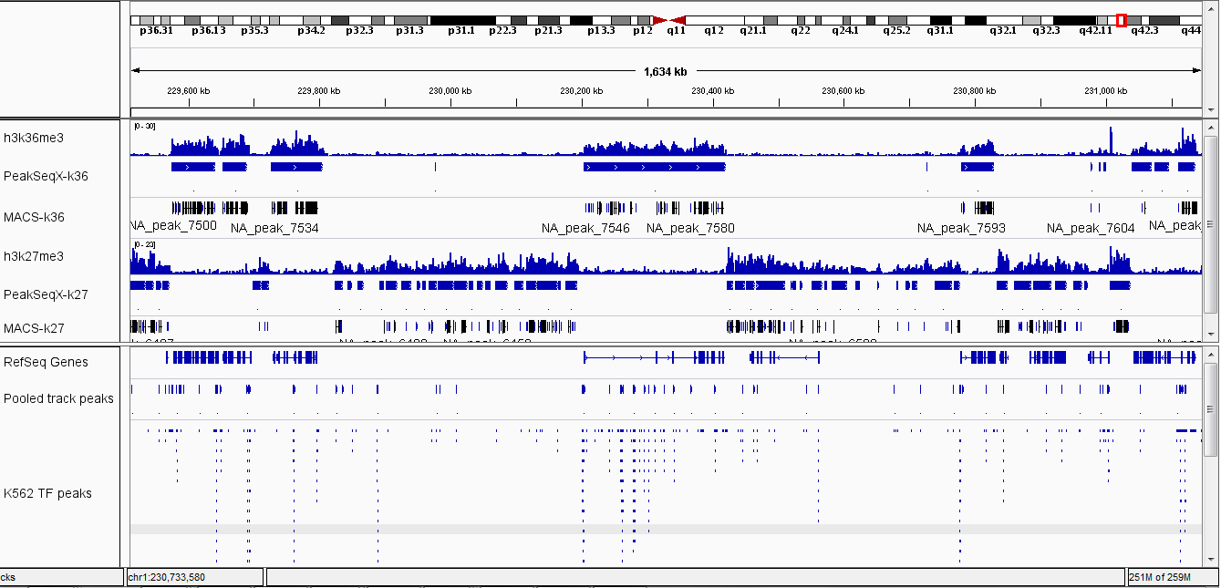
Peaks Splitting for k27 Peaks

Slide 7
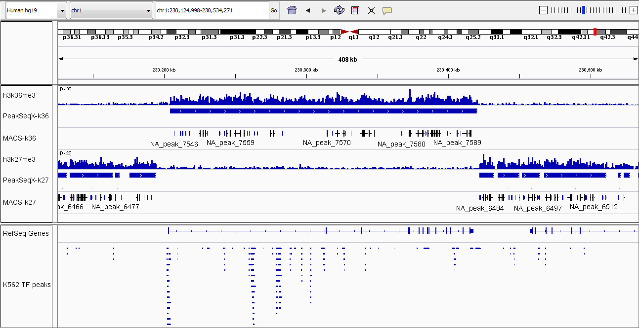
SeekPeak: Broad peak calling

Slide 8
Runtime
PeakSeqX processed these datasets in around 2 hours and 45 minutes
This can be decreased substantially
MACS is pretty fast
Both datasets finished in 20 minutes

Slide 9
SeekPeak: Feature Association
Broad peak calling is just one application
The peak merging aspect can be used to predict the association of signal features that are close to each other
Peaks close to TSSes/genes: TF target prediction
TF peaks
Pool the reads from the 33 TF ChIP-Seq experiments for K562
1,253,742,891 reads
Call the peaks for each TF
With punctate parameters
Call the peaks for the pooled track: 145,000 peaks are called
Overlap the per TF peaks with the pooled track peaks

Slide 10
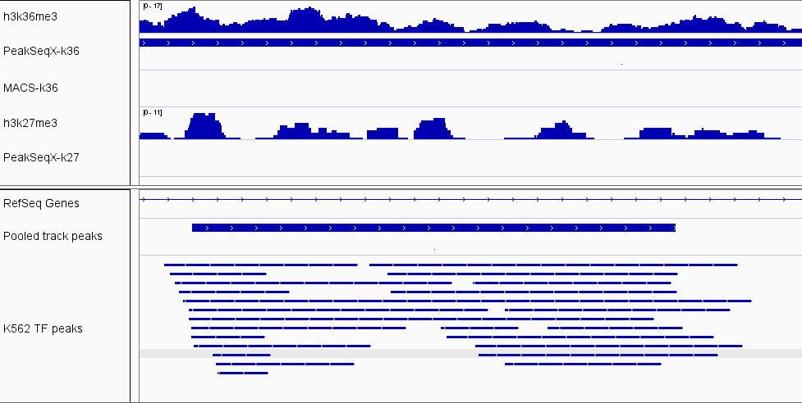
TF Association

Slide 11
Distribution of Number of Distinct TFs in Pooled track peaks

Slide 12
Rows: Pooled peaks
Cols: TFs
CTCF, Smc
and Znf143

Slide 13
TF/Histone Peak Annotation (In progress)
Peak Splitting: Some peaks are large regions with multiple peaks visible with eye
Identify the sub-peaks from a given peak
Motif identification: Identify the enriched k-mers in the set of called peaks, identify in each peak the regions the most likely positions that the TF is bound in addition to the peak region
Similar to identifying the motif for the TF
We can also run one of the motif finding algorithms
Incorporate variants: Allelic effects and motif breaks
TF target prediction:
Feature association (Find close by genes)
Expression/binding correlation

