Slide 1
Overview of the
ENCODE DAC
Mark Gerstein
on behalf of the DAC PI & co-Is
(Z Weng, M Kellis, S Liu, R Guigo, B Noble, R Irizarry
and their lab members, in particular,
J Rozowsky, A Kundaje, S Djebali....)
ENCODE Consortium Meeting, May 2013, CA

Slide 2
DAC Mission: to provide computational muscle to aid in AWG analyses

Slide 3
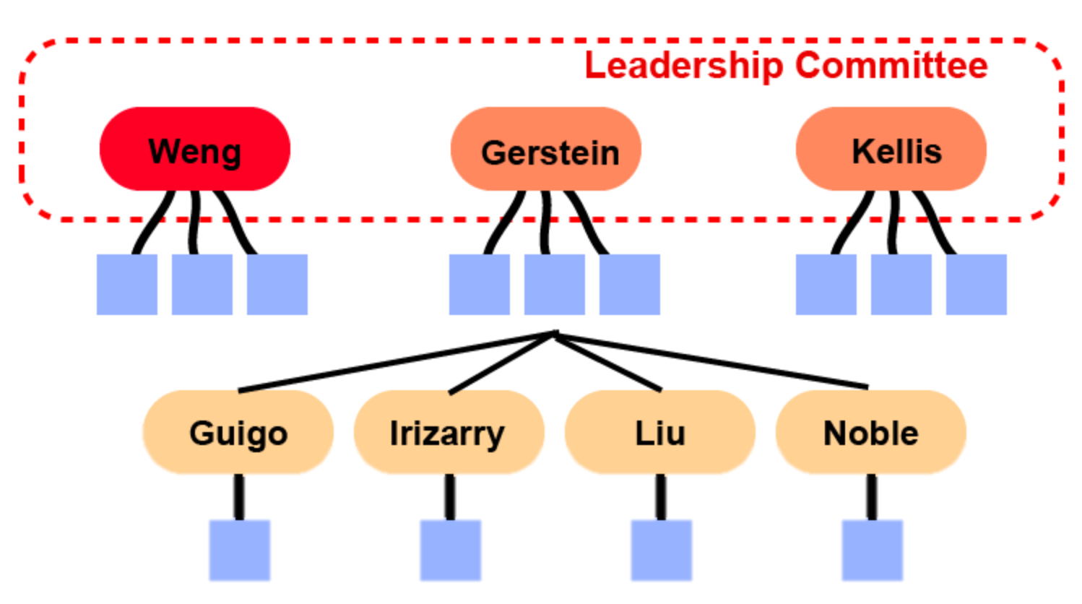
DAC Members
Zhiping Weng [PI, leadership committee]
Manolis Kellis [leadership committee]
Mark Gerstein [leadership committee]
Roderic Guigo
Rafael Irizarry
Shirley Liu
Bill Noble

Slide 4

Zhiping Weng
ENCODE 1 & 2
Integrate ChIP-seq data
with other data types
Sequence motifs; factorbook.org
Nucleosome modification and positioning
AWG co-chair
DNA methylation group
RNA-binding group

Slide 5
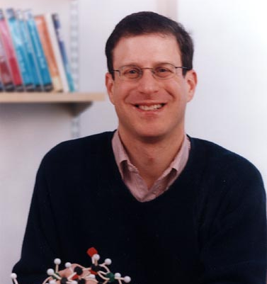
Mark Gerstein
ENCODE 1 & 2 + modENCODE
Transcriptomics
  Non coding transcription,
  clustering gene expression
  Pseudogenes
Peak calling & networks
  Enhancers
Statistical Models of Gene Expression
RNA call & some binding call
Comparative ENCODE

Slide 6

Manolis Kellis
ENCODE 2 + modENCODE
ChIP-seq of TFs & histone
modifications
Genome segmentation
Evolutionary conservation
Binding group
Outreach
Comparative ENCODE

Slide 7
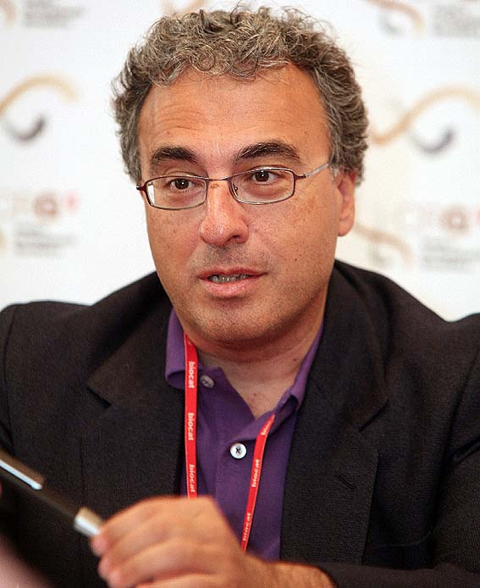
Roderic Guigo
ENCODE 1 & 2
Methods for RNA-seq
  Transcript quantification
  Splicing QTLs
Epigenomic regulation of RNA production
  Chromatin structure and splicing
  Long non coding RNAs
Selenoproteins
RNA call

Slide 8
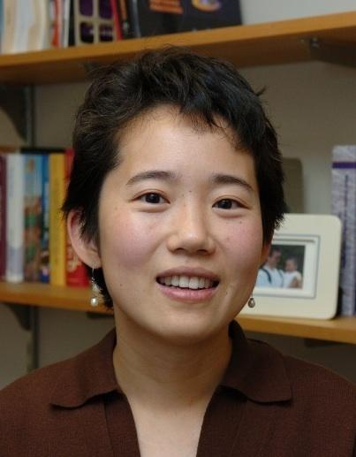
Shirley Liu
modENCODE
Transcription factor and transcriptional regulation
Chromatin regulators, chromatin dynamics, epigenetic drugs
lncRNA regulation, somatic mutations & cancer drug sensitivity
DNase I & ChiP-seq group

Slide 9

Bill Noble
ENCODE 1 & 2
Genome architecture
Chromatin
Motif discovery
Machine learning
5C & ChiA-PET group

Slide 10

Rafael Irizarry
ENCODE Newbie !
RNA-seq
Large range peak detection
Quality Metrics
Preprocessing and normalization
Statistics in general – anything to do with numbers, equations & symbols
DNA methylation group

Slide 11
Current DAC Activities
Assisting in establishing
uniform pipelines & QC metrics
  Chip-seq Peak calling
  RNA-seq analysis
  DNase I
  DNA methylation
  RNA-binding
  5C & ChIA-PET
Assisting in defining file formats across ENCODE data types with the DCC
  standardized FASTQs, BAMs, and BigWigs

Slide 12
Helping to Administer the AWG
AWG call
  Presentations by the U01s & the comparative modENCODE and mouseENCODE groups
  Future sub-calls
Binding & RNA calls
  Much of pipelines in the framework of these

Slide 13
TF Processing Pipeline

Slide 14
TF ChIP-seq Processing Pipeline
1a. Mapping statistics
1b. Library Complexity
2. Cross-correlation scores (NSC, RSC)
Labs
FASTQ (SE/PE)
Rep1 (Lane1)
Rep1 (Lane 2)
Rep2 (Lane1)
Rep2(Lane2)
2. Filter reads
Unmapped
Multimapping
Low Quality
Duplicates
BED
Rep1,
Rep2
Rep0 = Rep1+Rep2
Subsampled
Pseudo-Replicates
Rep1.pr1 , Rep1.pr2
Rep2.pr1, Rep2.pr2
Rep0.pr1, Rep0.pr2
1. Mapping (BWA)
BAM
Rep1
Rep2
5. Signal Correlation between replicates
BIGWIG
Rep1
Rep2
Rep0
5. Signal tracks
ChIP Fold-enrichment over input
3. Peak calling
SPP
GEM
PeakSeq
Processing Steps
4c. Fraction of reads in Peaks (FRiP)
4d. Overlap between peak callers
4a. Self consistency ratio (N1/N2)
4b. Rescue Ratio (Np/Nt)
QC
File Format
Relaxed Peak calls
Rep1 , Rep2
Rep0
Rep1.pr1, Rep2.pr2
Rep2.pr1, Rep2.pr2
Rep0.pr1, Rep0.pr2
Files at DCC
FASTQs
BAM
QC measures
Peak calls
Signal tracks
Motifs
Thresholded Peak calls (NarrowPeak)
SPP
GEM
PeakSeq
Consensus peaks
IDR thresholds
Nt = Rep1 VS Rep2
Np = Rep0.pr1 VS Rep0.pr2
N1 = Rep1.pr1 VS Rep1.pr2
N2 = Rep2.pr1 VS Rep2.pr2
Optimal = max(Np,Nt)
4. IDR
Motifs and motif hits
Integrated GEM motifs
Post-peak calling motifs
6. Motif Discovery

Slide 15
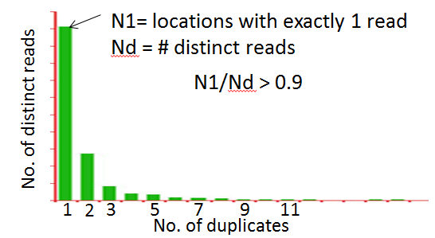
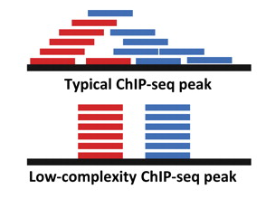
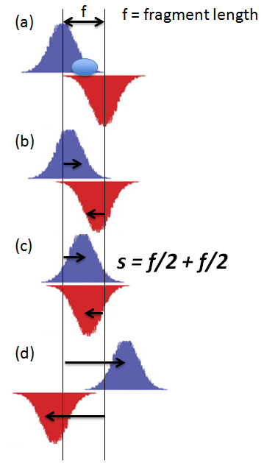
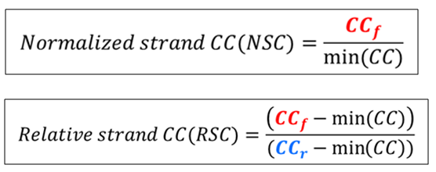
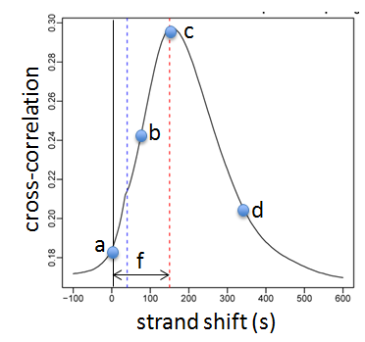
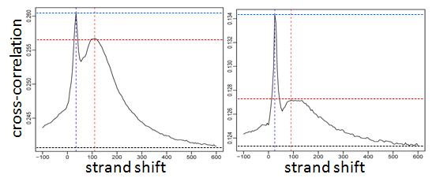
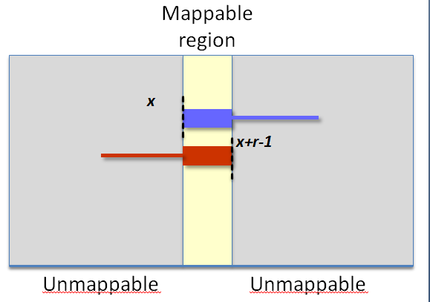
Quality Control
Library Complexity
  QC1: Read mapping statistics
  QC2: Library complexity
    PCR Bottleneck score (N1/Nd)
    Smith et al. Nature methods 2013
  Enrichment scores
    QC3: Cross correlation scores (NSC, RSC)
    QC6: Fraction of reads in peaks (FRiP)
  Reproducibility
    QC4, 5,7: IDR based replicate consistency
      Self Consistency Ratio
      Rescue Ratio
    QC8: Genome-wide replicate correlation scores
Cross correlation Coefficients
High Quality
Medium Quality
Low Quality
Read Length peak (CC_{r})
CC_{f}
CC_{f} << CC_{r}
CC_{r}
x
x+ r - 1

Slide 16
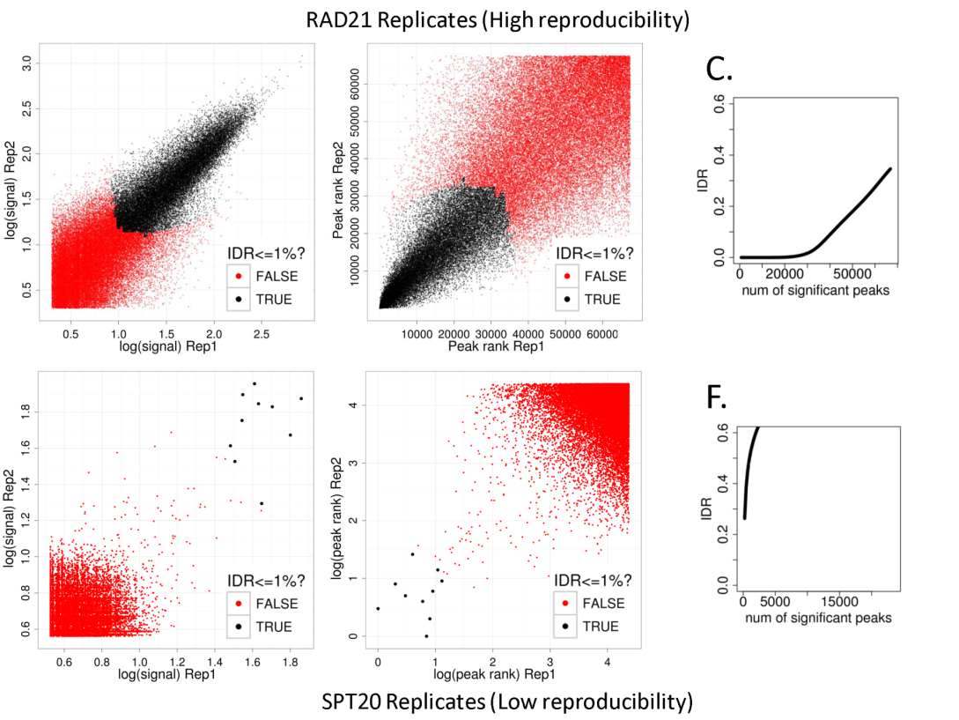
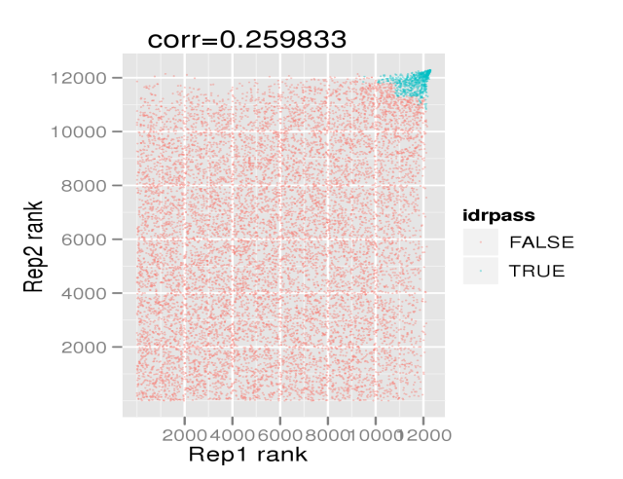
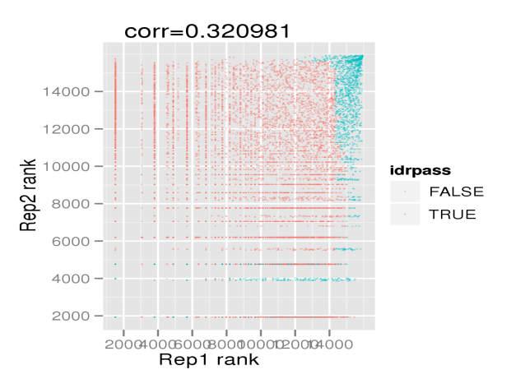
Peak Calling Evaluation
Irreproducible Discovery Rate (IDR) model
Evaluated multiple peak callers
  SPP, GEM, PeakSeq, MACSv2, MOSAICS, dPeak, Hotspot, BELT, Scripture
Evaluation datasets
  CTCF (narrow peaks, high SNR, high specificity motif, > 50K sites)
  POL2 (narrow and diffused peaks, high SNR, bind at/near TSSs, > 10K sites)
  GABP (narrow peaks, high SNR, homotypic closely spaced binding events, high specificity motif, > 5K sites)
  P300 (narrow peaks, high SNR, no sequence motif, enhancer binding)
  ZNF274 (diffused peaks, low SNR, at ZNF genes, < 1K peaks)
Evaluation criteria
  No. of reproducibile peak calls (IDR)
  Stability of ranking measures (peak rank scatter plots)
  Precision of binding events (distance from motifs)
  Resolution of closely spaced binding events
  Ability to detect sites for high and low SNR datasets
  Ease of use (Speed, memory)
  Backward compatibility
Peak Rank Scatter plots
Stable ranking measure
Unstable ranking measure
Rep2 peak ranks
Rep2 peak ranks
Peaks that pass IDR
Peaks that do not pass IDR
Rep1 peak ranks
Rep1 peak ranks

Slide 17
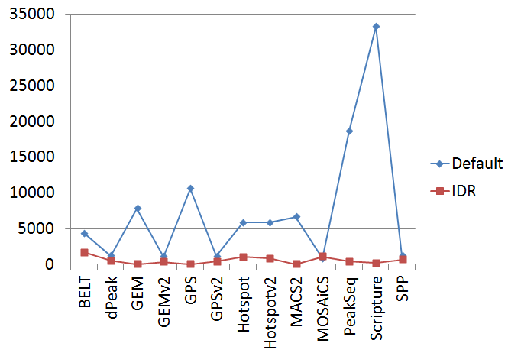
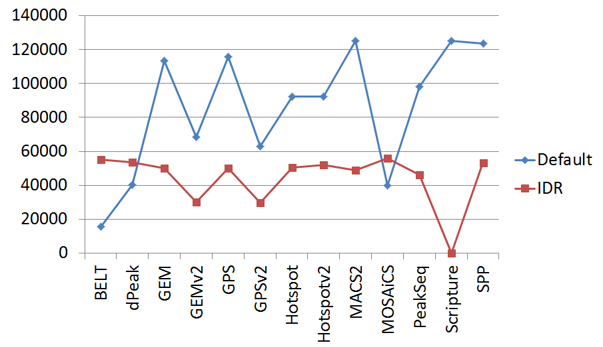
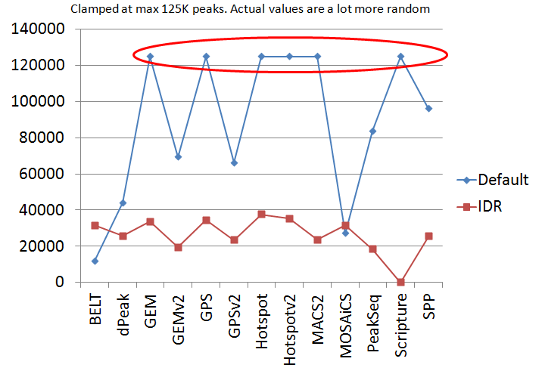
Peak Calling Evaluation
Default peak caller thresholds are highly unstable and incomparable
IDR greatly stabilizes peak calling thresholds
CTCF
POL2
ZNF274
Most peak callers have very similar thresholds post IDR
SPP, PeakSeq, GEM: well-behaved peak rank scatter plots
GEM, dPeak: deconvolve closely spaced binding events
GEM: Integrated motif discovery
GEM, SPP, dPeak: high motif precision
Final Selection: SPP, GEM and PeakSeq with IDR
SPP/GEM peaks (TBD): default view in the browser
All 3 peak sets available for download
Peaks annotated based on reproducibility across peak callers
(e.g. SPP only, SPP+GEM, SPP+GEM+PeakSeq)

Slide 18
Ongoing Efforts
Finalize uniform mapping parameters for ChIP-seq data
Deal with Duplicate reads
    Mark and remove duplicates OR
    Duplicate correction (FIXSEQ – Gifford lab)
Build consensus peak sets from multiple peak callers
Motif Discovery pipelines
Different types of controls (mockIP vs Input)
Different read-length and mappability
Minimal sequencing depth
  TF ChIP-seq: 30M mapped reads per replicate
    TF input DNA/control : 50M mapped reads
    Chromatin ChIP-seq: TBD
    Chromatin Input DNA/control: (100M mapped reads)
SE vs PE data for ChIP-seq
    Which TFs, proteins, histone marks, cell-lines would benefit from PE data?
Histone modification ChIP-seq
    QC measures
    Calling regions of enrichments (peaks + domains)
    Multi-track segmentations and chromatin state analysis
http://wiki.encodedcc.org/index.php/BINDING_(ChIP/CLIP/RIP-seq)

Slide 19
RNA-seq pipelines

Slide 20
RNA Assays vs Pipelines.
Metrics for Evaluation
DATA SETS | PIPELINES
 | Gingeras long | Graveley long | Wold long | Gingeras RAMPAGE | Gingeras small | Mortazavi micro
Gingeras long | Long RNASeq metrics
Graveley long
Wold long
Gingeras RAMPAGE |  |  |  | RAMPAGE metrics
Gingeras small |  |  |  |  | Small RNA metrics
Mortazavi micro

Slide 21
RNA-seq Pipeline Evolution
Phase 0 – ENCODE 3 project start
Phase 1 – Vetting initial pipelines from the production groups, initial harmonization
Evaluation – Run a detailed evaluation of the pipelines & other RNA-seq tools
Phase 2 – by the end of the year have updated & more unified pipelines based on the evaluation

Slide 22
RNA-seq Evaluation
Using newly sequence evaluation datasets
Based on lessons learnt in EGASP, RGASP, seqc, gtex, &c
Comparison of mappers & methods of transcript quantification
Evaluation of sensitivity to sequence variants (e.g. for allelic sites)
This will contribute:
  To better harmonize common pipelines
  To draft the ENCODE3 recommendations/standards for RNASeq data

Slide 23
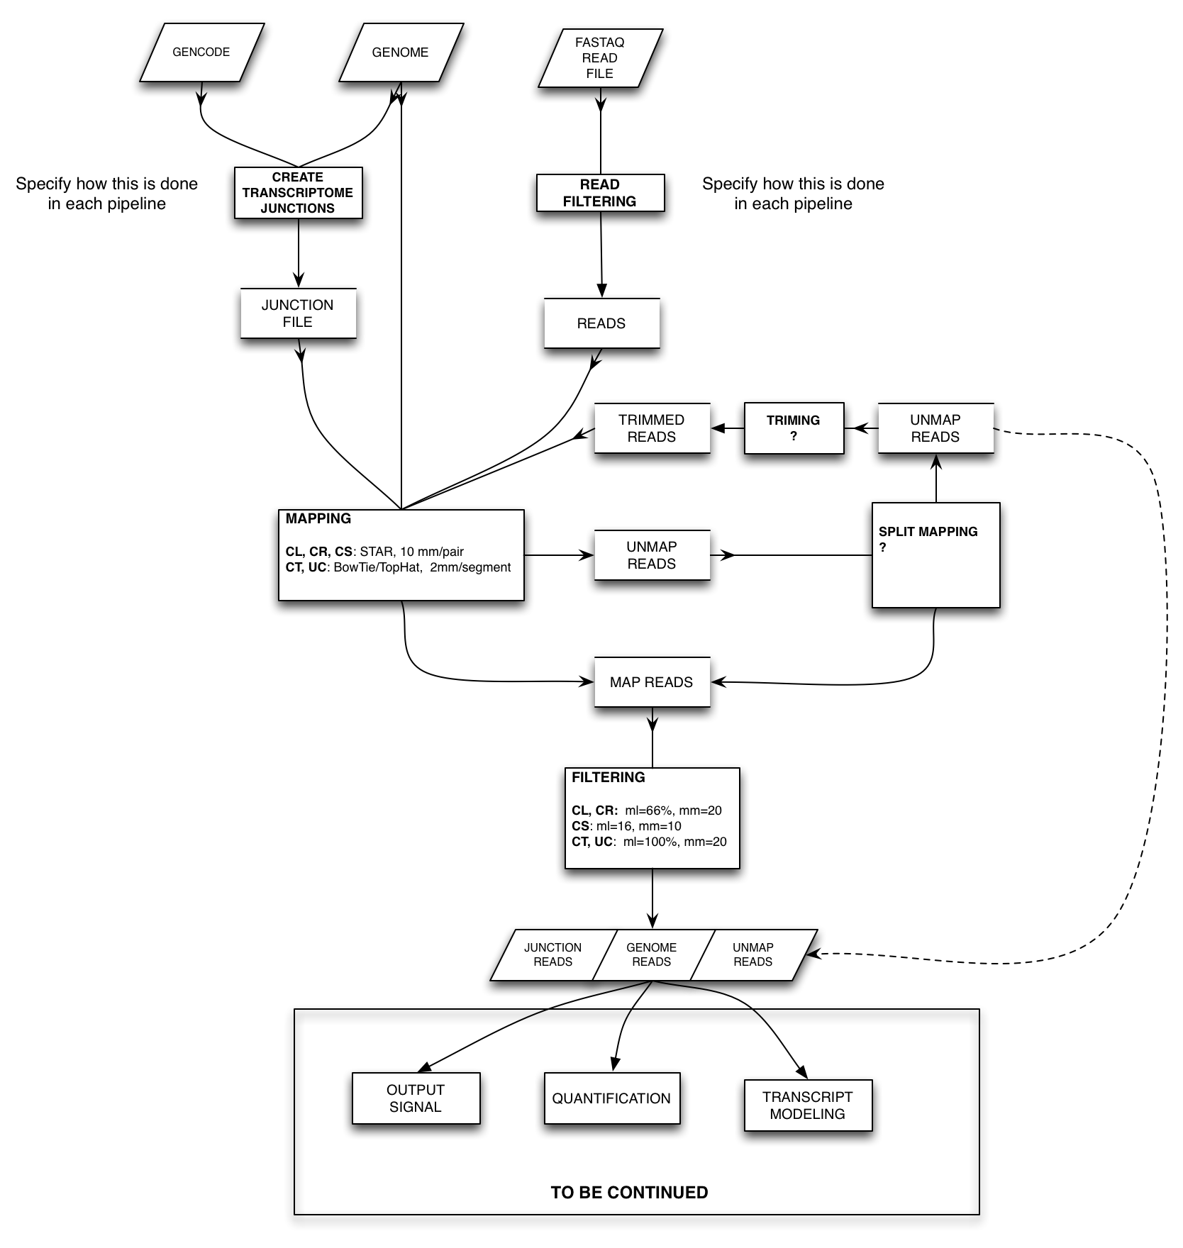

Slide 24
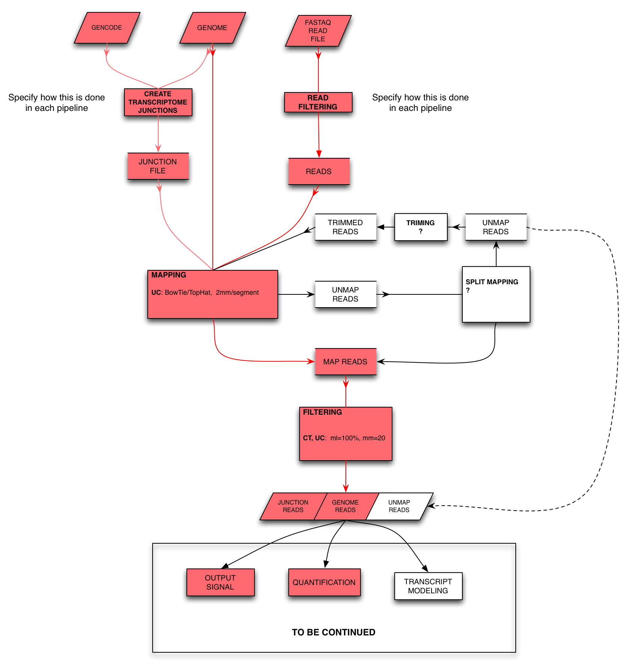
Graveley, long RNA-seq

Slide 25
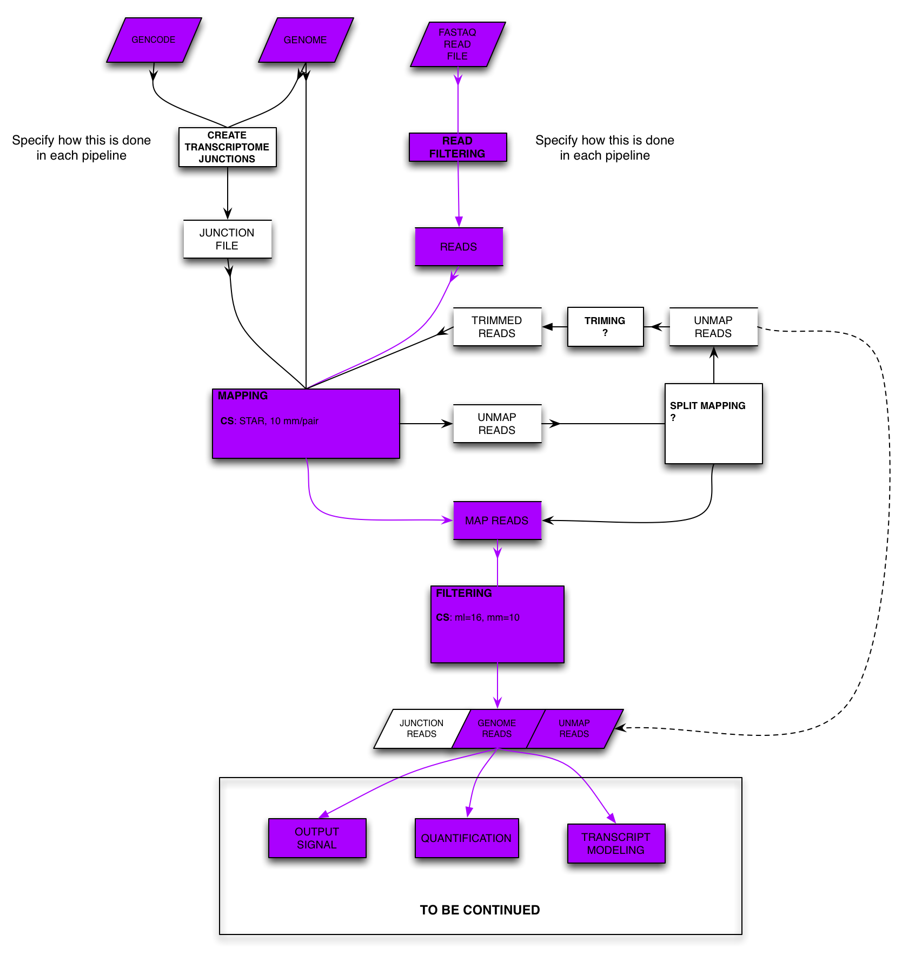
Gingeras, short RNASeq

Slide 26
DNase I Pipeline
Groups
  Stamatoyannopoulos (production group)
  Gifford & Pritchard (U01 analysis groups)
  Kent & Malladi (DCC)
  Liu (DAC)
Pipelines
  ENCODE II and Roadmap tools with (Bowtie, HotSpot) additional QC measures
Comparison Protocol & Metrics
  Can be used for both QC and uniform processing of SE/PE, 1/2 replicates, 5-500M read DNase-seq
  Runs robustly on UCSC and Galaxy
  Footprint and TF binding after QC is finalized
  Prototype in place, targeted deployment at DCC in late June, deployment at Galaxy in August

Slide 27
DNA Methylation
Groups
  Rick Myers (human WGBS, RRBS, Methyl-450)
  Joe Ecker (mouse WGBS)
Pipelines
  Bismark
  BSMAP
  Pash
Comparison Protocol & Metrics
  %methyl-C in & not-in CpGs, in and out of CpG islands
  Compare different cell lines & different labs
  Compare WGBS and RRBS on the same cell line
  Bismark and BSMAP showed similar performance

Slide 28
RNA Binding
Data producing groups
  Gene Yeo (CLIP)
  John Rinn (RIP)
Pipelines
  CLIPper (Yeo)
  Rinn
Comparison Protocol & Metrics
  Apply CLIPper on the RIP data and vice versa
  Compare CLIP and RIP data on the same RNA binding protein

Slide 29
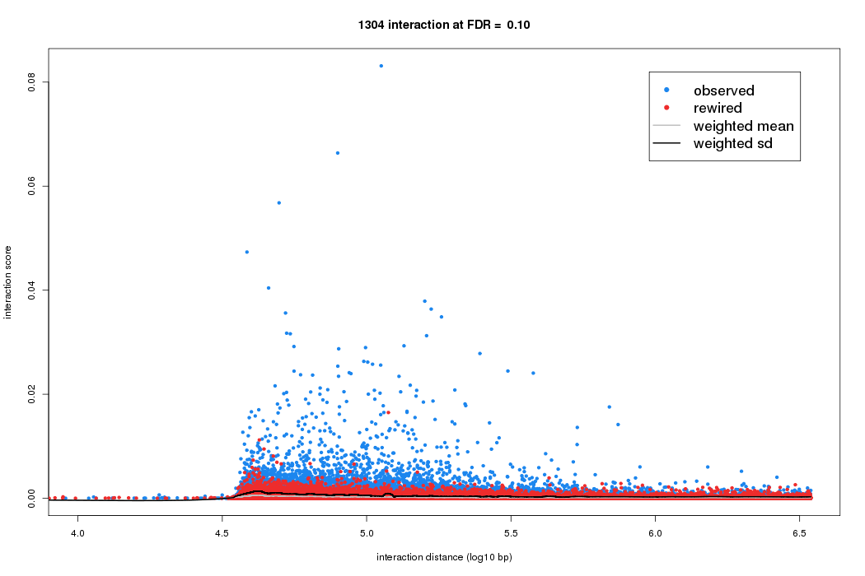
ChiA-PET Pipeline
Pipeline is written in Python and R
  (1) Linker Parsing (2) Read alignment (3) PET filtering
  (4) Calling peaks for the protein of interest
  (5) Calling chromatin interactions between peak regions
  (6) Preparing visualization files for IGV and summary
Input data
  Paired-end tags (PETs)
  Two linker sequences
Software dependencies
  Bowtie, bedtools, macs2,
  Boost C++, R libraries

Slide 30
Future Integrative Analysis
Integrative analysis
  Chromatin-supported non-coding transcription fragments
  Combine DNase and ChIP-seq data to predict TF binding sites
  Chromatin models of expression & binding & splicing
Developing Processed Data & Analysis Products
Statistical QC of data & analysis (e.g. IDR)
New tools as appropriate
Help with writing large-scale manuscripts
  Workshops

Slide 31
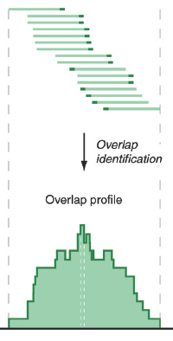
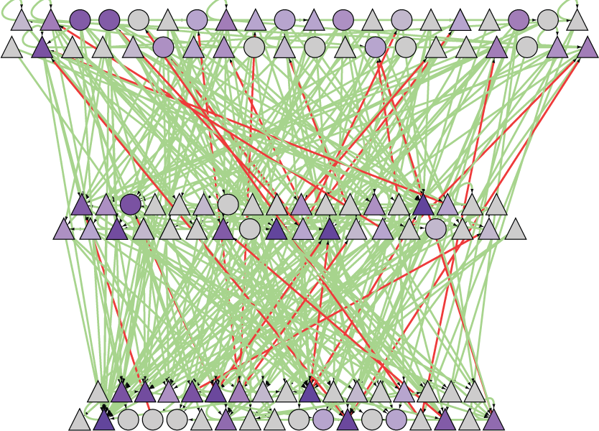
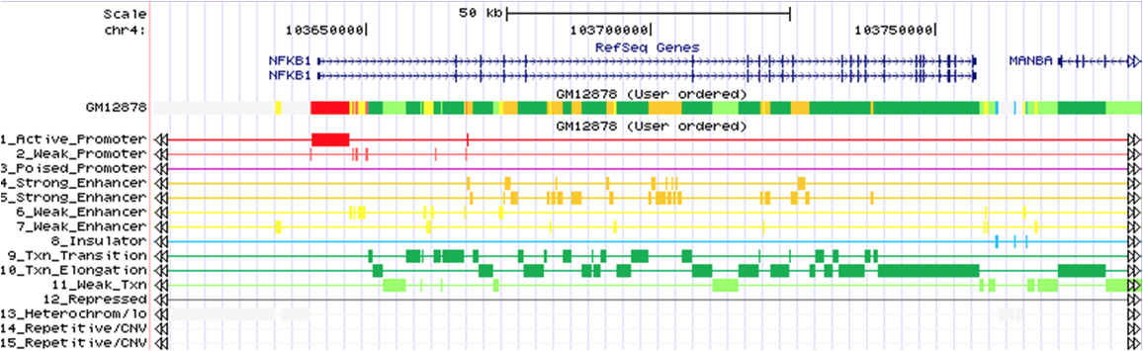
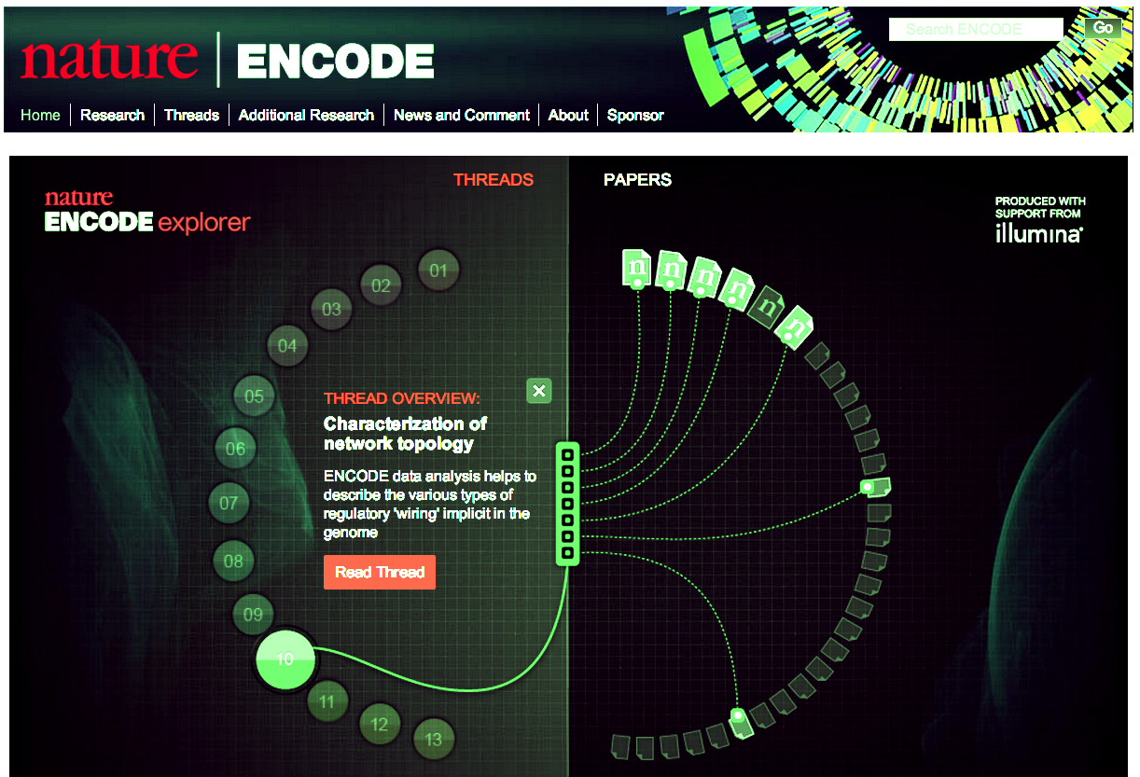
Hierarchical Presentation of Data & Analysis Products
Raw data (reads)
at the bottom
Progressive Processed Summaries
  Signals
  Site locations & motifs
  Conservation integration & allelic elements
  Targets & Regulatory Networks
  Chromatin states, enhancers
  Statistical models
At top are linked publications documenting everything, forming metadata

Slide 32


Source Code Control
DCC
Request
Create
Project team
Read/write
Github
repository
Read
Read

Slide 33
Overview of the ENCODE DAC
7 labs with diverse expertise + previous ENCODE experience
  Z Weng, M Gerstein, M Kellis, S Liu, R Guigo, B Noble, R Irizarry
Providing computational muscle to the AWG
Currently focusing on creating unified pipelines
  Peak caller evaluation
  Phased RNA pipeline development, with evaluation
  More pipelines: methylation, dnase, RNA-binding, 5C
Future Integrative Analysis
  Focused on creating useful data & analysis products

