Slide 1


Comparison of
3 Metazoan Transcriptomes
Joel Rozowsky
(Gerstein Lab Yale)
ENCODE AWG Call
24 May 2013

Slide 2
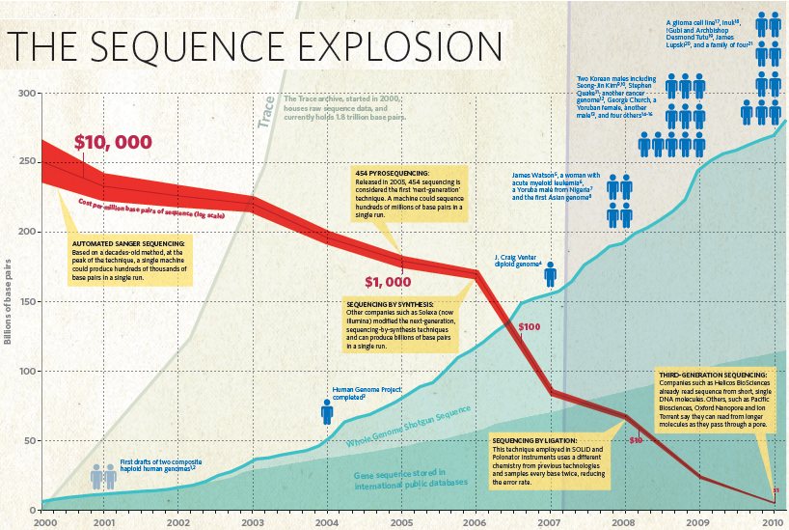
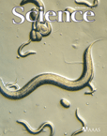


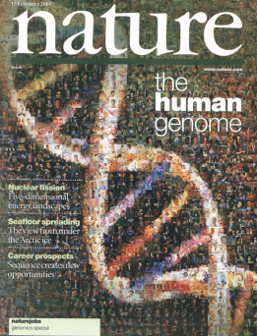
Nature (2010)

Slide 3
Motivation
Use comparison of transcriptomes of human, worm and fly to reveal general principals of transcription
  Integrate all ENCODE/modENCODE RNA-Seq data
Since these three genomes are highly divergent (i.e. no synteny), comparisons can either be made using:
  orthologs
  whole genome

Slide 4

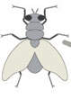
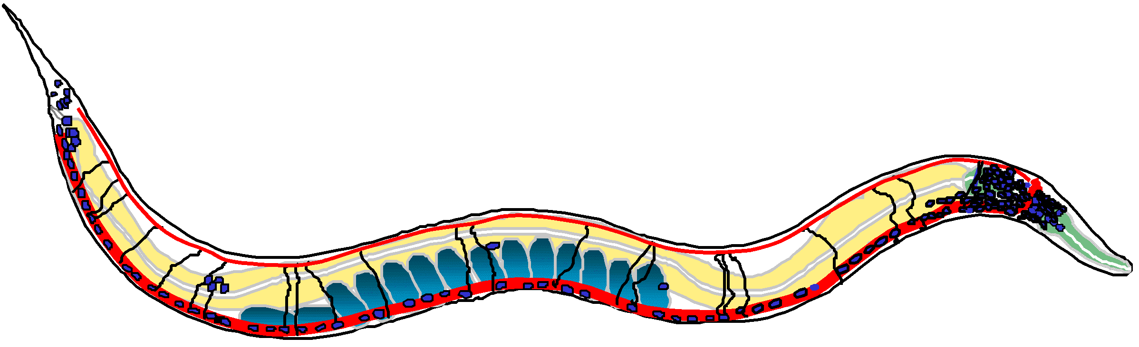

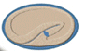
Data Sets
Broad sampling of conditions across transcriptomes of human, worm and fly
Fair comparisons
  whole cell PolyA+
    > 20 billion reads (571 datasets)
  embryo & embryonic stem cells
  developmental time course (worm & fly)
X3
X14
X6
Whole organism
Isolated tissue
Cell line
Blood
Muscle
X10
Skin
Adult
Lung
X2
Human
Neural
Liver
Worm
X18
Fly
Gonad
Whole
Gut
X14
X8
X3
X20
X6
9 mo
H
W
F
X2
X2
X4
12 hr
1 hr
X6
X8
X2
24 hr
2 hr
L4/Purpa
Larvae
22 hr
Embryo
4 hr
L1
20 hr
6 hr
X29
X4
18 hr
8 hr
X24
X9
X3
16 hr
10 hr
X3
L3
L2
X2
14 hr
12 hr
X14
X15
X16
Development

Slide 5
Protein Coding Genes
Comparison of protein coding gene annotations:
19,901 (human), 20,377 (worm) & 13,623 (fly)

Slide 6
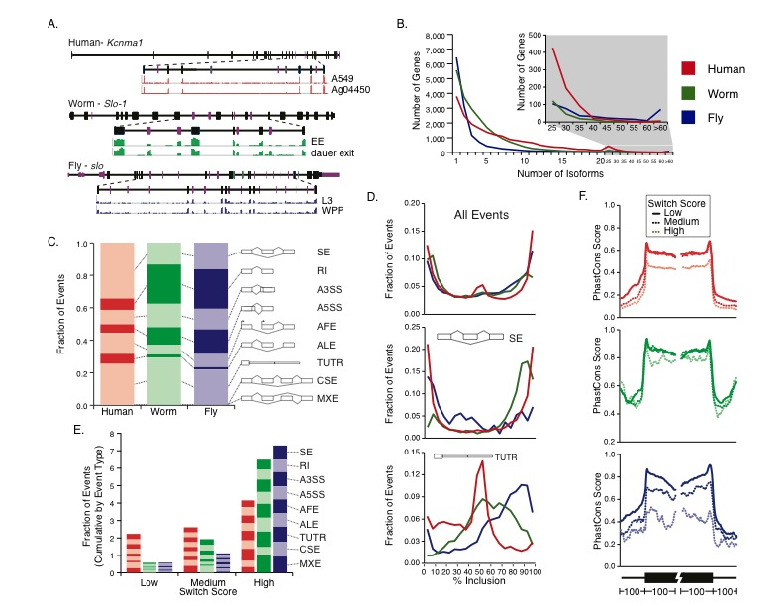
Alternative Splicing
Example:
Comparison of annotated alternative splicing
No examples of orthologs which share “orthologous” transcript splice isoforms
Some fly genes with extreme numbers of isoforms

Slide 7
Alternative Splicing Usage
Skipped Exons
For each sample compute the percent inclusion of an alternative splicing event (Ψ).
Switch score: maximal difference in Ψ across all RNA-Seq samples (i.e. ΔΨ). [High >50, Medium 25-50, Low <25]
We have investigated the effect of switch score across all samples for all alternative splicing events across the 3 organisms.
Human
Worm
Fly

Slide 8
Pseudogenes
Human
Worm
Fly
Varied repertoire of annotated pgenes.
Pseudogenes from the three organisms have very different ages (sequence similarity).

Slide 9
Pseudogenes
Example (RpS6):
Pseudogenes from the three organisms arise from different families of parent genes.
Enriched Pfam domains of Pgene parent genes

Slide 10
Pseudogenic Activity
Human
Worm
Fly
Similar fraction of transcribed pgenes (~15%) across 3 organisms.
Similar for other forms of biological acitivity.

Slide 11
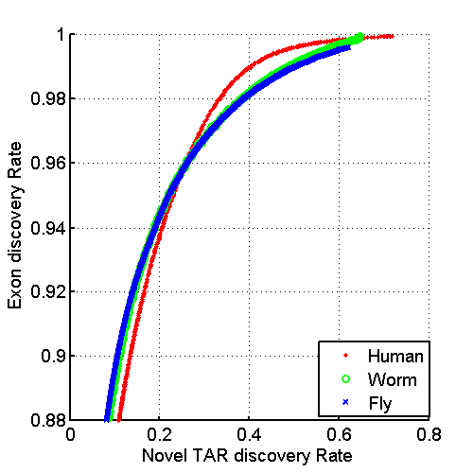
Annotated ncRNAs
 |  |  | Human |  |  | Worm |  |  | Fly
 |  |  | Elements | Genome Coverage |  | Elements | Genome Coverage |  | Elements | Genome Coverage
 |  |  |  | Kb | % |  | Kb | % |  | Kb | %
Annotated ncRNAs | Comparable ncRNAs | pri-miRNA | 58 | 1,158 | 0.04 | 44 | 16 | 0.02 | 43 | 300 | 0.23
 |  | pre-miRNAs | 1,756 | 162 | 0.006 | 221 | 20 | 0.02 | 236 | 22 | 0.02
 |  | tRNAs | 624 | 47 | 0.002 | 609 | 45 | 0.04 | 314 | 22 | 0.02
 |  | snoRNAs | 1,521 | 168 | 0.006 | 141 | 16 | 0.02 | 287 | 34 | 0.03
 |  | snRNAs | 1,944 | 210 | 0.007 | 114 | 14 | 0.01 | 47 | 7 | 0.006
 |  | lncRNAs | 10,840 | 10,581 | 0.37 | 233 | 184 | 0.18 | 852 | 868 | 0.68
 | Other ncRNAs |  | 5,411 | 3,268 | 0.11 | 40,104 | 2,329 | 2.3 | 376 | 2,103 | 1.6
 |  | nc-piRNA loci | 88 | 1,272 | 0.04 | 35,329 | 449 | 0.45 | 27 | 1,473 | 1.1
Total ncRNAs |  |  | 22,154 | 17,770 | 0.62 | 41,466 | 2,611 | 2.6 | 2,155 | 3,279 | 2.6
Identify non-canonical transcription in regions of the genome excluding mRNA exons, pseudogenes or annotated ncRNAs.

Slide 12
Non-Canonical Transcription
 |  |  | Human |  |  | Worm |  |  | Fly
 |  |  | Elements | Genome Coverage |  | Elements | Genome Coverage |  | Elements | Genome Coverage
 |  |  |  | Kb | % |  | Kb | % |  | Kb | %
Total ncRNAs |  |  | 22,154 | 17,770 | 0.62 | 41,466 | 2,611 | 2.6 | 2,155 | 3,279 | 2.6
Regions Excluding mRNAs, Pseudogenes or Annotated ncRNAs |  |  | 283,816 | 2,731,811 | 95.5 | 143,372 | 63,520 | 63.3 | 60,108 | 89,445 | 69.6
 | Transcription Detected (TARs) |  | 708,253 | 916,401 | 32.0 | 232,150 | 37,029 | 36.9 | 83,618 | 44,256 | 34.5
 |  | Supervised Predictions | 104,016 | 13,835 | 0.48 | 2,525 | 392 | 0.39 | 599 | 164 | 0.13
Comparable amount of non-canonical transcription (intronic & intergenic) ~ between 32-37%
Predict novel ncRNAs using a supervised machine learning model
Enrichment of transcription associated with enhances (i.e. eRNAs)
Identified significant numbers of positionally conserved anti-sense transcription

Slide 13
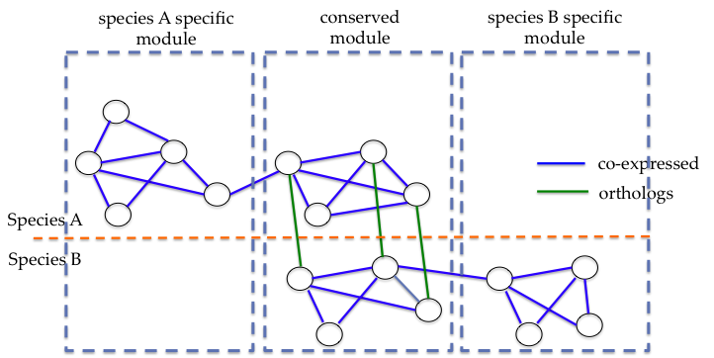
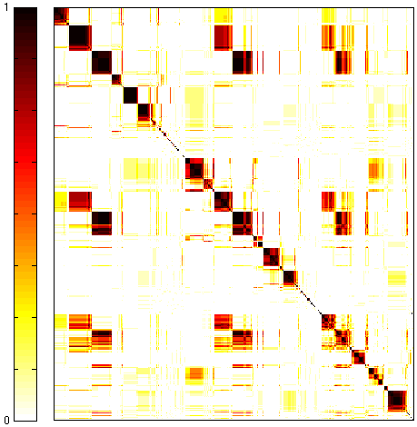
Cross-Species Co-expression Clustering
Use Potts model (generalized Ising model) to simultaneously cluster co-expressed genes within an organism as well as orthologs shared between organisms.
ncRNAs can also be assigned to modules base of co-expression.
16 conserved
modules
Conservation of module across number of species
human-worm-fly
1
worm-fly
Conservation of module across number of species
19901 genes
worm-specific
gene-gene co-association
20377 genes
13623 genes
0

Slide 14
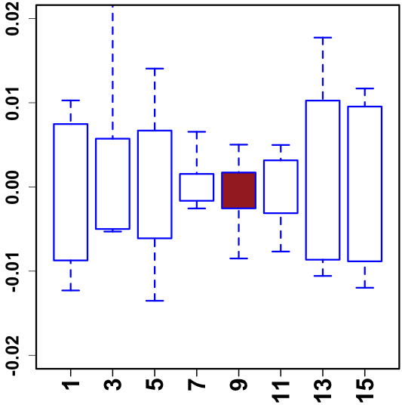
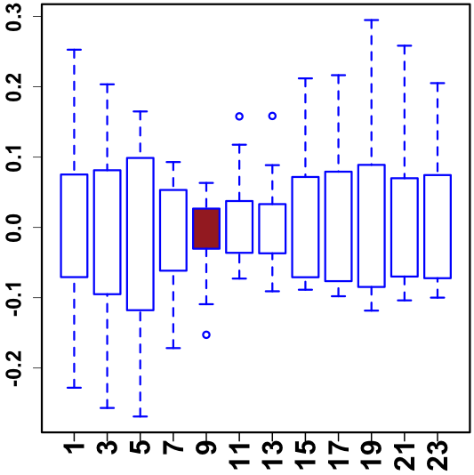
Hourglass Behavior
“Hourglass hypothesis”: all organisms go through a particular stage in embryonic development ("phylotypic" stage) where expression differences between orthologous genes are the smallest.
We identify modules (12 out of 16) which have hourglass behavior at the phylotypic stage (worm 6-8hr, fly 8-10hr).
We also observe that the expression of genes in our modules are the most tightly coordinated within a single organism at the phylotypic stage.
phylotypic stage
Expression of a module across 6 fly species
Expression across modules in fly
Stage (hour)
Kalinda et al. (2010)

Slide 15
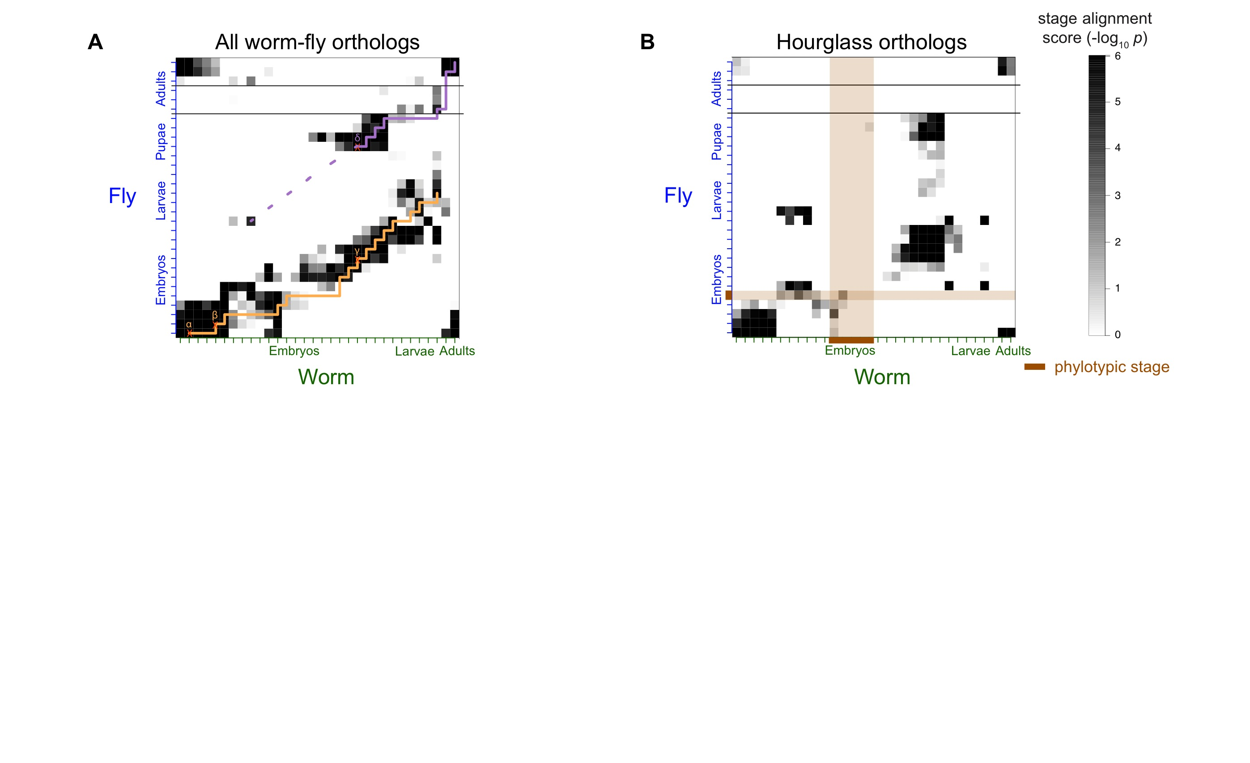
Alignment of Developmental Time-Course
Align developmental stages using shared orthologs between worm and fly
  Reuse of genes from LE in worm in fly pupa
Using only orthologs in hourglass modules we find similar behavior except for absence of genes at the phylotypic stage

Slide 16
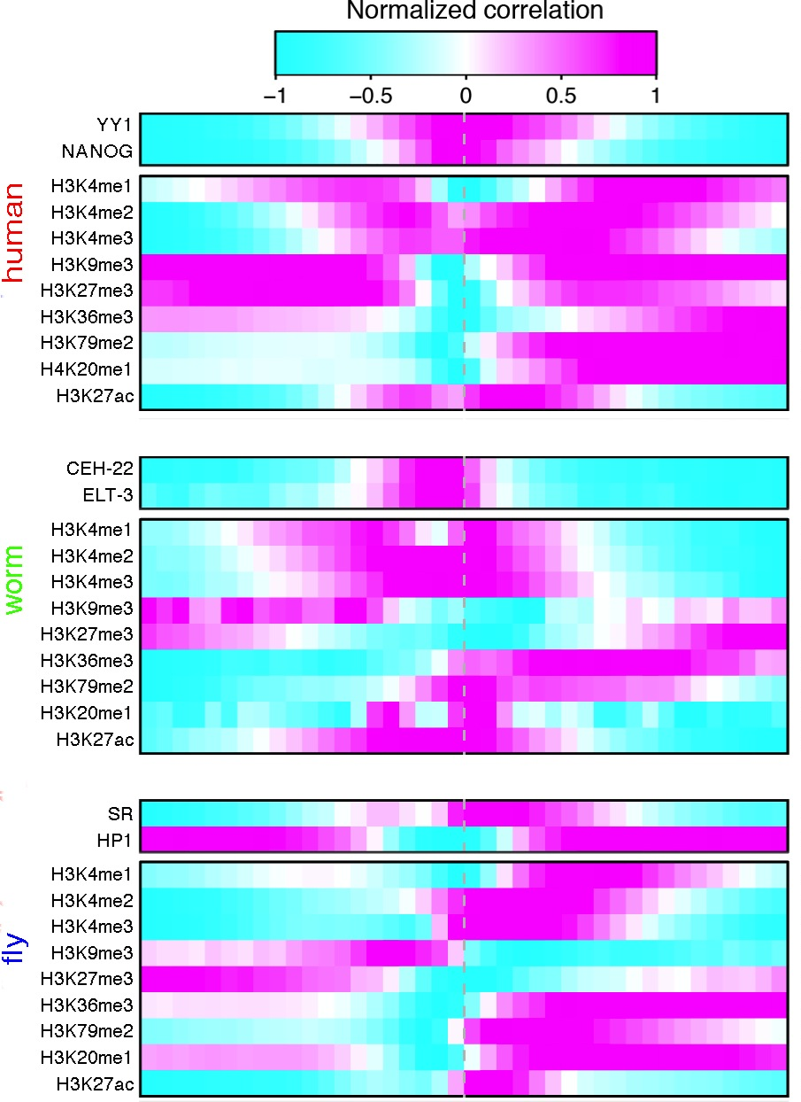
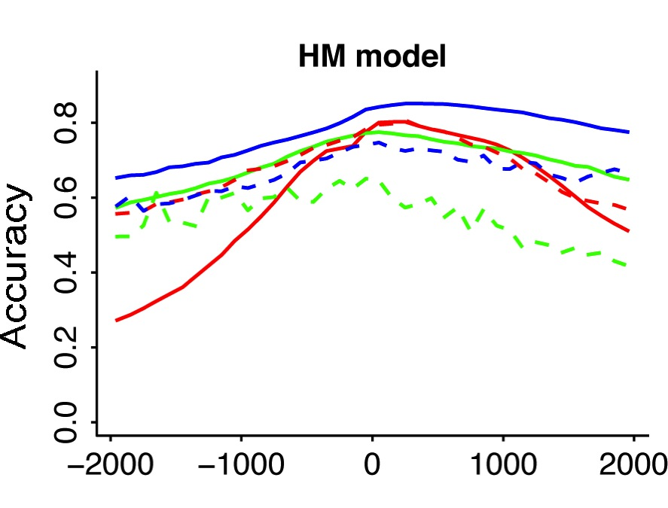
Models for Gene Expression
Normalized Correlation of Binding with Expression
Human
mRNA
ncRNA
Worm
Construct models for predicting gene expression
works for mRNAs and ncRNAs
models use either histone marks or TFs
TF model accuracy only needs a small number of TFs for high accuracy (>90%)
even fewer in human – perhaps indicating …
Fly
-2Kb
TSS
+2Kb

Slide 17
Universal Model
Human
Worm
Fly
Universal
We construct single universal HM model
(one set of parameters)
works almost as well as species specific models
works for both mRNAs and ncRNAs

Slide 18
Conclusions
Even though human, fly and worm are highly divergent they share many general principals of transcription:
Similar splicing patterns (with some exceptions)
Similar fraction of active pseudogenes
Similar amount of non-canonical transcription
We identify conserved modules of genes with conserved GO functions
We map developmental life cycle between worm and fly
We construct a universal HM model for gene expression which works for mRNAs and ncRNAs

Slide 19
Acknowledgements
Mark B. Gerstein^{1,2,3}, Joel Rozowsky^{1,2}, Koon-Kiu Yan^{1,2}, Daifeng Wang^{1,2}, Chao Cheng^{4,5}, James B. Brown^{6,7}, Carrie A. Davis⁸, LaDeana Hillier⁹, Cristina Sisu^{1,2}, Jingyi Jessica Li⁷, Baikang Pei^{1,2}, Arif O. Harmanci^{1,2}, Michael O. Duff¹⁰, Sarah Djebali^{11,12}, Roger P. Alexander^{1,2}, Burak H. Alver¹³, Raymond K. Auerbach^{1,2}, Kimberly Bell⁸, Peter J. Bickel⁷, Max E. Boeck⁹, Nathan P. Boley^{6,7}, Benjamin W. Booth⁶, Lucy Cherbas^{14,15}, Peter Cherbas^{14,15}, Chao Di¹⁶, Alex Dobin⁸, Jorg Drenkow⁸, Brent Ewing⁹, Gang Fang^{1,2}, Megan Fastuca⁸, Elise A. Feingold¹⁷, Adam Frankish¹⁸, Guanjun Gao¹⁶, Peter J. Good¹⁷, Phil Green⁹, Roderic Guigó^{11,12}, Ann Hammonds⁶, Jen Harrow¹⁸, Roger A. Hoskins⁶, Cédric Howald^{19,20}, Long Hu¹⁶, Haiyan Huang⁷, Tim J. P. Hubbard¹⁸, Chau Huynh⁹, Sonali Jha⁸, Dionna Kasper²¹, Masaomi Kato²², Thomas C. Kaufman¹⁴, Rob Kitchen^{1,2}, Erik Ladewig²³, Julien Lagarde^{11,12}, Eric Lai²³, Jing Leng^{1,2}, Zhi Lu¹⁶, Michael MacCoss⁹, Gemma May^{10,24}, Rebecca McWhirter²⁵, Gennifer Merrihew⁹, David M. Miller²⁵, Ali Mortazavi^{26,27}, Rabi Murad^{26,27}, Brian Oliver²⁸, Sara Olson¹⁰, Peter Park¹³, Michael J. Pazin¹⁷, Norbert Perrimon^{29,30}, Dmitri Pervouchine^{11,12}, Valerie Reinke²¹, Alexandre Reymond¹⁹, Garrett Robinson⁷, Anastasia Samsonova^{29,30}, Gary I. Saunders¹⁸, Felix Schlesinger⁸, Frank J. Slack²², William C. Spencer²⁵, Marcus H. Stoiber⁷, Pnina Strasbourger⁹, Andrea Tanzer^{31,32}, Owen A. Thompson⁹, Kenneth H. Wan⁶, Guilin Wang²¹, Huaien Wang⁸, Kathie L. Watkins²⁵, Jiayu Wen²³, Kejia Wen¹⁶, Chenghai Xue⁸, Li Yang^{10,33}, Kevin Yip^{34,35}, Chris Zaleski⁸, Yan Zhang^{1,2}, Henry Zheng^{1,2}, Steven E. Brenner^{36,37}, Brenton R. Graveley¹⁰, Susan E. Celniker⁶, Thomas R Gingeras⁸, Robert Waterston⁹

