Slide 1
Relation of pseudogenes by chromosomes

Slide 2
All p-genes from Baikang

Slide 3
Recent p-genes (>=97%) from Baikang

Slide 4
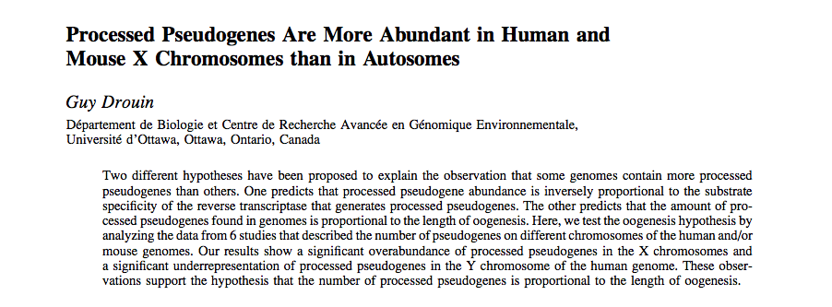

Slide 5
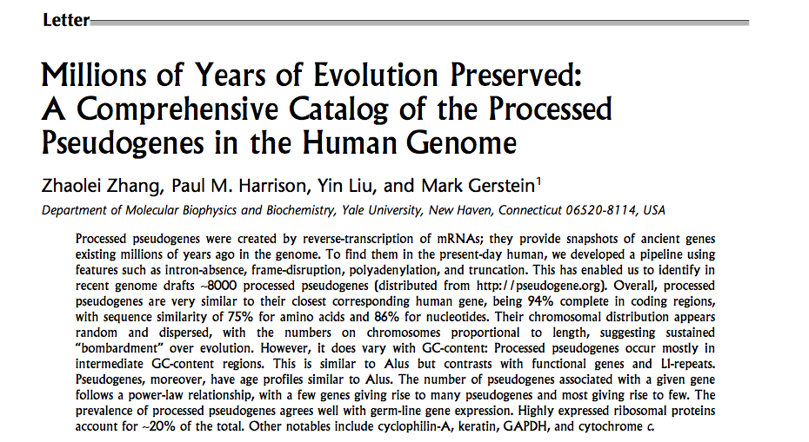

Slide 6
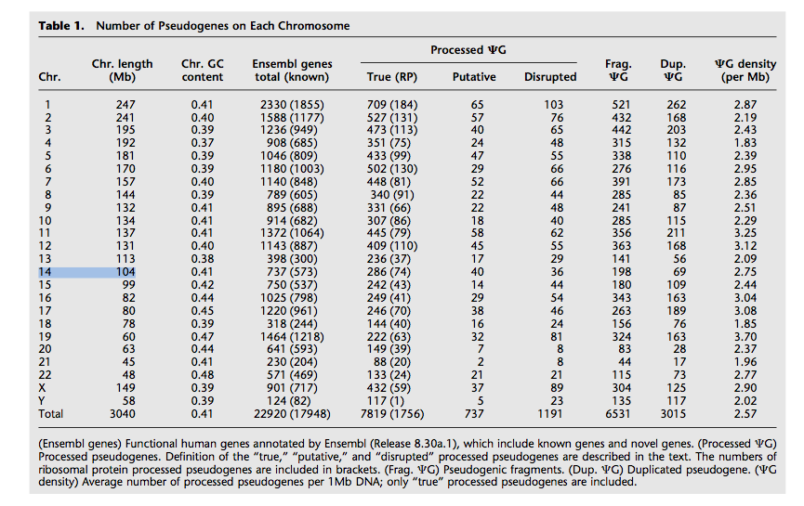

Slide 7
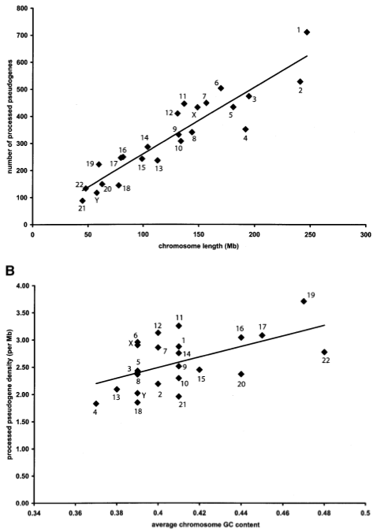

Slide 8
All results

