Slide 1
Pottie: An integrated network framework for clustering expression profiles from multiple species

Slide 2
MetaPotts: An integrated network framework for clustering expression profiles from multiple species

Slide 3
Concept of cross-species modules in a multiplex network
Figure 1A
species A specific
module
conserved
module
species B specific
module
co-expressed
orthologs
Species A
Species B

Slide 4
Overview of MetaPotts

Slide 5
Figure 1B
Set initial temperature T(0)
Input
randomly assign
spins (1,2,..,q) to nodes
Orthologous pairs
between species
simulated annealing
to optimize H
Energy function
H
system evolves (spins flip) according to H
Expression profiles of species A
T(k+1)
=αT(k)
Expression profiles of species B
co-expression
networks
flipping rate
is low?
Potts Clustering
Extendable to
more species
at most q modules
labeled by spin values
High-confidence modules
based on multiple runs
Output
A set of cross-species modules, with different number of shared orthologs
conserved
module
B-specific
module
A-specific
module

Slide 6
Application of MetaPotts on simultaneously clustering the expression profiles of worm and fly

Slide 7
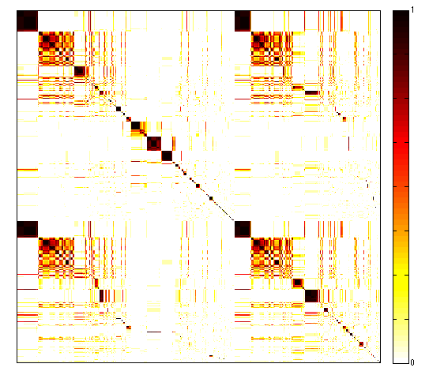
Figure 2A
worm and fly
genes
Sharing of
GO terms
231
218
worm
(20377)
117
Conserved module
16
14
fly
(13623)
worm specific
module
fly specific
module
co-appear
frequency

Slide 8
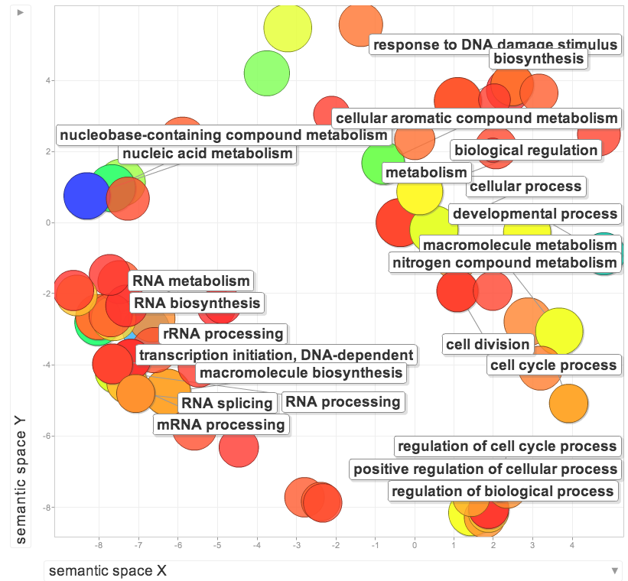
Figure 2B
GO terms of a conserved module

Slide 9
Effects and Determination of the coupling constant
We employed two independent approaches
  A set of metagenes as gold standard.
    Metagenes were constructed by comparing the co-expression networks of worm, fly, human, yeast … , but based on a more local approach.
    Components of a metagene should be grouped to the same module by our algorithm
  A reference network based on the similarity of GO terms between genes
inverse document frequency
whether gene i is annotated with GO term j

Slide 10
Figure 3

Slide 11
Construction of conserved modules for annotating uncharacterized elements in human, worm and fly

Slide 12
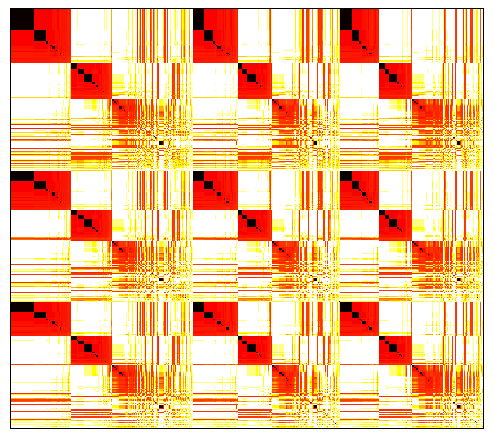
Figure 4A

Slide 13
Figure 4B

Slide 14
Functions of the conserved modules
Module | Key GOs (1-1-1 orthologs)
1 | cell projection organization, anatomical structure formation involved in morphogenesis
2 | cellular aromatic compound metabolic process, RNA methyltransferase activity, nucleoplasm
3 | neurogenesis, ribosome biogenesis, nervous system development, DNA-directed RNA polymerase activity, nucleolus
4 | synaptic vesicle targeting, ubiquitin binding, exocyst
5 | larval locomotory behavior, neurotransmitter biosynthetic process, G-protein coupled receptor signaling pathway, gamma-aminobutyric acid transmembrane transporter activity, cell periphery
6 | RNA processing, regulation of cell cycle, RNA polymerase II carboxy-terminal domain kinase activity, nuclear part, mRNA cleavage factor complex
7 | nucleic acid metabolic process, RNA prcoessing, RNA splicing, cell cycle, helicase activity, RNA binding, spliceosomal complex, intracellular membrane-bounded organelle
8 | protein catabolic process, mitotic spindle elongation, response to DNA damage stimulus, endopeptidase activity, proteasome complex, proteasome regulatory particle
9 | spindle elongation, structural constituent of ribosome, ribosomal subunit
10 | RNA splicing, DNA-directed RNA polymerase activity, spliceosomal complex
11 | peptidyl-diphthamide biosynthetic process from peptidyl-histidine, tRNA processing, transferase activity, DNA-directed RNA polymerase III complex
12 | DNA replication, nucleobase-containing compound metabolic process, 3'-5' DNA helicase activity, MCM complex
13 | protein targeting to mitochondrion, structural constituent of ribosome
14 | cilium assembly, cell projection morphogenesis
15 | nervous system development, lateral inhibition, nucleoside phosphate binding, DNA replication factor C complex
16 | ribosome biogenesis, ncRNA processing, rRNA processing, purine NTP-dependent helicase activity, nucleolus
Table 1

Slide 15
Validation of modules
For each module, compare the enriched GO terms among human, worm and fly genes. Expect a high overlap

Slide 16
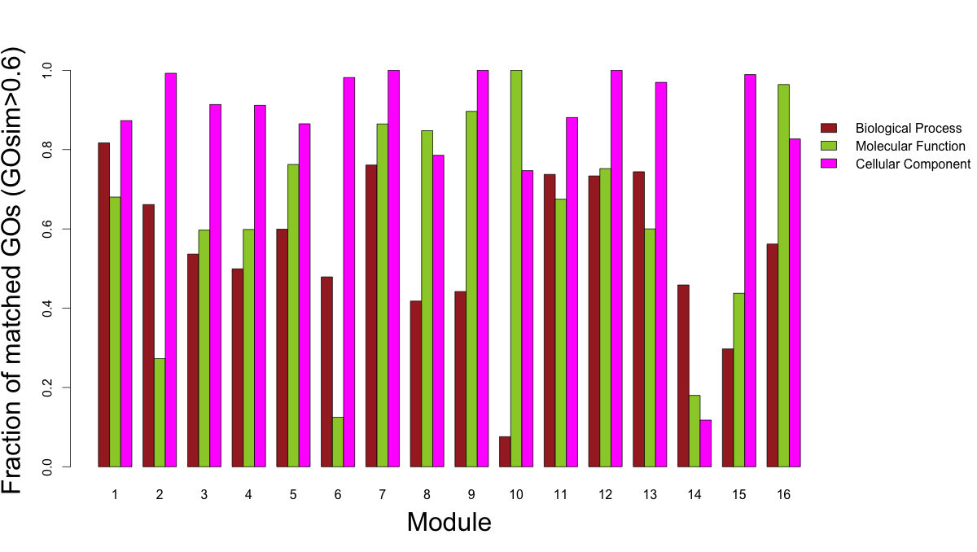
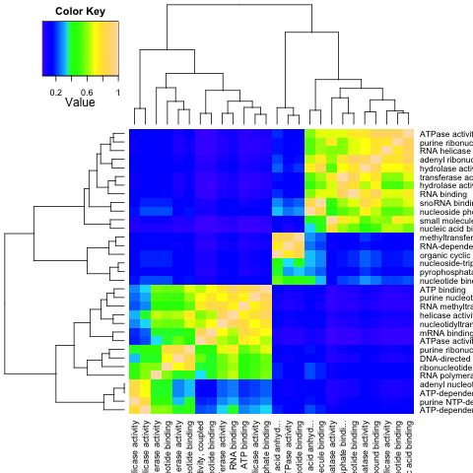
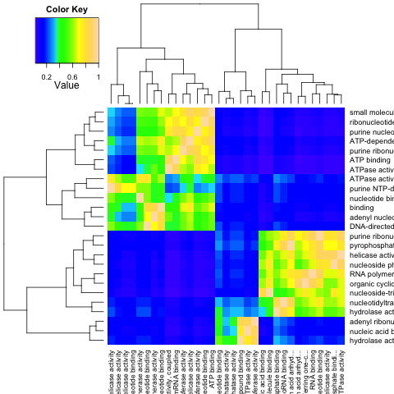
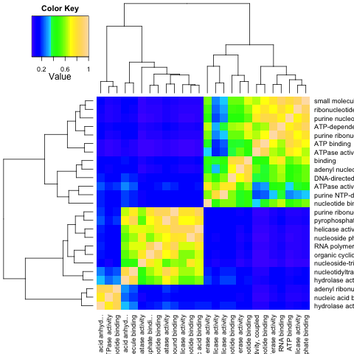
Figure 3: GO terms verification
Figure 5
* only GOs w/ p<0.01 & >=5 genes
fly vs. human
worm vs. fly
worm vs. human

Slide 17
Mapping protein-coding genes to the modules
Annotate functions of genes using guilt-by-association
By mapping genes with well-characterized GO terms, we validate the performance of the clusters as well as the mapping process. This is important because the same approach is applied for ncRNAs in the next section
Correlation coefficients with elements inside a module
Correlation coefficients with elements outside a module
separation of the two distributions
by Wilcoxon rank test

Slide 18
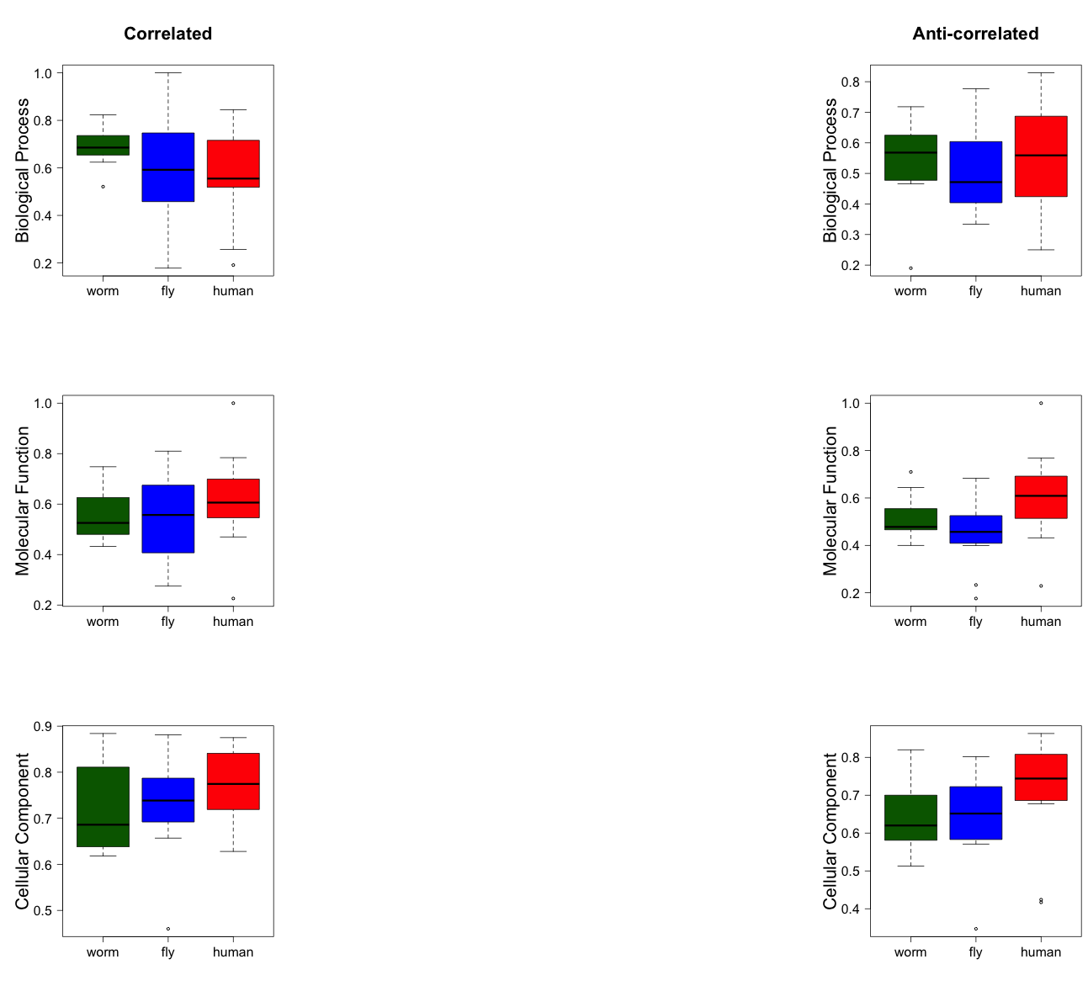
average overlap of GO terms
between genes in a cluster
and genes mapped to the cluster
Benchmark of each mapping
Figure 6B
Figure 6A

Slide 19
Mapping of ncRNAs

Slide 20
1
2
3
4
5
6
7
8
9
10
11
12
13
14
15
human
1-1-1 orthologs
Figure 7
16
worm
Negatively correlated
fly

Slide 21
extra analysis
Any suggestions?

Slide 22
Need extra analysis
Any suggestions?
How the 16 modules are organized in a network fashion?
ncRNAs can be mapped to multiple modules, a natural way for linkage
In relation to
  Salmena et al. Cell 2011: A ceRNA hypothesis
  Guttman and Rinn Nature 2012: modular regulatory principles of large ncRNAs

Slide 23
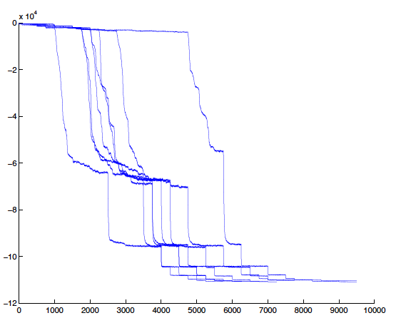
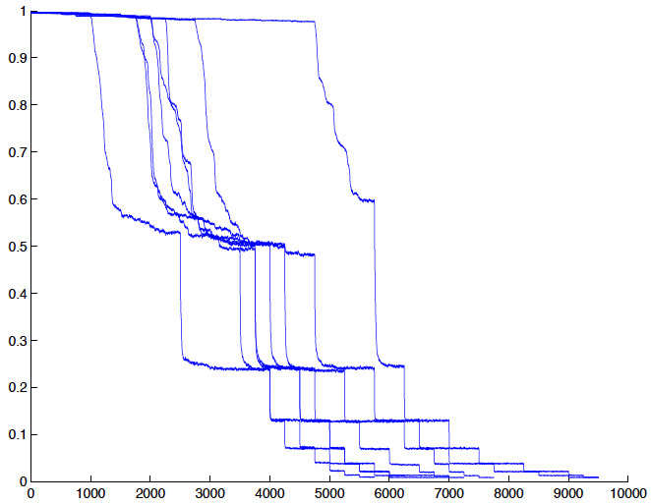
Figure S1
energy
flipping rate
the number of sweep
Notes:
Why similar?
Each trajectory represents a single run of the algorithm. We start with a random configuration, and a rather high temperature.
LHS is the energy, RHS is the flipping rate
At the beginning, energy is high, and flipping rate is close to 1.

Slide 24
Figure S2
Figure S3

Slide 25
Figure S4

Slide 26
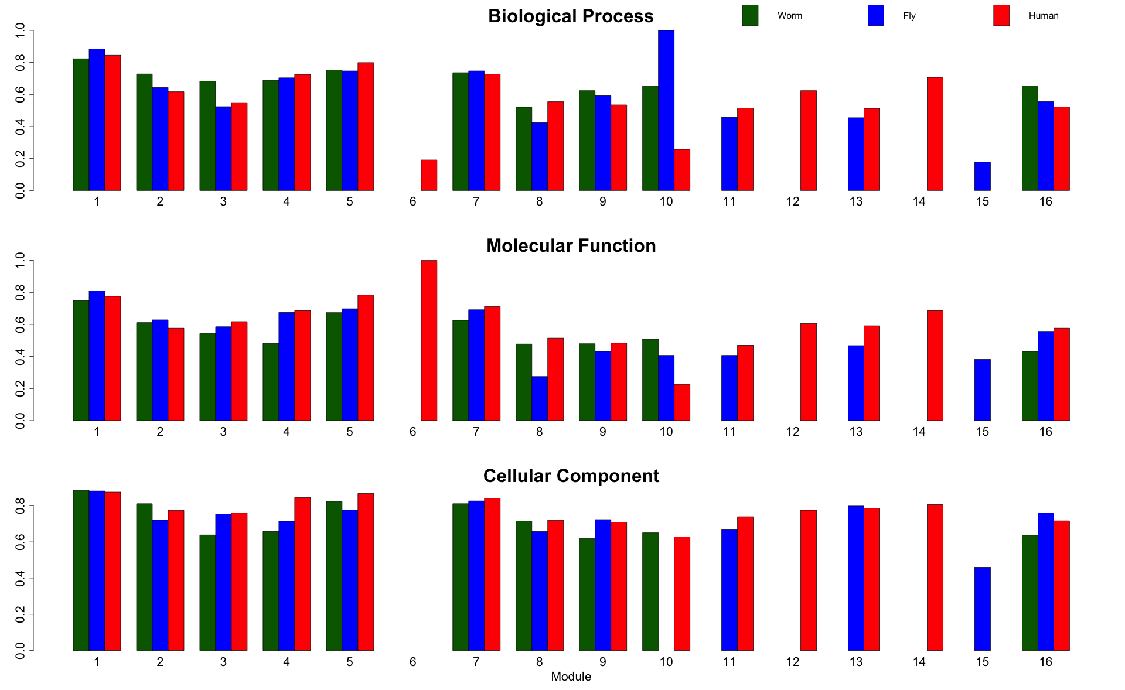
Figure S5a? GO similarity of modular genes and mapped genes (correlated)
Notes:
Mapped to the module w/ least wx test p-value (must be < 0.01)

Slide 27
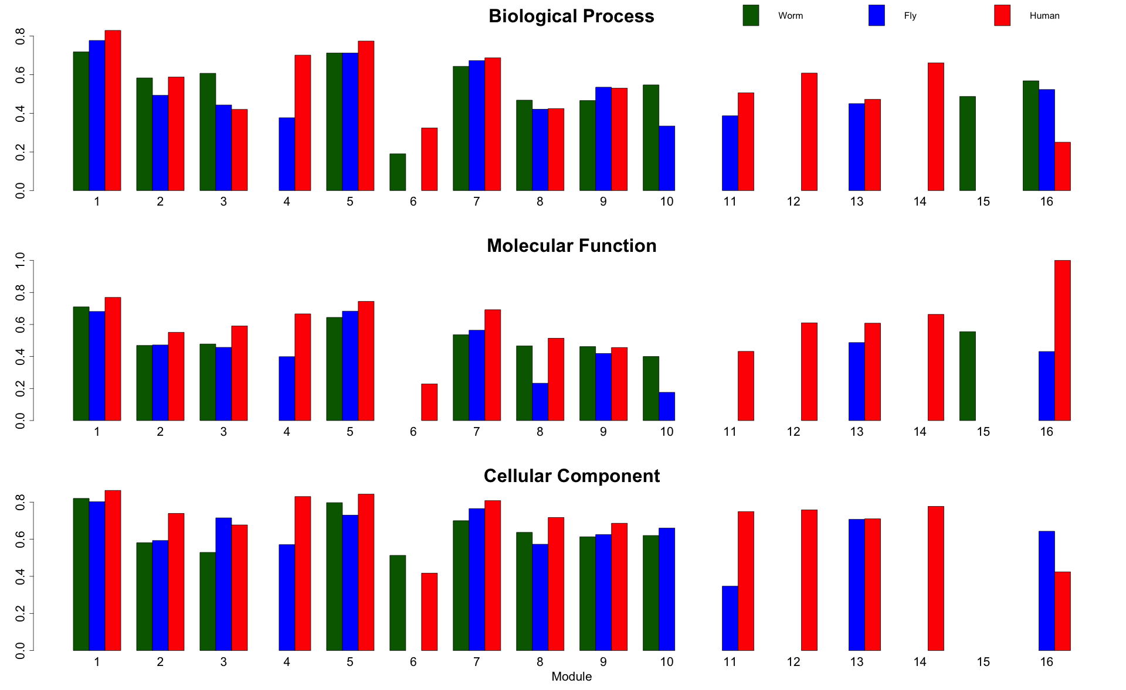
Figure S5b? GO similarity of modular genes and mapped genes (anti-corr.)
Notes:
Mapped to the module w/ least wx test p-value (must be < 0.01)

Slide 28
Supp: TAR mapping
negatively correlated
with modules
positive correlated
with modules
Genomics location of TARs wrt the co-expressed genes. co-localized?

Slide 29
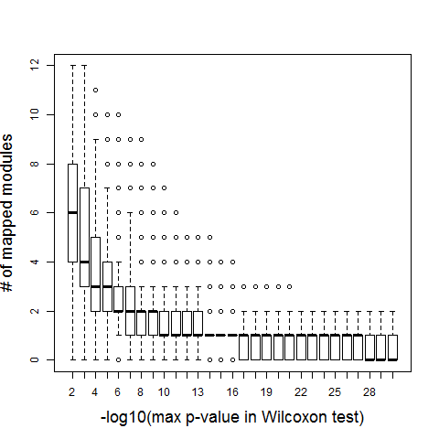
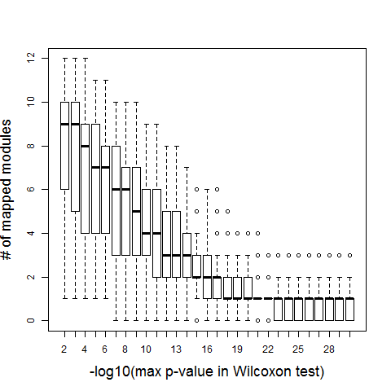
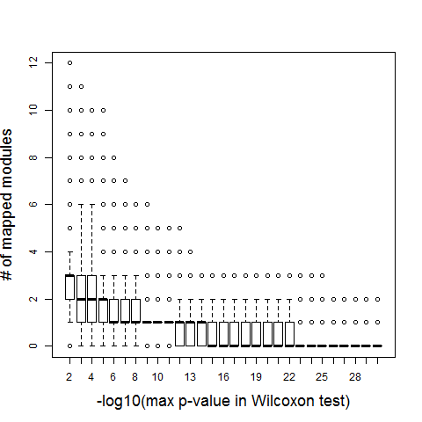
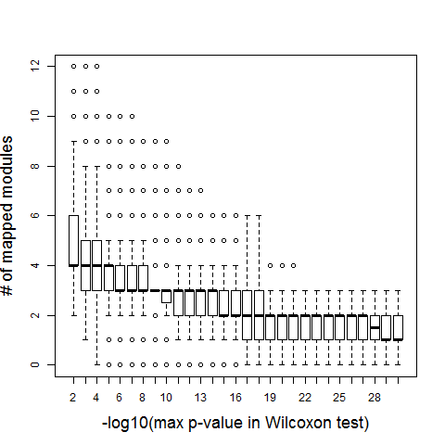
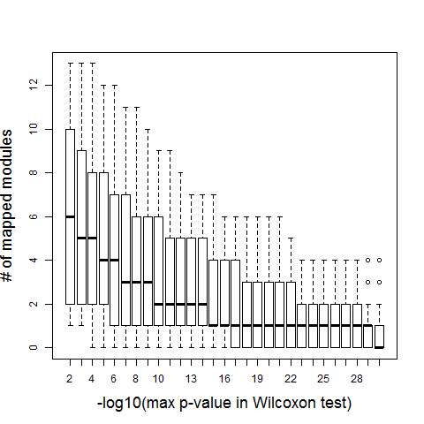
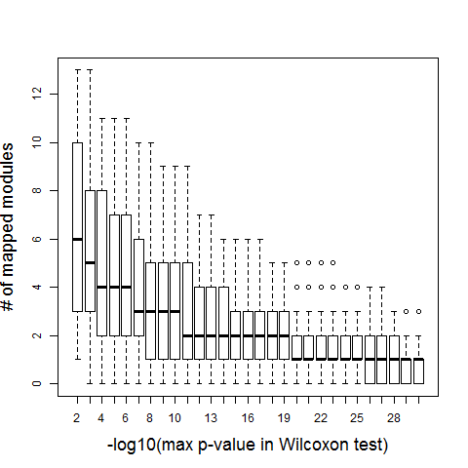
Supp. Mapping of ncRNAs to modules
Correlated ncRNAs in Human
Anti-correlated ncRNAs in Worm
Anti-correlated ncRNAs in Human
Correlated ncRNAs in Worm
Anti-correlated ncRNAs in Fly
Correlated ncRNAs in Fly

Slide 30
Figure 1B
simulated annealing
to optimize H
Set initial temperature T(0)
Input
Orthologous pairs
between species
randomly assign
spins (1,2,..,q) to nodes
19901 human genes across 33 cell types
Energy function
H
system evolves (spins flip) according to H
20377 worm genes
across 33 stages
co-expression
networks
13623 fly genes
across 30 stages
flipping rate
is low?
T(k+1)
=αT(k)
ENCODE/modENCODE
transcriptome data
High-confidence modules
based on multiple runs
at most q modules
labeled by spin values
5999 human
ncRNAs expression
Correlations between ncRNAs and modular orthologs
Output
Mapped worm ncRNAs
Mapped human ncRNAs
23263 worm
ncRNAs expression
538 fly
ncRNAs expression
module
Significantly correlated ncRNAs to modules via Wilcoxon rank test
mapping ncRNAs to
the cross species modules
Mapped fly ncRNAs
Notes:
We let the system evolve according to the Energy fct,
Wait for equ..
The system will then be settled in a low energy state.
Shared orthologs, as well as species specific genes.

