Slide 1
modENCODE hourglass companion

Slide 2
Outline
Conserved modules
Coordinate during phylotypic (high corr. or minimal divergence), i.e., hourglass
Species-specific modules
No hourglass
Conserved modules
Low correlations before and after phylotypic
(Possibly) Coordinate with specific modules
Conserved-specific module pairs
Function related before and after phylotypic

Slide 3
Data
Potts clustering for worm and fly only
modENCODE RNA-seq RPKMs
33 worm stages, 30 fly stages
29 worm-fly conserved modules
108 worm specific modules
52 fly specific modules

Slide 4
Fly conserved modules
phylotypic stage

Slide 5
Worm conserved modules

Slide 6
Fly specific modules

Slide 7
Worm specific modules

Slide 8
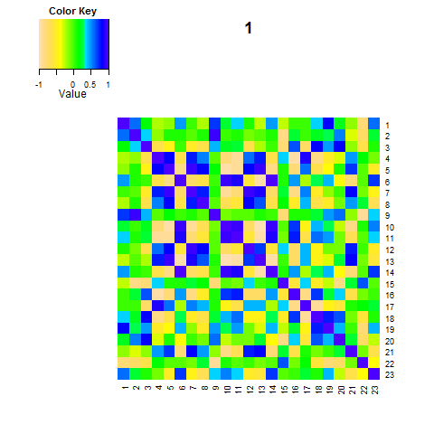
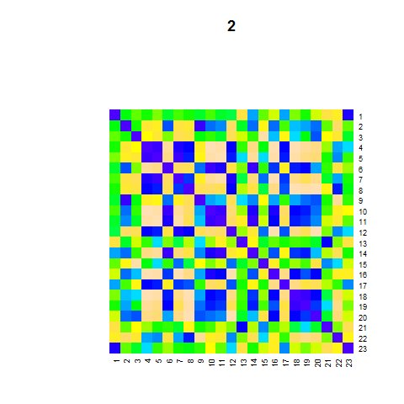
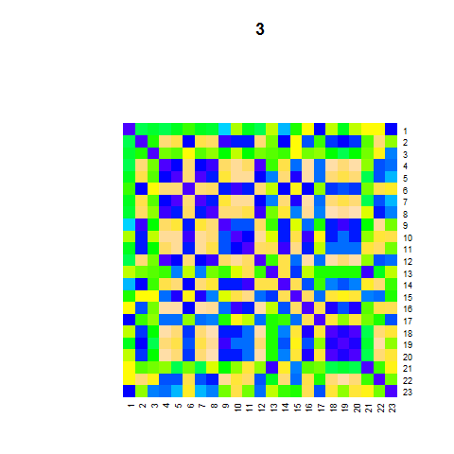
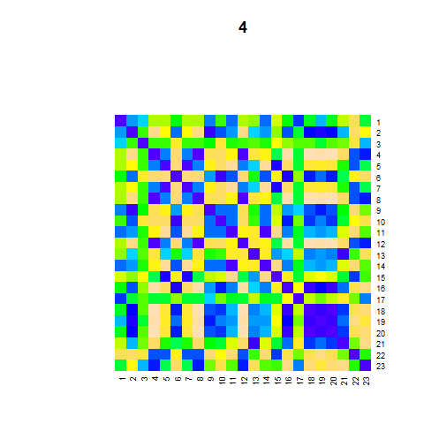
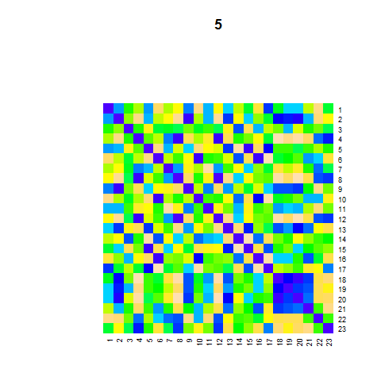
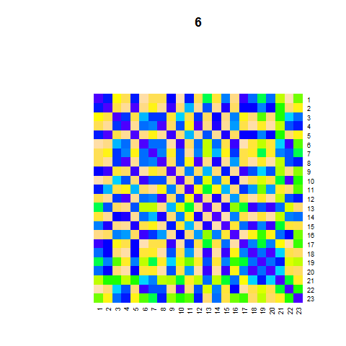
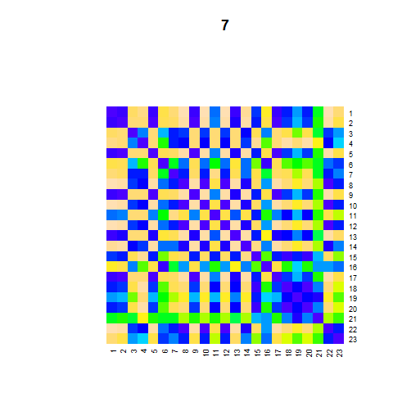
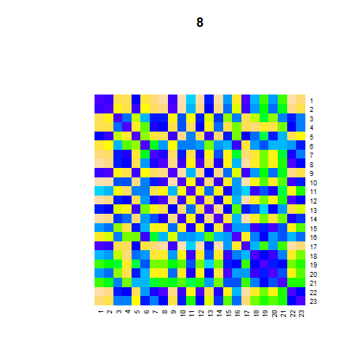
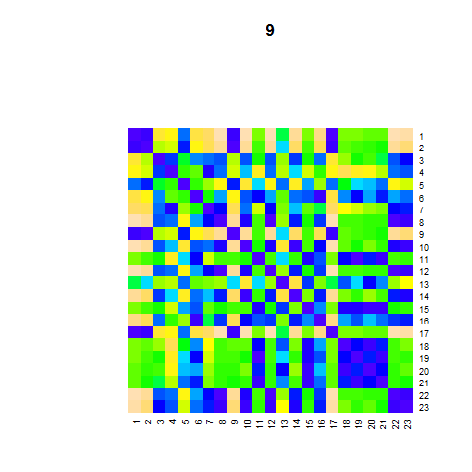
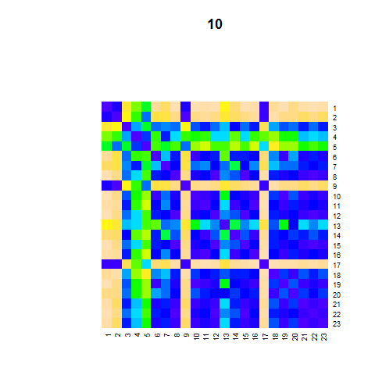
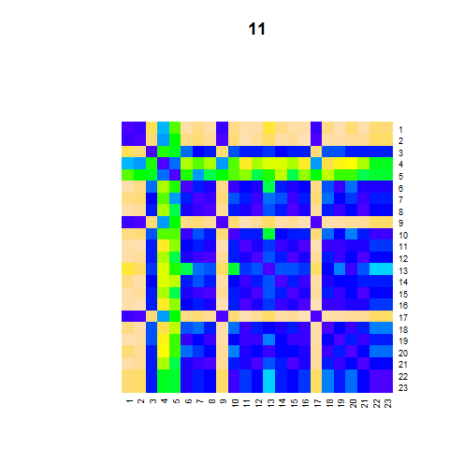
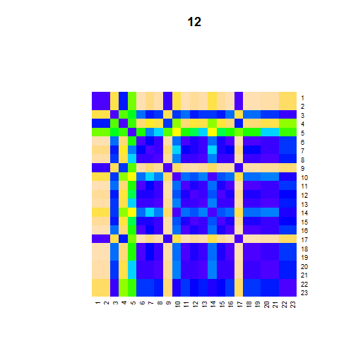
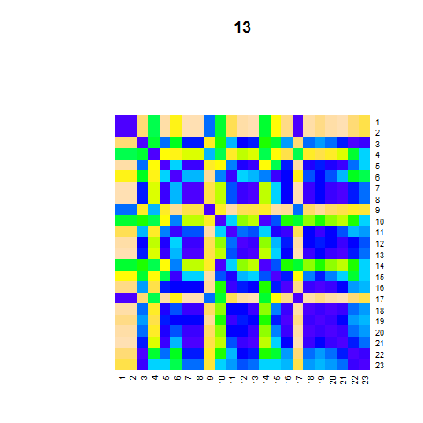
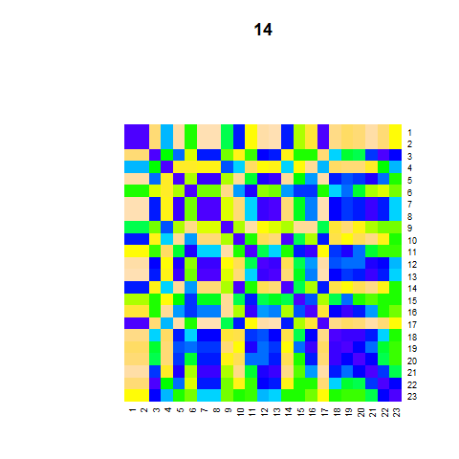
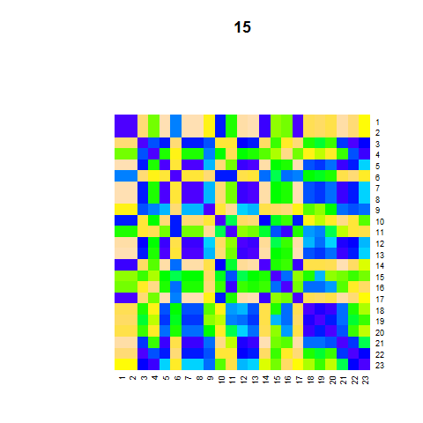
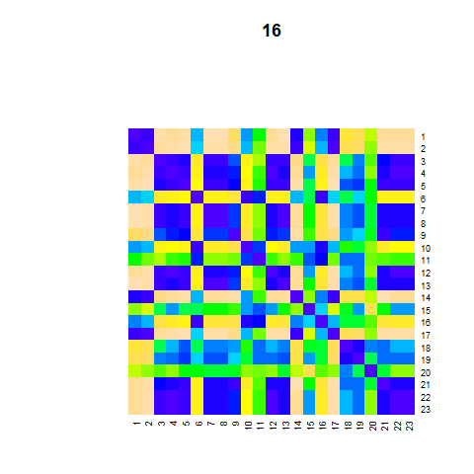
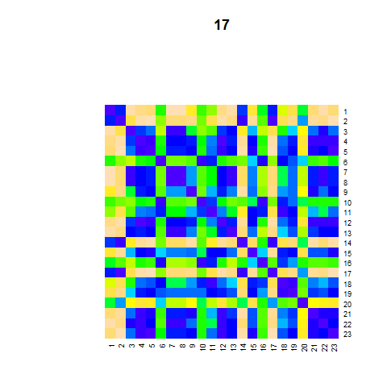
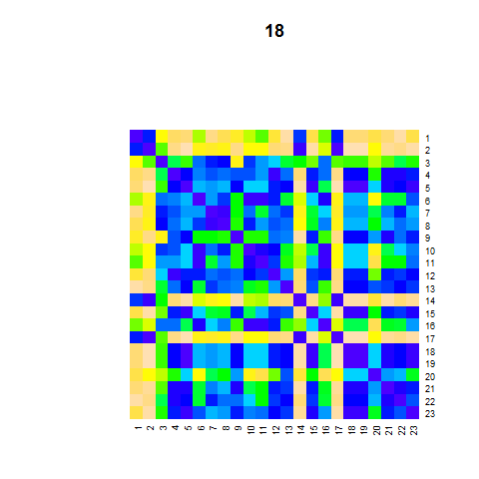
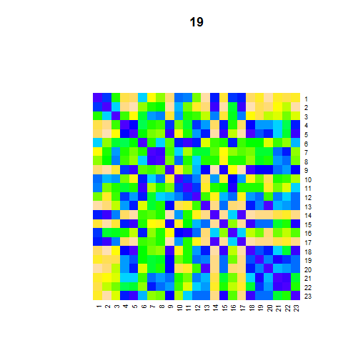
Worm sliding-window correlation matrices of all windows(1-19)
Phylotypic stages

Slide 9
Worm sliding-window corr. matrix distances to window No. 5 (mid=3.5 hr)

Slide 10
Conserved modules
Coordinate during phylotypic stages -> Conserved functions
Some don’t coordinate before and after phylotypic stages -> Species-specific functions
Who do they coordinate?
Specific modules

Slide 11
Example: Conserved No. 14 vs. Specific No. 31 & 102
Molecular Function
Conserved Module No. 14
[1] "unfolded protein binding" "ATP binding"
[3] "adenyl ribonucleotide binding" "adenyl nucleotide binding"
[5] "purine ribonucleoside triphosphate bindi..." "ribonucleotide binding"
[7] "purine ribonucleotide binding" "purine nucleotide binding"
[9] "nucleotide binding" "organic cyclic compound binding"
[11] "nucleoside phosphate binding" "small molecule binding"
[13] "protein binding"
Expression Correlation
Specific Module No. 31
[1] "galactosyltransferase activity" "transferase activity, transferring hexos..."
[3] "nucleic acid binding transcription facto..." "sequence-specific DNA binding transcript..."
[5] "cation channel activity" "sequence-specific DNA binding"
[7] "G-protein coupled receptor activity" "transferase activity, transferring glyco..."
[9] "metal ion transmembrane transporter acti..."
Specific Module No. 102
[1] "serine-type endopeptidase activity" "serine-type peptidase activity"
[3] "serine hydrolase activity" "peptidase activity, acting on L-amino ac..."
[5] "peptidase activity" "hydrolase activity, acting on carbon-nit..."
[7] "lysozyme activity" "structural constituent of collagen and c..."
Stage

Slide 12
Examples: worm cons-spec module pairs

Slide 13
Fly conserved modules (traditional hourglass)

