Slide 1
FunSeq v1
April 22,2013

Slide 2
FunSeq
Input (Bed , Vcf)
1KG Filter
2
4
Non-Coding
Coding
1
1
Annotation
VAT
Motif Breaking
Non-synonymous
1
Sensitive
LoF
Ultra-sensitive
0
Selection
1
1
Target gene
Hub
1
Hub

Slide 3
566 non-coding HGMD mutations
Random sample ~566 common (MAF > 0.5%) Phase I non-coding SNVs.

Slide 5


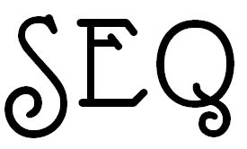
SNVs File:
(BED or VCF)
Or upload File:
Upload…
Input Format : (BED or VCF)
MAF : (Minor Allele Frequency)
Output Format : (BED or VCF)
Run FunSEQ

