Slide 1
Retroduplications and cell cycle
(additional analysis)
Alexej Abyzov
April 15, 2013

Slide 2
Reviewer’s comments
Furthermore, periodic expression evidence is quite weak: the authors use periodic expression data from Whitfield et al. (2002), but it seems that there is a more recent study that is more comprehensive and accurate (Bar-Joseph et al. 2008; PNAS, doi: 10.1073/pnas.0704723105). These points aside, I would not consider the apparent association of cell cycle period expression with retrotransposition presense/copy-number, unless total expression level of these genes had been controlled for. In other words, I would like to see the authors rigorously show that mitotic expression is a significantly better predictor of retroduplication than total expression level across the entire cell cycle.

Slide 3
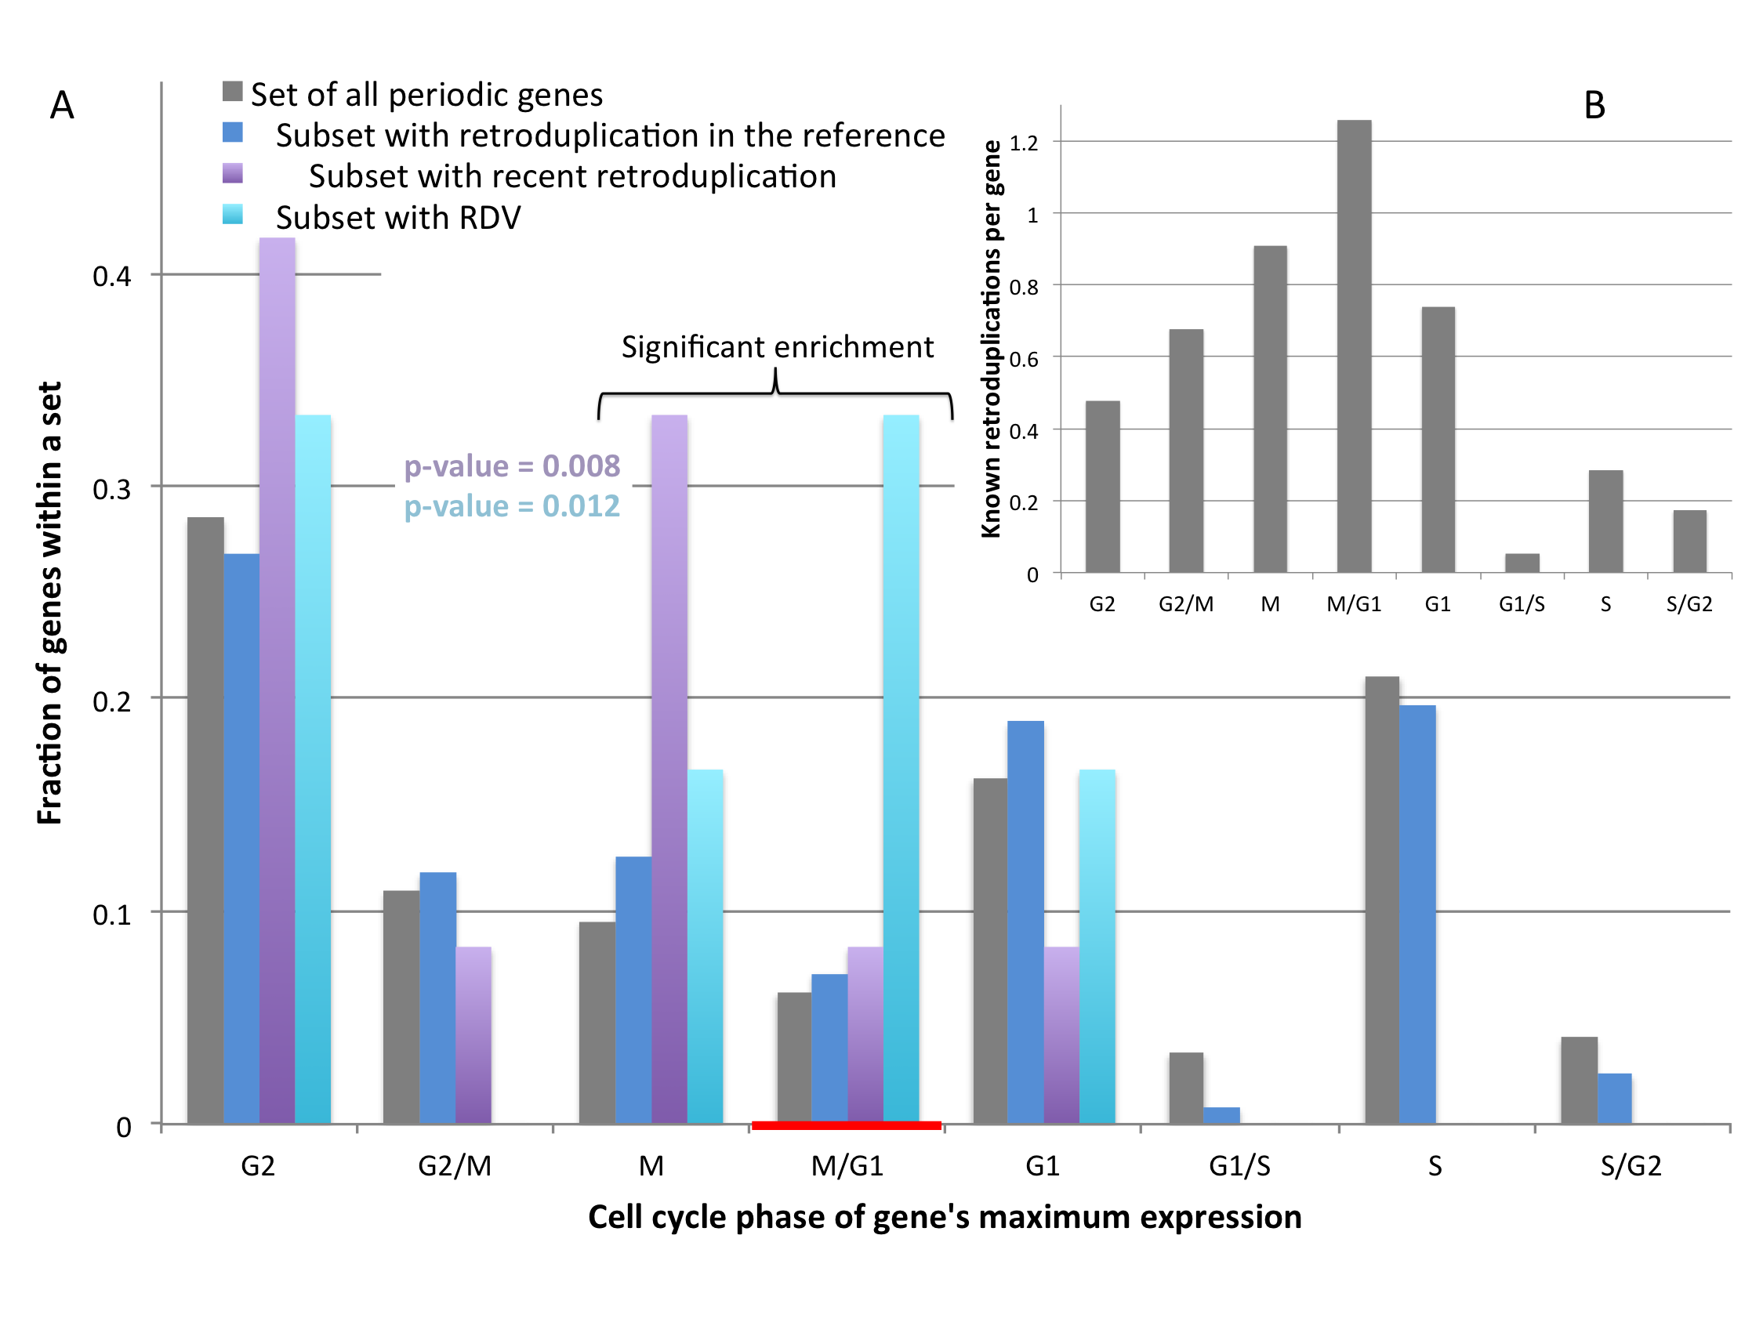
Whitfield et al. data (HeLa)

Slide 4
Bar-Joseph et al. data
(foreskin fibroblasts)

Slide 5
Reviewer’s comments
Furthermore, periodic expression evidence is quite weak: the authors use periodic expression data from Whitfield et al. (2002), but it seems that there is a more recent study that is more comprehensive and accurate (Bar-Joseph et al. 2008; PNAS, doi: 10.1073/pnas.0704723105). These points aside, I would not consider the apparent association of cell cycle period expression with retrotransposition presense/copy-number, unless total expression level of these genes had been controlled for. In other words, I would like to see the authors rigorously show that mitotic expression is a significantly better predictor of retroduplication than total expression level across the entire cell cycle.

Slide 6
My thoughts
One need to have precise and absolute (not relative) expression profiles for all (most) genes to answer this question

Slide 7
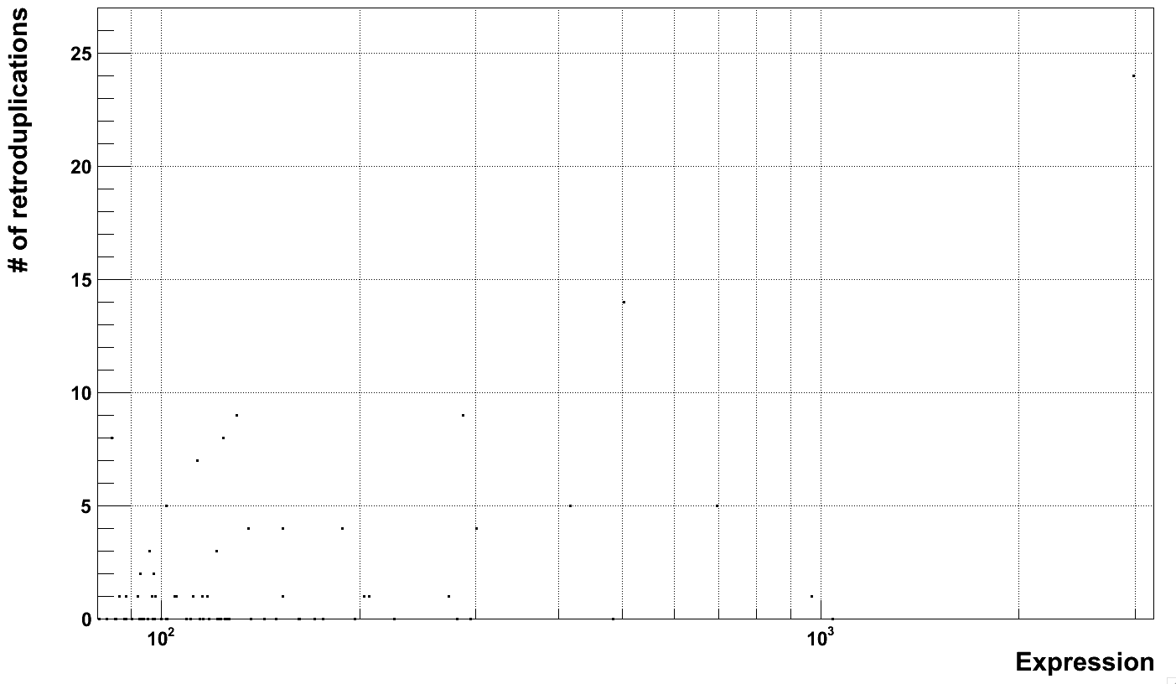
Correlation = 0.25 (Pearson’s rank)

Slide 8
Weighting expression
Using this ratios
as weights

Slide 9
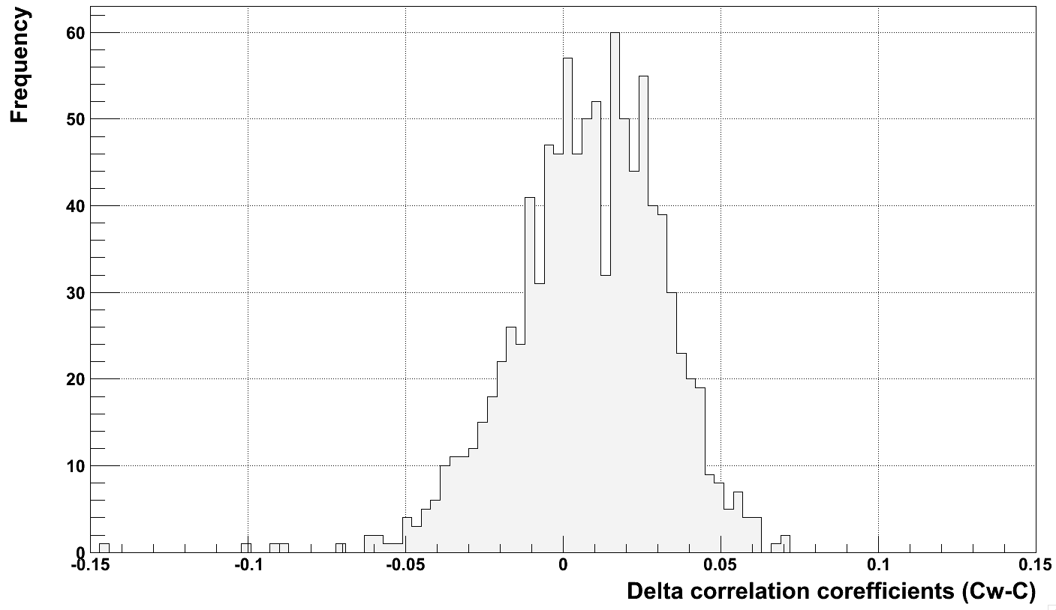
Weighting improves correlation!
In 684 cases (out of 1000)
correlation improved
P-value = 3.9e-32 by binomial test

