Slide 1
de novo SNPs in 03 family
Alexej Abyzov, Mike Wilson, Mark Gerstein
iPS meeting
April 10, 2013

Slide 2
Why 03
4 individuals in a family => more data to analyze
High coverage for 03-03 i6 => more data to analyze

Slide 3
Data
4 lanes: F + i2 + i3 + i9
5.4 + 6.4 + 4.5 + 5 ≈ 21X
4 lanes: F + i5 + i8 + i9
3.8 + 5.4 + 4.6 + 3.3 ≈ 17X
03
4 lanes: F + i2 + i3 + i4
4.3 + 8 + 8 + 9 ≈ 29X
4 lanes: F + F + i1 + i5 + i6 + i6 + i6
3.5 + 10.4 + 6.5 + 4.1 + 4.3 + 6.9 + 7 ≈ 42X

Slide 4
SNP calls
Sample | Coverage | # of SNPs | in dbSNP | in 1KG
03-01 | 21X | 3,328,658 | 3,286,870 (98.7%) | 3,214,252 (96.6%)
03-02 | 17X | 3,272,942 | 3,234,259 (98.8%) | 3,154,212 (96.4%)
03-03 | 29X | 3,262,444 | 3,223,325 (98.8%) | 3,152,517 (96.6%)
03-04 | 41X | 3,326,935 | 3,281,767 (98.6%) | 3,218,802 (96.7%)

Slide 5
Predicting de novo SNPs in proband
3,262,444 (100%)
SNP calls
3,133 (0.1%)
No evidence of existence
in other family members
Unique to proband
Not in 1KG
31,981 (1%)
1,855 (0.06%)
Not in masked regions
Evidence from reliably
mapped reads (proband)
16,940 (0.5%)
768 (0.02%)

Slide 6
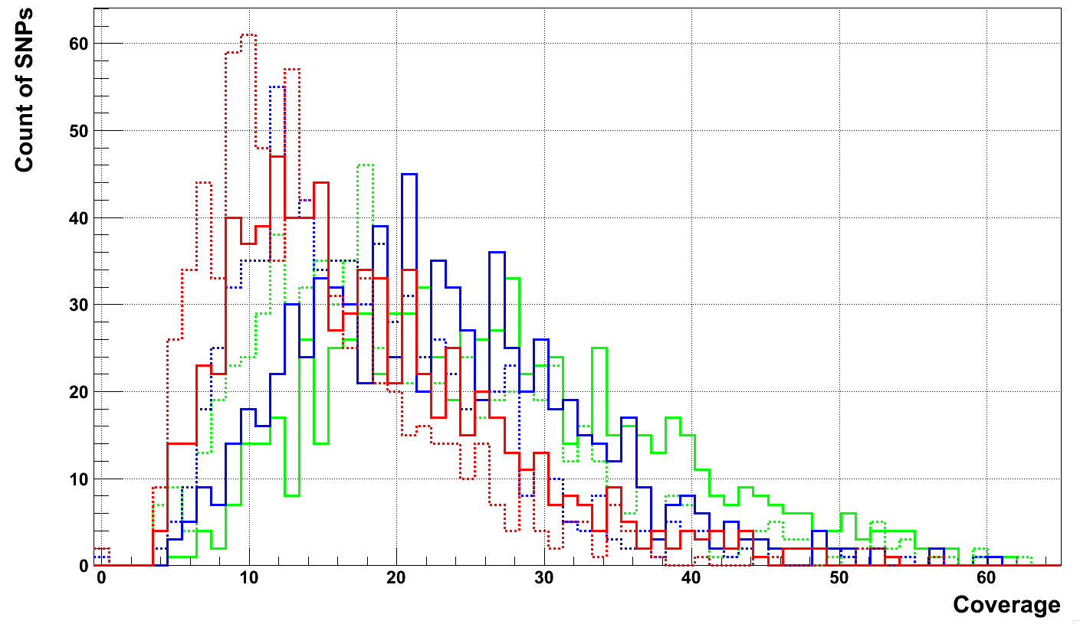
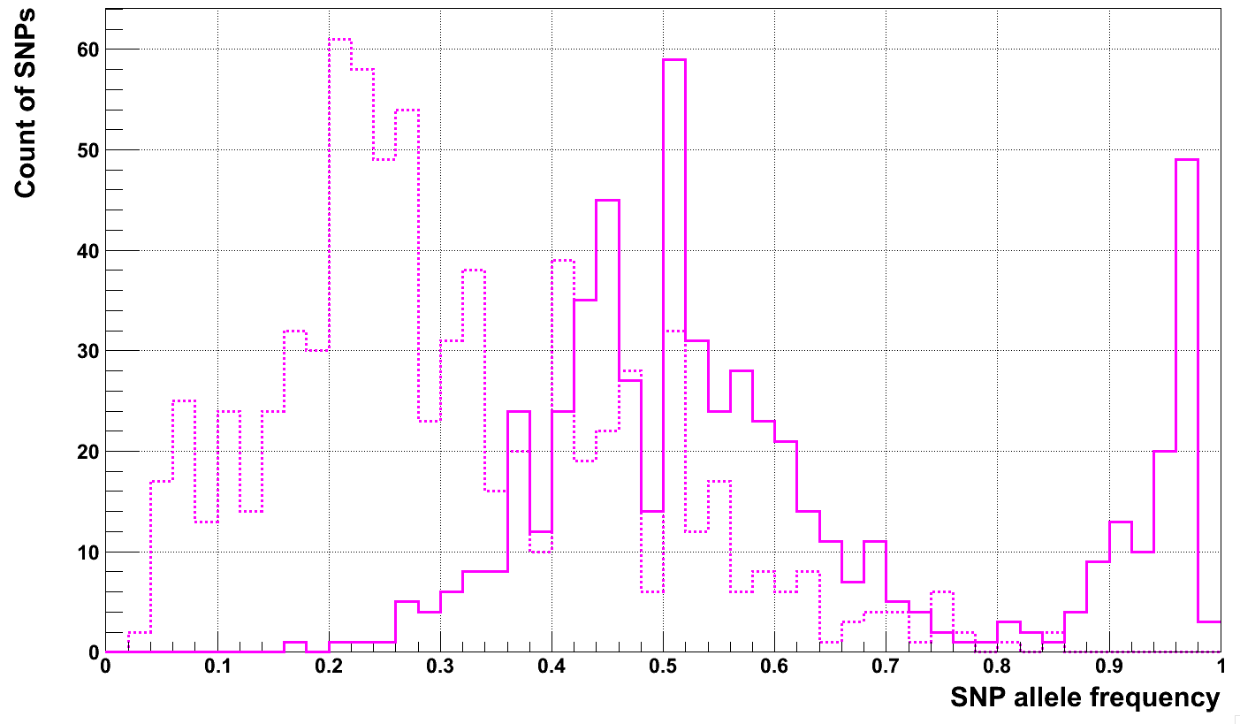
Comparison with real SNPs
de novo (dashed)
real SNPs (solid)
Mother
Father
Proband
254 candidates,
176 candidates (coverage > 14)
False positives,
somatic in iPS lines
0.35
0.75

Slide 7
Selection by iPS/F lines
# of iPS/F lines with support | # of de novo SNP candidates | In dbSNP
At least in 1 | 176 | 7 (4.0%)
At least in 2 | 161 | 6 (3.7%)
At least in 3 | 155 | 6 (3.9%)
In 4 | 107 | 5 (4.7%)

Slide 8
Comparison
178 SNPs (preliminary)
176 SNPs (now)
103
75
101

Slide 9
Next
Validation is necessary to understand how well are we currently predicting
  Is prediction in proband is wrong?
  Do we miss SNPs in parents and sibling?
Additional set reduction by
  Increasing stringency on base-call supporting SNP
  Increasing stringency on read mapping supporting SNP
  Requiring supporting reads be mapping in both orientations

