Slide 1
mod/ENCODE Transcription Comparison Paper
Figure Slide Pack
8 Mar 2013
Transcriptome Comparison Group

Slide 2
Exhibit 1: Data Sets

Slide 3
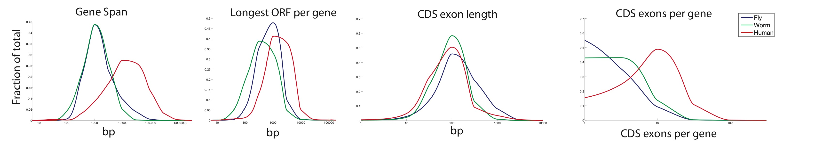
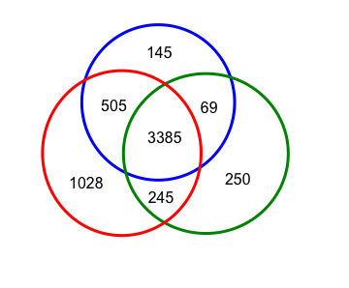
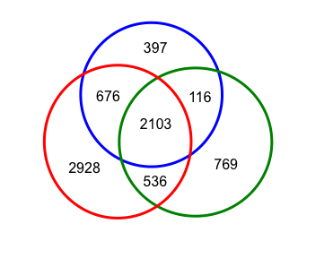
Exhibit 2: Summary Statistics for Protein Coding Genes
A
5’
I
C
3’
B
Pfam Domains
Domain Combinations
C

Slide 4
Exhibit 3: Splicing Figure

Slide 5
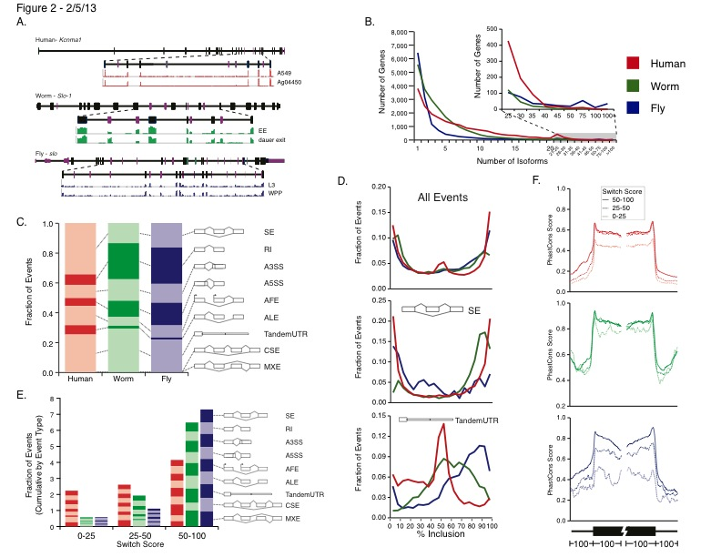

Slide 6
Exhibit 4: Pseudogenes

Slide 8
Exhibit 5: Comparison of ncRNAs

Slide 9
 |  |  |  |  | Human |  |  | Worm |  |  | Fly
 |  |  |  |  | Elements | Genome Coverage (Kb [%]) | Mapped Reads (fraction) | Elements | Genome Coverage (Kb [%]) | Mapped Reads (fraction) | Elements | Genome Coverage (Kb [%]) | Mapped Reads (fraction)
Annotated ncRNAs |  | Comparable ncRNAs |  | piRNA loci | 88 | 1,272 [0.04] | 3.2 e-4 | 35,322 | 449 [0.45] | 6.7 e-3 | 21 | 1,604 [1.2] | 1.6 e-3
 |  |  |  | pri-miRNA | 58 | 1,158 [0.04] | 3.6 e-4 | 44 | 16 [0.02] | 6.6 e-6 | 43 | 316 [0.25] | 1.7 e-4
 |  |  |  | pre-miRNAs | 1,756 | 162 [0.006] | 2.7 e-3 | 221 | 20 [0.02] | 2.1 e-4 | 235 | 22 [0.02] | 7.2 e-5
 |  |  |  | tRNAs | 624 | 47 [0.002] | 3.0 e-4 | 638 | 45 [0.04] | 1.3 e-5 | 308 | 22 [0.02] | 1.4 e-6
 |  |  |  | snoRNAs | 1,521 | 168 [0.006] | 3.3 e-4 | 141 | 16 [0.02] | 2.9 e-4 | 287 | 34 [0.03] | 2.9 e-4
 |  |  |  | snRNAs | 1,944 | 210 [0.007] | 4.6 e-5 | 114 | 14 [0.01] | 4.9 e-5 | 47 | 7 [0.006] | 8.5 e-5
 |  |  |  | lncRNAs | 10,840 | 10,581 [0.37] | 2.2 e-2 | 417 | 184 [0.18] | 8.3 e-4 | 558 | 868 [0.68] | 1.3 e-2
 |  | Other ncRNAs |  |  | 9,281 | 2,624 [0.091] | 3.9 e-3 | 2,935 | 530 [0.53] | 2.9 e-3 | 398 | 381 [0.30] | 2.1 e-3
Total ncRNAs |  |  |  |  | 26,112 | 16,103 [0.56] | 2.9 e-2 | 39,832 | 1,268 [1.26] | 1.1 e-2 | 1,897 | 3,022 [2.35] | 1.6 e-2
Transcriptionally Unannotated Regions |  |  |  |  | 294,956 | 2,749,660 [96.1] | 2.0 e-1 | 146,913 | 64,232 [64.1] | 5.1 e-2 | 60,267 | 89,630 [69.8] | 5.5 e-2
 | TARs |  |  |  | 718,537 | 923,774 [32.3] | 2.0 e-1 | 235,915 | 37,482 [37.4] | 4.6 e-2 | 76,757 | 47,542 [37.0] | 5.5 e-2
 |  |  | Supervised Predictions |  | 104,001 | 13,844 [0.51] | 1.2 e-2 | 2,509 | 390 [0.77] | 2.5 e-4 | 599 | 164 [0.004] | 2.4 e-5
 |  |  | Overlapping TEs |  | 1,633,407 | 455,803 [15.9] | 8.0 e-2 | 65,600 | 5,621 [5.6] | 2.3 e-3 | 38,595 | 7,414 [5.8] | 2.9 e-2
 |  |  | Overlapping Introns |  | 1,300,035 | 360,778 [12.6] | 1.2 e-1 | 173,253 | 18,347 [18.3] | 2.5 e-2 | 79,012 | 28,857 [22.5] | 1.9 e-2
A)
Notes:
TARs

Slide 10
 |  |  |  | Human |  |  | Worm |  |  | Fly
 |  |  |  | Elements | Genome Coverage |  | Elements | Genome Coverage |  | Elements | Genome Coverage
 |  |  |  |  | Kb | % |  | Kb | % |  | Kb | %
Annotated ncRNAs | Comparable ncRNAs |  | piRNA loci | 88 | 1,272 | 0.04 | 35,322 | 449 | 0.45 | 21 | 1,604 | 1.2
 |  |  | pri-miRNA | 58 | 1,158 | 0.04 | 44 | 16 | 0.02 | 43 | 316 | 0.25
 |  |  | pre-miRNAs | 1,756 | 162 | 0.006 | 221 | 20 | 0.02 | 235 | 22 | 0.02
 |  |  | tRNAs | 624 | 47 | 0.002 | 638 | 45 | 0.04 | 308 | 22 | 0.02
 |  |  | snoRNAs | 1,521 | 168 | 0.006 | 141 | 16 | 0.02 | 287 | 34 | 0.03
 |  |  | snRNAs | 1,944 | 210 | 0.007 | 114 | 14 | 0.01 | 47 | 7 | 0.006
 |  |  | lncRNAs | 10,840 | 10,581 | 0.37 | 417 | 184 | 0.18 | 558 | 868 | 0.68
 | Other ncRNAs |  |  | 9,281 | 2,624 | 0.091 | 2,935 | 530 | 0.53 | 398 | 381 | 0.30
Total ncRNAs |  |  |  | 26,112 | 16,103 | 0.56 | 39,832 | 1,268 | 1.26 | 1,897 | 3,022 | 2.35
Transcriptionally Unannotated Regions |  |  |  | 294,956 | 2,749,660 | 96.1 | 146,913 | 64,232 | 64.1 | 60,267 | 89,630 | 69.8
 | TARs |  |  | 718,537 | 923,774 | 32.3 | 235,915 | 37,482 | 37.4 | 76,757 | 47,542 | 37.0
 |  | Supervised Predictions |  | 104,001 | 13,844 | 0.51 | 2,509 | 390 | 0.77 | 599 | 164 | 0.004
 |  | Overlapping TEs |  | 1,633,407 | 455,803 | 15.9 | 65,600 | 5,621 | 5.6 | 38,595 | 7,414 | 5.8
 |  | Overlapping Introns |  | 1,300,035 | 360,778 | 12.6 | 173,253 | 18,347 | 18.3 | 79,012 | 28,857 | 22.5
A)
Notes:
TARs

Slide 11
 |  |  |  | Human |  |  | Worm |  |  | Fly
 |  |  |  | Elements | Genome Coverage |  | Elements | Genome Coverage |  | Elements | Genome Coverage
 |  |  |  |  | Kb | % |  | Kb | % |  | Kb | %
Annotated ncRNAs | Comparable ncRNAs |  | piRNA loci | 88 | 1,272 | 0.04 | 35,322 | 449 | 0.45 | 21 | 1,604 | 1.2
 |  |  | pri-miRNA | 58 | 1,158 | 0.04 | 44 | 16 | 0.02 | 43 | 316 | 0.25
 |  |  | pre-miRNAs | 1,756 | 162 | 0.006 | 221 | 20 | 0.02 | 235 | 22 | 0.02
 |  |  | tRNAs | 624 | 47 | 0.002 | 638 | 45 | 0.04 | 308 | 22 | 0.02
 |  |  | snoRNAs | 1,521 | 168 | 0.006 | 141 | 16 | 0.02 | 287 | 34 | 0.03
 |  |  | snRNAs | 1,944 | 210 | 0.007 | 114 | 14 | 0.01 | 47 | 7 | 0.006
 |  |  | lncRNAs | 10,840 | 10,581 | 0.37 | 417 | 184 | 0.18 | 558 | 868 | 0.68
 | Other ncRNAs |  |  | 9,281 | 2,624 | 0.091 | 2,935 | 530 | 0.53 | 398 | 381 | 0.30
Total ncRNAs |  |  |  | 26,112 | 16,103 | 0.56 | 39,832 | 1,268 | 1.26 | 1,897 | 3,022 | 2.35
Transcriptionally Unannotated Regions |  |  |  | 294,956 | 2,749,660 | 96.1 | 146,913 | 64,232 | 64.1 | 60,267 | 89,630 | 69.8
 | TARs |  |  | 718,537 | 923,774 | 32.3 | 235,915 | 37,482 | 37.4 | 76,757 | 47,542 | 37.0
 |  | Supervised Predictions |  | 104,001 | 13,844 | 0.51 | 2,509 | 390 | 0.77 | 599 | 164 | 0.004
 |  | Overlapping TEs |  | 1,633,407 | 455,803 | 15.9 | 65,600 | 5,621 | 5.6 | 38,595 | 7,414 | 5.8
 |  | Overlapping Introns |  | 1,300,035 | 360,778 | 12.6 | 173,253 | 18,347 | 18.3 | 79,012 | 28,857 | 22.5
 |  | The Rest |  |  | 93,349 | 3.0 |  | 13,124 | 13.0 |  | 11,107 | 9.0
A)
Notes:
TARs

Slide 12
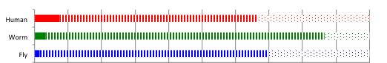
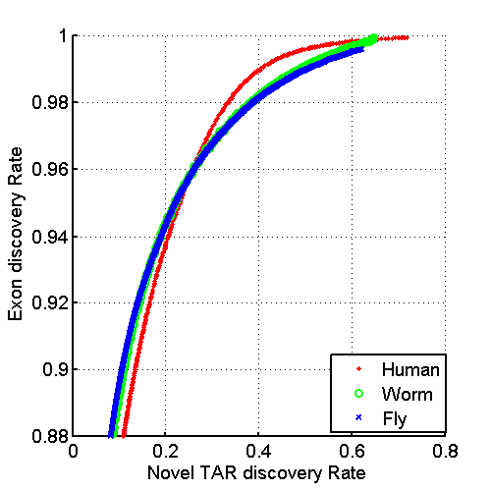
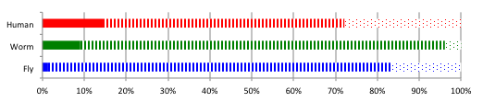
B)
C)
Enhancers
Total
192,386
18,320
14,848
Distal HOT Regions
31,974
541
522
Percentage Overlap with Supervised ncRNA Predictions ( ) and TARs ( )
D)

Slide 13
Exhibit 6: Expression Clustering of Coding Genes and ncRNAs

Slide 14
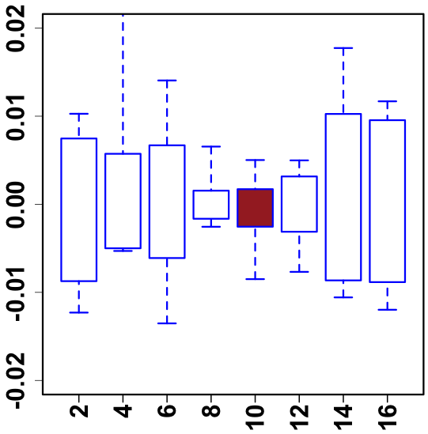
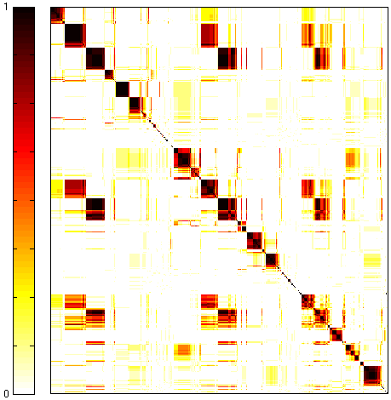
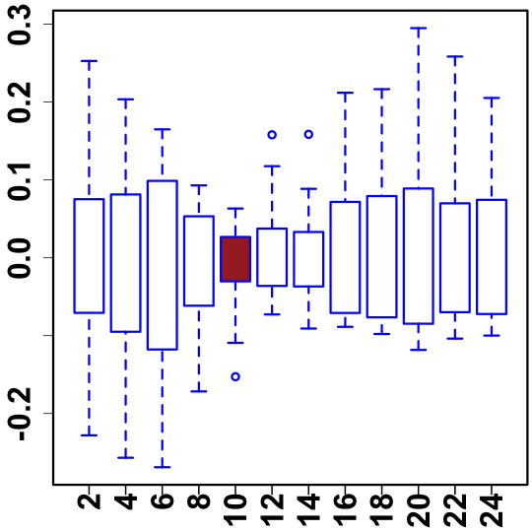
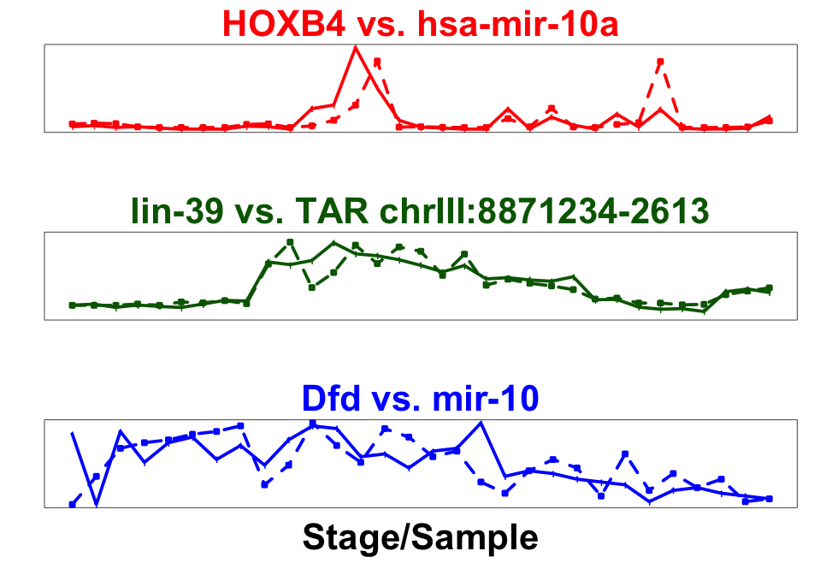
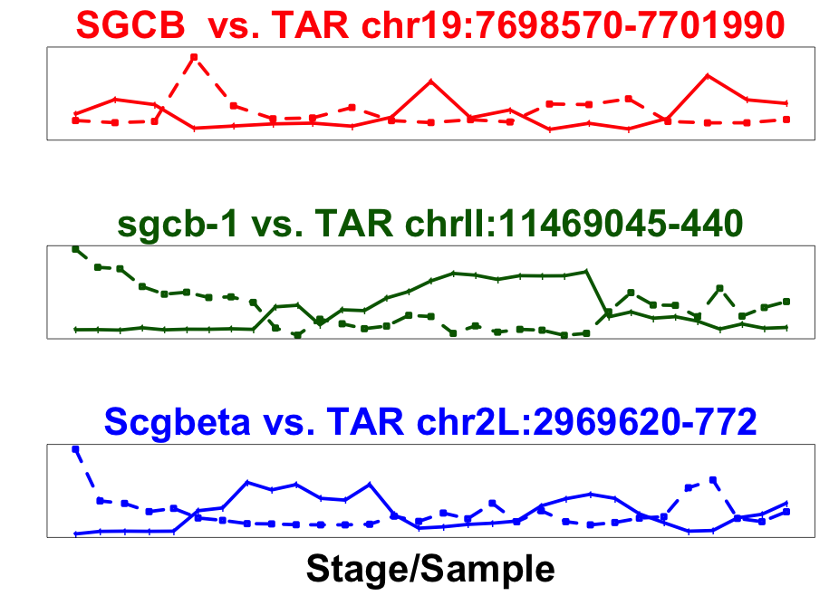
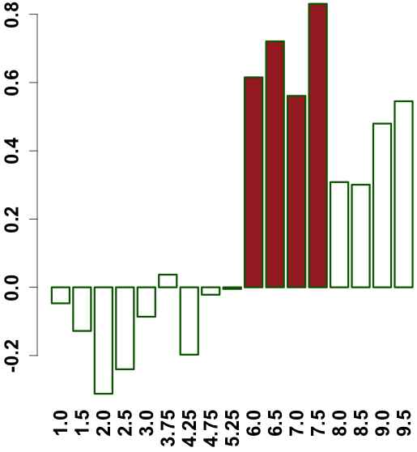
A
Conservation of module across number of species
B
phylotypic stage
human-worm-fly
1
worm-fly
Expression of a module across 6 fly species
19901 genes
worm-specific
gene-gene co-association
20377 genes
13623 genes
0
Expression across modules in fly
C
Ortholog
ncRNA/TAR
Correlated
Anti-correlated
Median expression correlation across modules in worm
Expression
Stage (hour)

Slide 15
Exhibit 7: Stage Mapping of Worm and Fly Developmental Timecourses

Slide 16
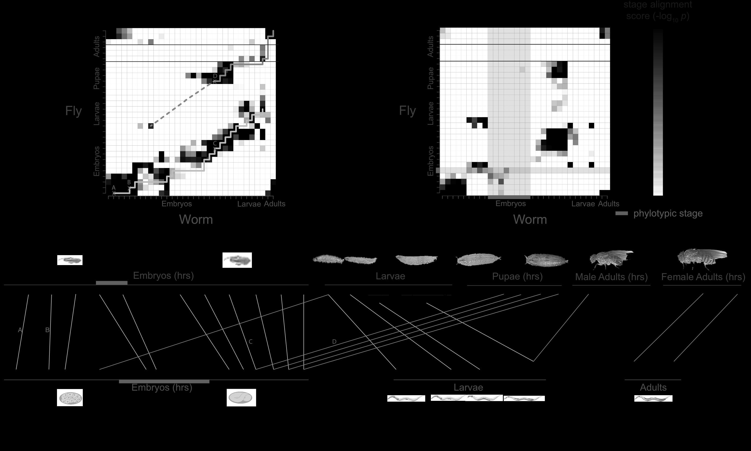

Slide 17
Exhibit 8: Histone and TF Models for Gene Expression

Slide 18
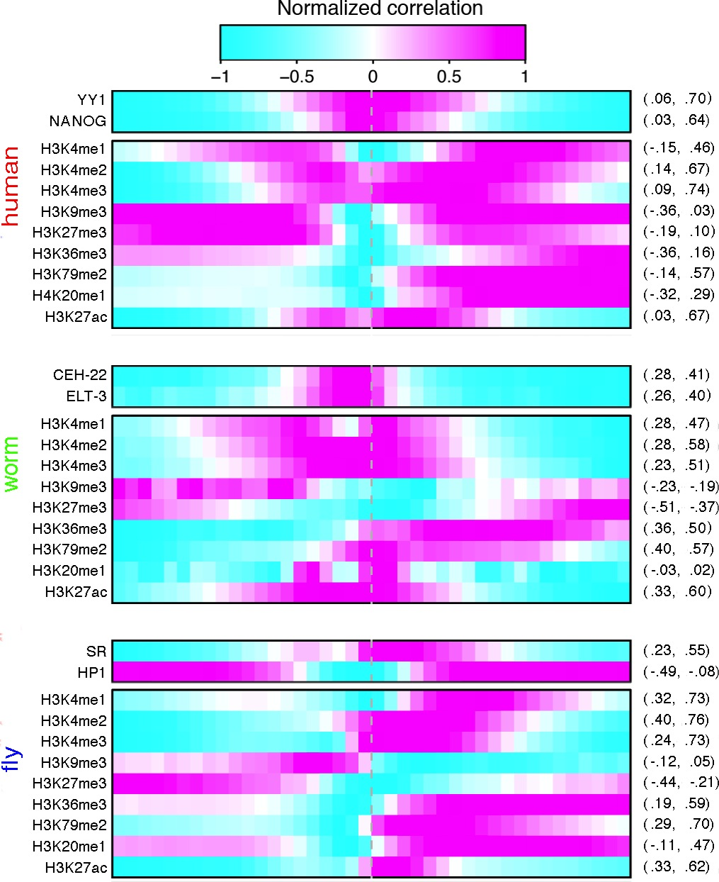
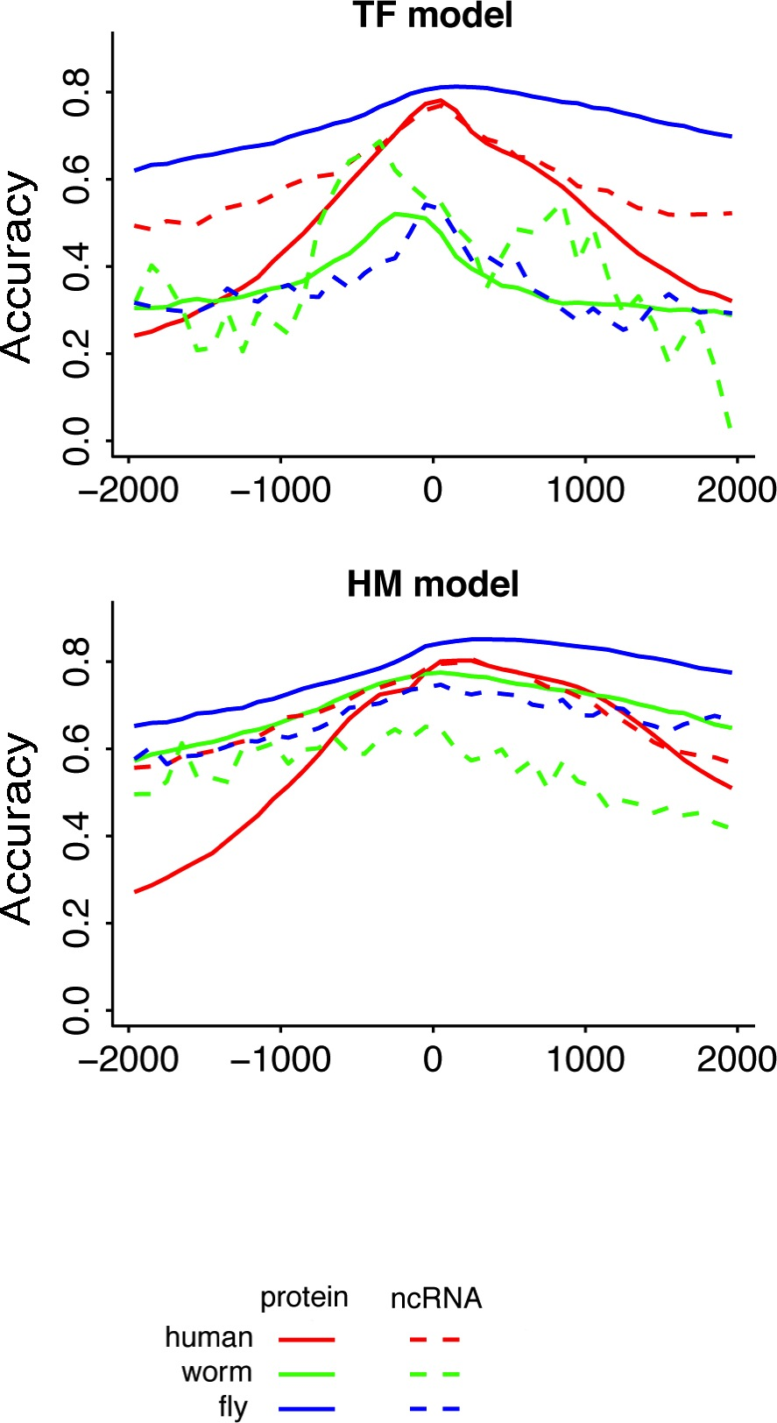
A
B
C
Pol II ρ=0.64
H3K4me3 ρ=0.58
(bin at TSS)
D
E
Human
Worm
Fly
Universal
F

