Slide 1
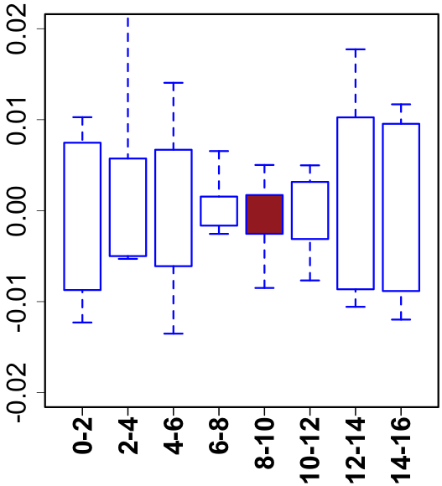
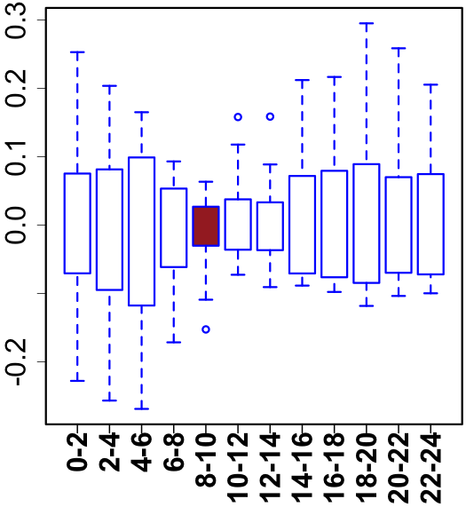
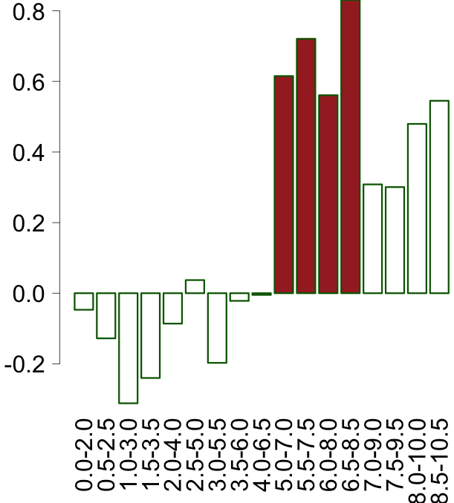
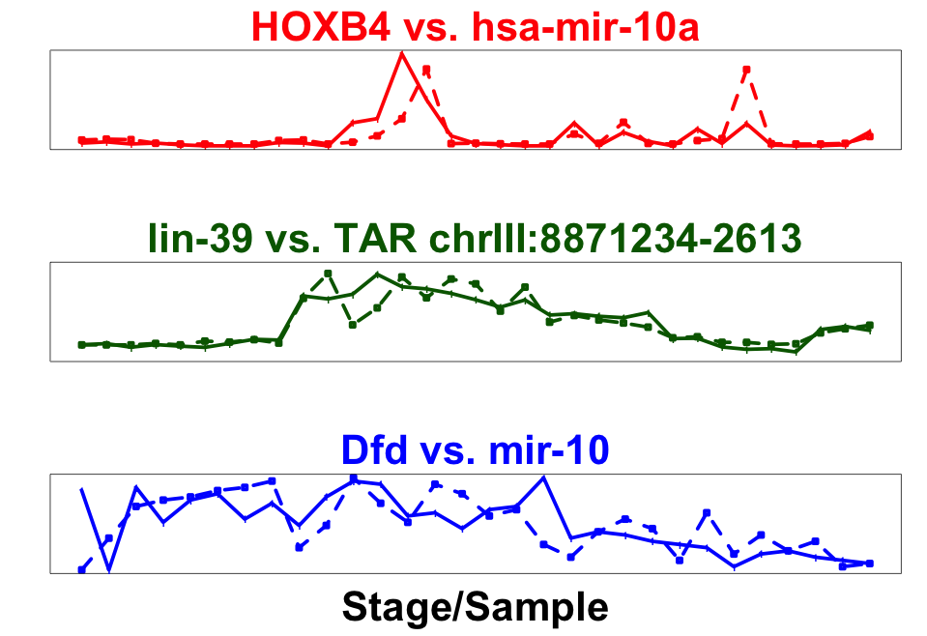
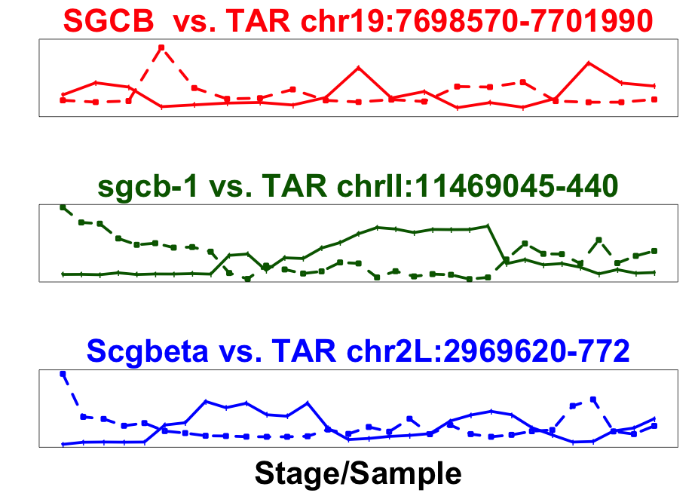
A
Conservation of module across number of species
B
phylotypic stage
human-worm-fly
1
worm-fly
Expression of a module across 6 fly species
19901 genes
worm-specific
gene-gene co-association
20377 genes
13623 genes
Expression across modules in fly
0
C
Ortholog
ncRNA/TAR
Correlated
Anti-correlated
Median expression correlation across modules in worm
Expression
Stage (hour)

