Slide 1
Pgenes, TAR-incRNA vs.
Peptides Identified by MSMS
(Example: Worm whole genome)
Yan Zhang
Feb 20, 2013

Slide 2
Data
Genome:
  TAR-incRNA98 intersection
  Worm pseudogenes
Proteome:
  The Global Proteome Machine GPMDB, built from raw spectra [1,2]
  Observable peptides for eukaryotes (FASTA)

Slide 3
Analysis
Map TAR/Pgenes to Ref. Genome
Translate in 6 frames, consider only ORFs.

Slide 4
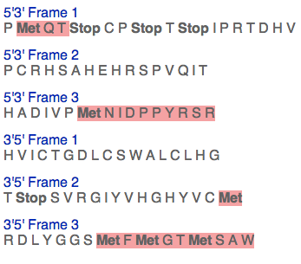
Example
Notes:
CCCATGCAGACATAGTGCCCATGAACATAGATCCCCCGTACAGATCACGTG – whatever exampleCCCATGCAGACATAGTGCCCATGAACATAGATCCCCCGTACAGATCACGTG

Slide 5
(1) Conserved domains
Find the protein domains in pgenes and TARs
https://yale.box.com/files/0/f/663034167/Worm_pgene_&_tar_protein_domain_hits

Slide 6
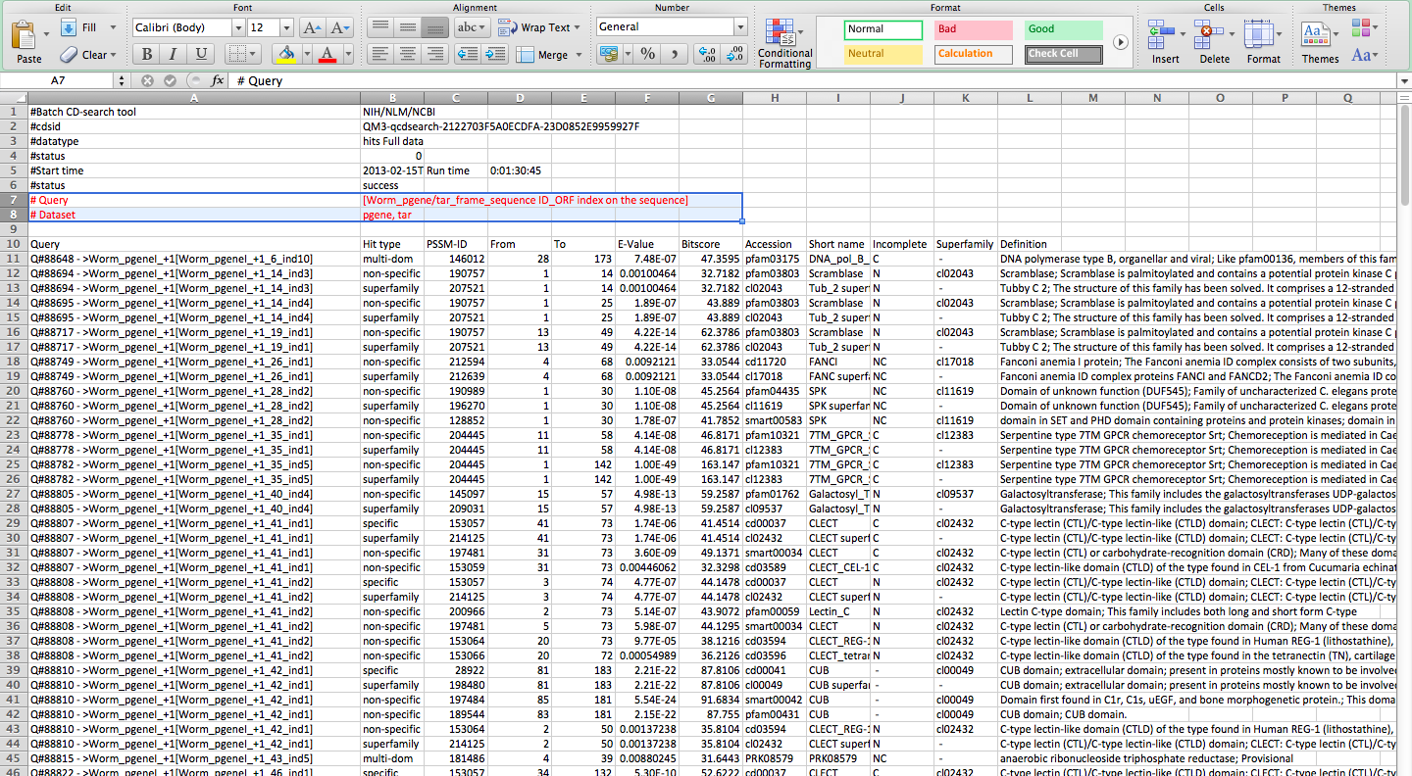
Chr 1, found 360 conserved domains, all on pseudogenes.

Slide 7
Hits of conserved domains
 | Pgenes | TAR-incRNA98 intersection
Chr I | 360 | 0
Chr II | 559 | 2
Chr III | 566 | 1
Chr IV | 1066 | 5
Chr V | 1080 | 2
Chr X | 202 | 0

Slide 8
(2) pgene/TAR-peptide pairs translated? or evolutionary related
Simulate random peptides sequences
Search pgene/TARs against MS+random peptides
  MS peptides 88622
  Random peptides ~ 1500
Calculate pairwise PAM250 score
  Null dist. determined by scores of random vs MS peptides
Determine FDR and p-value

Slide 9
Distribution of lengths of MS peptides
Notes:
Thus Gamma distribution is used for simulation

Slide 10
References
Using Annotated Peptide Mass Spectrum Libraries for Protein Identification., R. Craig, et al. J. Proteome Res. 2006, 10.1021/pr0602085.
A First Step Toward Completion of a Genome-Wide Characterization of the Human Proteome., G. Marko-Varga, et al. J. Proteome Res. 2013, 12, 1-5.

