Slide 1
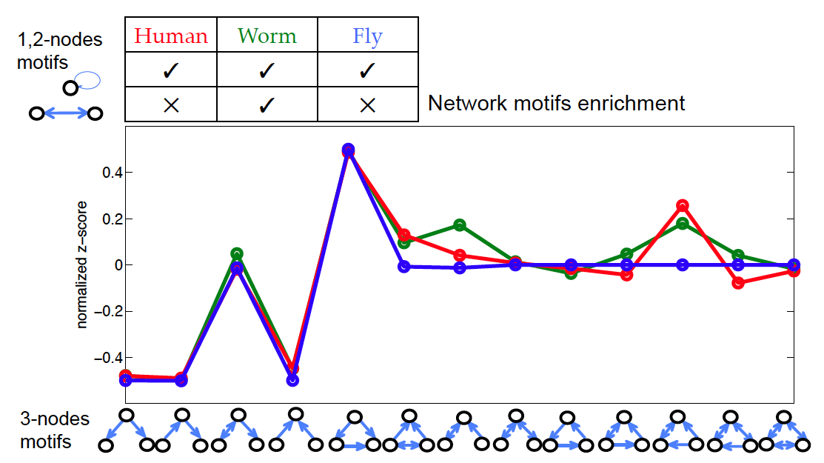
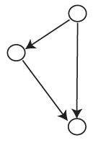
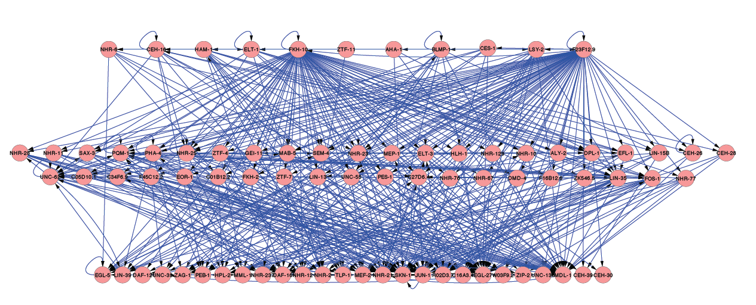
A.
B.
MAZ, SP4, GTF2F1, ETS1, TRIM28, JUNB, TBL1XR1, POU5F1, CEBPD
HAM-1, LIN-35, NHR-11, PQM-1
CG8478, Tr1
FOSL2, RCOR1, GATA3, HDAC1, UBTF, CTBP2
FOS-1, MAB-5, JUN-1
psq
HUMAN
WORM
FLY
BCL3, STAT2, ESRRA, MAFK
DAF-16, EFL-1, PEB-1, C27D6.4
LolaI
C.
 | Human | Worm | Fly
Number of TFs (interactions) | 155 (1331) | 79 (496) | 25 (50)
Fraction of feedback edges | 30% | 22% | 4%
% of nodes in (B, M, T) levels | (30, 37, 33) | (32, 55, 13) | (46, 47, 7)

