Slide 1
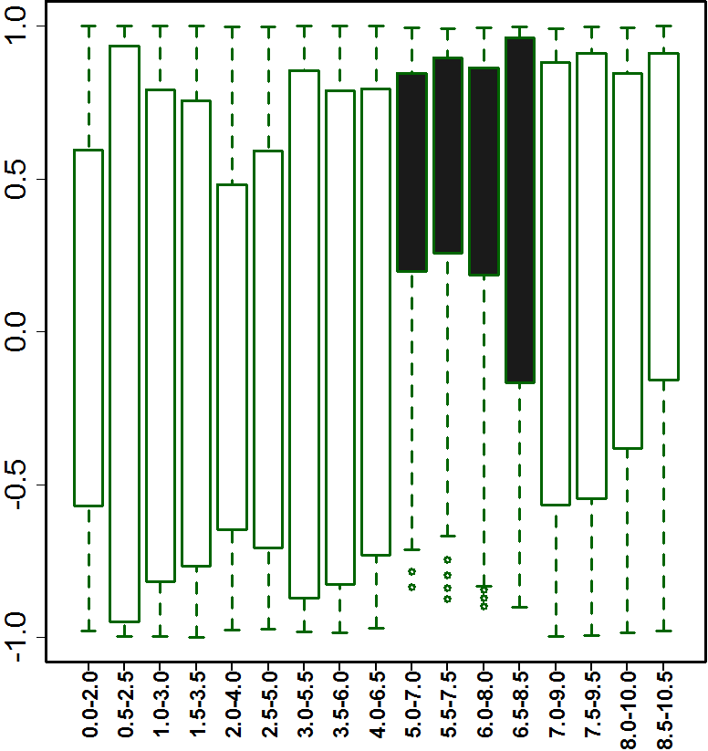
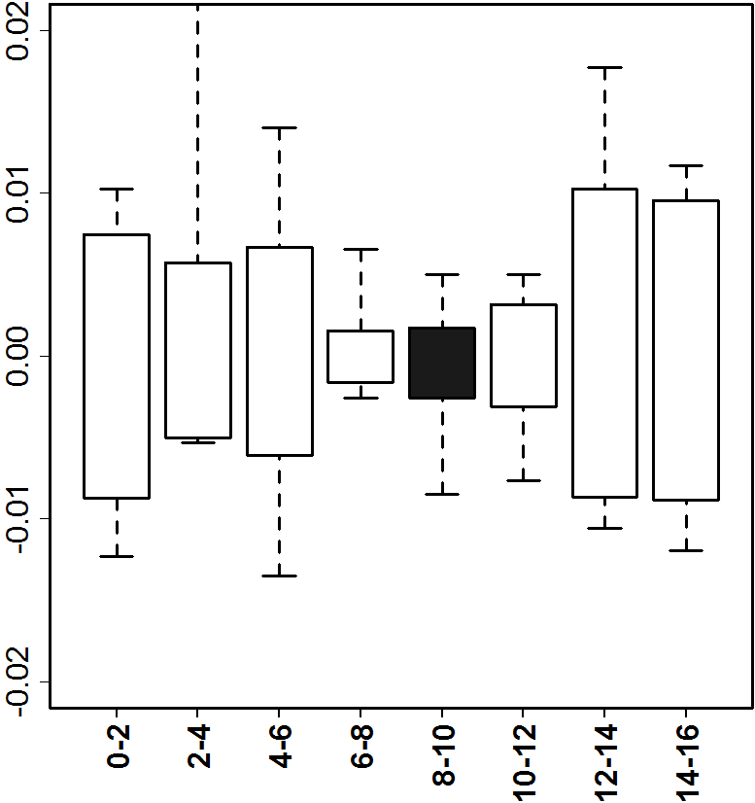
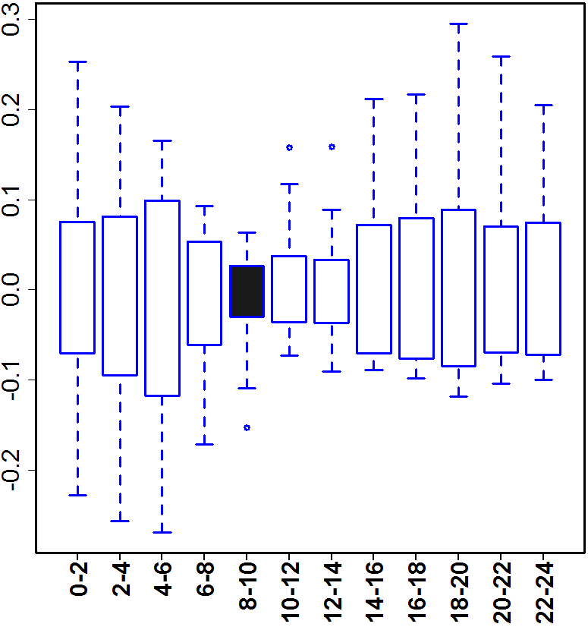
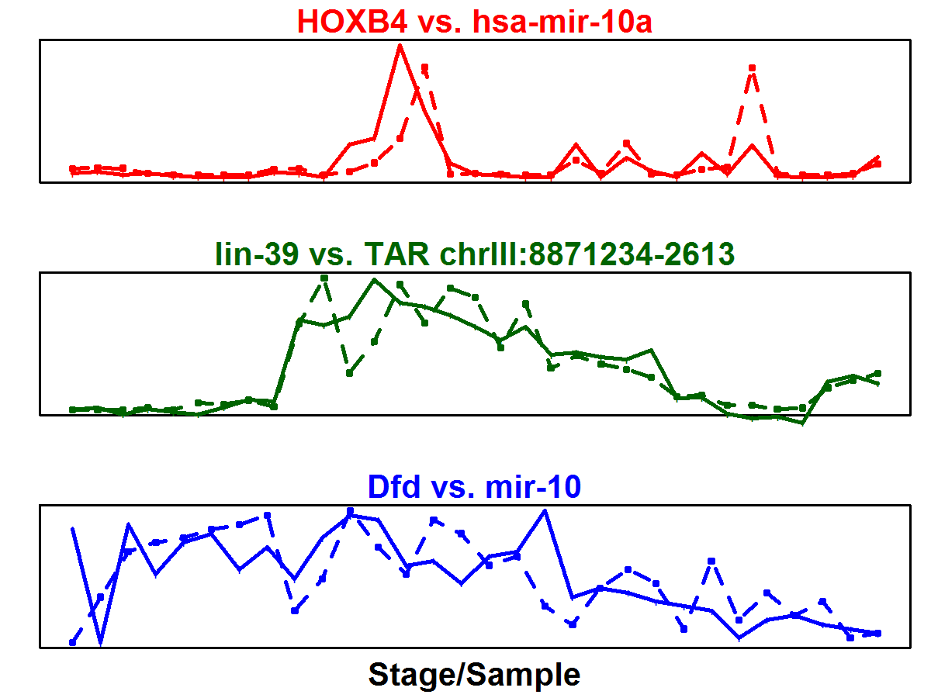
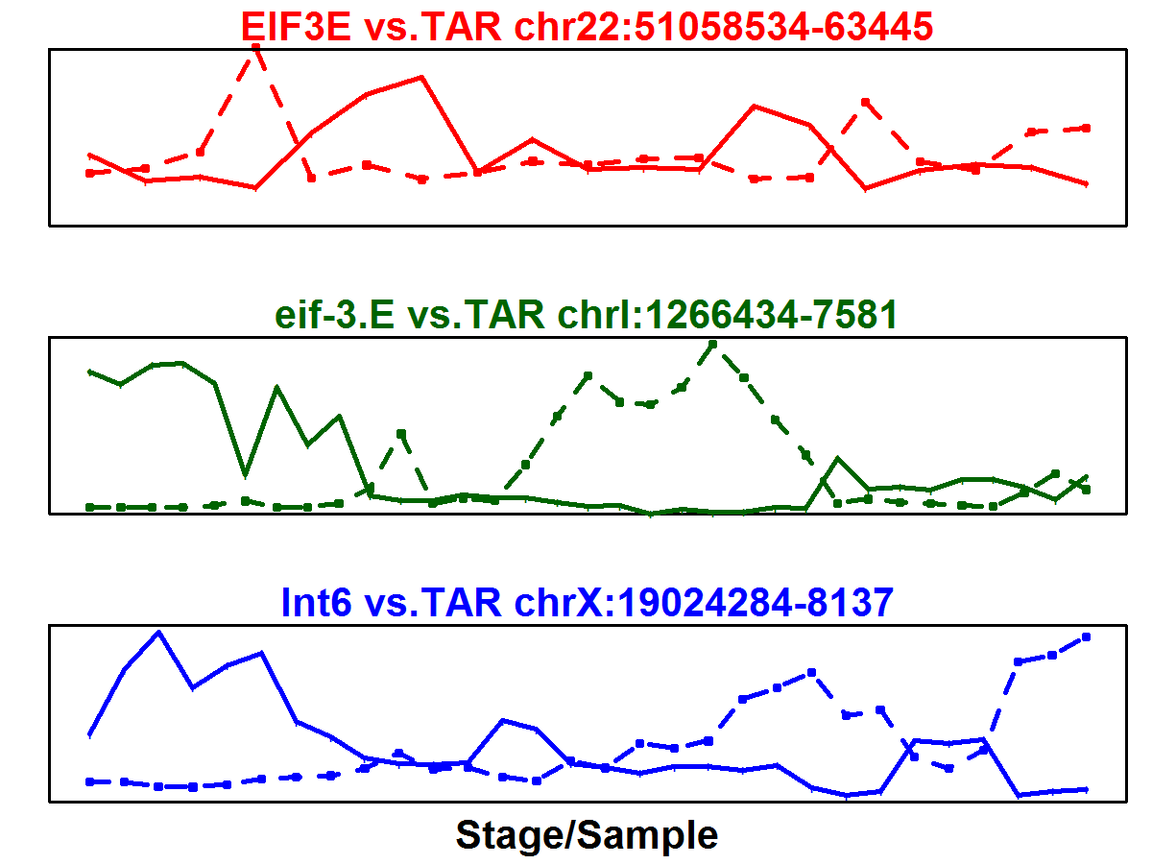
A
Conservation of module across number of species
B
phylotypic stage
human-worm-fly
1
worm-fly
Expression correlation across modules in worm
worm-specific
Co-appearance frequency (normalized)
Expression of a module in 6 fly species
0
C
Ortholog
ncRNA/TAR
Expression across modules in fly
Expression
Expression
Stage (hour)

