Slide 1
Clustered mutations and their implication to evolution and cancer
Journal club by
Alexej Abyzov,
February 12, 2013

Slide 2
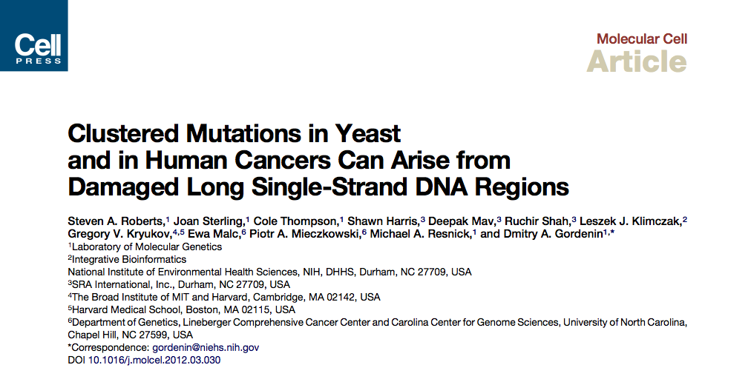

Slide 3
Abstract
Mutations are typically perceived as random, independent events. We describe here nonrandom clustered mutations in yeast and in human cancers. Genome sequencing of yeast grown under chronic alkylation damage identified mutation clusters that extend up to 200 kb. A predominance of ‘‘strand- coordinated’’ changes of either cytosines or guanines in the same strand, mutation patterns, and genetic controls indicated that simultaneous mutations were generated by base alkylation in abnormally long single-strand DNA (ssDNA) formed at double-strand breaks (DSBs) and replication forks. Significantly, we found mutation clusters with analogous features in sequenced human cancers. Strand-coordinated clusters of mutated cytosines or guanines often resided near chromosome rearrangement breakpoints and were highly enriched with a motif targeted by APOBEC family cytosine-deaminases, which strongly prefer ssDNA. These data indicate that hypermutation via multiple simultaneous changes in randomly formed ssDNA is a general phenomenon that may be an important mechanism producing rapid genetic variation.

Slide 4
Experiments in yeast

Slide 5
Design
Using URA3 and CAN1 as reporters
URA3 – orotidine 5-phosphate decarboxylase (ODCase)
loss of ODCase activity leads to a lack of cell growth unless uracil or uridine is added
5-FOA (5-Fluoroorotic acid) kill cells as ODCase converts it to toxic 5-fluorouracil (pyrimidine analog)
mutations confers 5-FOA resistance
CAN1 – plasma membrane arginine permease
mutation confers canavanine (arginine analog) resistance

Slide 6
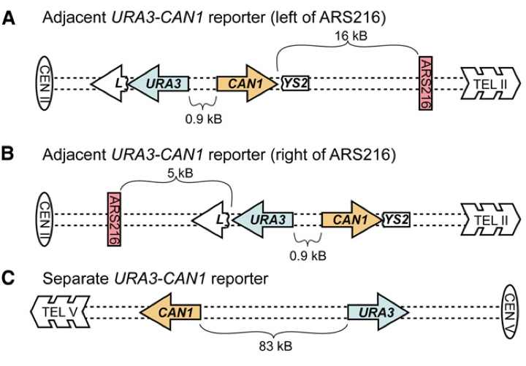
Engineered yeast strains
ARS216 – origin of replication
URA3 – resistance to 5-FOA
CAN1 – resistance to canavanine
Experiment
WT yeast – URA3 and CAN1 are on different chroms.
Eng. strains – URA3 and CAN1 are adjacent
Grow strains and WT for 25 generations with mutagen methyl-methane-sulfonate (MMS)
MMS preferentially mutated ssDNA
Compare resistance to both drugs (5-FOA and canavanine)
Sequence resistant engineered strains

Slide 7
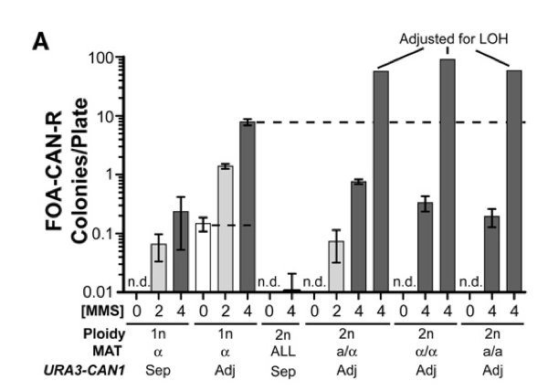
Results

Slide 8
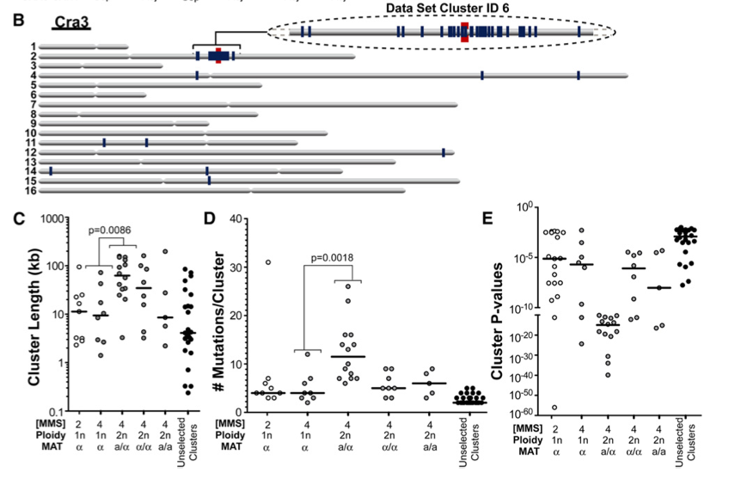
Mutation distribution

Slide 9
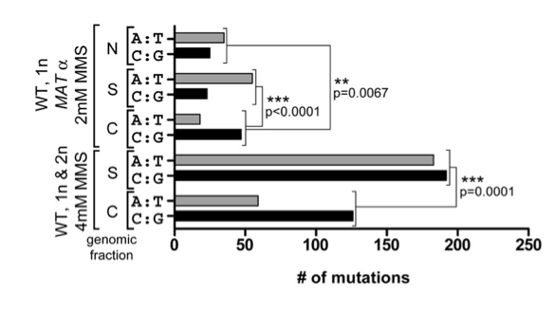
Mutation content
C – clustered
S – scattered
N – no selection on drug resistance

Slide 10
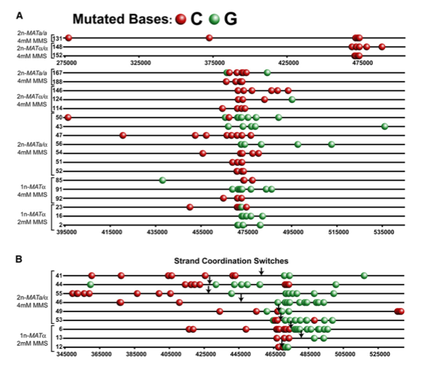
Strand coordinated mutations

Slide 11
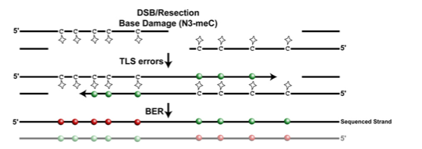
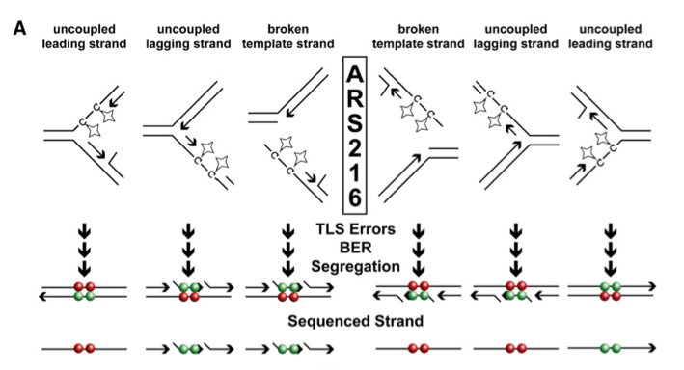
Models
G:C – mutations is feature of MMS

Slide 12
Conclusion so far
Clustered mutations can be observed
They are results of
double stranded break repair
dysfunctional replication forks
They can confer selective advantage
Does it have anything to do with real life?

Slide 13
Mutation clusters in cancer
Data
Chapman et al., 2011
Berger et al., 2011
Stransky et al., 2011
Detected clusters
394 clusters
12 to 53,411 base pairs in length
1,625 mutations

Slide 14
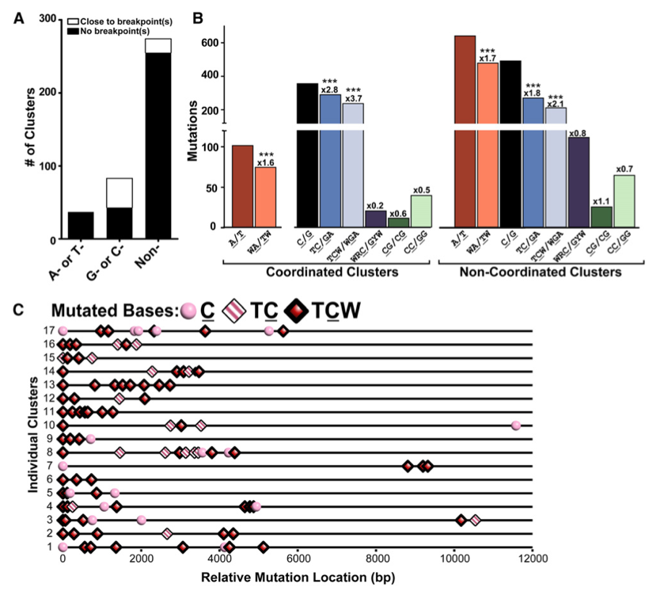
⬅ APOBEC motifs
W is A or T
R is T or C
Y is A or G

Slide 15
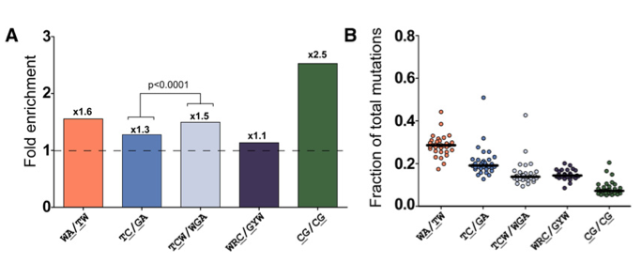
Genome wide
APOBEC

Slide 16
Conclusions
Clustered mutations in yeast and cancer
Can drive evolution and cancer
Particular motifs
Mutation strand coordination
Correlation with breakpoints of rearrangement
Multiple Paths to Mutation Clusters but may be ssDNA is a prerequisite
dsDNA break
replication fork stalling
…

Slide 17
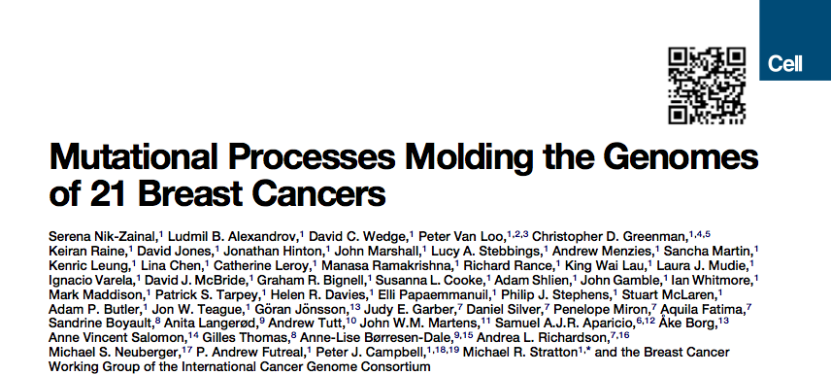

Slide 18
Abstract
All cancers carry somatic mutations. The patterns of mutation in cancer genomes reflect the DNA damage and repair processes to which cancer cells and their precursors have been exposed. To explore these mechanisms further, we generated catalogs of somatic mutation from 21 breast cancers and applied mathematical methods to extract mutational signatures of the underlying processes. Multiple distinct single- and double-nucleotide substitution signatures were discernible. Cancers with BRCA1 or BRCA2 mutations exhibited a characteristic combination of substitution mutation signatures and a distinctive profile of deletions. Complex relationships between somatic mutation prevalence and transcription were detected. A remarkable phenomenon of localized hypermutation, termed ‘‘kataegis,’’ was observed. Regions of kataegis differed between cancers but usually colocalized with somatic rearrangements. Base substitutions in these regions were almost exclusively of cytosine at TpC dinucleotides. The mechanisms underlying most of these mutational signatures are unknown. However, a role for the APOBEC family of cytidine deaminases is proposed.

Slide 19
The Catalogue of Somatic Mutations
183,916 somatically acquired SNV
2,869 somatically acquired indels

Slide 20
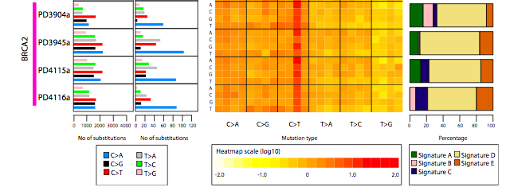
5’ …

Slide 21
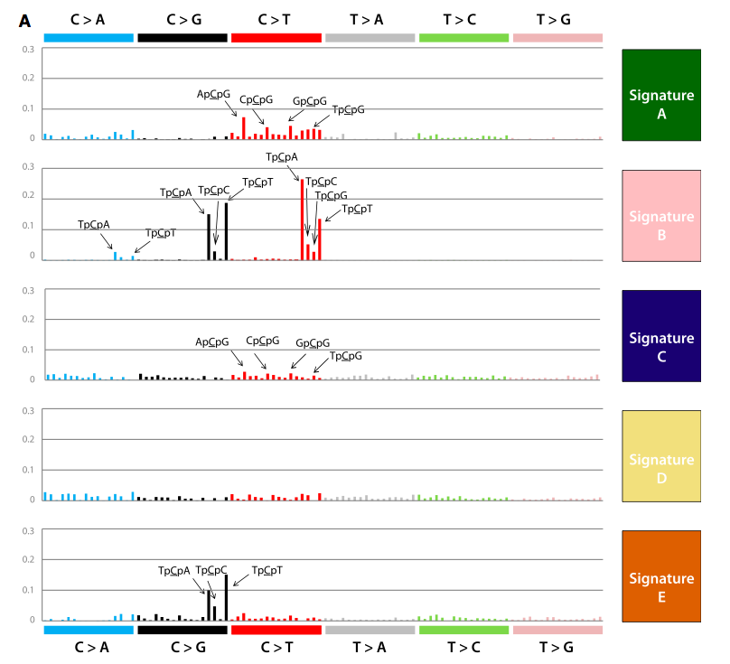
Non-negative Matrix Factorization (NMF)

Slide 22
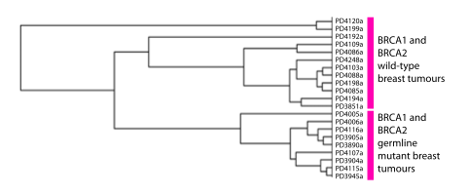
Mutation signatures differentiate
cancer subtypes

Slide 23
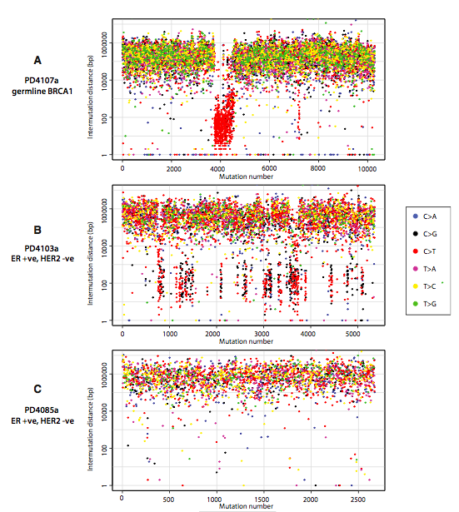
Clusters
* Mostly TCX motif
* Mostly on the same haplotype
* Switches C>T then G>A
* Co-localization with
rearrangement breakpoints

Slide 24
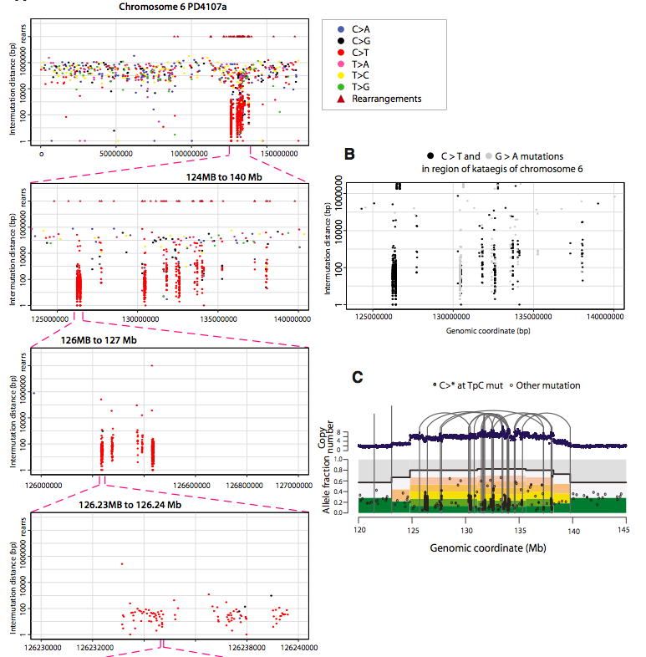

Slide 25
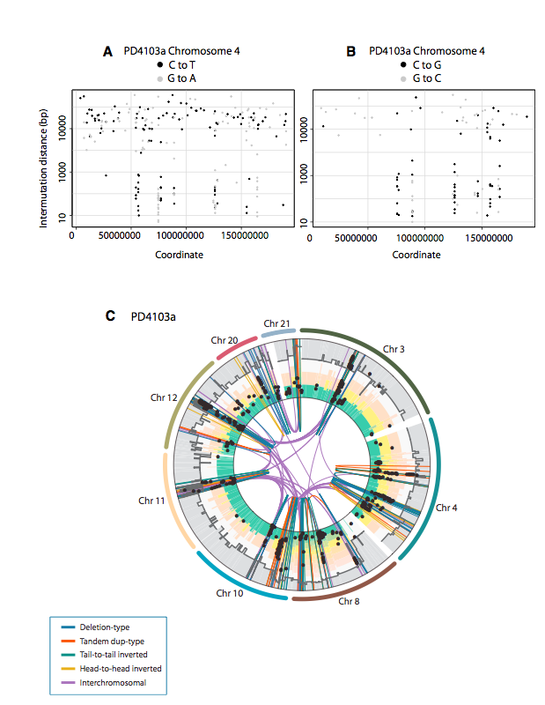

Slide 26
Conclusion
Clustered mutations in yeast and cancer
Particular motifs
Mutation strand coordination
Correlation with breakpoints of rearrangement
Possible relation with transcription
Suggest involvement of APOBEC in mutagenesis

Slide 27
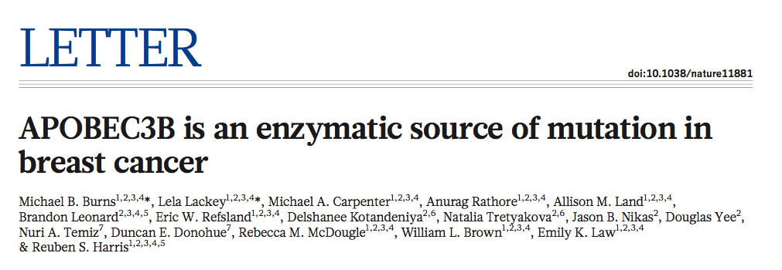

Slide 28
Abstract
Several mutations are required for cancer development, and genome sequencing has revealed that many cancers, including breast cancer, have somatic mutation spectra dominated by C-to-T transitions. Most of these mutations occur at hydrolytically disfavored non-methylated cytosines throughout the genome, and are sometimes clustered8. Here we show that the DNA cytosine deaminase APOBEC3B is a probable source of these mutations. APOBEC3B messenger RNA is upregulated in most primary breast tumours and breast cancer cell lines. Tumours that express high levels of APOBEC3B have twice as many mutations as those that express low levels and are more likely to have mutations in TP53. Endogenous APOBEC3B protein is predominantly nuclear and the only detectable source of DNA C-to-U editing activity in breast cancer cell-line extracts. Knockdown experiments show that endogenous APOBEC3B correlates with increased levels of genomic uracil, increased mutation frequencies, and C-to-T transitions. Furthermore, induced APOBEC3B overexpression causes cell cycle deviations, cell death, DNA fragmentation, c-H2AX accumulation and C-to-T mutations. Our data suggest a model in which APOBEC3B-catalysed deamination provides a chronic source of DNA damage in breast cancers that could select TP53 inactivation and explain how some tumours evolve rapidly and manifest heterogeneity.

Slide 29
Thank you!

